Slide 1
REVIEW OF THE OF THE YOUNG GAMBLERS’ EDUCATION TRUST GAMBLING AWARENESS PROGRAMME
FINDINGS FROM PHASE 1
07 September 2017
Dr Margaret Carran

Slide 2
Background to the evaluation
Review of YGAM programme
The Gambling Act 2005 (of course)
  The need to protect children and other vulnerable groups from being harmed or exploited by gambling
  BUT
  Continuing struggle with preventing minors from accessing prohibited gambling
  ‘Normalisation of gambling’
  Most interventions aimed at adult gamblers & voluntary
Paucity of available, non-technical training to those not directly involved in the gambling industry
  Teachers and educators’ confidence levels of being able to deal with gambling issues
  Perception of ‘growing issue’
Cost (taxpayers) contribution to prevention programmes = need to ensure that money is well spent

Slide 3
Key characteristics of ‘effective’ prevention programme
Comprehensiveness of teaching materials
Variety of teaching methods
Sufficient dosage
Are appropriate timed
Provide opportunity for positive relationship
Theory driven
Are socio-culturally relevant
Are delivered by well trained staff
Include outcome evaluation
Are interactive
Maury ‘and others’ (2003)

Slide 4
Theoretical principles – borrowed from drug preventation model
Social Learning theory
Problem Behaviour theory
Health Belief Model
Reasoned Action
Planned behavior
Social norm theory
Vadrucci ‘and others’ (2016)

Slide 5
Aims and objective of the review (the brief)
Review of YGAM programme
Phase 1 – current review
  Objectives
    Identification of strengths and weaknesses of the YGAM’s initiative
    Review of the ‘Train the Trainer’ workshop
    Assessment of resources & materials
Phase 2 – future plans
  Objectives
    Assessment of programme’s implementations by the attendees of the ‘Train the Trainer’ workshop
    Evaluation of impact on ultimate target group

Slide 6
Phase 1 - Methodology
Review of YGAM programme
Ethical approval sought and granted by the City Law School Ethics Committee
  Pre-workshop and post-workshop surveys evaluating:
    Motivations for workshop attendance
    General attitudes & beliefs in effectiveness of school based gambling prevention programmes
    Feedback on the workshop
    Implementation plans & barriers to implementation
  Expert assessment of module materials
  Analysis
    Focus on qualitative analysis using thematic approach
  Sample
    139 valid responses to pre- and post – workshop surveys
    4 expert opinions – 2 from United Kingdom, 1 from Canada, 1 from Australia
    2 in-depth post workshop interviews

Slide 7
Key results and findings

Slide 8
Motivations for workshop attendance
Key results and findings
Increased need for information on gambling - related matters
To gain better understanding and knowledge of gambling generally
To gain access to suitable material
For implementation in schools/youth clubs
For use with one – to – one counselling or individual work with pupils, students, their families and others
Due to work requirements or specific recommendation
Upon request from manager or
Upon recommendation from previous attendees
More specifically to find out:
What prompts young people to gamble
How gambling – related harm manifests itself
What solutions and interventions are available
Recognised by the individual as needed in his/her line of work or

Slide 9
Motivations for workshop attendance
Key results and findings
  61 respondents came across someone who was affected by gambling – related harm
  Some viewed it as a ‘highly’ prevalent problem in their line or work
  Some became concerned due to indirect factors
  But
Only 12 agreed or strongly agreed that they felt confident in their own ability to help
32 either disagreed (25, 41%) or strongly disagreed (7, 11%) with the statement that they had sufficient knowledge and abilities to help
17 (28%) neither agreed nor disagreed
Participants were not asked why they opted for YGAM programme in preference to others BUT
Several comments alluded to the lack of any alternative providers

Slide 10
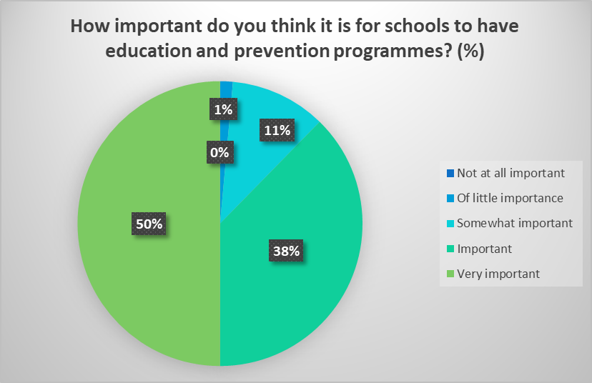
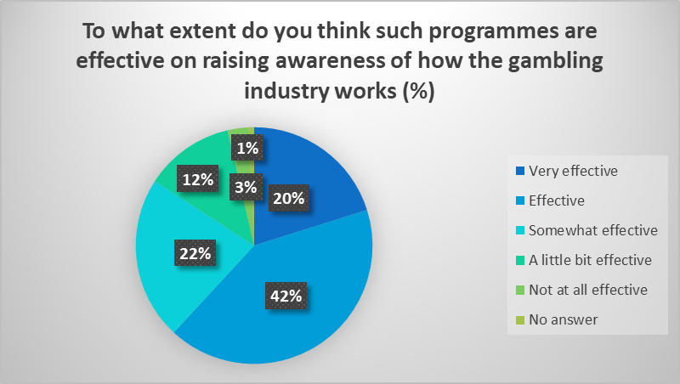
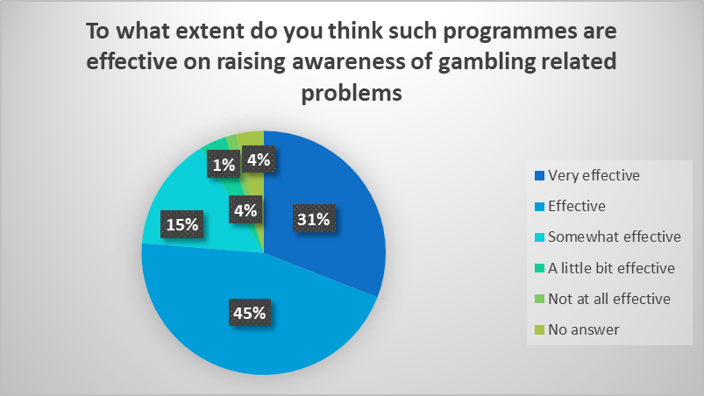
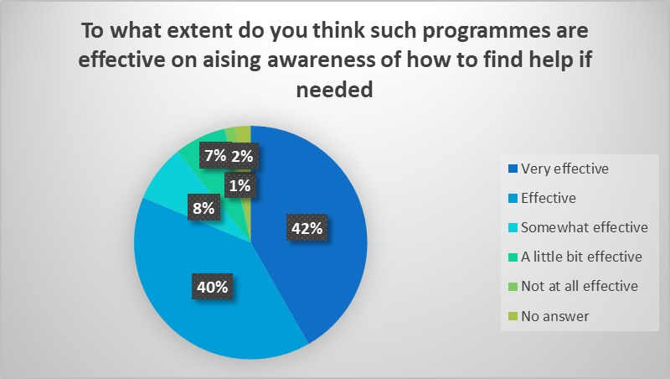
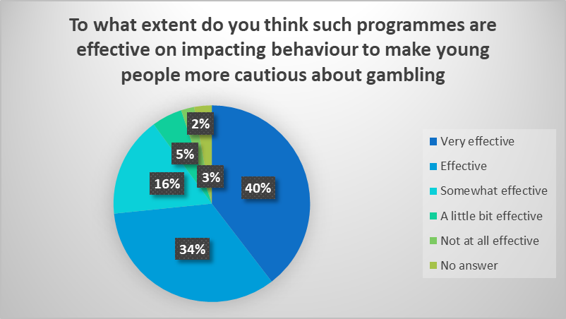
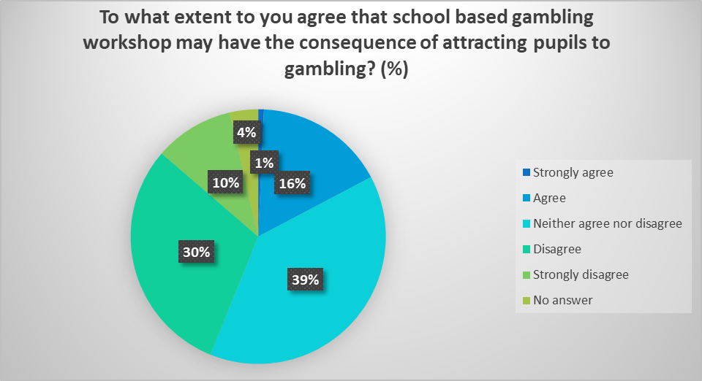
Prevalence of existing educational programmes and perceptions of effectiveness
Key results and findings

Slide 11
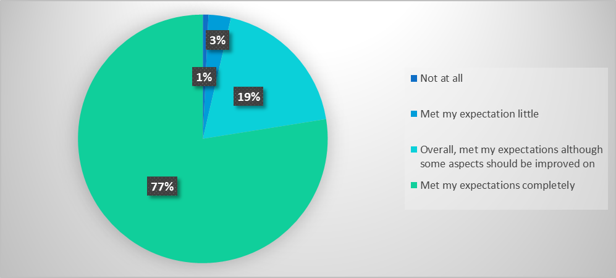
Meeting participants’ needs & expectations
Key results and findings
  To what extent has the workshop met your expectation?
Improvements’ suggestions
  Development of materials suitable for one-to-one delivery methods
  Include more details / training exercises on:
    Available interventions
    Where to direct those who have been identified as suffering from gambling issues
    How to spot the symptoms
    Underlying reasons that contribute to the development of gambling disorder
    The gambling industry itself
    How the programme has already been delivered in schools / to students
  Include hands-on exercises on popular gaming apps

Slide 12
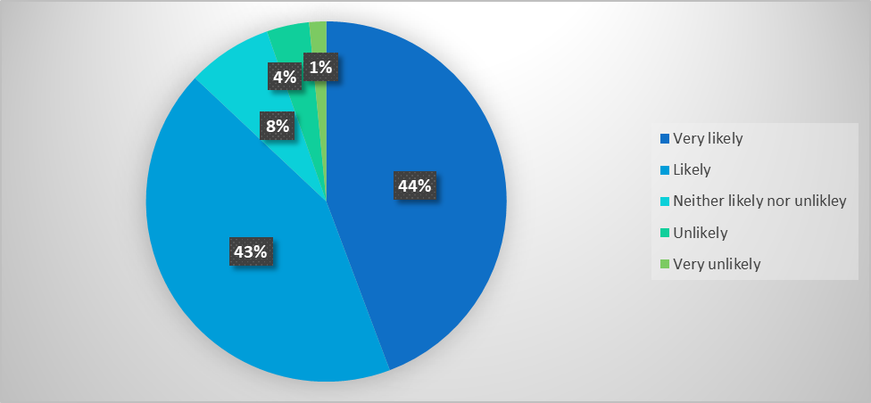
Implementations plans
Key results and findings
  How likely are you to implement the whole or parts of the programme in your school / organisation?
What may hinder your implementation plans?
  Financial and time resources
  Gambling awareness education remain outside the compulsory remit of PSHE education
  Competing priorities
  Lack of ‘buy-in’ from decision makers
  Lack of engagement from pupils / young people
  Unsuitability of resources to one-to-one sessions

Slide 13



Key results and findings - resource assessment
Workshops’ participants assessment
Small number of comments but all very complementary
Resources seen as ‘informative, well presented, easy to use and useful for group work’
Education programme must target the right predictive variable and must be based on sound theoretical understanding of causes of gambling disorder
Resources must focus on altering cognitive variable that are capable of modification over the short and long term and to correct misconceptions
Resources need to be attractive to the age group
The target audience must take control over their own learning
Challenges must deal honestly not only with negatives but only with positive aspects of gambling
Clear distinction must be made for different forms of gambling
Experts’ own identified criteria

Slide 14

Key results and findings - resource assessment
Learning outcomes
Good range of relevant topics
Accessible infographics
Scope for interactive and pupils/students’ led discussions
Reference to the topic of Facebook style games
Universal strategy
3
Experts’ assessment – strengths
Continuing need to develop materials to ensure currency, up-to-date correctness and accuracy
To avoid using abstract concept/examples or overly sophisticated words
To ensure that resources are presented in a neutral tone – avoiding negative overtones
To ensure that positive aspects of gambling (fun) is also covered
Experts’ assessments – suggestions for improvements (generic)
Include more interactive reference to e.g., ‘ThinkUKnow’ Campaign
Add more specific information on different forms of gambling, addiction as a mental health issues and its consequences and clearer exposition of enjoyment
5
Experts’ assessments – suggestions for improvements (specific)

Slide 15
Conclusions and recommendations

Slide 16
Conclusion and recommendation
Review of YGAM programme
Conclusion
YGAM’s initiative offers many advantages and benefits from many strengths
Recommendation 1 -
workshop
Offer more clarity of the intended aims of the workshop and the targeted audience
Development of sub-workshop to clearly differentiate between workshop for teachers / educators and to professionals working in other industries
Fills an important market gap
Offers good quality PSHE / ASDAN accredited materials
Is very proactive at ensuring wide reach
Add additional content on interventions, where to seek help, signposting, trigger points, symptoms spotting
Promotes an initiative that meets many of the requirements of ‘effective’ prevention programmes – comprehensiveness of material, variety of teaching methods, ‘well-trained’ staff, interactivity, scope for positive relationship and taking control of their learning by students.
Add hand-on exercises on games that are attractive to young people to aid understanding

Slide 17
Conclusion and recommendation
Review of YGAM programme
Recommendation 3 – resources
Introduce systematic internal evaluation of the materials to ensure up-to-date correctness and accuracy of the resources
Recommendation 4 -
resources
Offer clarity and transparency on each units in the context of
Avoid abstract component or superfluous examples
Avoid ‘fearmongering’
Which variable they aim to modify
On the basis of which theoretical framework (social learning theory, health belief model, behavioural problem theory, planned behavior theory or social norm theory or others).
Recommendation 2 - resources
Expand portfolio of resources to cater for one-to-one delivery and counseling
Add challenges where pupils/students can frankly and honestly discuss not only the negative side of gambling but also the positive side of enjoyment and pleasure.

