Slide 1
THE BLURRED LINES
YEAR 7 / LESSON 4
V1.1/Dec20

Slide 2
CHALLENGE
YEAR 7 / LESSON 4
Does gaming promote gambling? Think about random in game purchases, advertising both within games you play and through eSports and streaming platforms. How are these regulated/are they regulated?

Slide 3
LEARNING OBJECTIVES
YEAR 7 / LESSON 4
To be able to recognise risks related to online gaming
To be able to analyse gambling style features within games
To be able to discuss regulation
To work as a team to present findings and consensus

Slide 4
LEARNING OUTCOMES
YEAR 7 / LESSON 4
I can recognise risks in online gaming
I can discuss and analyse the gambling style features within games
I can explore regulation and discuss my opinion
I can work in a team to research and present findings with a common consensus

Slide 5
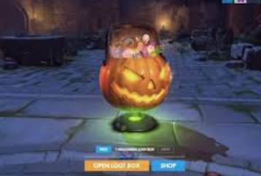
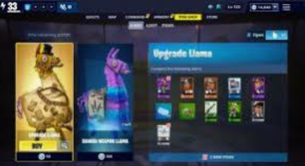
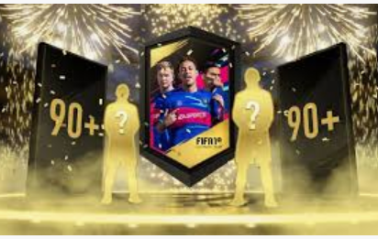
YEAR 7 / LESSON 4
©YGAM 2020: All rights reserved

Slide 6
ACTIVITY: LOOT BOXES
YEAR 7 / LESSON 4
In groups, create a thought shower using the title LOOT BOXES. Provide a definition for someone who might not know what these are.
How do you get them? Discuss your experiences with the class.
THOUGHT SHOWER

Slide 7
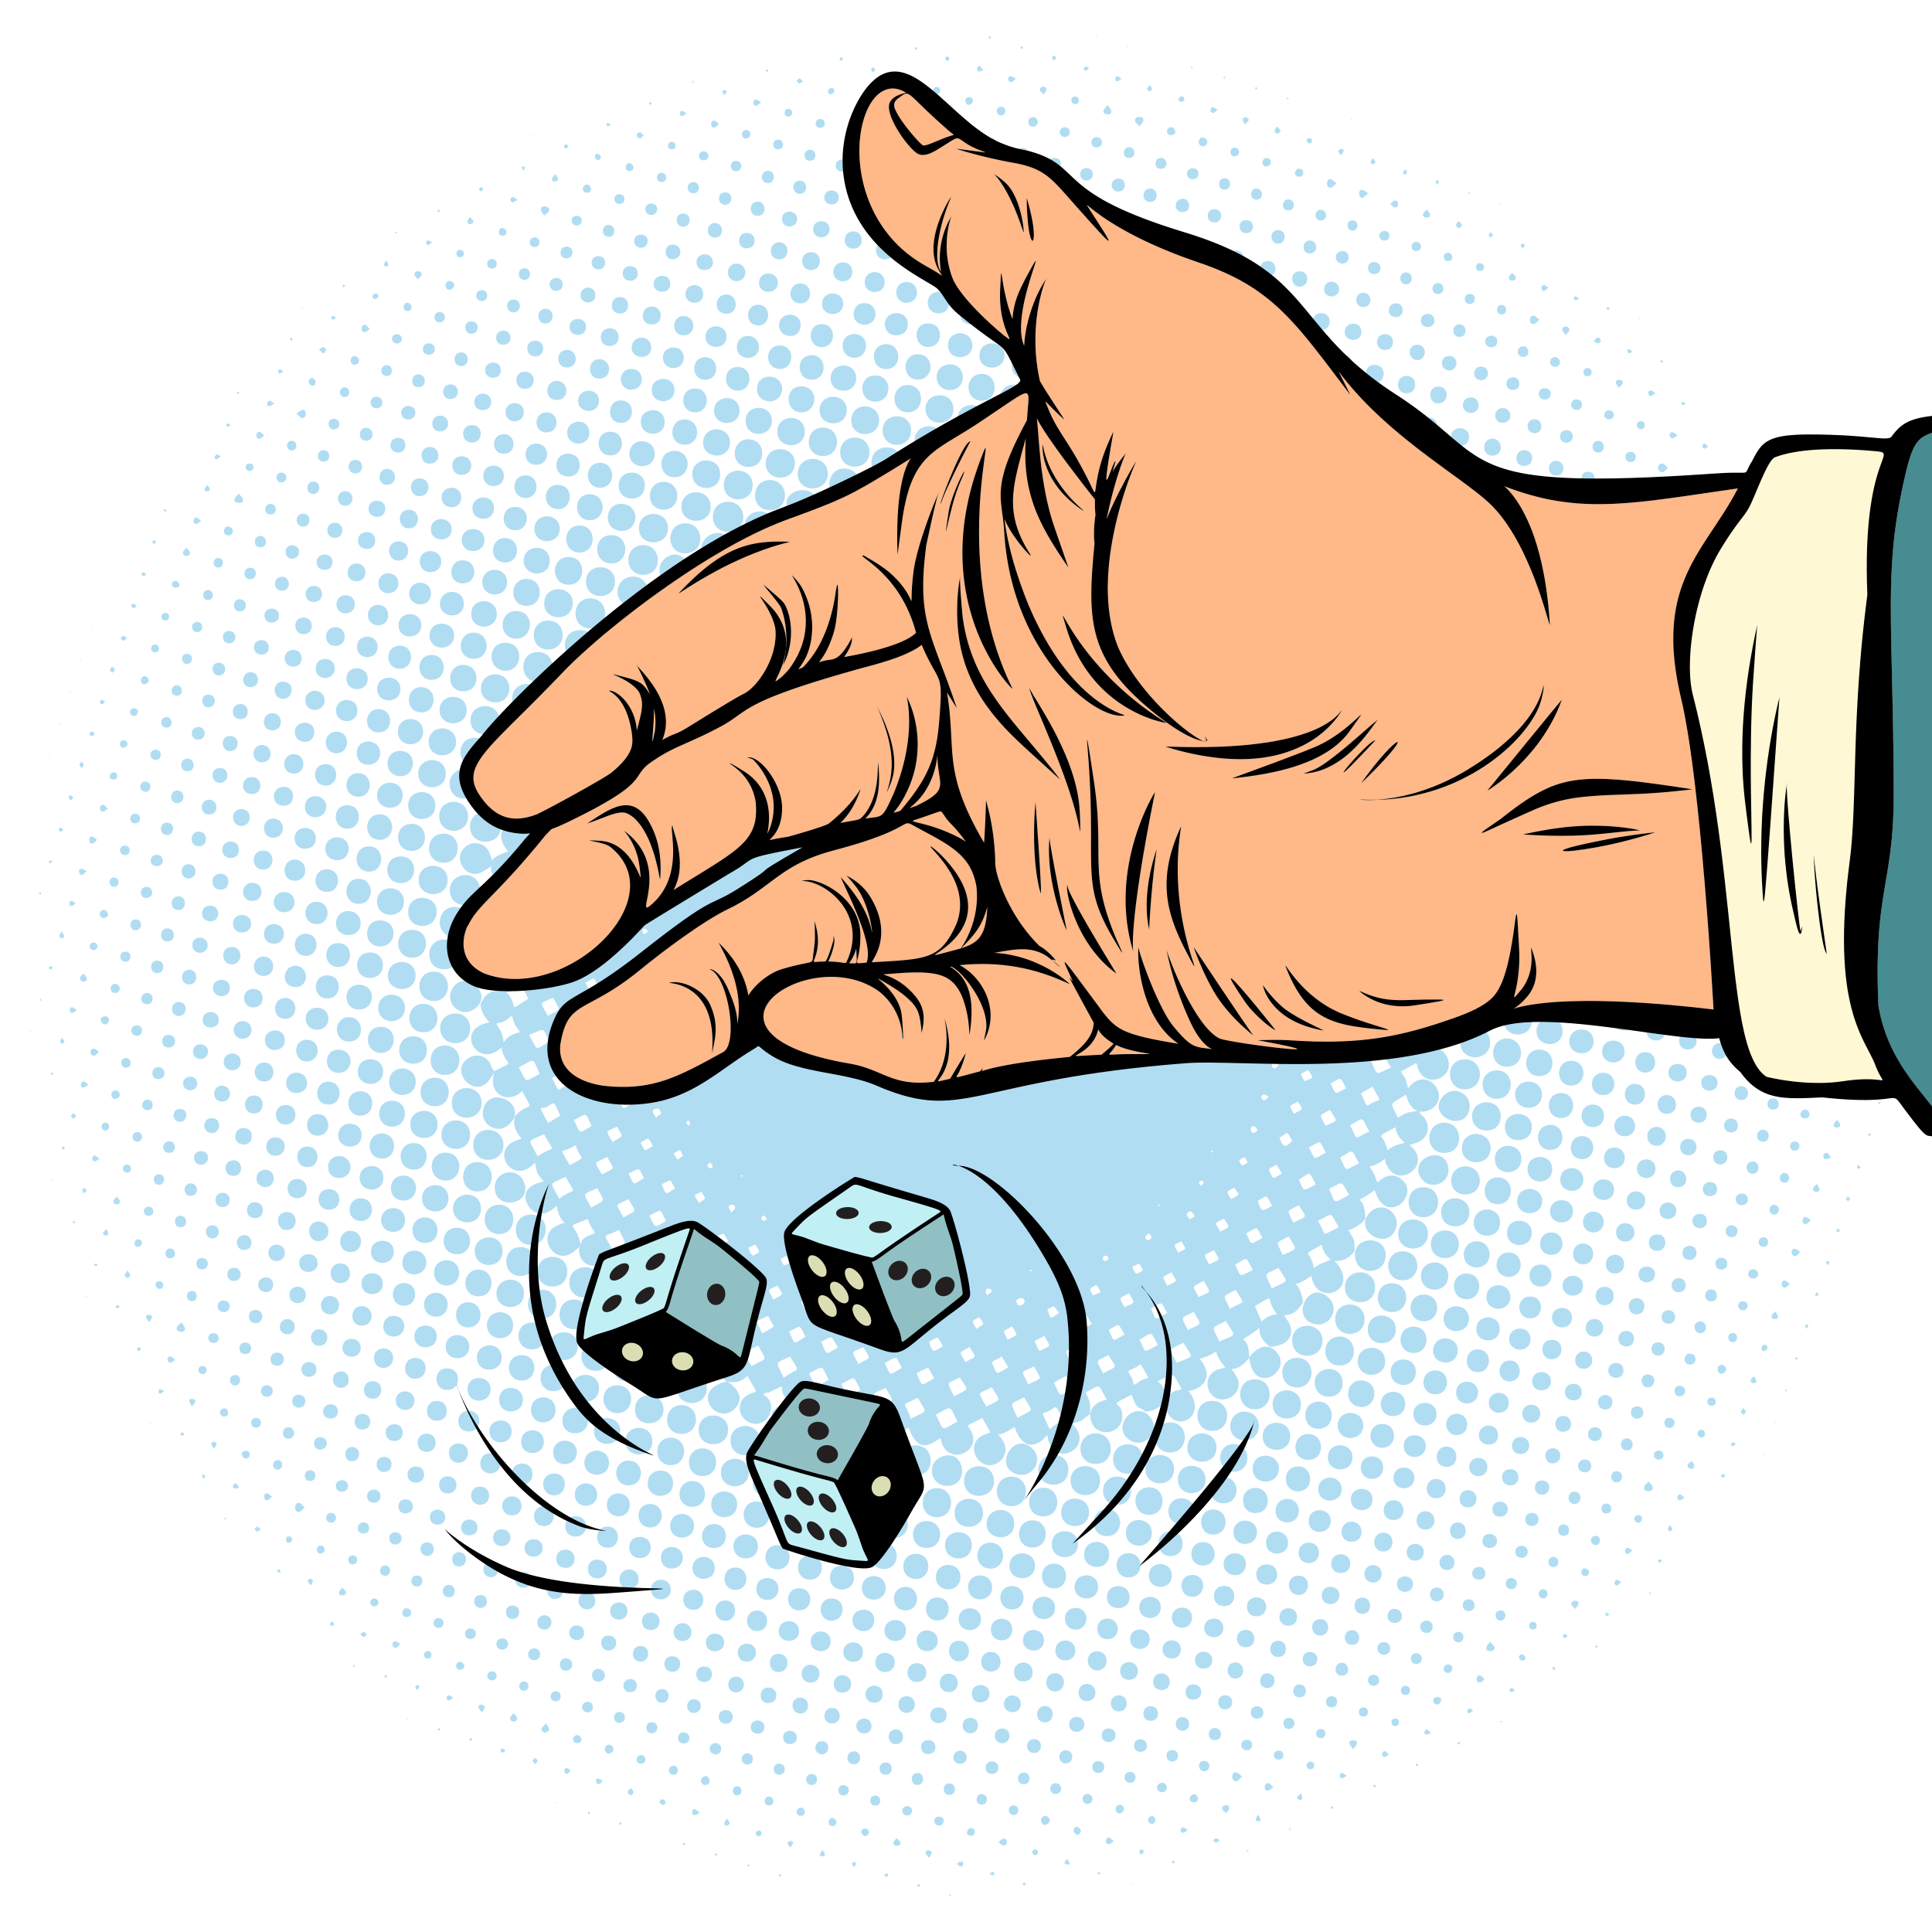
ACTIVITY: WHAT ARE THE ODDS?
YEAR 7 / LESSON 4
Explore the resources provided detailing the probability of buying coveted items. Do you think children would be more/less likely to spend their money on these items if they knew the odds?
Prepare a five-minute presentation to share your responses.

Slide 8
ACTIVITY: WHERE’S THE REGULATION?
YEAR 7 / LESSON 4
Option 1:
Should there be regulations placed on loot boxes and what would that look like?
What could be done to help children and young people make informed decisions about the items they’re buying? In groups agree on three measures which could be taken.
Option 2:
What would be your top 3 tips for gamers? Share your ides with the class.

Slide 9
If you need help…
YEAR 7 / LESSON 4
If you are worried about any of the content today you can talk to a teacher or member of staff. For additional support relating to your own or someone else’s relationship with gambling/gaming you can contact Childline or BigDeal.

