Slide 1
KS4: CONTENTS
YEAR 11 | YEAR 12
Y11L1: GAMBLING: ADVERTISING AND MARKETING | Y12L1: PROBABILITY AND LUCK: THE GAMBLER’S FALLACY
Y11L2: SAFEGUARDING | Y12L2: THE STOCK MARKET: MONEY AND DEBT
Y11L3: WHY DO YOUNG PEOPLE GAMBLE? PART 1 | Y12L3: WHY PEOPLE GAMBLE
Y11L4: WHY DO YOUNG PEOPLE GAMBLE? PART 2 | Y12L4: ADDICTION AND MENTAL HEALTH
Y11L5: MONEY AND DEBT | Y12L5: THE GAMBLING INDUSTRY - MARKETING
Y11L6: GAMBLING TRENDS | Y12L6: GAMBLING – REMOVING THE STIGMA
V1.0 August 21

Slide 2
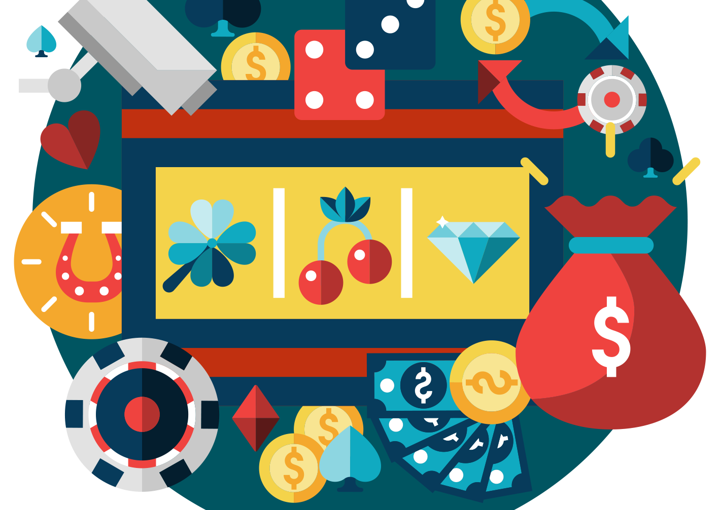
GAMBLING: ADVERTISING AND MARKETING
YEAR 11 / LESSON 1
V1.0 August 21

Slide 3
CHALLENGE
YEAR 11 / LESSON 1
How does gambling advertising work?
Investigate the type of advertising and the processes involved. How have things changed over time? Share your findings using photographs and/or diagrams.

Slide 4
LEARNING OBJECTIVES
YEAR 11 / LESSON 1
To understand why companies use advertising
To understand the different types of advertising
To be able to reflect on how you feel about advertising
To analyse and evaluate the changes in advertising over time.

Slide 5
LEARNING OUTCOMES
YEAR 11 / LESSON 1
Understand
I understand what advertising is and why companies use it
Explain
Describe
I can describe the changes in advertising over time.
Present
I can present my findings using visual aids.
I can explain how I feel about advertising and discuss how it impacts me

Slide 6
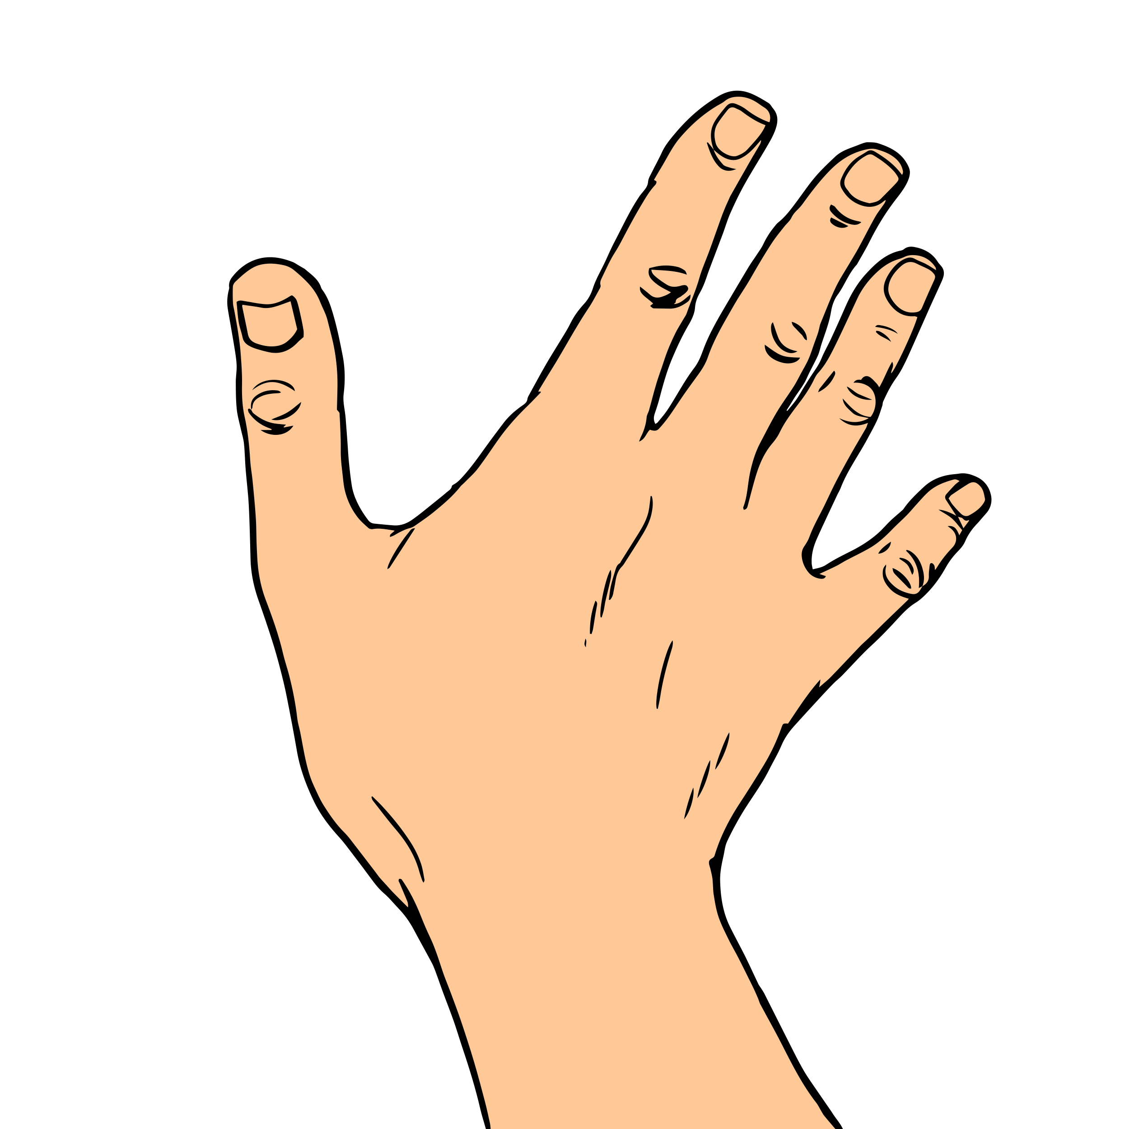
ACTIVITY: GIVE ME FIVE
YEAR 11 / LESSON 1
List five different ways that a gambling or gaming brand might use advertising.
What do you think of the methods used and are young people protected?
Whose responsibility is it to protect young people? Think about all the different methods used.
How does advertising make you feel? Does it ever influence you or your decisions?
Feedback your ideas to the rest of the class

Slide 7
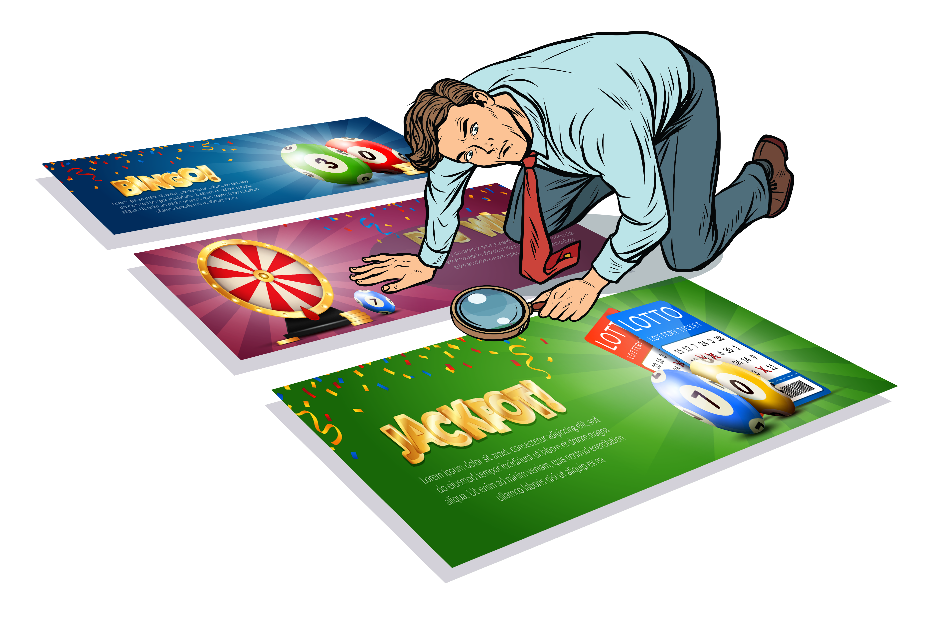
ACTIVITY: LET’S INVESTIGATE
YEAR 11 / LESSON 1
Let’s find out how gambling and gaming brands use advertising, has this changed over time?
Create a mind-map or timeline to display your findings.

Slide 8
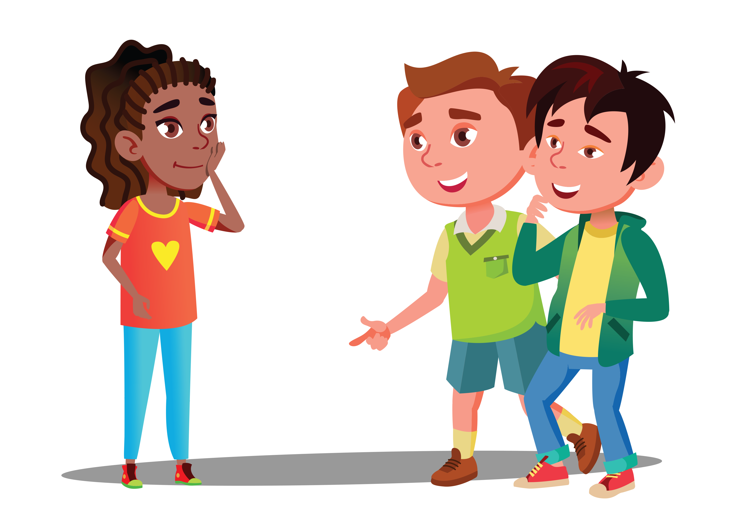
ACTIVITY: DEBATE
YEAR 11 / LESSON 1
Sometimes you see them on day time TV
I hear stuff on the radio, all the time!
I see a lot of in-app adverts on my phone?
I saw the TV advert but fast forwarded past it
Which is the most/least effective form of advertising, and why?
I saw the TV advert but fast forwarded past it
it
My favourite sports team have a sponsorship
Social media is a major influence on young people
it
Do online banners work?

Slide 9
ACTIVITY: REFLECT
YEAR 11 / LESSON 1
How does it impact you?
Are there any safeguarding measures in place?
Are young people protected?
Consider the following questions:
I saw the TV advert but fast forwarded past it
it
How does advertising make you feel?
What should consumers be aware of?
it

Slide 10
ACTIVITY: SUGGESTION
YEAR 11 / LESSON 1
A study published by ipsos MORI on behalf of GambleAware made the following suggestions regarding advertising:
Use technology to minimise risk to young and vulnerable people
Make reference to risk and safer gambling within advertising
Reduce volume of gambling advertising
Consider whether ‘particular appeal’ remains a useful definition for protecting children and young people from the potentially harmful impacts of gambling advertising
Maintain careful oversight over unlicensed operators online, particularly in relation to Esports. Consider the potential role and value of education initiatives.
What do you think? Is this enough? What more could be done?
Source::https://www.ipsos.com/sites/default/files/ct/publication/documents/2020-03/gambling-marketing-advertising-effect-young-people-final-report.pdf
I saw the TV advert but fast forwarded past it
it
it

Slide 11
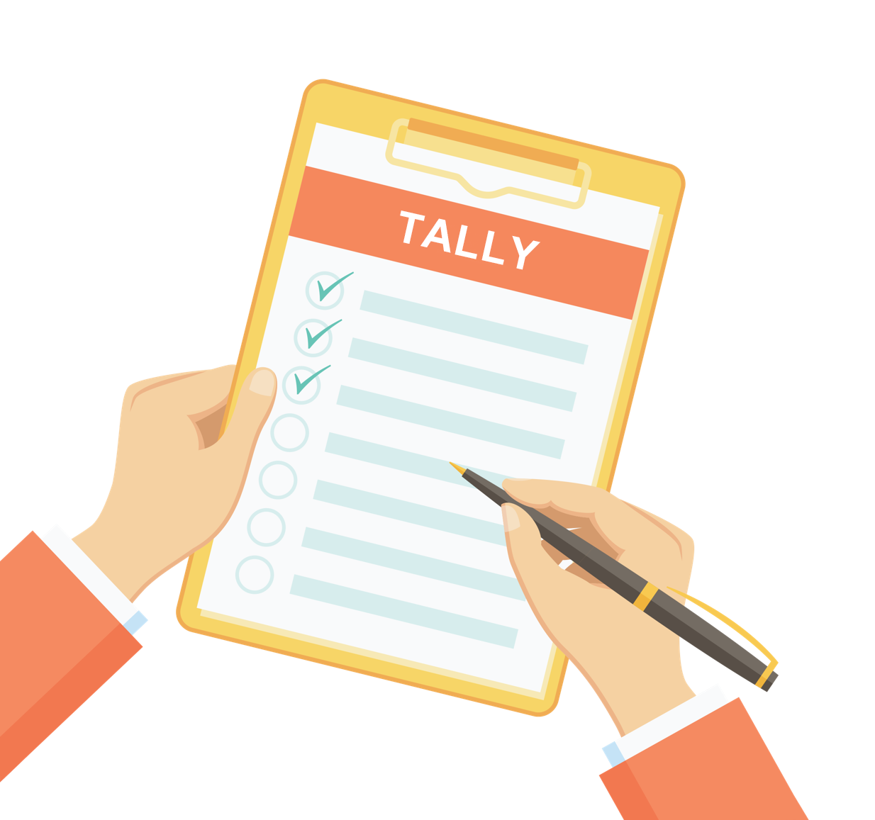
ACTIVITY: HOMEWORK: TALLY
YEAR 11 / LESSON 1
Create a tally chart so you can record how many times you see gambling being advertised throughout the week.
Think about the different types of gambling you may see and where.
How do these adverts make you feel, personally?
What impact do you think they have on young people?

Slide 12
If you need help…
YEAR 11 / LESSON 1
If you are worried about any of the content today you can talk to a teacher or member of staff. For additional support relating to your own or someone else’s relationship with gambling/gaming you can contact Childline or GamCare.
YoungPeopleService@gamcare.org.uk
T: 02030926964

Slide 13
SAFEGUARDING
YEAR 11 / LESSON 2

Slide 14
CHALLENGE
YEAR 11 / LESSON 2
Whose responsibility is it to safeguard people in relation to gambling and gambling related harms?
Consider individual, family, media, marketing, gambling industry, financial institutions and any other organisations who may have a role to play. Create a presentation to share your findings/ideas.

Slide 15
LEARNING OBJECTIVES
YEAR 11 / LESSON 2
TO identify who is and should be responsible for safeguarding people in relation to gambling
To consider whether there is enough safeguarding of people in relation to gambling
To evaluate and present information on safeguarding in relation to gambling

Slide 16
LEARNING OUTCOMES
YEAR 11 / LESSON 2
I can identify and discuss safeguarding and responsibility in relation to gambling
I can evaluate and present information on safeguarding in relation to gambling

Slide 17
ACTIVITY: POST-IT – SAFEGUARDING, WHAT DOES IT MEAN?
YEAR 11 / LESSON 2
On post-it notes, write down what you think safeguarding means in relation to gambling.
Let’s discuss and agree upon a definition.

Slide 18
ACTIVITY: MIND-MAP
YEAR 11 / LESSON 2
In groups, draw a mind-map of the different people and organisations you feel should be involved in safeguarding young people against gambling.
Feedback your ideas to the class, add any missed people to your mind-map.
MIND MAP
On your mind-map, circle the people who you think are currently involved in safeguarding.

Slide 19
ACTIVITY: WE PROUDLY PRESENT…
YEAR 11 / LESSON 2
Create a short presentation to show who you think should be responsible for safeguarding people in relation to gambling.
Make sure you can explain your ideas and reasoning.

Slide 20
ACTIVITY: VOTING STATIONS
YEAR 11 / LESSON 2
Deliver your presentation to the class.
Vote for the group who delivered the strongest presentation, explaining your choice.

Slide 21
EXTENSION: WHAT HAPPENS IF THE SAFEGUARDS FAIL?
YEAR 11 / LESSON 2
What would happen if there were no safeguards? How would health and wellbeing, physical and financial health be impacted?
Explore the 1985 Order.
Are the current safeguarding measures effective?
Write to your local MLA to suggest further safeguarding measures.

Slide 22
If you need help…
YEAR 11 / LESSON 2
If you are worried about any of the content today you can talk to a teacher or member of staff. For additional support relating to your own or someone else’s relationship with gambling/gaming you can contact Childline or GamCare.
YoungPeopleService@gamcare.org.uk
T: 02030926964

Slide 23
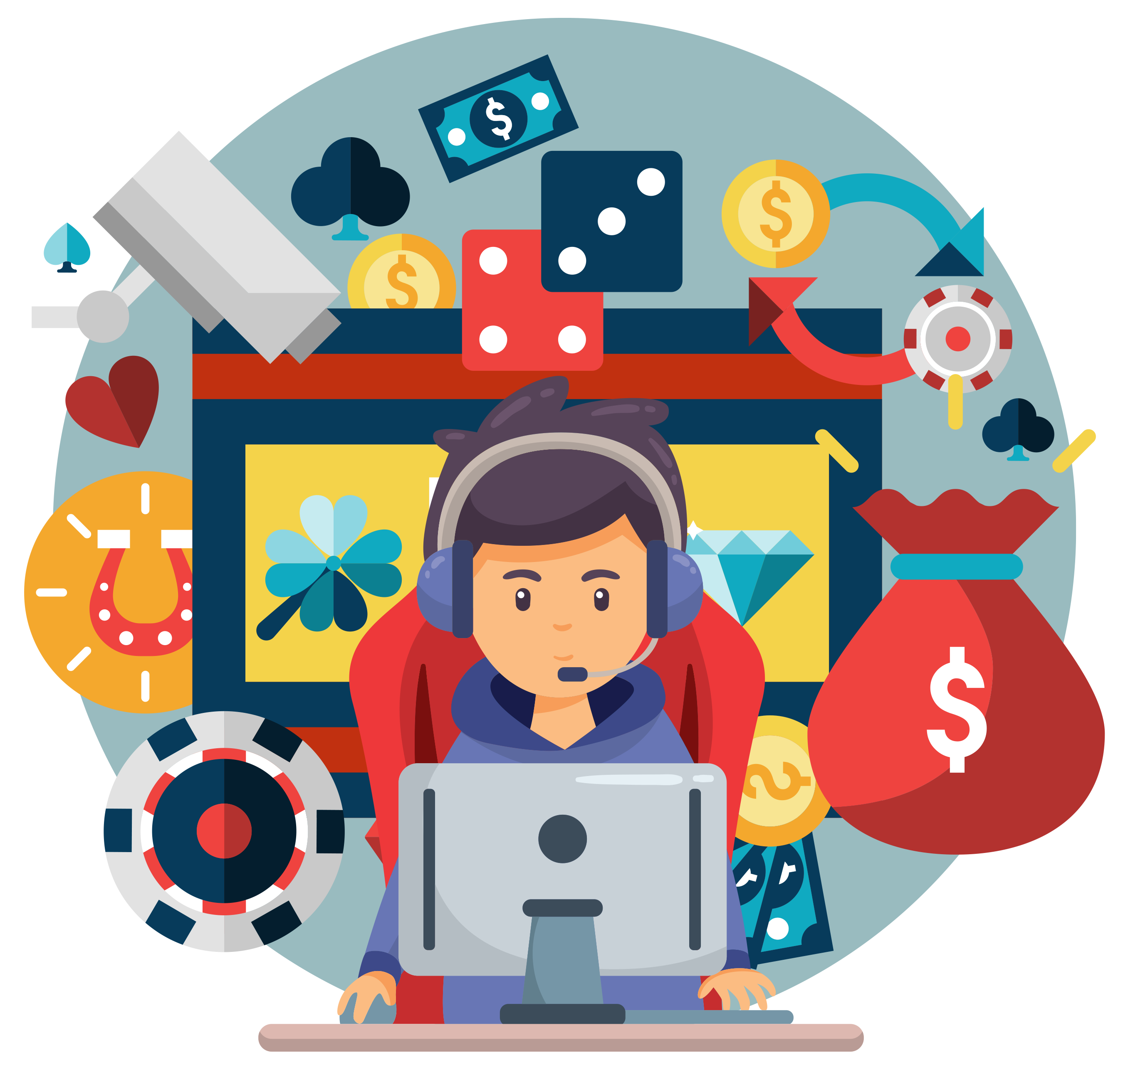
WHY DO YOUNG PEOPLE GAMBLE? PART 1
YEAR 11 / LESSON 3
V1.1/Dec20

Slide 24
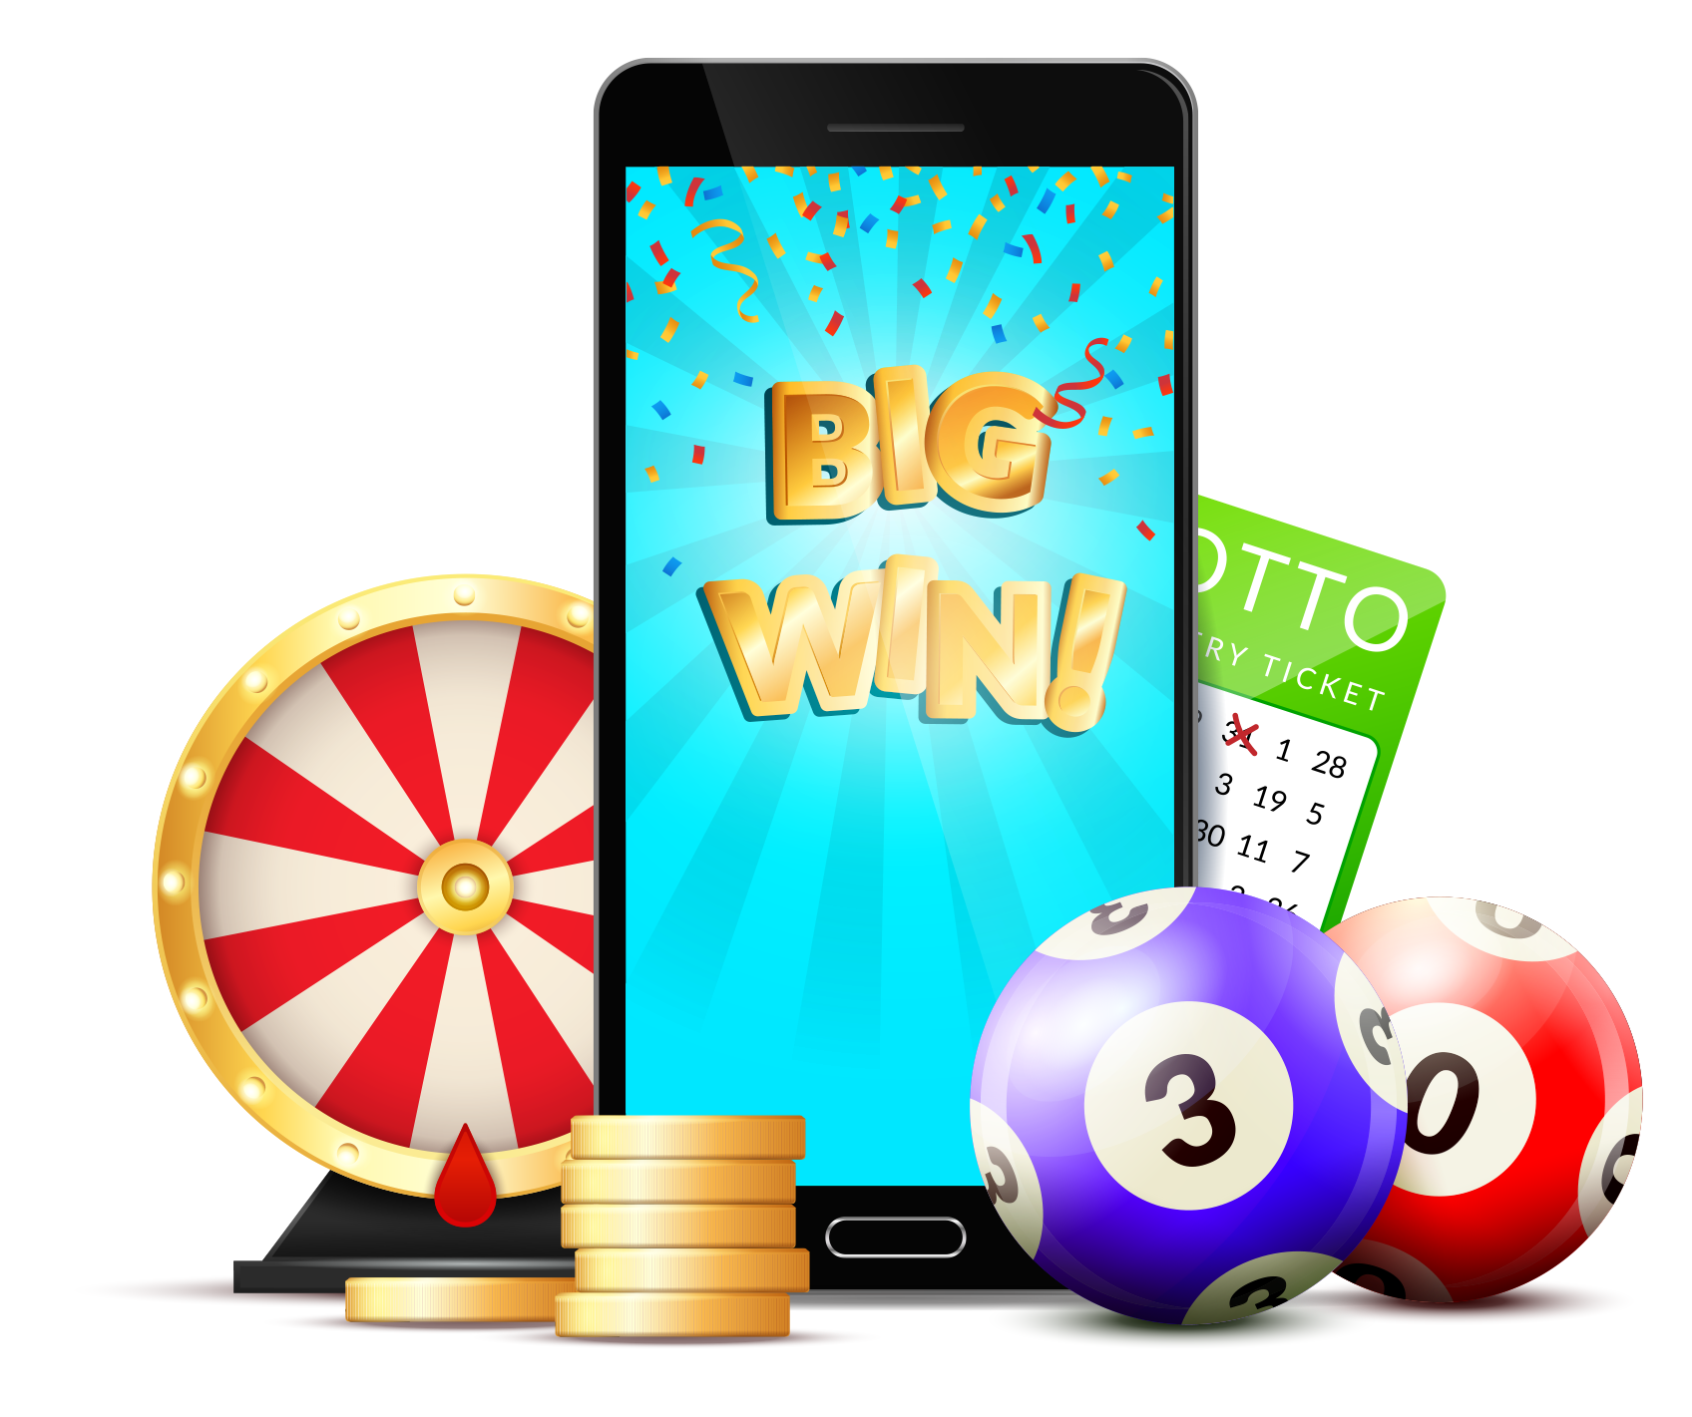
CHALLENGE
YEAR 11 / LESSON 3
Consider the motivations of young people who gamble, and the potential risks involved.
Conduct a questionnaire to explore the motivations of your class/school/youth group. Create learning materials to demonstrate your findings. You should explore also, why young people do not gamble.

Slide 25
LEARNING OBJECTIVES
YEAR 11 / LESSON 3
To consider the reasons why young people gamble.
To consider the risks involved in gambling.
To investigate and present findings on the motivations of gambling.

Slide 26
LEARNING OUTCOMES
YEAR 11 / LESSON 3
I can identify the motivations of young people who gamble.
I can identify the potential risks involved in gambling.
I understand that gambling may take place within games, such as the use of loot boxes.
I can create and conduct a questionnaire.
I can analyse the findings of an investigation.
I can present information to my peers.

Slide 27
ACTIVITY: MIND-MAP
YEAR 11 / LESSON 3
Create a mind-map of the different motivations young people may have for gambling.
This can include gambling through online games, such as the use of loot boxes or via games like penny up/pitch and toss.
MIND MAP

Slide 28
ACTIVITY: WHY NOT?
YEAR 11 / LESSON 3
List the reasons why young people don’t gamble?
REASONS
Illegal under a certain age
Not morally ethical
Prevent harmful effects

Slide 29
ACTIVITY: THINK PAIR SHARE
YEAR 11 / LESSON 3
discuss and note down the risks of gambling/gaming.
share your ideas AND REASONING with the class.

Slide 30
ACTIVITY: LET’S INVESTIGATE!
YEAR 11 / LESSON 3
What are the motivations for gambling, gaming and in-app purchasing within your class?
Create a questionnaire to find out.
Produce a presentation/learning material to demonstrate the information you have collected; this could include graphs and pie charts.

Slide 31
ACTIVITY: EXIT TICKET
YEAR 11 / LESSON 3
Write down one risk associated with gambling.
How can this risk be mitigated?

Slide 32
If you need help…
YEAR 11 / LESSON 3
If you are worried about any of the content today you can talk to a teacher or member of staff. For additional support relating to your own or someone else’s relationship with gambling/gaming you can contact Childline or GamCare.
YoungPeopleService@gamcare.org.uk
T: 02030926964

Slide 33
WHY DO YOUNG PEOPLE GAMBLE? PART 2
YEAR 11 / LESSON 4

Slide 34
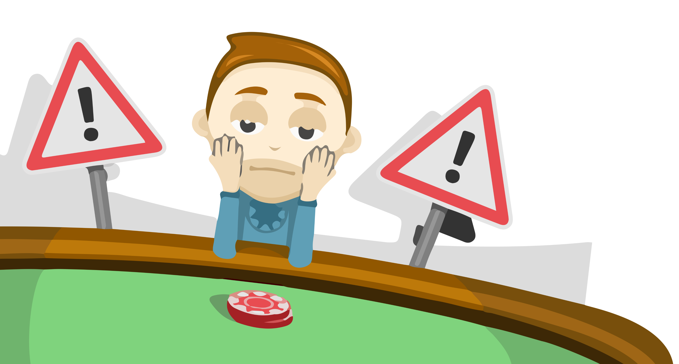
CHALLENGE
YEAR 11 / LESSON 4
Explore how young people can be supported to recognise the potential harm of gambling.
Create resources to support them in recognising the potential harms.
©YGAM 2020: All rights reserved

Slide 35
LEARNING OBJECTIVES
YEAR 11 / LESSON 4
To consider the risks and potential harms involved in gambling
To identify key behaviours that someone is experiencing harm
To raise awareness of the potential harms of gambling and signpost support

Slide 36
LEARNING OUTCOMES
YEAR 11 / LESSON 4
Identify
I can identify the potential risks involved in gambling
Define
I can define gambling related harm
Recognise
I can recognise key behaviours linked to gambling related harm
Create
I can create resources in order to raise awareness of the potential harms of gambling

Slide 37
ACTIVITY: THINK PAIR SHARE
YEAR 11 / LESSON 4
What is Gambling related harm? What does it look like?
Working in pairs, discuss and agree upon a definition.

Slide 38
ACTIVITY: A DEFINITION
YEAR 11 / LESSON 4
“When someone’s habit compromises, disrupts or damages family, personal or recreational pursuits.”
(Gambling Commission)

Slide 39
ACTIVITY: LET’S SORT IT!
YEAR 11 / LESSON 4
Sort the statement cards into the following categories:
RED
HARMFUL
AMBER
AT RISK
GREEN
NOT HARMFUL

Slide 40
ACTIVITY: ARE WE AWARE?
YEAR 11 / LESSON 4
Create a resource to promote awareness regarding the potential harms of gambling
What type of resource would be best?
How and where can people seek support?
Present your resource to the class.

Slide 41
If you need help…
YEAR 11 / LESSON 4
If you are worried about any of the content today you can talk to a teacher or member of staff. For additional support relating to your own or someone else’s relationship with gambling/gaming you can contact Childline or GamCare.
YoungPeopleService@gamcare.org.uk
T: 02030926964

Slide 42
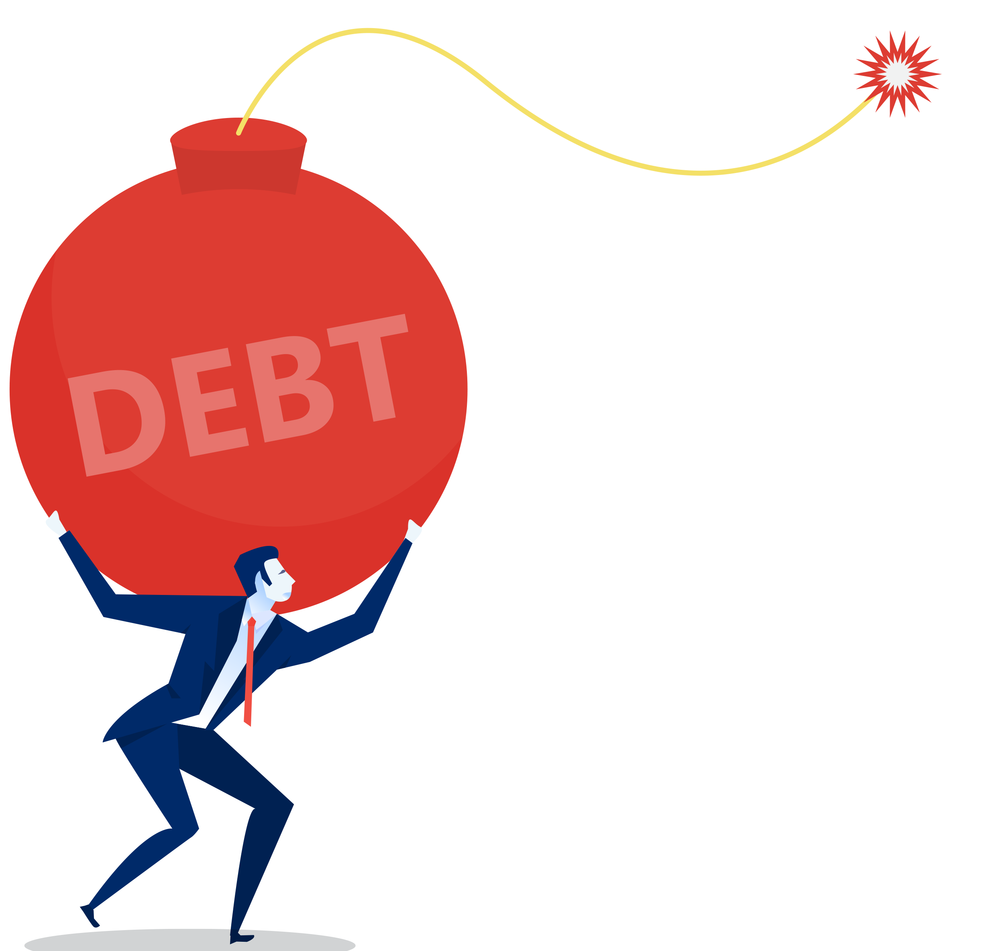
MONEY AND DEBT
YEAR 11 / LESSON 5

Slide 43
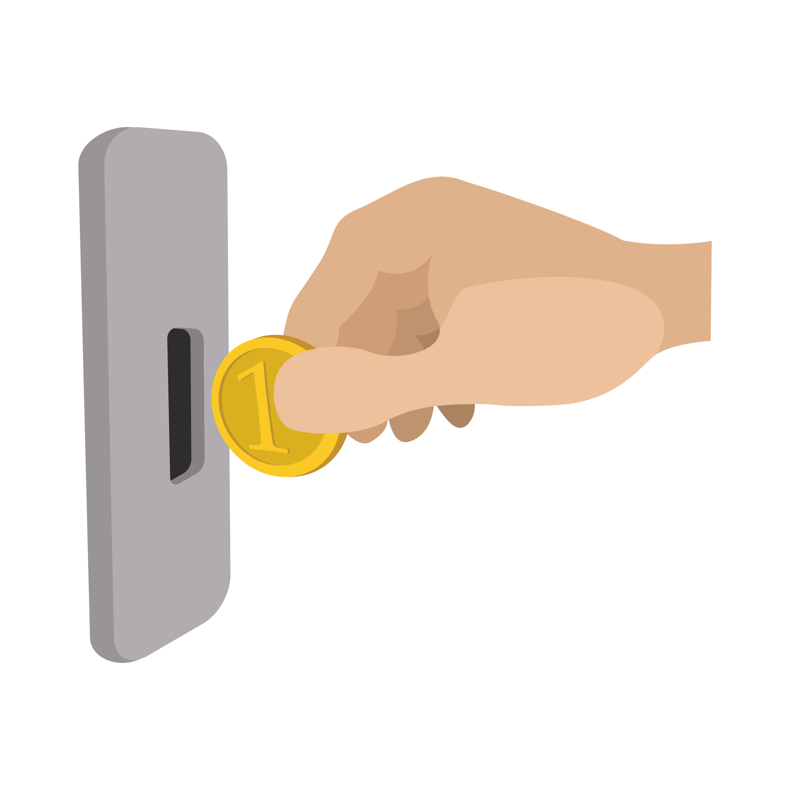
CHALLENGE
YEAR 11 / LESSON 5
Consider the average amount of money spent on gambling by 11-16 year olds.
How else could this money be spent? Set yourself a short-term and long-term financial plan.

Slide 44
LEARNING OBJECTIVES
YEAR 11 / LESSON 5
To understand how gambling links to finances
To identify ways to manage personal finances
To evaluate your own personal finances

Slide 45
LEARNING OUTCOMES
YEAR 11 / LESSON 5
Describe
I can describe the link between gambling and finances for young people
Explore
I can explore other activities and ways to spend money
Identify
I can identify ways to manage my own finances
Create
I can create a financial plan
Reflect
I can reflect upon my current and future spending

Slide 46
ACTIVITY: GIVE ME FIVE
YEAR 11 / LESSON 5
List five things that you think young people spend their money on.
Share your ideas.

Slide 47
ACTIVITY: GAMBLING SPENDS
YEAR 11 / LESSON 5
11%
35%
49%
44%
7%
Of 11-16 year olds have spent money on gambling in the last 7 days
Of these 11- 16 year olds have spent more that £10 in the last 7 days
Of these 11-16 year olds have sent £5 or less on gambling in the last 7 days
Of 11-16 year olds have paid money to open loot boxes
Of 11-16 year olds have spent money gambling online

Slide 48
ACTIVITY: MIND-MAP
YEAR 11 / LESSON 5
Create a mind map of alternative activities young people could spend their money on.
MIND MAP

Slide 49
ACTIVITY: FINANCIAL PLANS
YEAR 11 / LESSON 5
FINANCIAL PLAN
Create a short-term and long-term financial plan.
SHORT-TERM
LONG-TERM
Play less
Limit my spending
Don’t take risks
Save money
Seek gambling help and advice
Improve health

Slide 50
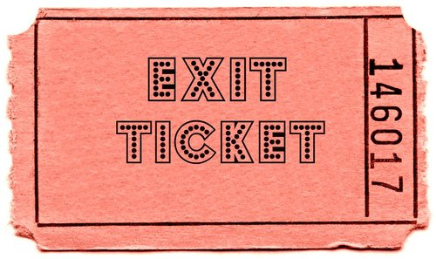
ACTIVITY: EXIT TICKET
YEAR 11 / LESSON 5
Write down one way to ensure that you manage your finances now or in the future.

Slide 51
If you need help…
YEAR 11 / LESSON 5
If you are worried about any of the content today you can talk to a teacher or member of staff. For additional support relating to your own or someone else’s relationship with gambling/gaming you can contact Childline or GamCare.
YoungPeopleService@gamcare.org.uk
T: 02030926964

Slide 52
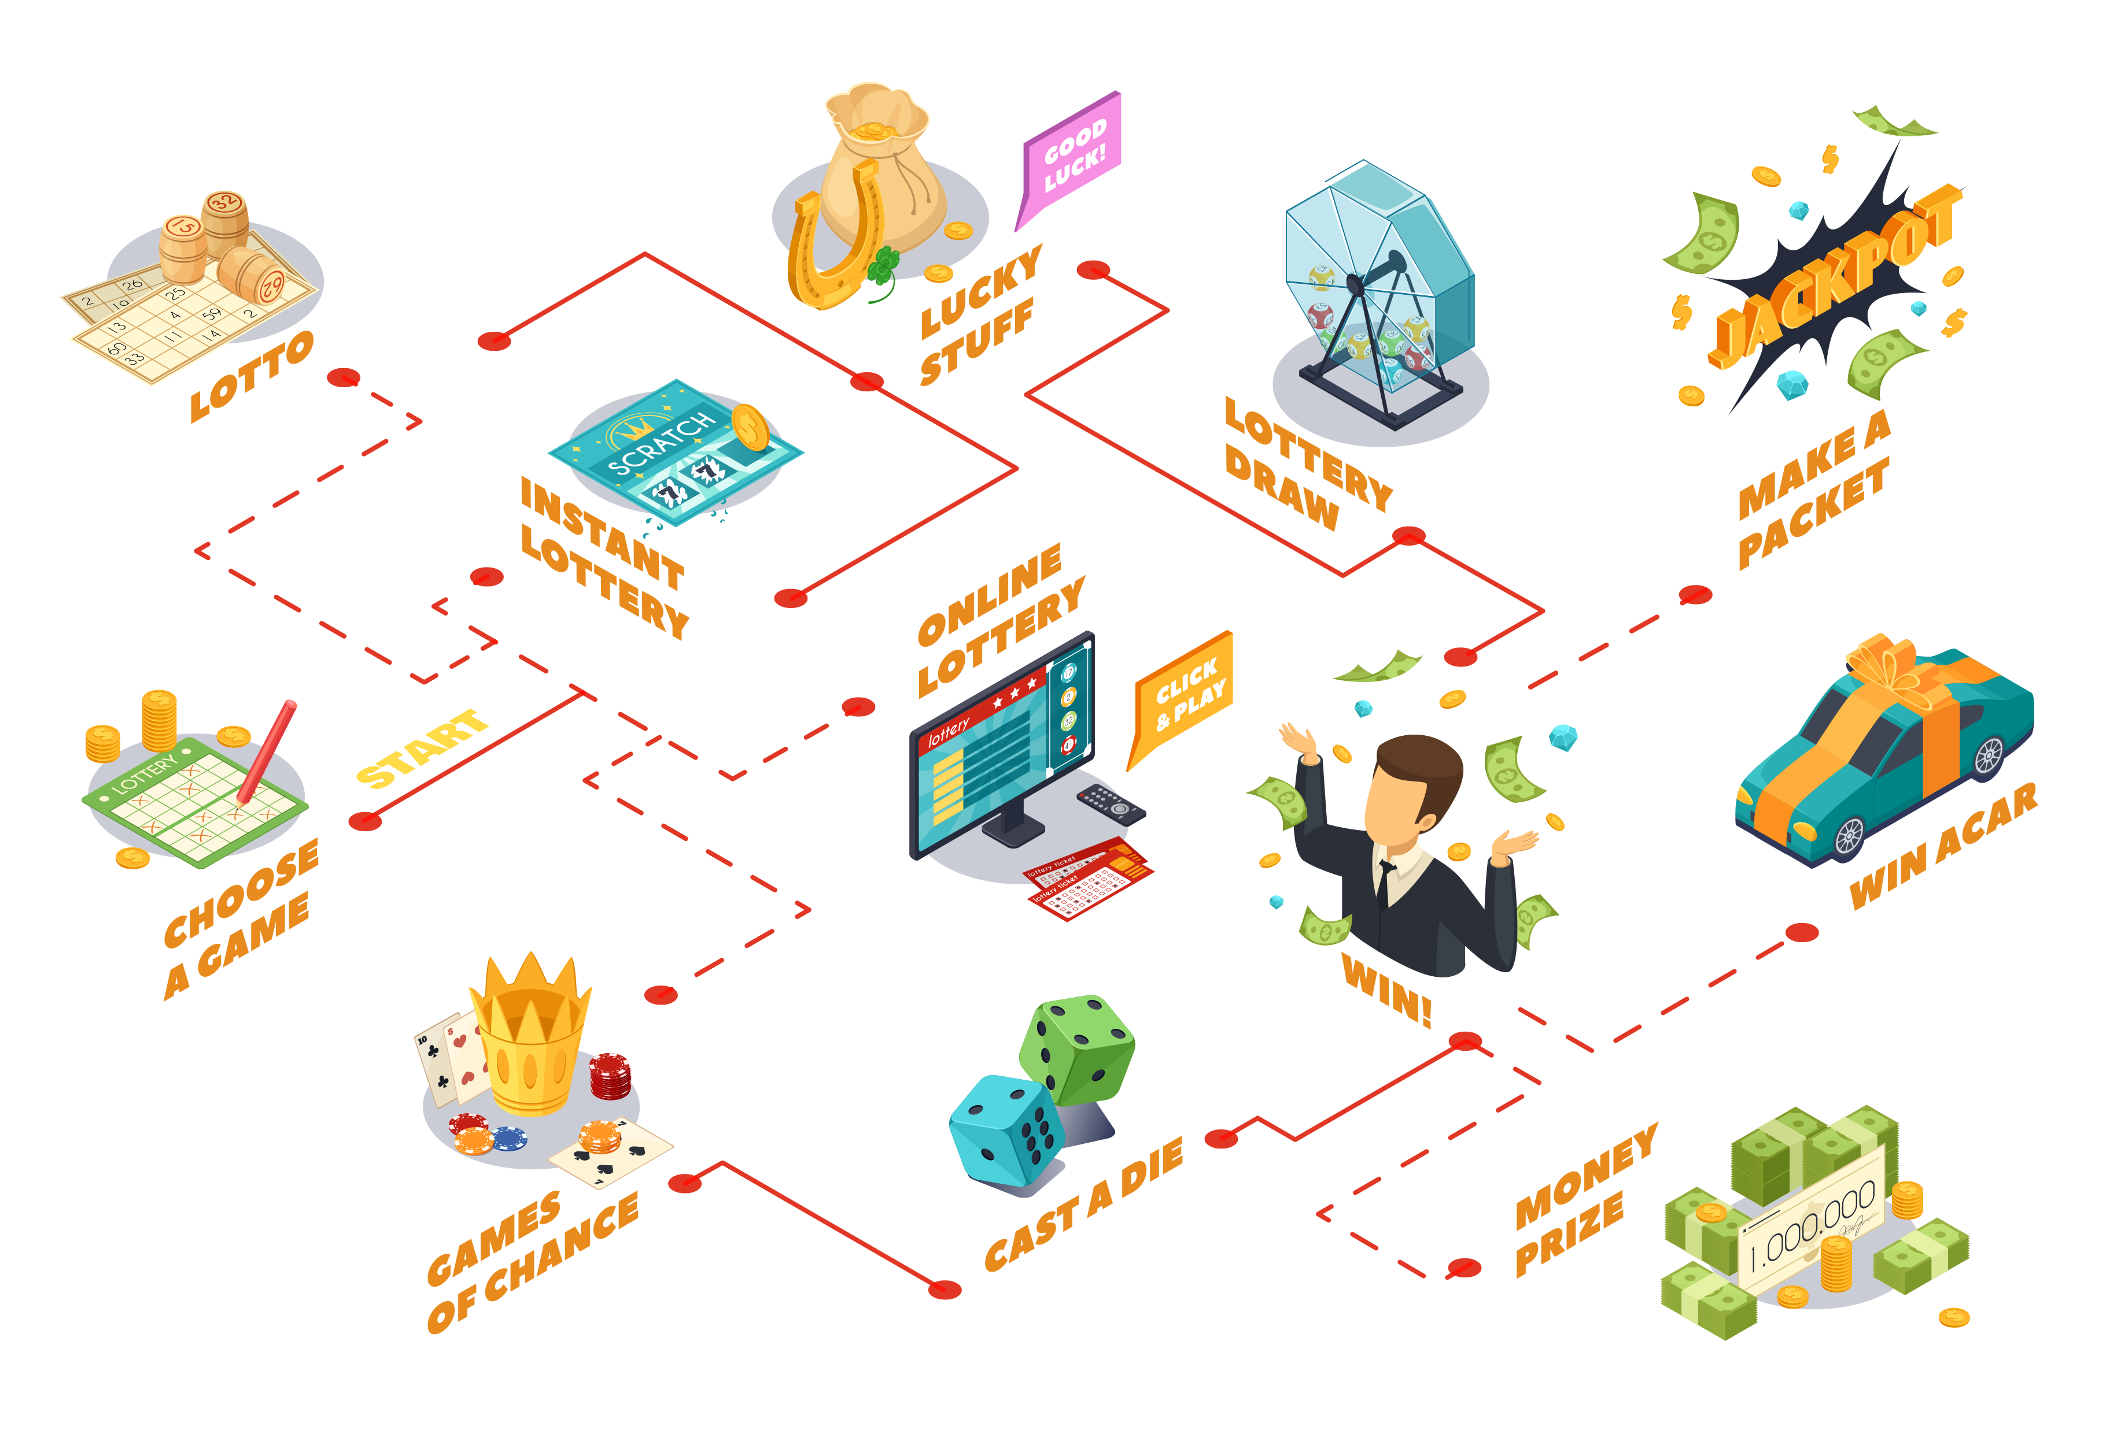
GAMBLING TRENDS
YEAR 11 / LESSON 6

Slide 53
CHALLENGE
YEAR 11 / LESSON 6
Conduct a brief survey and find out more about gambling, risks and harm.
Are there any key messages ? You may wish to interview someone who has lived experience of gambling harm to understand further the potential risks.

Slide 54
LEARNING OBJECTIVES
YEAR 11 / LESSON 6
To identify the different forms of gambling available within the UK
To investigate the types of gambling activities adult’s have tried, and why
To present information to your peers

Slide 55
LEARNING OUTCOMES
YEAR 11 / LESSON 6
I can identify different forms of gambling
I can create a survey to investigate gambling
I can analyse my findings and create a graph or chart to demonstrate my findings
I can present my findings to my peers

Slide 56
ACTIVITY: POST-IT
YEAR 11 / LESSON 6
On post-it notes, write down as many different types of gambling you can think of.

Slide 57
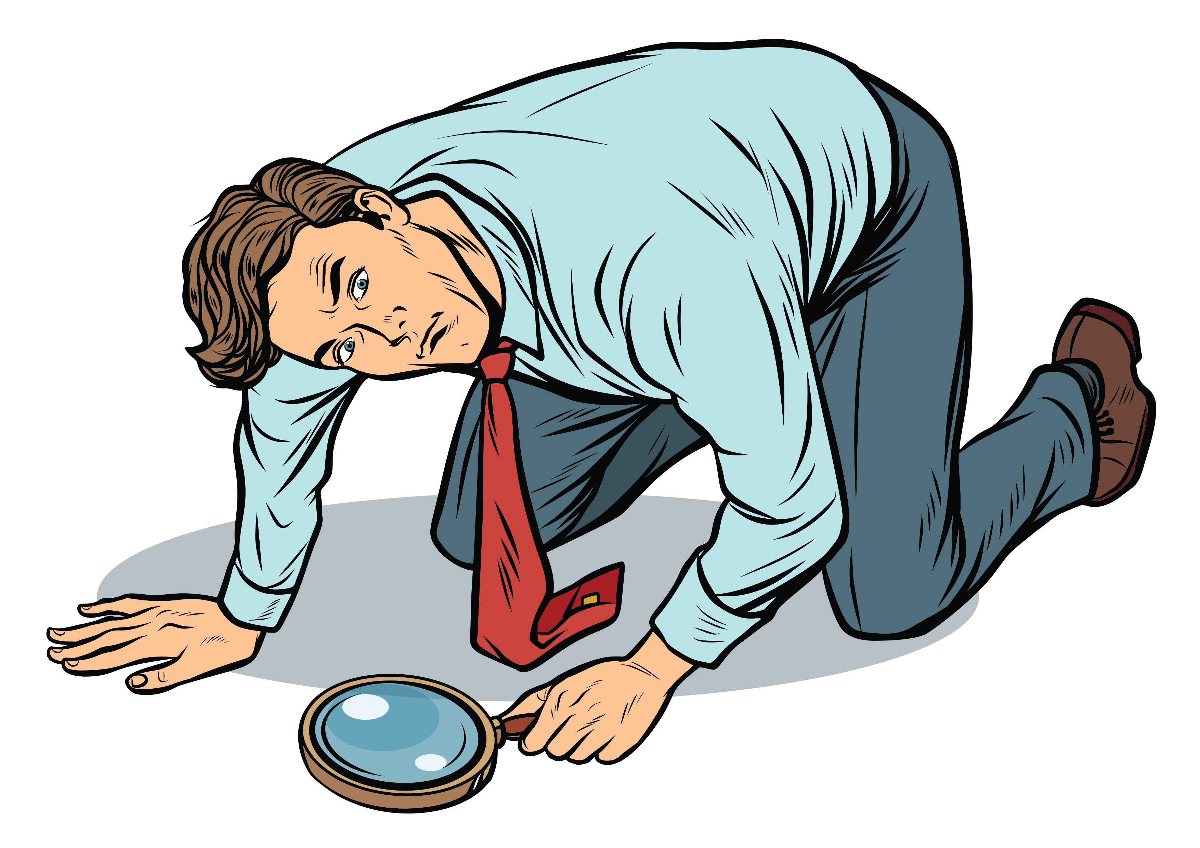
ACTIVITY: LET’S INVESTIGATE
YEAR 11 / LESSON 6
Create a survey to find out which forms of gambling adults have tried and why, you should also talk to those who have not and discuss why.
You could use an online survey to help you gather this information.
You may wish to use a search engine to explore trends. Pay attention to how people may be affected and, consider why people may abstain from gambling.
You should be sensitive to the viewpoint of others.

Slide 58
ACTIVITY: LET’S INVESTIGATE
YEAR 11 / LESSON 6
Create a graph or chart to present your survey findings to the class.

Slide 59
ACTIVITY: 60 SECOND SCRIBBLE
YEAR 11 / LESSON 6
What have you learnt today?
You have 60 seconds to write down as much as you can.

Slide 60
If you need help…
YEAR 11 / LESSON 6
If you are worried about any of the content today you can talk to a teacher or member of staff. For additional support relating to your own or someone else’s relationship with gambling/gaming you can contact Childline or GamCare.
YoungPeopleService@gamcare.org.uk
T: 02030926964

Slide 61
PROBABILITY AND LUCK: THE GAMBLER’S FALLACY
YEAR 12 / LESSON 1
© YGAM 2020: All rights reserved

Slide 62
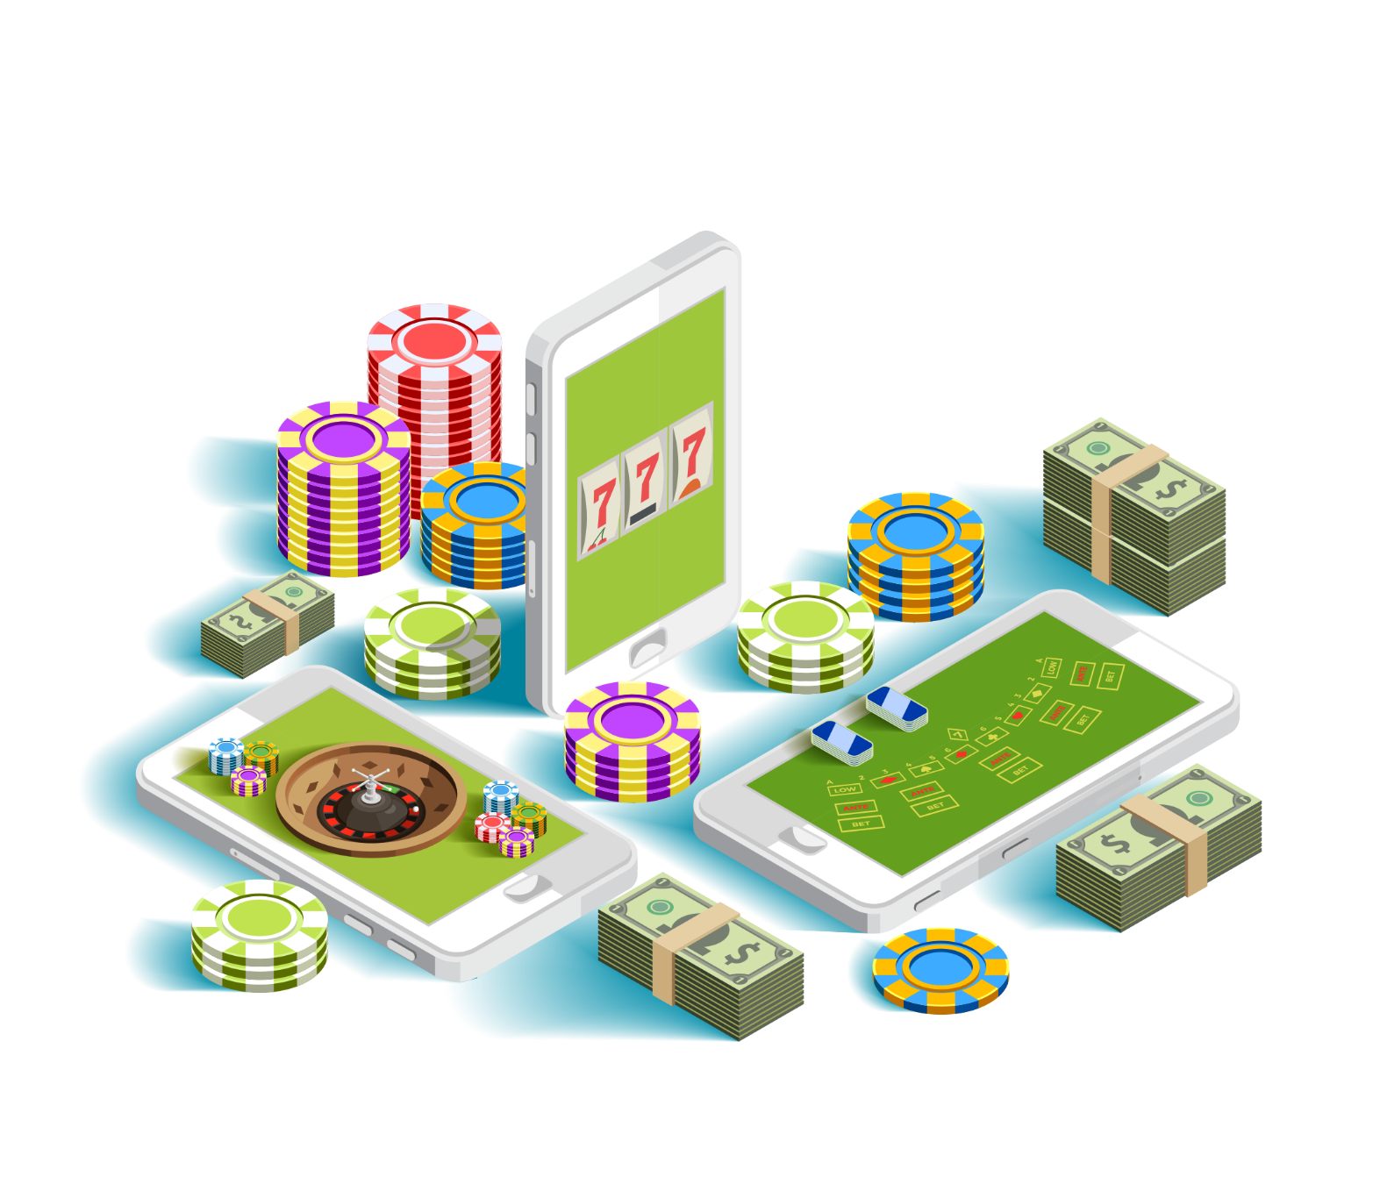
CHALLENGE
YEAR 12 / LESSON 1
It is often said that ‘the House always wins’ in gambling. But what does this actually mean?
Create a presentation to share with the rest of your group.

Slide 63
LEARNING OBJECTIVES
YEAR 12 / LESSON 1
To understand the meaning of ‘the House always wins’
To present information on the subject: gambler’s fallacy.

Slide 64
LEARNING OUTCOMES
YEAR 12 / LESSON 1
I understand the meaning of ‘the House always wins’
I understand the meaning of bias
I understand the meaning of ‘gambler’s fallacy’
I can present information to my peers.

Slide 65
ACTIVITY: 60 SECOND SCRIBBLE
YEAR 12 / LESSON 1
What does the term ‘bias’ mean?
Share your ideas with the class.
What do you think we mean by ‘the House always wins?’

Slide 66
ACTIVITY: A DEFINITION
YEAR 12 / LESSON 1
THE HOUSE ALWAYS WINS
‘when you gamble in a casino, betting shop, online etc., the odds are stacked in favour of the establishment’.
Why may this cause harm in relation to gambling?
What are the risks and what do people need to know?

Slide 67
YEAR 12 / LESSON 1
Video: The Gambler’s Fallacy
Discuss and decide upon a class definition of ‘Gambler’s fallacy’.

Slide 68
ACTIVITY: LET’S INVESTIGATE
YEAR 12 / LESSON 1
Let’s explore probability and the odds of winning.
Create a presentation based on your research to show that ‘the House always wins’.

Slide 69
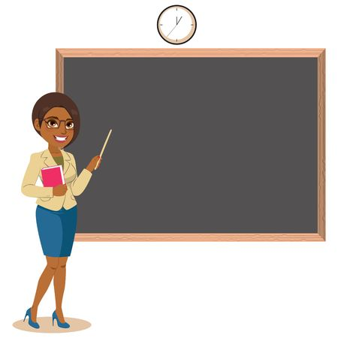
ACTIVITY: WE PROUDLY PRESENT…
YEAR 12 / LESSON 1
Present your work to the class.

Slide 70
If you need help…
YEAR 12 / LESSON 1
If you are worried about any of the content today you can talk to a teacher or member of staff. For additional support relating to your own or someone else’s relationship with gambling/gaming you can contact Childline or GamCare.
YoungPeopleService@gamcare.org.uk
T: 02030926964

Slide 71
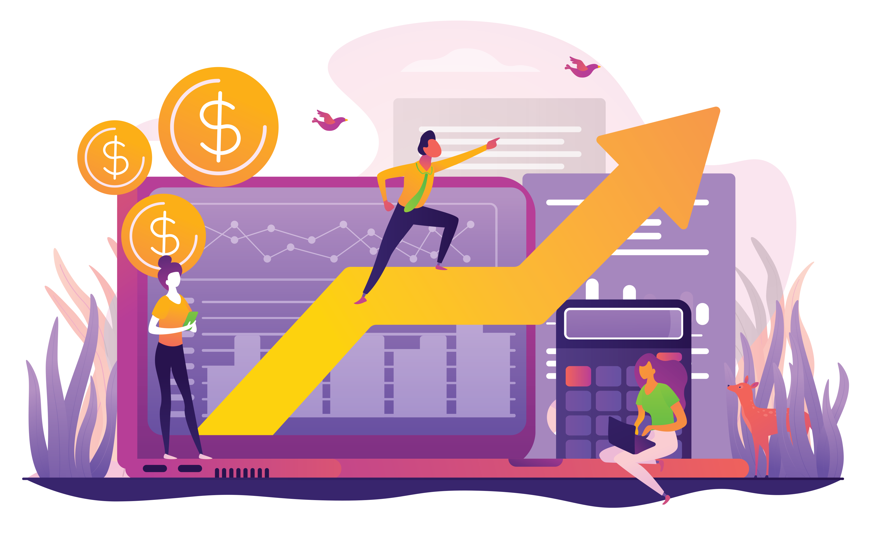
THE STOCK MARKET: MONEY AND DEBT
YEAR 12 / LESSON 2

Slide 72
CHALLENGE
YEAR 12 / LESSON 2
Should the stock market be classified as gambling? How does it compare to other forms of gambling?

Slide 73
LEARNING OBJECTIVES
YEAR 12 / LESSON 2
To understand what the stock market is and how it works.
To understand the difference between investing and gambling.
To evaluate the different forms of gambling.

Slide 74
LEARNING OUTCOMES
YEAR 12 / LESSON 2
I understand what the stock market is and how it works.
I understand the meaning of investment.
I can compare the stock market to other forms of gambling.
I can put forward arguments to my peers.

Slide 75
ACTIVITY: LET’S SORT IT!
YEAR 12 / LESSON 2
Sort the statements into the following categories:
Gambling
Stock market
What are the similarities and differences between the stock market and other forms of gambling?
Discuss and agree upon a class definition for the stock market and investment.

Slide 76
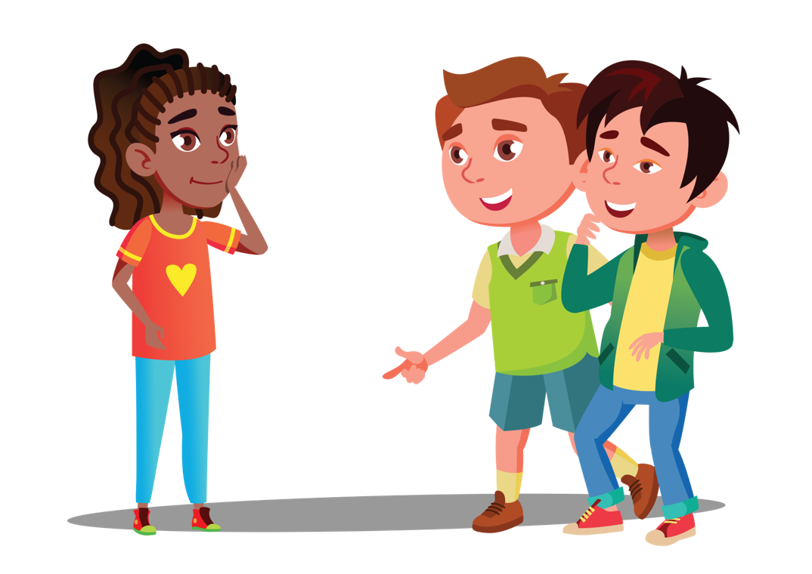
ACTIVITY: LET’S DEBATE
YEAR 12 / LESSON 2
‘Stock markets should be classified as a form of gambling.’
Discuss, develop and prepare your argument.

Slide 77
ACTIVITY: EXIT TICKET
YEAR 10 / LESSON 2
Stock markets are a form of gambling….
Note down your viewpoint on this statement.

Slide 78
If you need help…
YEAR 12 / LESSON 2
If you are worried about any of the content today you can talk to a teacher or member of staff. For additional support relating to your own or someone else’s relationship with gambling/gaming you can contact Childline or GamCare.
YoungPeopleService@gamcare.org.uk
T: 02030926964

Slide 79
WHY PEOPLE GAMBLE
YEAR 12 / LESSON 3

Slide 80
CHALLENGE
YEAR 12 / LESSON 3
Create a support tool.
Include information on the organisations which deal with the prevention of gambling and gaming-related harms and other organisations who help those already addicted. Use illustrations and photographs to convey your message.

Slide 81
LEARNING OBJECTIVES
YEAR 12 / LESSON 3
To identify organisations that deal with the prevention of gambling and gaming-related harms
To identify organisations that support people who are already addicted
To create a support tool for young people

Slide 82
LEARNING OUTCOMES
YEAR 12 / LESSON 3
Describe
I can describe the key indicators that suggest gambling or gaming may be causing harm.
Identify
I can identify organisations that prevent gambling or gaming-related harm.
Identify
I can identify organisations that support people who are already addicted/experiencing harm.
Create
I can create a support tool for young people and present this to my peers.

Slide 83
ACTIVITY: GIVE ME FIVE
YEAR 12 / LESSON 3
What signs or behaviours could indicate gambling or gaming-related harm?
Draw around your hand and write down a sign or behaviour for each finger.
Share and discuss.

Slide 84
ACTIVITY: LET’S CREATE
YEAR 12 / LESSON 3
Prepare an information handbook to inform people on:
The signs of gambling or gaming-related harm
The organisations which deal with the prevention of gambling and gaming-related harms
The organisations who support people who are experiencing gambling and gaming-related harms.

Slide 85
ACTIVITY: TWEET
YEAR 12 / LESSON 3
On a post-it, write a Tweet advertising one of the organisations you have researched.

Slide 86
If you need help…
YEAR 12 / LESSON 3
If you are worried about any of the content today you can talk to a teacher or member of staff. For additional support relating to your own or someone else’s relationship with gambling/gaming you can contact Childline or GamCare.
YoungPeopleService@gamcare.org.uk
T: 02030926964

Slide 87
ADDICTION AND MENTAL HEALTH
YEAR 12 / LESSON 4

Slide 88
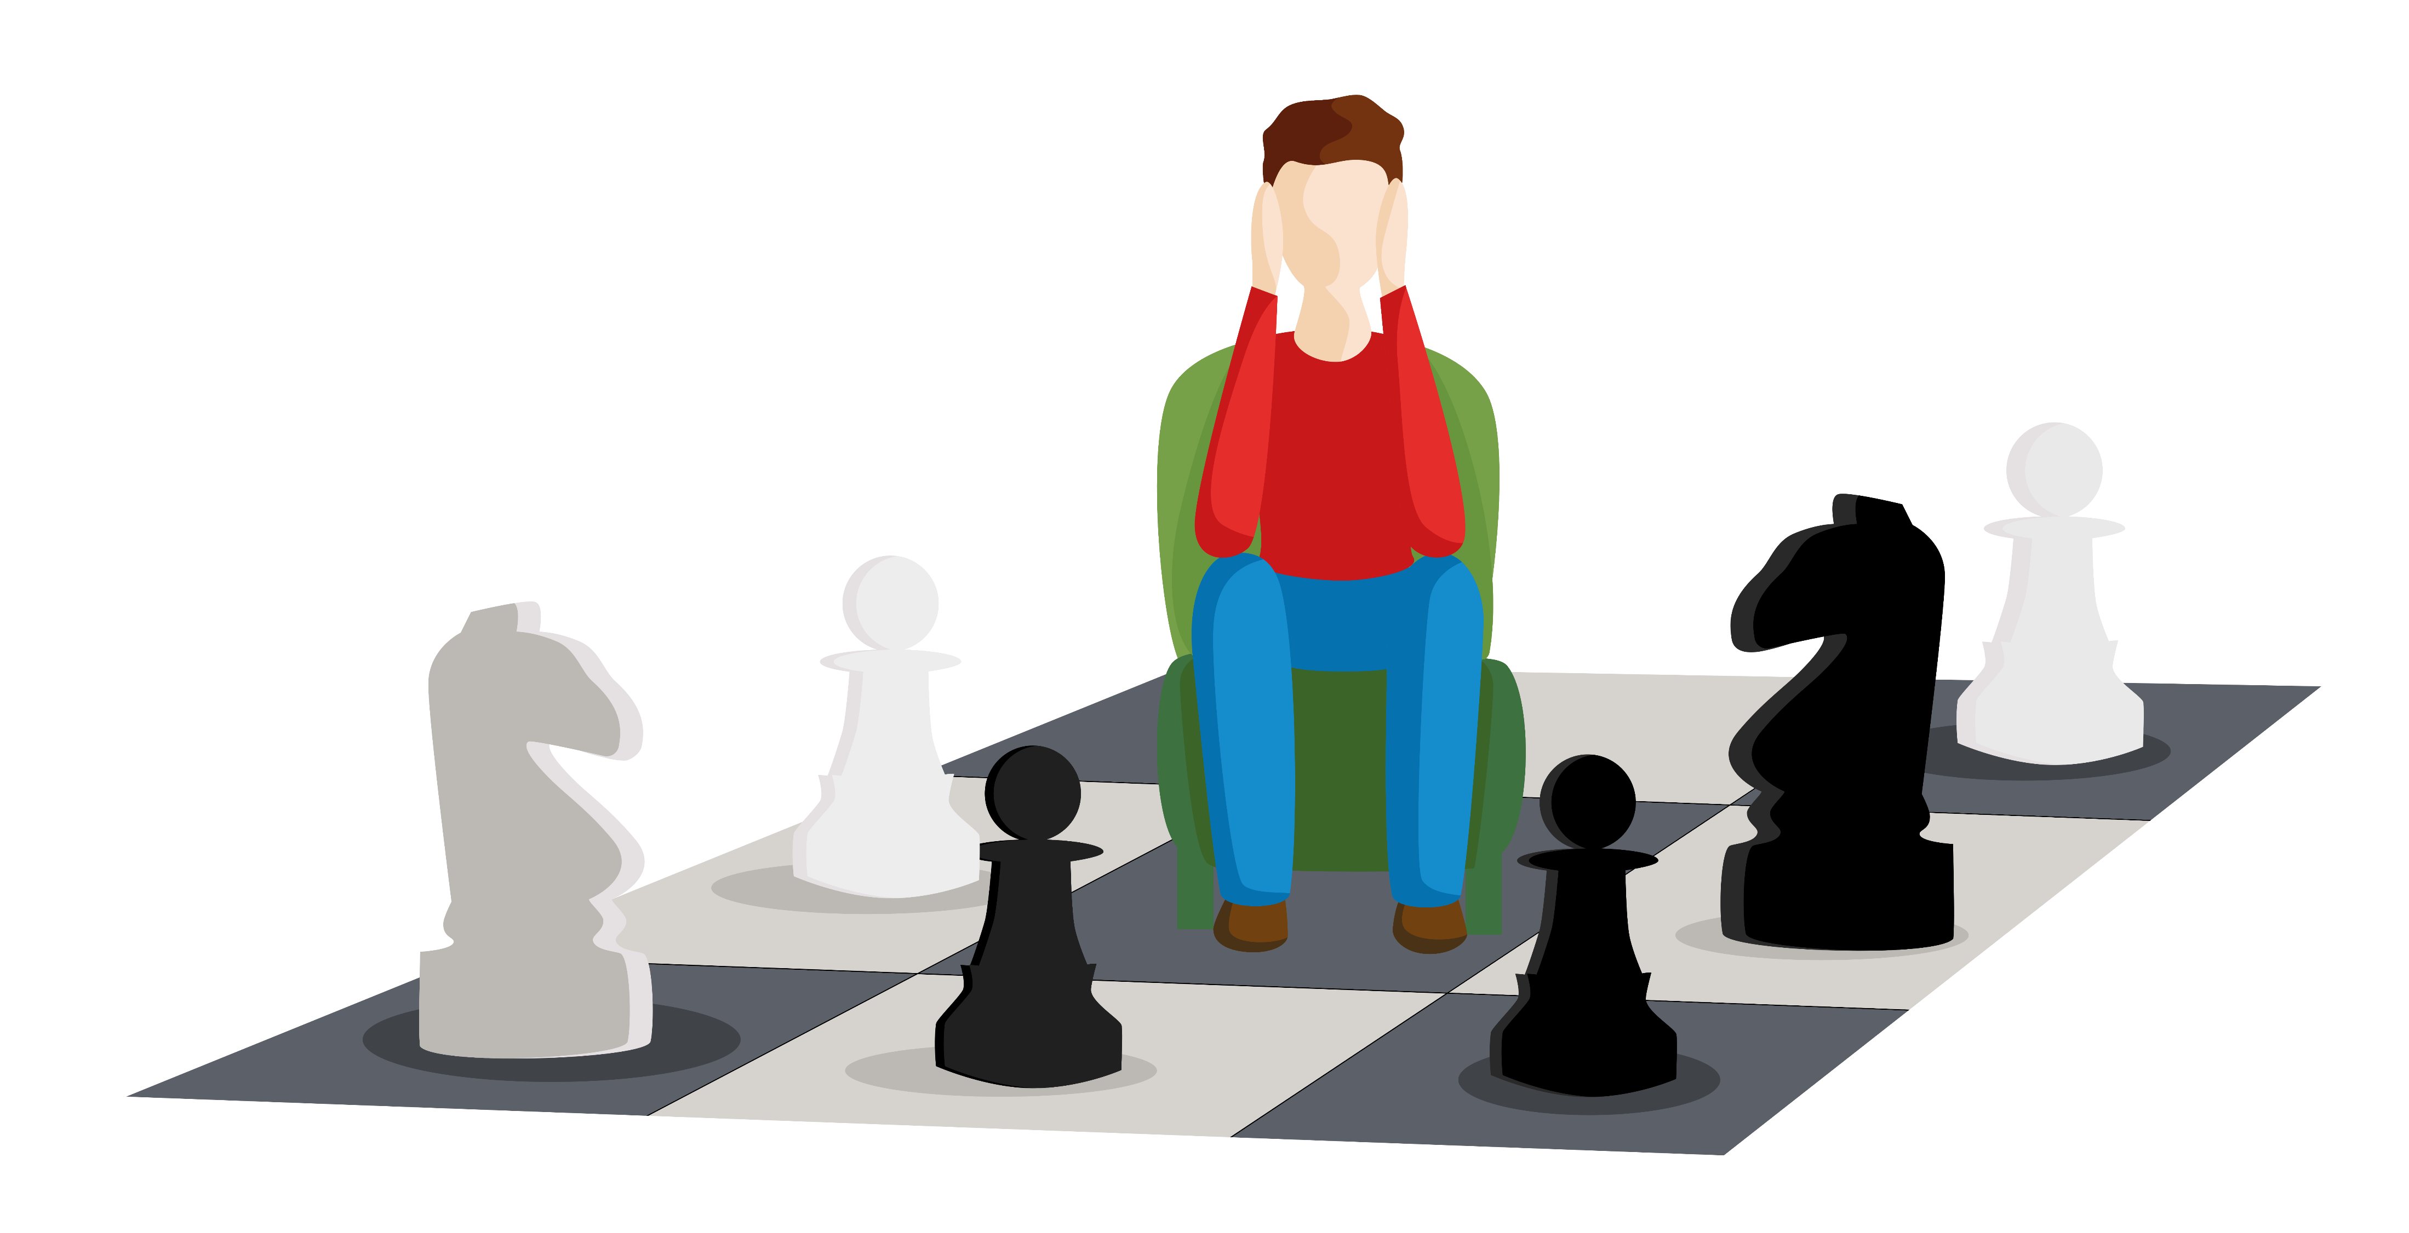
CHALLENGE
YEAR 12 / LESSON 4
Define addiction.
Why might a young person develop addictive behaviours that are linked to gambling? How does it affect different health aspects? Research these areas and find a case study to support your findings.
Create a podcast, blog or resource to share your findings.

Slide 89
LEARNING OBJECTIVES
YEAR 12 / LESSON 4
To identify the signs of gambling related harm
To understand what is meant by addiction
To identify how addiction may affect people and impact on various aspects of their life
To understand cause and effect

Slide 90
LEARNING OUTCOMES
YEAR 12 / LESSON 4
I can identify the signs of gambling related harm
I can recognise how gambling can impact on various aspects of an individual's health
I understand cause and effect

Slide 91
ACTIVITY: WHAT IS MEANT BY ADDICTION?
YEAR 12 / LESSON 4
Take 2 minutes to consider what is meant by addiction.
How does gambling harm differ to other harms, e.g. alcohol, illegal drugs, tobacco?

Slide 92
ACTIVITY: CAUSE AND EFFECT
YEAR 12 / LESSON 4
Cause and Effect Tree:
List the reasons/causes for gambling related harm in young people
On the branches write down what you think might be the effects.
Share your ideas with the person next to you. How do your ideas compare?

Slide 93
ACTIVITY: THINK, PAIR, SHARE
YEAR 12 / LESSON 4
Match the reasons young people gamble to the results given in the gambling survey 2019.

Slide 94
ACTIVITY: GAMBLING: HEALTH AND WELLBEING
YEAR 12 / LESSON 4
OPTION 1:
Use of IT / Internet
OPTION 2:
Joe and Sam’s story
Research the reasons why some young people gamble, and the impact on their health and wellbeing. In small groups, use the material to help create an educational podcast, blog or resource.

Slide 95
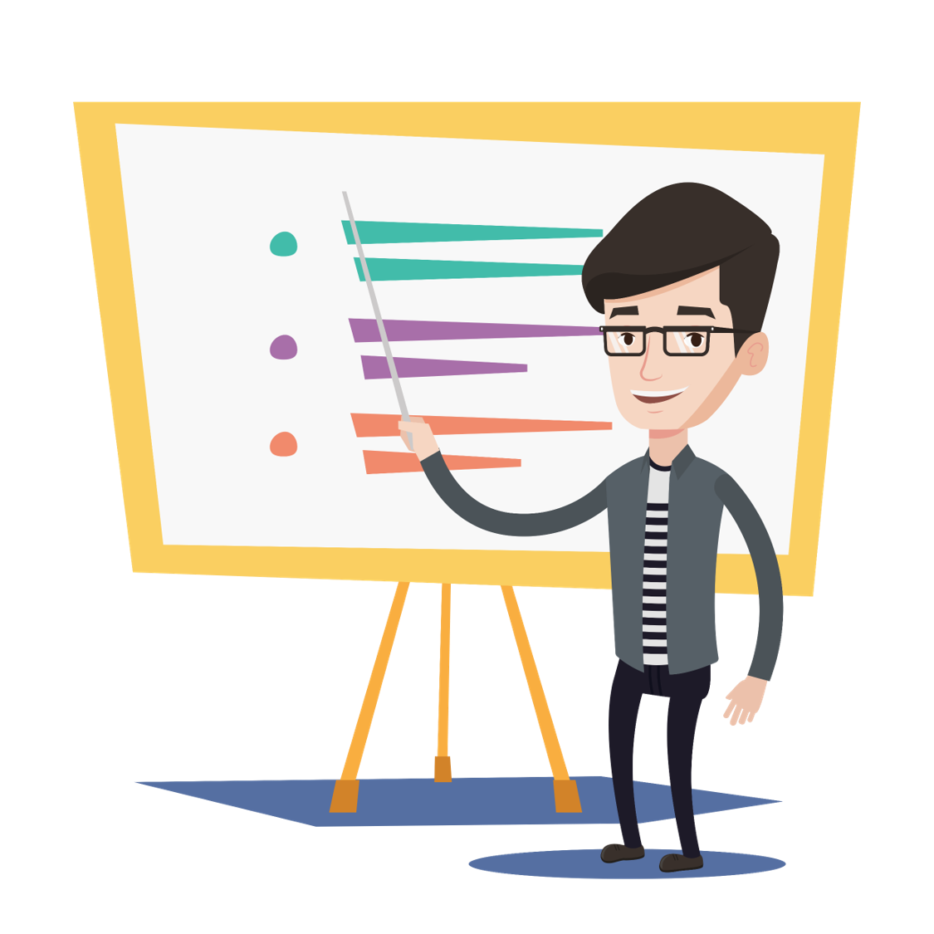
ACTIVITY: I’M PROUD TO PRESENT
YEAR 12 / LESSON 4
Share your work with the class.
Think of one other group to share
your resource with.

Slide 96
If you need help…
YEAR 12 / LESSON 4
If you are worried about any of the content today you can talk to a teacher or member of staff. For additional support relating to your own or someone else’s relationship with gambling/gaming you can contact Childline or GamCare.
YoungPeopleService@gamcare.org.uk
T: 02030926964

Slide 97
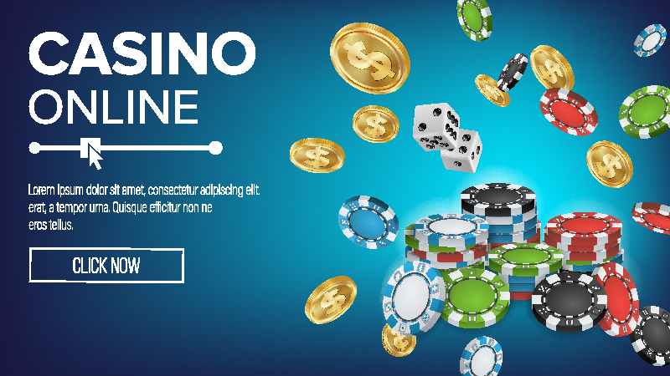
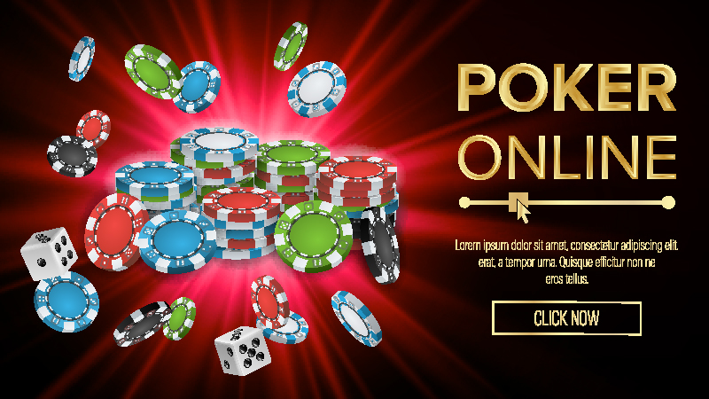
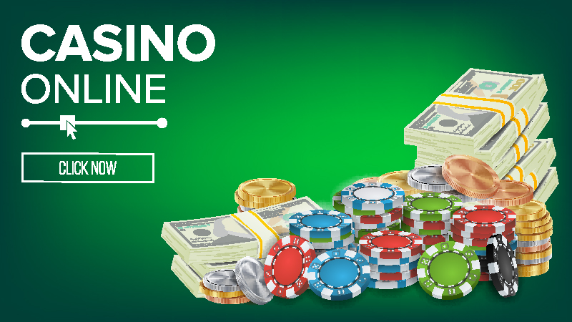
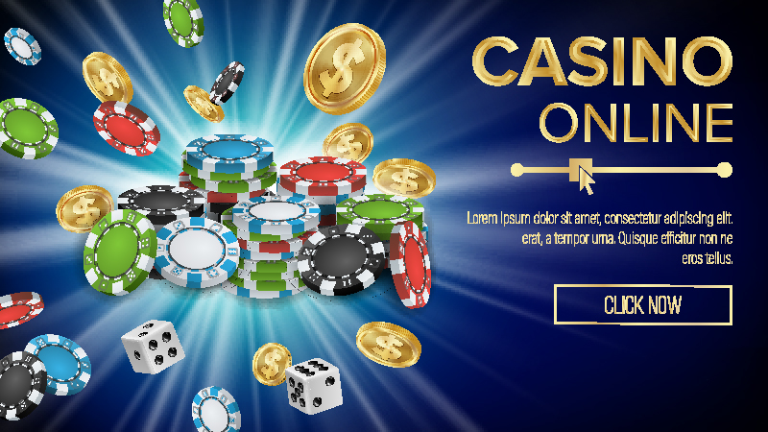
THE GAMBLING INDUSTRY - MARKETING
YEAR 12 / LESSON 5

Slide 98
CHALLENGE
YEAR 12 / LESSON 5
Explore gambling advertising and marketing.
How much, is too much? Should there be a ban?

Slide 99
LEARNING OBJECTIVES
YEAR 12 / LESSON 5
To identify the different types of advertising and how companies market their product(s)
To explore the frequency and types of marketing, evaluating the impact
To use information and knowledge to create a presentation

Slide 100
LEARNING OUTCOMES
YEAR 12 / LESSON 5
I can identify types of advertising and methods of marketing
I can explore the frequency of advertisements, and make informed opinions and decisions
I can analyse information and present my ideas and arguments to my peers

Slide 101
ACTIVITY: 60 SECOND SCRIBBLE
YEAR 12 / LESSON 5
Take 60 seconds… write down all the different ways that gambling is marketed.
Let’s discuss:
What do you think would be most effective in promoting the product?
Do you see lots of advertising? How does that make you feel?
How are gambling adverts perceived in your community?
Does gambling advertising normalise the activity?

Slide 102
ACTIVITY: MARKETING- RESEARCH.
YEAR 12 / LESSON 5
Discuss these key facts with the person next to you.
Ipsos Mori published a report in March 2020 on behalf of GambleAware. It found that:
96% of the 12-24 year old participants had been exposed to gambling marketing messages in the last month.
More than four out of five (85%) aged 12-24 reported seeing gambling advertising on TV (including national lottery adverts).
70% of children and young people noticed gambling adverts in betting shops on the high street, window displays as well as promotions on shop floors and near tills.
Two-thirds (66%) reported seeing gambling promotions on their social media channels
Source: https://www.ipsos.com/sites/default/files/ct/publication/documents/2020-03/gambling-marketing-advertising-effect-young-people-final-report.pdf
What are your immediate observations?

Slide 103
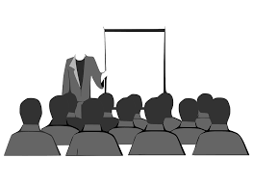
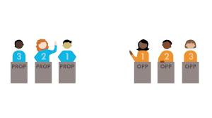
ACTIVITY: MARKETING- RESEARCH.
YEAR 12 / LESSON 5
OPTION 1:
Gambling Ads: How much is too much?
Create a presentation in response to the
above question.
OPTION 2:
Debate: Agree/Disagree
All gambling advertising should be
restricted until after the watershed.

Slide 104
ACTIVITY: WE PROUDLY PRESENT…
YEAR 12 / LESSON 5
Present your work to the class.

Slide 105
ACTIVITY: POST-IT
YEAR 12 / LESSON 5
In your opinion…
What is the most ethical form of marketing?
What is the least ethical form of marketing?
Explain your reasoning.

Slide 106
ACTIVITY: EXIT TICKET
YEAR 12 / LESSON 5
Write a statement explaining how gambling advertising affects you.

Slide 107
ACTIVITY: HOMEWORK
YEAR 12 / LESSON 5
Over the next week, keep a record of how many forms of marketing you see for gambling/gaming and where you see them.

Slide 108
If you need help…
YEAR 12 / LESSON 5
If you are worried about any of the content today you can talk to a teacher or member of staff. For additional support relating to your own or someone else’s relationship with gambling/gaming you can contact Childline or GamCare.
YoungPeopleService@gamcare.org.uk
T: 02030926964

Slide 109
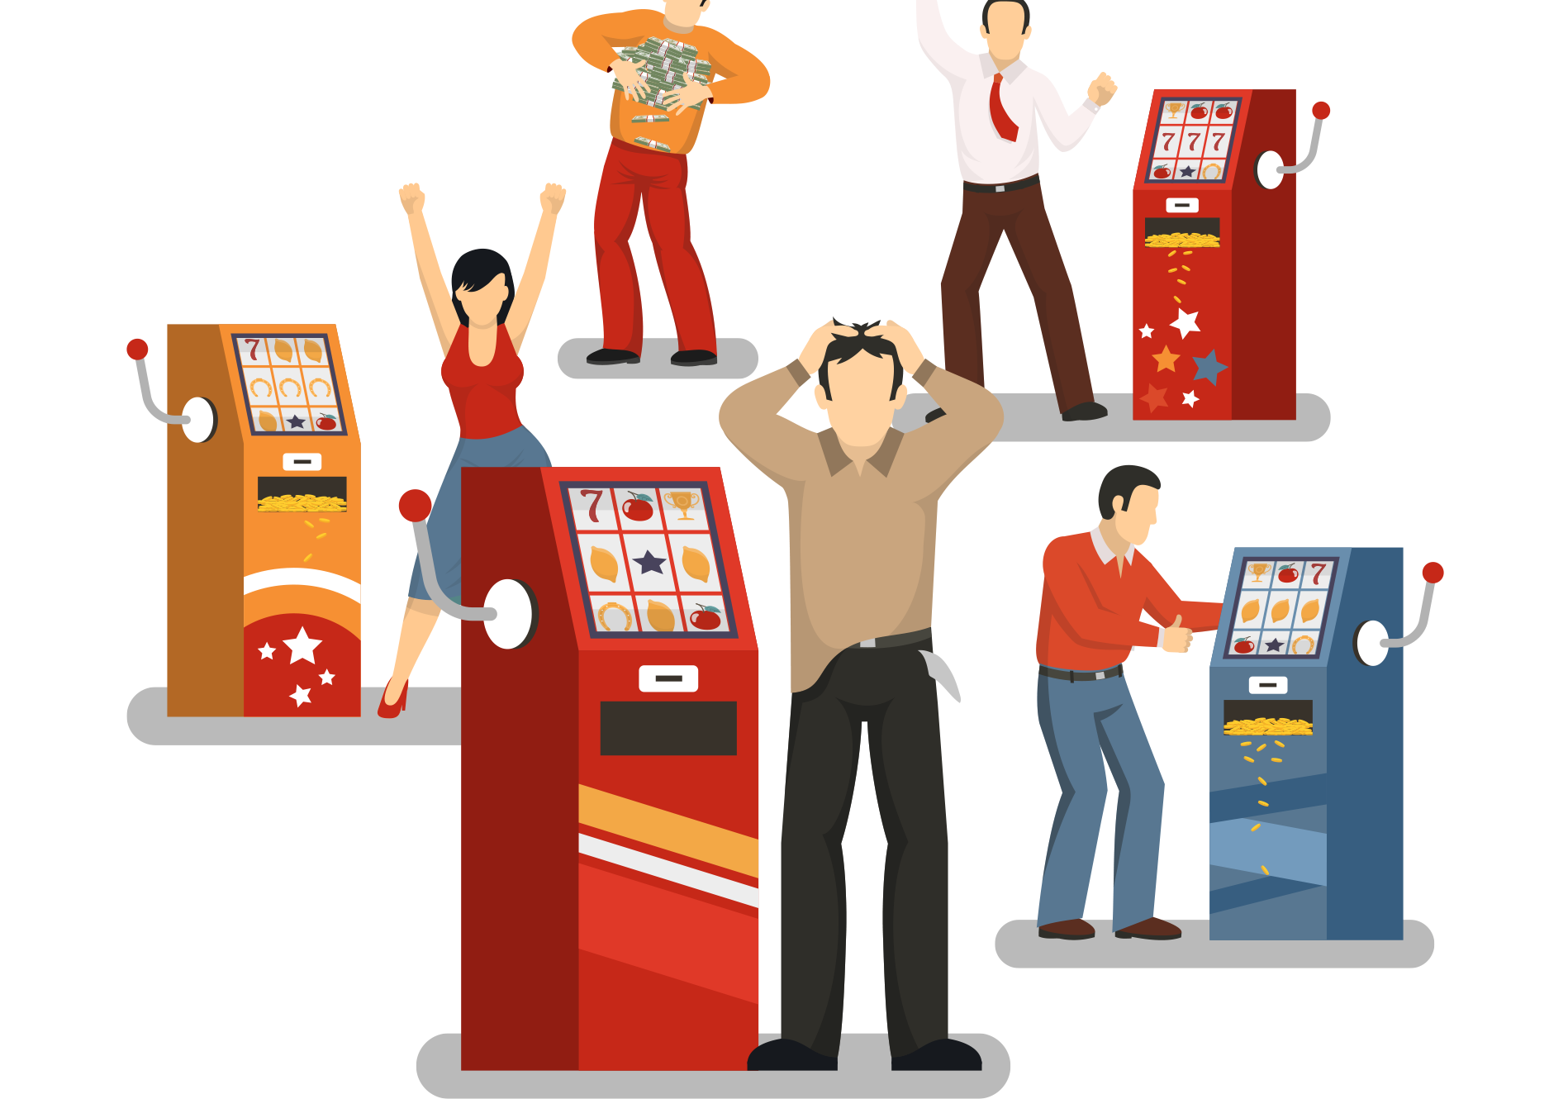
GAMBLING:REMOVING THE STIGMA
YEAR 12 / LESSON 6

Slide 110
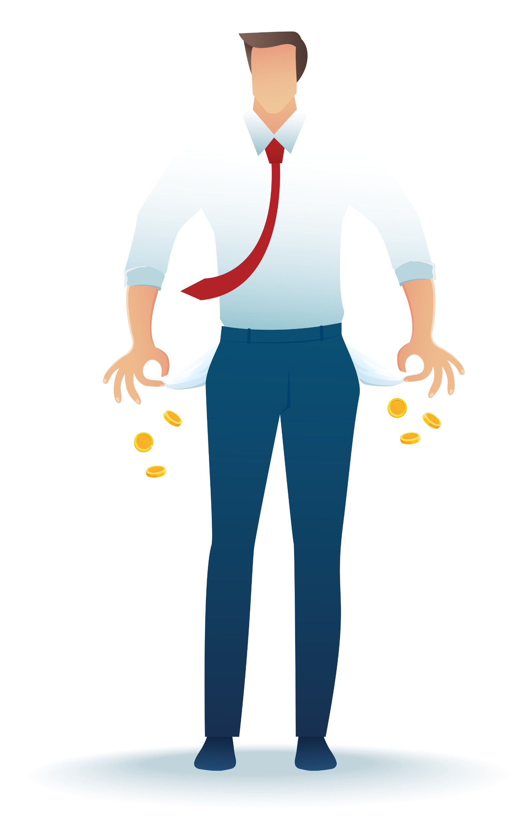
CHALLENGE
YEAR 12 / LESSON 6
Create a campaign to raise awareness about the potential harms of gambling and remove the stigma.

Slide 111
LEARNING OBJECTIVES
YEAR 12 / LESSON 6
To understand the potential risks of gambling
To understand how gambling may be perceived by others
To be able to develop a campaign and respectfully share your ideas and consider the viewpoint of others

Slide 112
LEARNING OUTCOMES
YEAR 12 / LESSON 6
I understand the potential risks of gambling
I understand how gambling may be viewed by others
I can work as a team to create an awareness campaign
I can think critically and consider differing viewpoints
I can develop my thoughts and present them to my peers
I can listen to others and respond respectfully

Slide 113
ACTIVITY: THINK, PAIR, SHARE
YEAR 12 / LESSON 6
Is there a stigma around gambling and someone who is experiencing harm?
Explore from your own perspective
Explore from community perspectives, does it differ from one community to another?
How do religious and cultural beliefs impact this?

Slide 114
YEAR 12 / LESSON 6
Build a Campaign
TASK: Run a campaign to raise awareness around the potential harm of gambling with the intent of removing stigma.
Work in a group.
What is your message?
Select a medium, e.g. social media campaign, film
Share your campaign with your class
Who is your target
audience?
Title, slogan and hashtag
©YGAM 2020: All rights reserved

Slide 115
ACTIVITY: Deliver your Campaign
YEAR 12 / LESSON 6
Deliver your campaign to your classmates. Provide time for Q&A.
OPTION: You could deliver your campaign as part of a school assembly or to a community group.

Slide 116
ACTIVITY: EXIT TICKET
YEAR 12 / LESSON 6
Write down one key thing that you have learnt from either today’s lesson or our previous lessons on gaming and gambling.
Share your thoughts with the class.

Slide 117
If you need help…
YEAR 12 / LESSON 6
If you are worried about any of the content today you can talk to a teacher or member of staff. For additional support relating to your own or someone else’s relationship with gambling/gaming you can contact Childline or GamCare.
YoungPeopleService@gamcare.org.uk
T: 02030926964

