Slide 1
KS3: CONTENTS
YEAR 8 | YEAR 9 | YEAR 10
Y8L1: GAMES: WHAT, WHEN AND HOW? | Y9L1: WHY DO SOME YOUNG PEOPLE GAMBLE? | Y10L1: WHY PEOPLE GAME
Y8L2: WHAT ARE THE RISKS? | Y9L2: WHAT ARE THE RISKS? | Y10L2: SOCIAL AND MORAL VIEWPOINTS
Y8L3: ESPORTS | Y9L3: THE BLURRED LINES | Y10L3: MICROTRANSACTIONS
Y8L4: THE BLURRED LINES | Y9L4: THE HOUSE EDGE | Y10L4: WHAT’S THE PROBLEM?
Y8L5: PROBABILITY AND LUCK | Y9L5: GAMBLING, MONEY & DEBT | Y10L5: GAMBLING AND GAMING, THE POTENTIAL FOR HARM
Y8L6: GAMING: THE GOOD, THE BAD AND THE MISUNDERSTOOD | Y9L6: THE GAMBLING ACT | Y10L6: MONEY AND DEBT
V1.0/August 21

Slide 2
GAMES: WHAT, WHEN AND HOW?
YEAR 8 / LESSON 1
V1.0/August 21

Slide 3
CHALLENGE
YEAR 8 / LESSON 1
Build a survey, focussing on the games young people play. How much time do they spend on these? Do they pay to play? How do they play? Do they feel any peer pressure to buy items, play longer or play particular games? Present findings.

Slide 4
LEARNING OBJECTIVES
YEAR 8 / LESSON 1
To understand the emotions attached to gaming (positive and negative)
To understand the motivations of people who play video games
To be able to gather information and interpret data
To explore the links between gaming and gambling
To work as a team to agree options

Slide 5
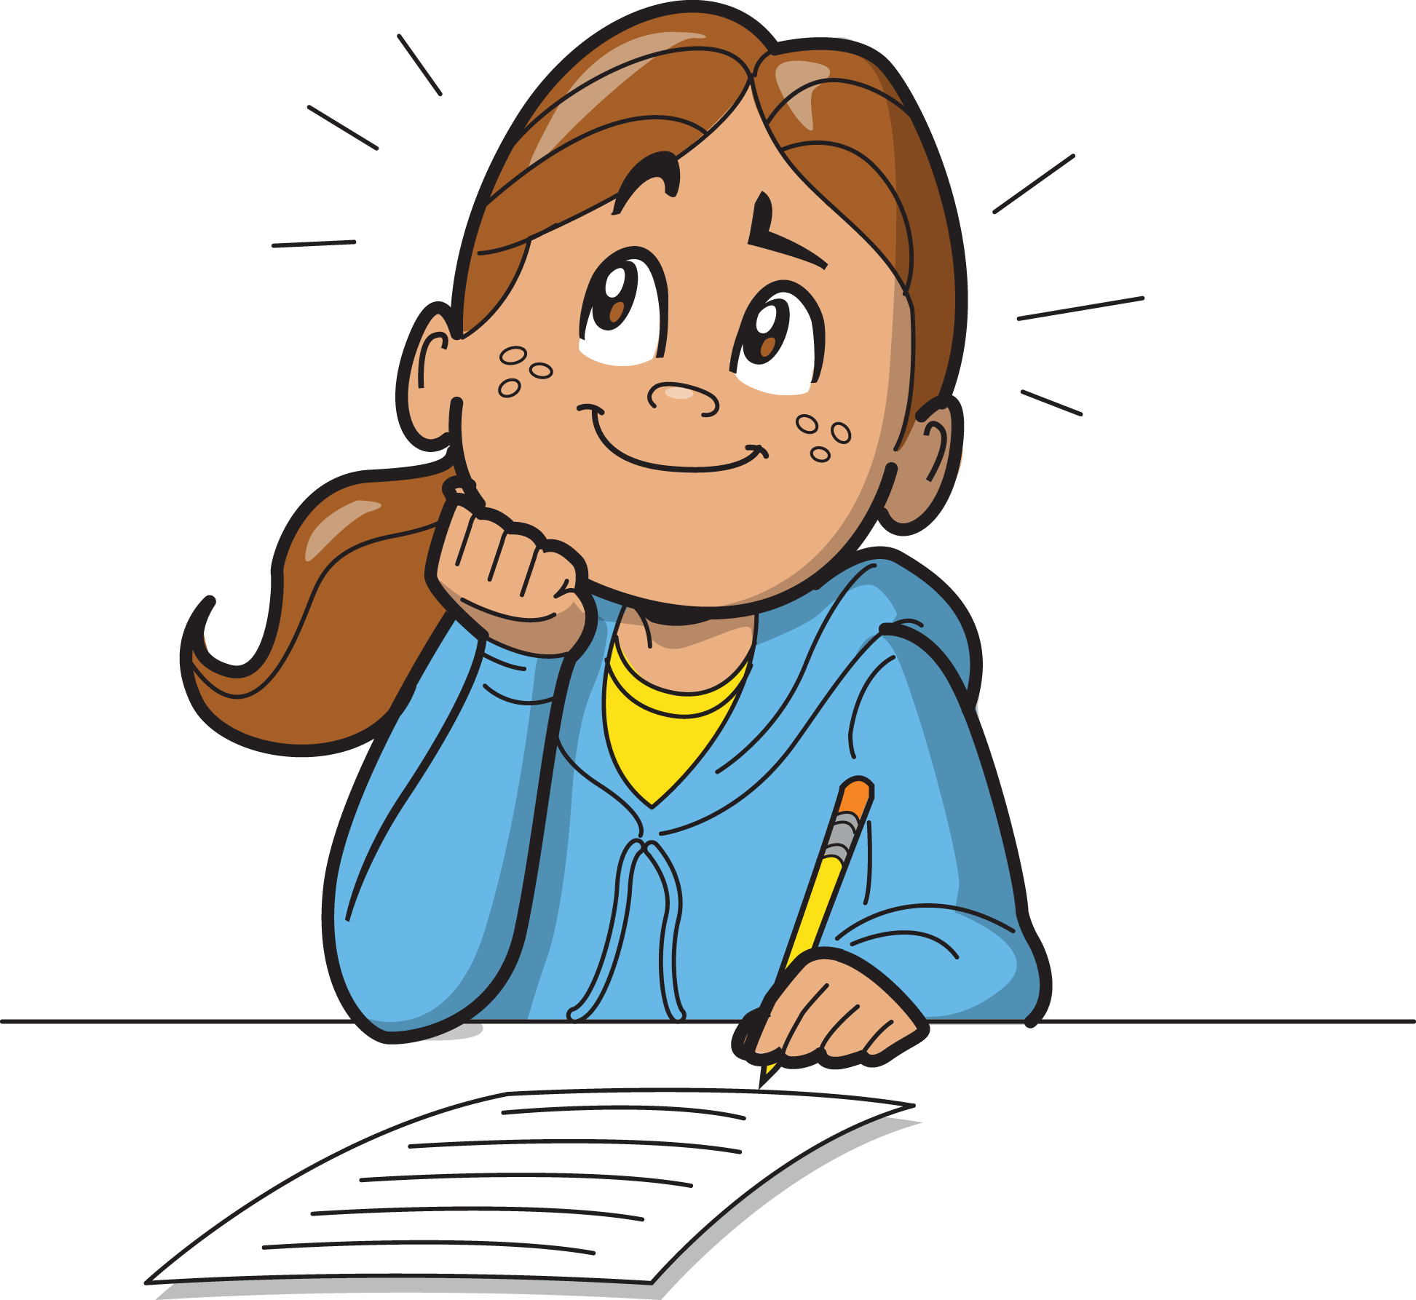
LEARNING OUTCOMES
YEAR 8 / LESSON 1
I can discuss the emotions people may attach to gaming
I can recognise positive and negative emotions of gaming
I understand why people might want to play video games
I can discuss the links between gaming and gambling
I can gather information and draw conclusions by studying the data,
communicating my ideas clearly
I can work with others as part of a team

Slide 6
ACTIVITY: GAME EMOTIONS
YEAR 8 / LESSON 1
What emotions do you associate with gaming?
60 SECONDS!
You have 60 seconds to list all the things you associate with gaming

Slide 7
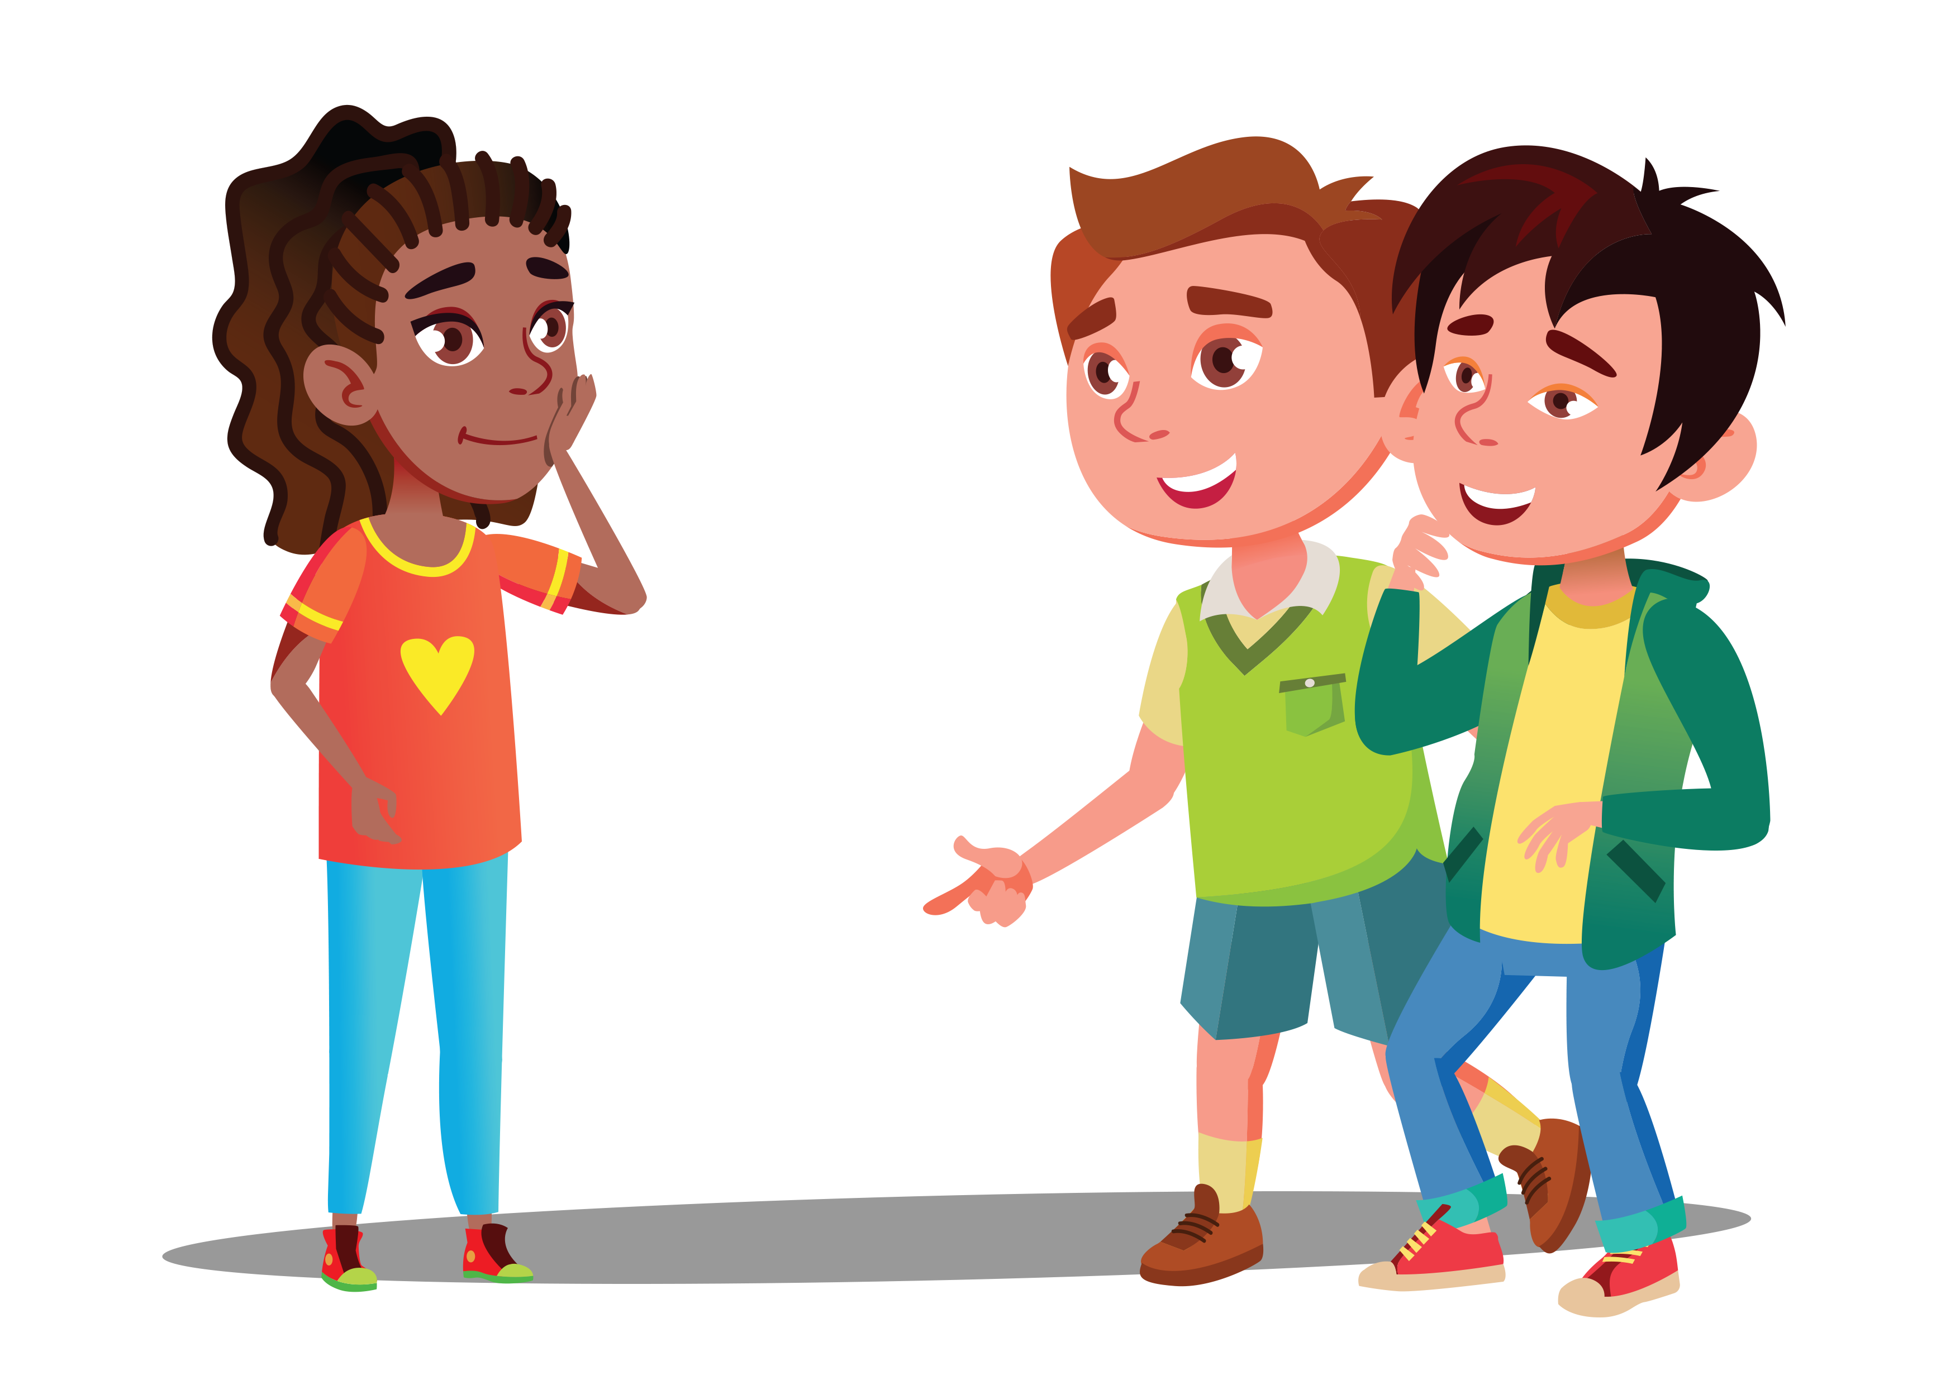
ACTIVITY: WHAT GAMES DO YOU PLAY?
YEAR 8 / LESSON 1
I prefer single player action games
In groups, discuss the games you play/the method of play. Which games are most popular in your group and what is the most appealing feature of the game?
Feedback your findings to the class.
I like MMORPG games best
I like a good old fashioned FPS shooting game

Slide 8
ACTIVITY: WHAT, WHEN AND HOW
YEAR 8 / LESSON 1
Question about length of time played
In groups, think of ten questions you could ask your peers in order to find out about the gaming habits of the class. You could consider questions that focus on the length of time played, the amount of money spent, online/offline, emotions whilst playing, have they ever experienced negative behaviour etc.
Feedback your ideas to the class and then agree upon a class survey.
Note down your own answers to the survey and then hand them in so everyone's responses can be recorded.
Question about amount of money spent, online/offline
Question about emotions whilst playing
Do some games blur lines with gambling?

Slide 9
ACTIVITY: WHAT DO THE RESULTS SHOW US?
YEAR 8 / LESSON 1
Explore the results from the survey. On average how much time do students game? Do we think this is balanced with other activities; how could we determine this?
Are students paying to play? How might students be affording this? How could we measure the amount of money spent?
Do some games blur the lines with gambling? Do they feature gambling style mechanisms or encourage you to buy items?
Average time spent gaming
Is this balanced with non-gaming?
How can we determine this?

Slide 10
ACTIVITY: RECORD YOUR ACTIVITIES
YEAR 8 / LESSON 1
Create a diary to record your activities at home over the next two weeks. You will want to measure the activities so you will need to consider the type of activity and the amount of time.
Why not also consider how you feel before/during and after each activity?

Slide 11
ACTIVITY: WHAT WOULD YOU DO?
YEAR 8 / LESSON 1
You’re playing a game in an online forum and the group begin bullying one of the players for not having the ‘right skin’. How do you think you would respond?
Can you think of five things you could try to stop this/assist the person being bullied?

Slide 12
If you need help…
YEAR 8 / LESSON 1
If you are worried about any of the content today you can talk to a teacher or member of staff. For additional support relating to your own or someone else’s relationship with gambling/gaming you can contact Childline or GamCare.
YoungPeopleService@gamcare.org.uk
T: 02030926964

Slide 13
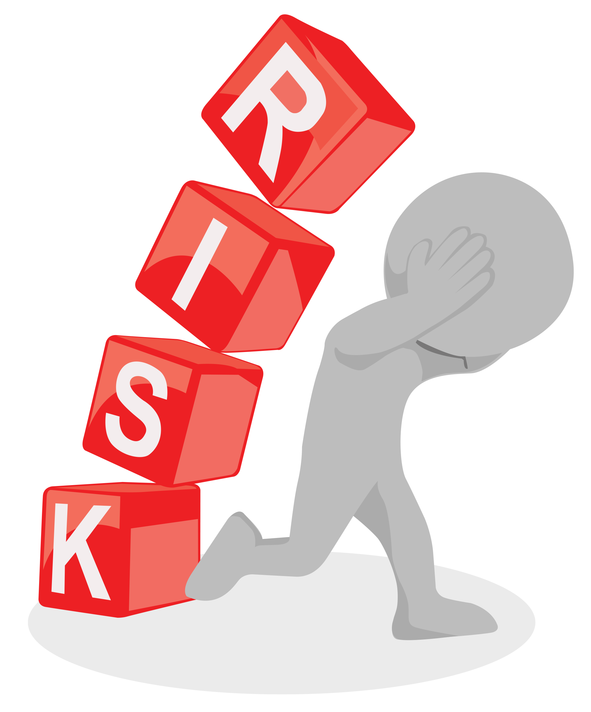
WHAT ARE THE RISKS?
YEAR 8 / LESSON 2

Slide 14
CHALLENGE
YEAR 8 / LESSON 2
Choose 10 images you associate with gaming and associated mental health issues. Create a collage and share your thoughts, use key words to support your images.

Slide 15
LEARNING OBJECTIVES
YEAR 8 / LESSON 2
To be able to identify and critique the benefits and risks associated with gaming
To attach ideas and feelings to images associated with risk and gaming related harm
To be able to offer an opinion on gaming benefits and risks
To recognise the potential link between gaming and gambling
To be able to suggest ways to minimise risk
To be able to identify how and where to get help

Slide 16
LEARNING OUTCOMES
YEAR 8 / LESSON 2
I can recognise the benefits and risks of gaming
I can choose images to depict my thoughts and feeling about gaming
I am communicate my ideas and opinions effectively
I can recognise links to gambling
I can suggest ways to minimise the risk
I know where to get help if I am worried about my own or someone else’s relationship with gambling or gaming.

Slide 17
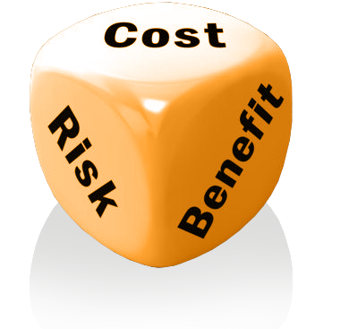
ACTIVITY: RISKS AND BENEFITS?
YEAR 8 / LESSON 2
Discuss, record and share your thoughts on the following questions, you have 5 minutes for each:
What are the potential risks associated with gaming?
What are the benefits of gaming?

Slide 18
ACTIVITY: COLLAGE/MOOD BOARD
YEAR 8 / LESSON 2
Let’s get creative: Choose 10 images to demonstrate the potential risks of gaming.
Use key words and annotations to detail your thoughts and feelings on this topic.

Slide 19
ACTIVITY: LETS EXPLORE
YEAR 8 / LESSON 2
Option 1: Share your collage /mood board with a partner. Discuss your ideas and why you chose each image.
Option 2: Moving around the room, explore the work of others. Feedback your thoughts for each.
Option 3: If selected, share and discuss your collage / mood board with the class.
Extension:
What five tips could you give to ensure people experience the benefits of gaming more than the risks?

Slide 20
If you need help…
YEAR 8 / LESSON 2
If you are worried about any of the content today you can talk to a teacher or member of staff. For additional support relating to your own or someone else’s relationship with gambling/gaming you can contact Childline or GamCare.
YoungPeopleService@gamcare.org.uk
T: 02030926964

Slide 21
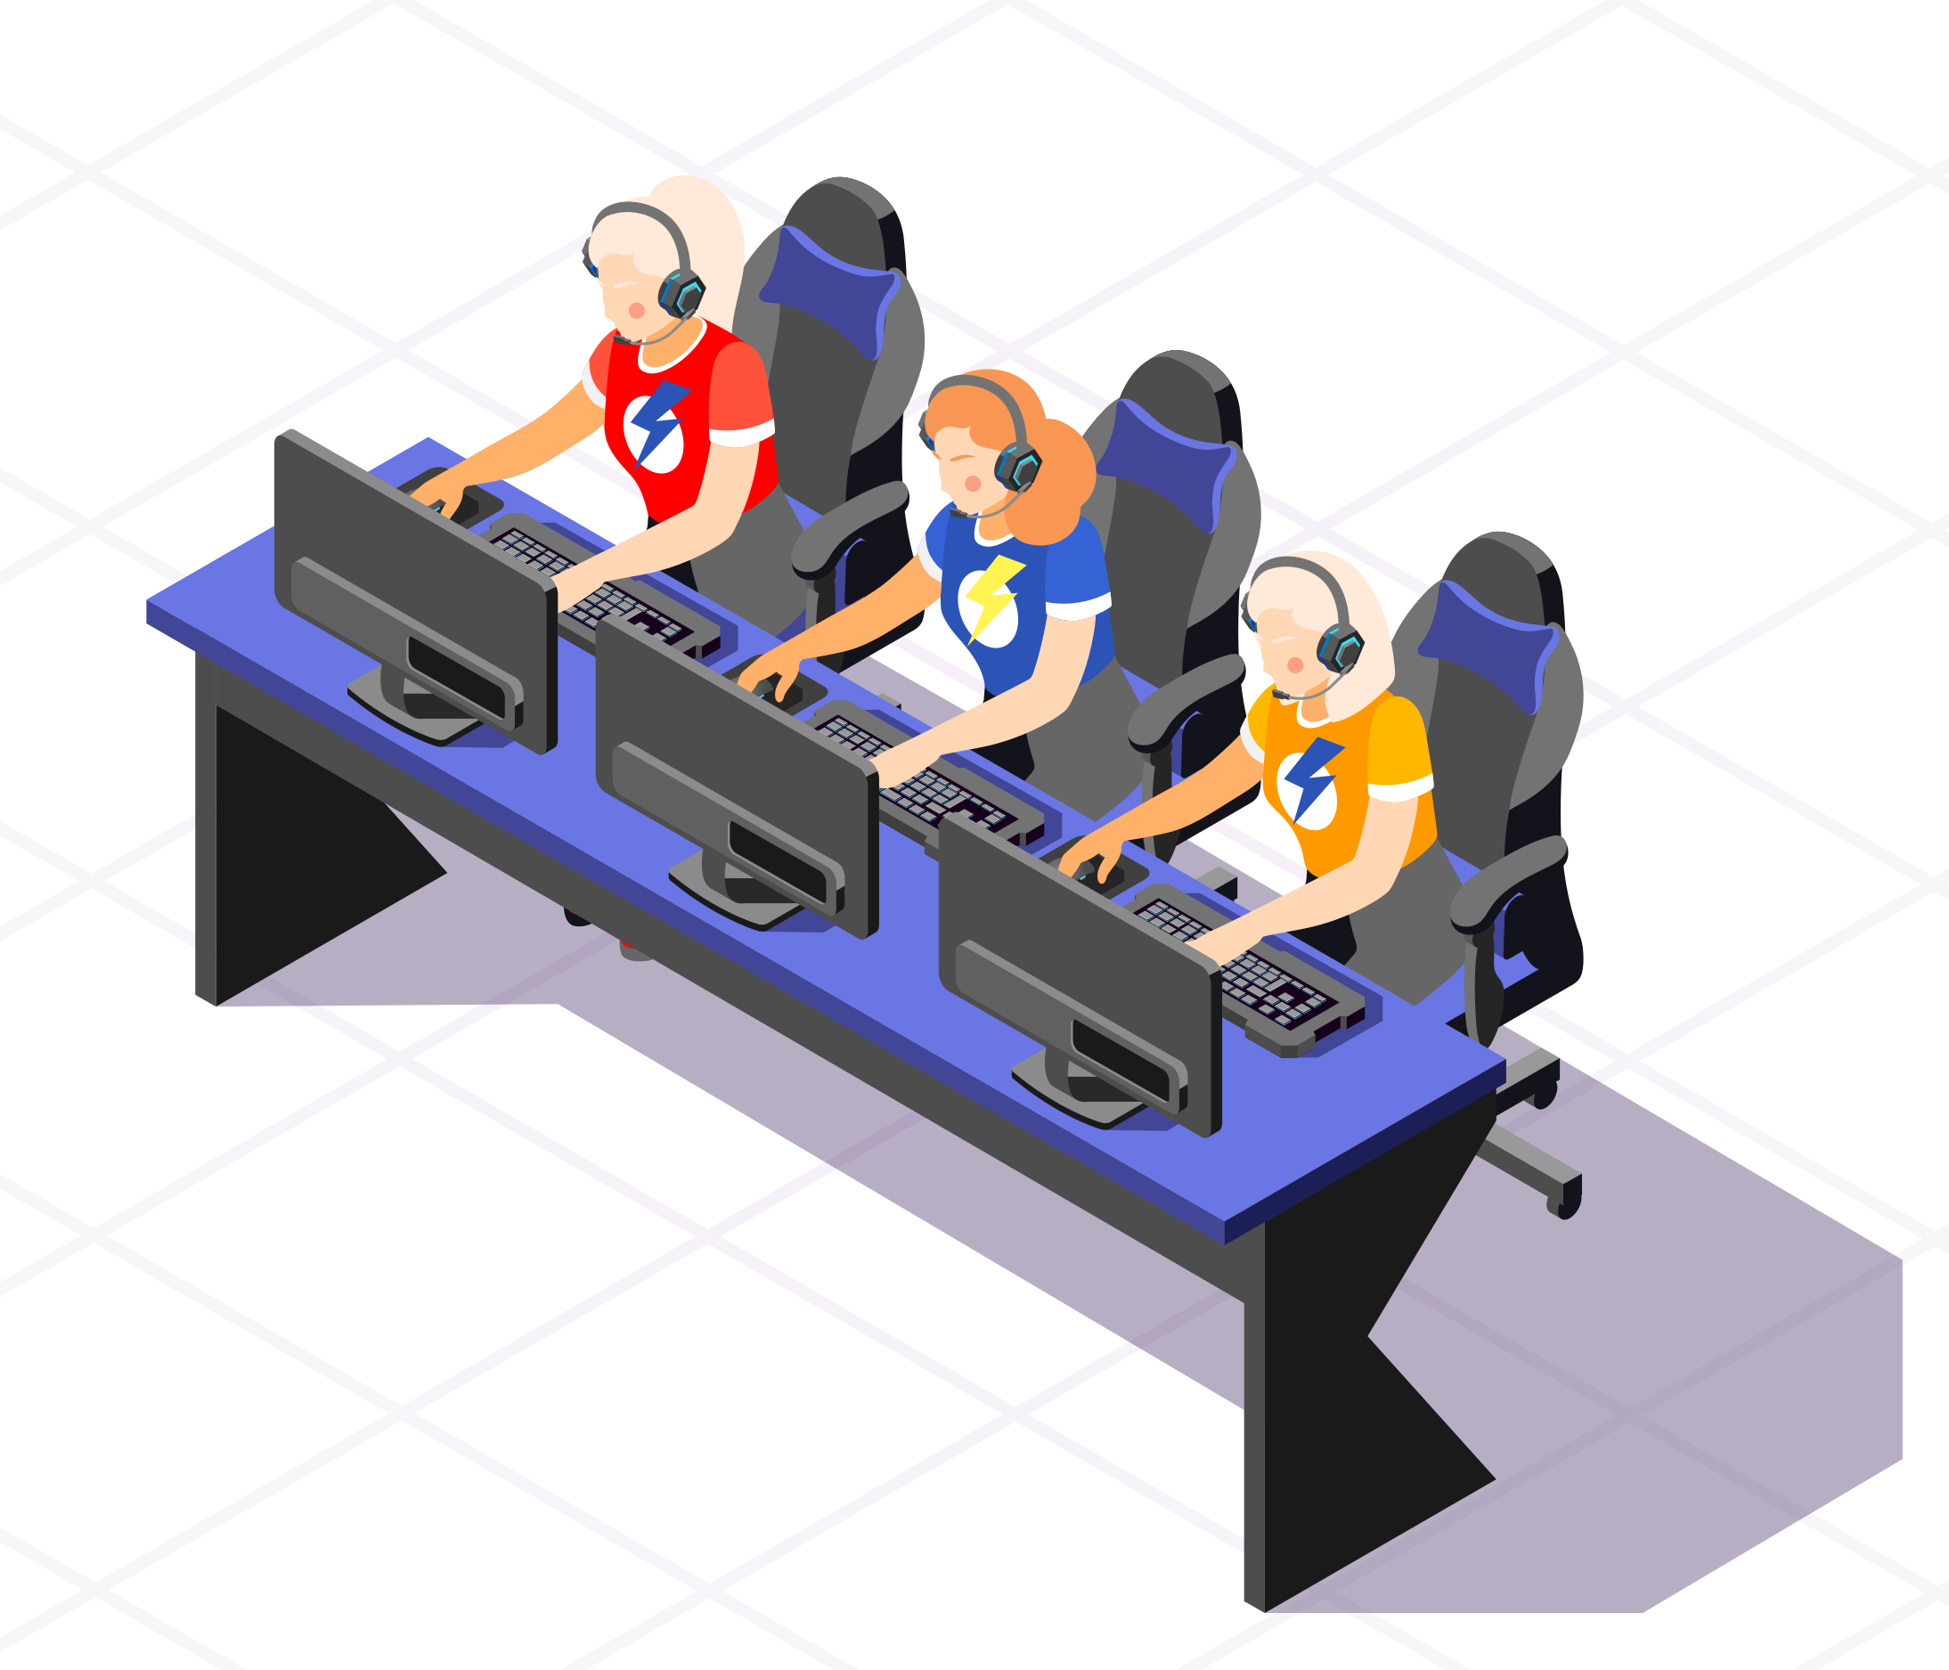
ESPORTS
YEAR 8 / LESSON 3

Slide 22
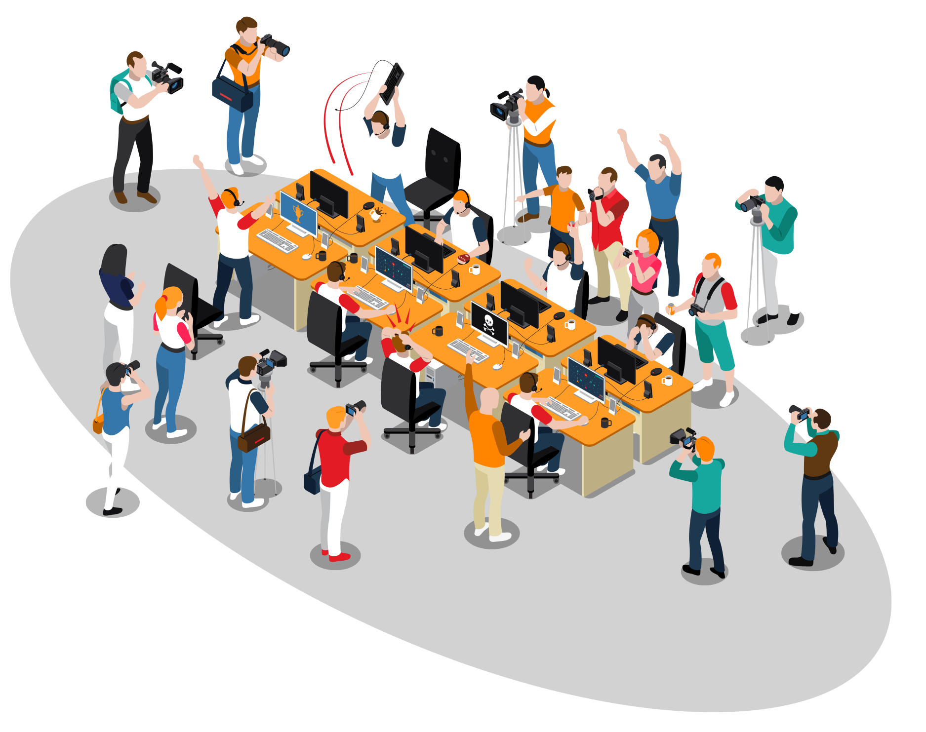
CHALLENGE
YEAR 8 / LESSON 3
Is Esports a positive career choice? Consider the role of a professional athlete. Investigate the opportunities presented and the potential risks associated with it and debate.

Slide 23
LEARNING OBJECTIVES
YEAR 8 / LESSON 3
To be able to identify the risks and benefits of professional gaming
To be able to research a topic and form an argument
To be able to debate based on a particular argument or viewpoint
To be able to recognise how to look after physical and mental wellbeing

Slide 24
LEARNING OUTCOMES
YEAR 8 / LESSON 3
I can recognise the benefits and risks of professional gaming
I can research information effectively to investigate issues
I can use information to form an argument
I can work effectively with others as part of a team and
participate in a debate
I can suggest options to support physical and mental well being

Slide 25
ACTIVITY: WHAT IS ESPORTS?
YEAR 8 / LESSON 3
Discuss and answer the following questions:
What is Esports?
How much do you think ESports is worth?
Do you know of any professional players?
How old do you think the best player is?
What do you think are the pros of being an Esports professional?
What are the negatives?
What do you think it takes to become a professional?

Slide 26
ACTIVITY: WHAT IS ESPORTS WORTH?
YEAR 8 / LESSON 3
398.8 Million
$40 Million
$8.4 Million
Global Esports audience
The prize pool for the International DotA 2
Highest earning player
Source: Guinness World Records
Source: statista
Source: BBC 2021

Slide 27
ACTIVITY: LET’S DISCUSS
YEAR 8 / LESSON 3
Wouldn’t sitting at a computer all day be bad for your health?
Agree/Disagree: Esports is a good career choice
In teams, research and prepare a five-minute argument for Agree or Disagree. Try to include facts and figures to support the main points of your argument.
Now let’s put your argument to the class, answering any subsequent questions or counter arguments put forward.
But I can’t afford the games?
Playing games to earn money, that sounds great!

Slide 28
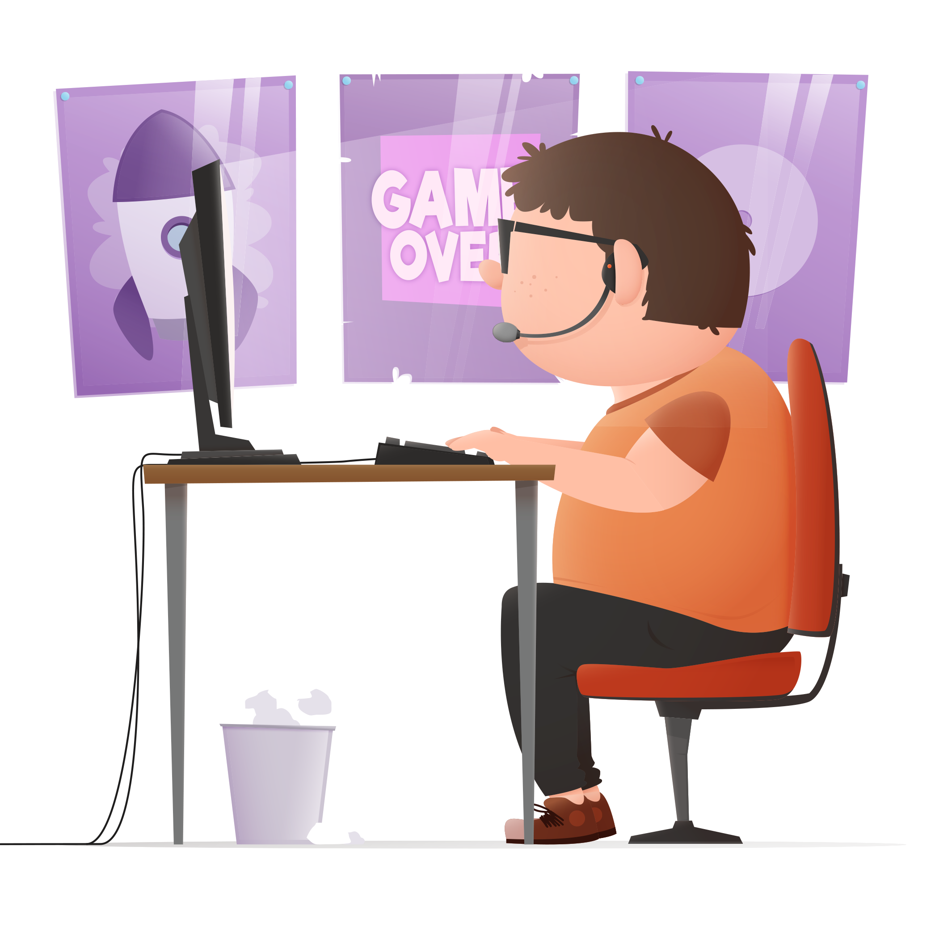
ACTIVITY: HOW COULD AN ESPORTS PLAYER LOOK AFTER THEIR HEALTH?
YEAR 8 / LESSON 3
Think about the debate and the key points raised, what could an Esports player do to look after their physical and mental health? Discuss and share your ideas.
Final thoughts: Is there any bias in the documents/research you studied? Why might that be?

Slide 29
If you need help…
YEAR 8 / LESSON 3
If you are worried about any of the content today you can talk to a teacher or member of staff. For additional support relating to your own or someone else’s relationship with gambling/gaming you can contact Childline or GamCare.
YoungPeopleService@gamcare.org.uk
T: 02030926964

Slide 30
THE BLURRED LINES
YEAR 8 / LESSON 4

Slide 31
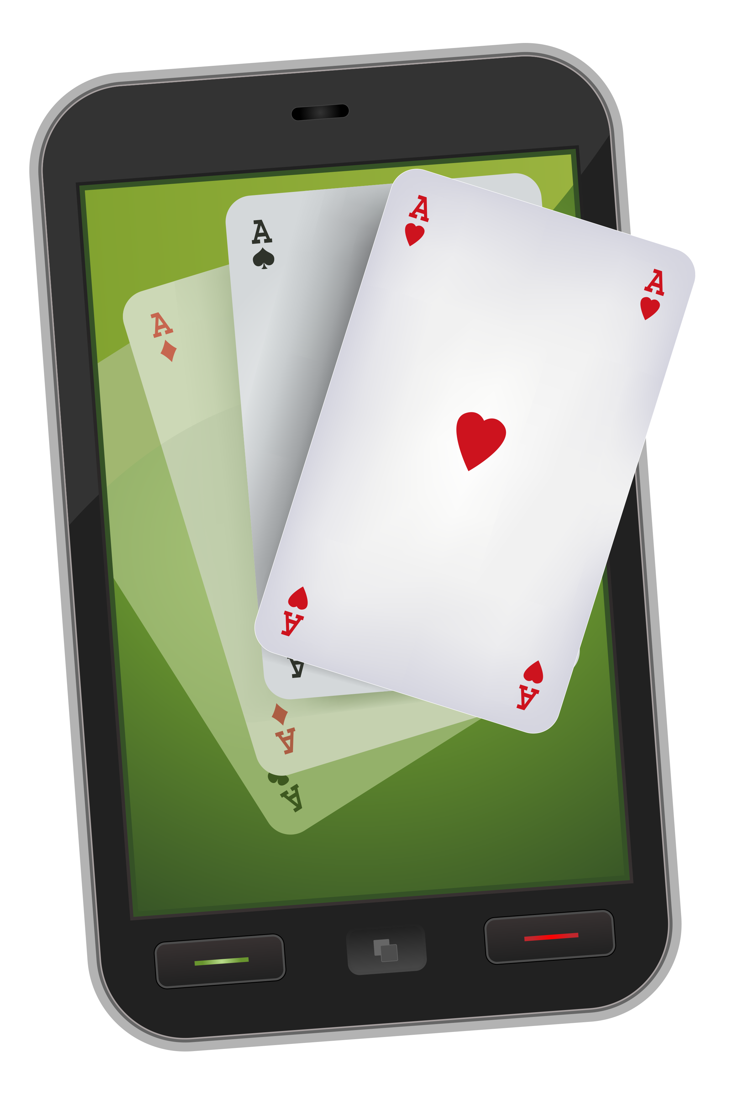
CHALLENGE
YEAR 8 / LESSON 4
Does gaming promote gambling? Think about random in-game purchases, advertising both within the games you play and through Esports and streaming platforms. How are these regulated/are they regulated?

Slide 32
LEARNING OBJECTIVES
YEAR 8 / LESSON 4
To be able to recognise risks related to online gaming
To be able to analyse gambling style features within games
To be able to discuss regulation
To work as a team to present findings and consensus

Slide 33
LEARNING OUTCOMES
YEAR 8 / LESSON 4
I can recognise risks in online gaming
I can discuss and analyse the gambling style features within games
I can explore regulation and discuss my opinion
I can work in a team to research and present findings with a common consensus
I can communicate effectively, showing awareness of audience and purpose

Slide 34
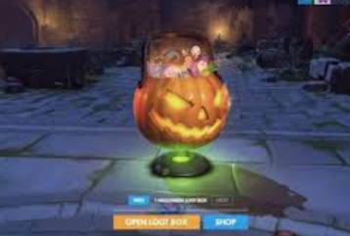
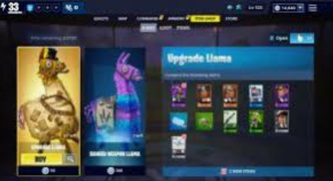
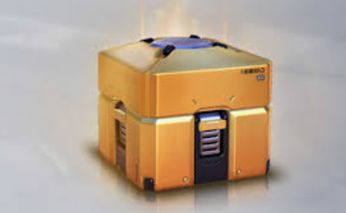
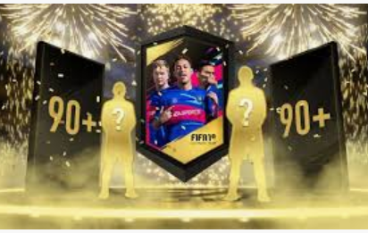
YEAR 8 / LESSON 4
©YGAM 2020: All rights reserved

Slide 35
ACTIVITY: LOOT BOXES
YEAR 8 / LESSON 4
In groups, create a thought shower using the title LOOT BOXES. Provide a definition for someone who might not know what these are.
How do you get them? Discuss your experiences with the class.
THOUGHT SHOWER

Slide 36
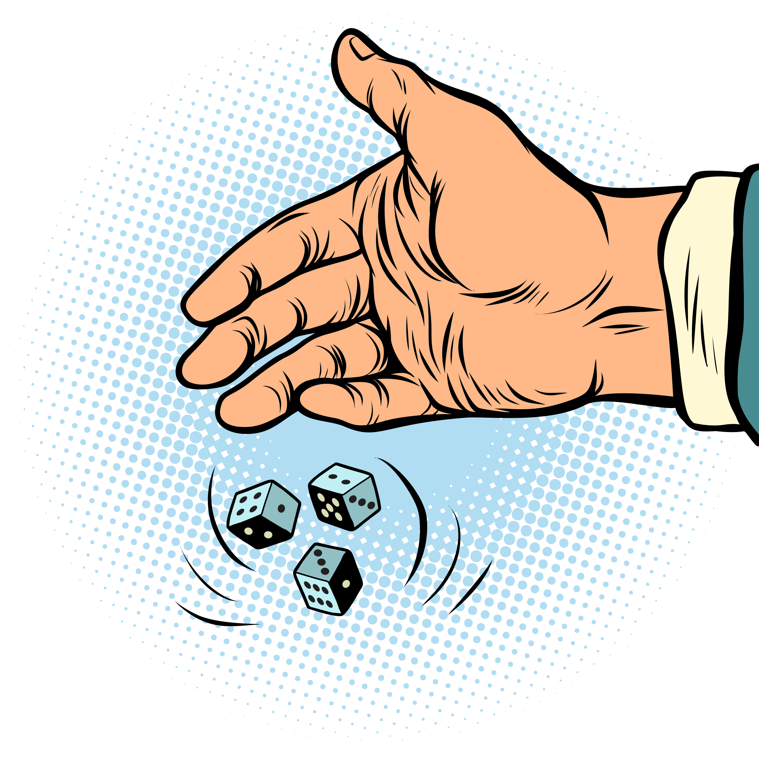
ACTIVITY: WHAT ARE THE ODDS?
YEAR 8 / LESSON 4
Explore the resources provided detailing the probability of buying coveted items. Do you think children would be more/less likely to spend their money on these items if they knew the odds?
Prepare a five-minute presentation to share your responses.

Slide 37
ACTIVITY: WHERE’S THE REGULATION?
YEAR 8 / LESSON 4
Option 1:
Should there be regulations placed on loot boxes and what would that look like?
What could be done to help children and young people make informed decisions about the items they’re buying? In groups agree on three measures which could be taken.
Option 2:
What would be your top 3 tips for gamers? Share your ideas with the class.

Slide 38
If you need help…
YEAR 8 / LESSON 4
If you are worried about any of the content today you can talk to a teacher or member of staff. For additional support relating to your own or someone else’s relationship with gambling/gaming you can contact Childline or GamCare.
YoungPeopleService@gamcare.org.uk
T: 02030926964

Slide 39
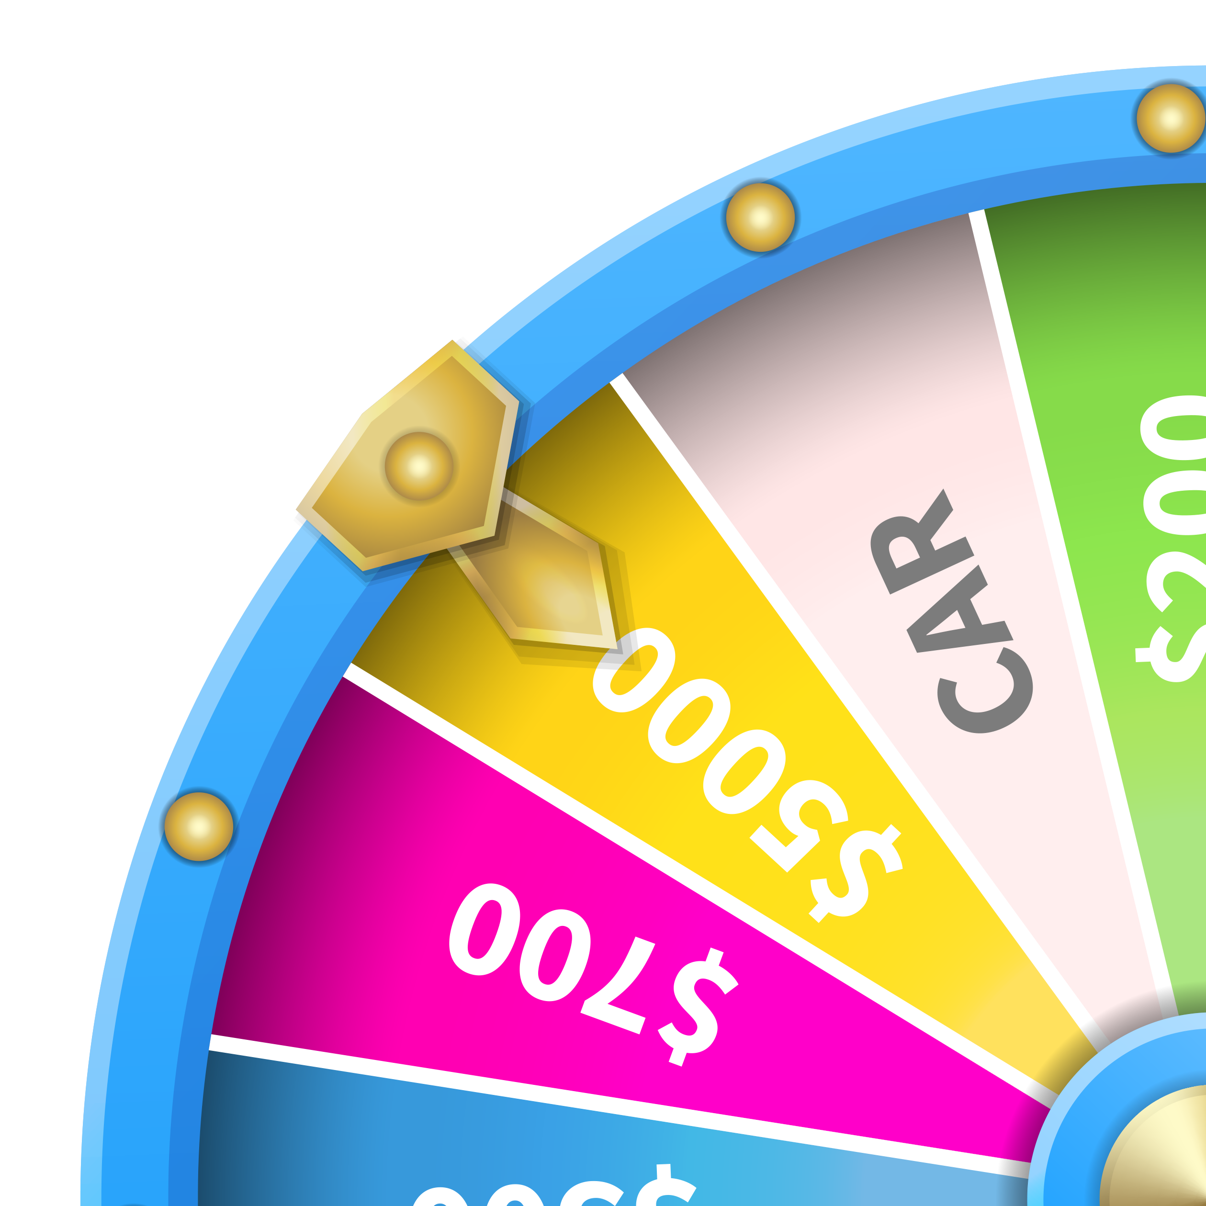
PROBABILITY AND LUCK
YEAR 8 / LESSON 5

Slide 40
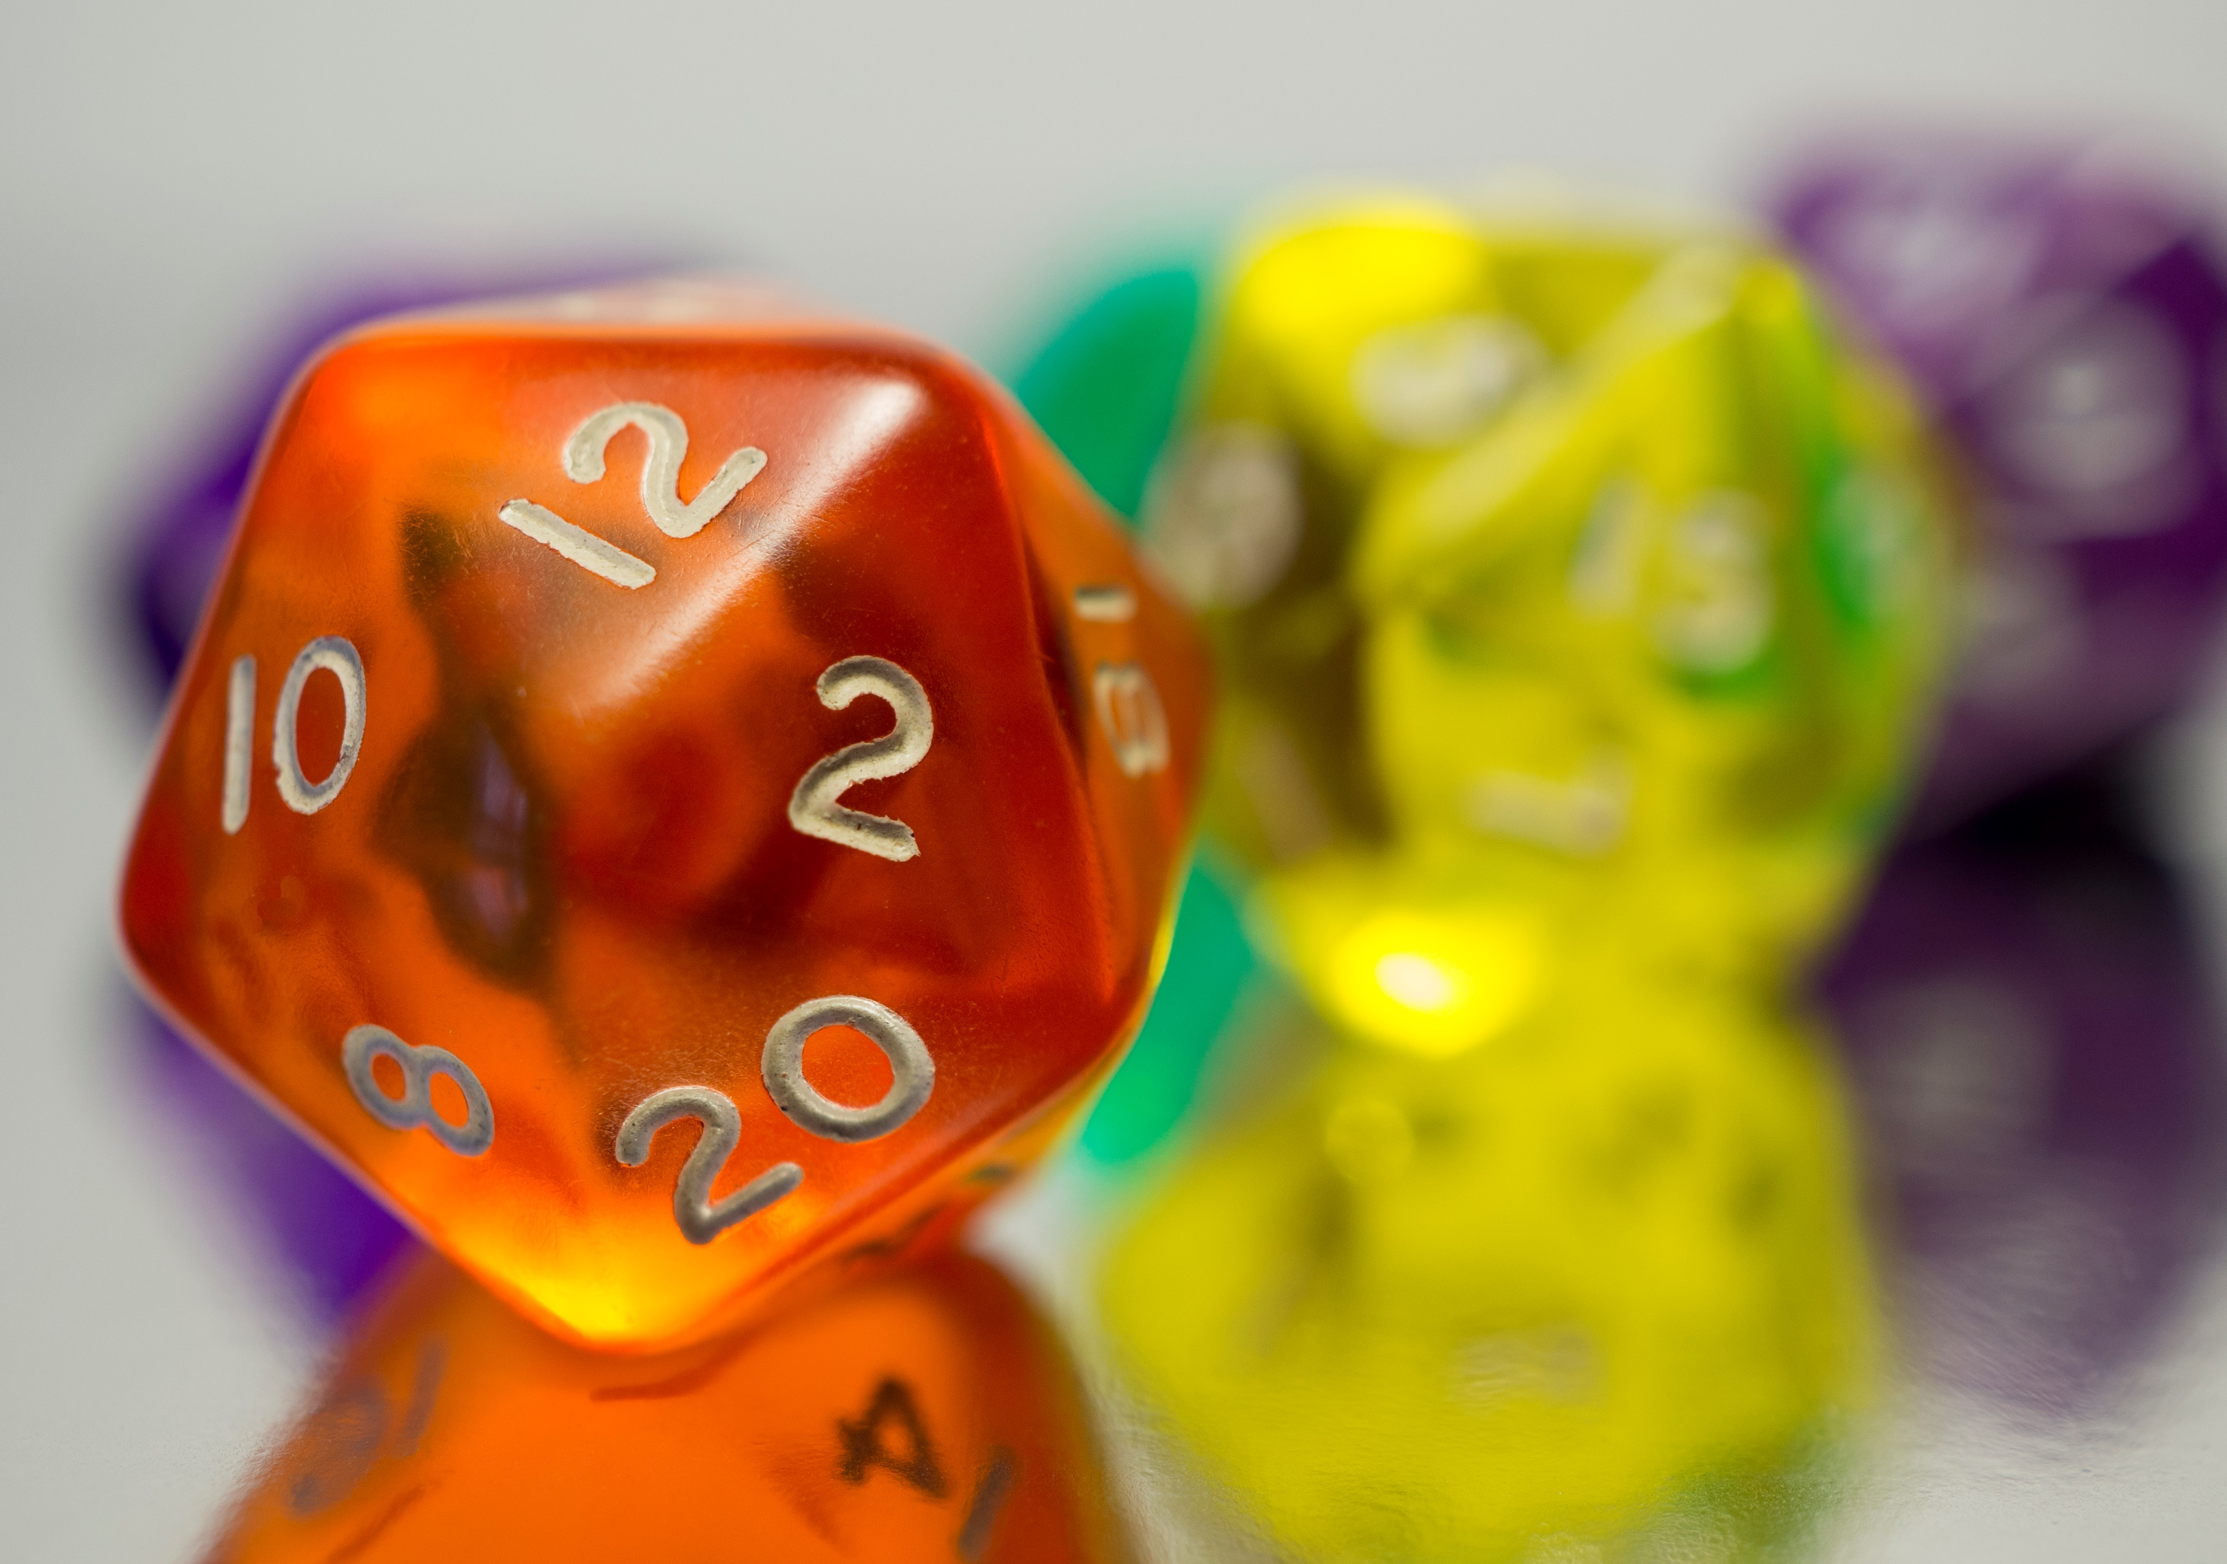
CHALLENGE
YEAR 8 / LESSON 5
Do people understand the probability of certain events.
Prepare a 5-minute talk to share with your class.

Slide 41
LEARNING OBJECTIVES
YEAR 8 / LESSON 5
To understand and define the terms probability and luck
To understand what is meant by gambling
To understand how you can lose money through gambling
To consider the motivations of those who may gamble
To be able to identify how to get help

Slide 42
LEARNING OUTCOMES
YEAR 8 / LESSON 5
I understand what is meant by gambling
I can offer a definition of probability and luck
I understand how money can be lost due to gambling
I understand why people might gamble
I know where to get help if I am worried about my own or someone else’s relationship with gambling

Slide 43
ACTIVITY: AGREE/DISAGREE RATIONALE
YEAR 8 / LESSON 5
Do you agree or disagree with the following statements? Share your reasoning.
Some people are luckier than other
Gambling adverts should be banned
Gambling is immoral
Gambling is a waste of time and money
You can improve your chances of winning by spending more
Gambling is a quick way to make a lot of money
You’re more likely to win the lottery by thinking positively
Gambling on a free internet site is harmless because no money is lost
You need to lose a lot of money before you can
be considered to be experiencing harm
It’s fine to borrow money to gamble
Gambling is just a form of entertainment
Playing bingo doesn’t cause harm
Gambling should be banned
The house always wins

Slide 44
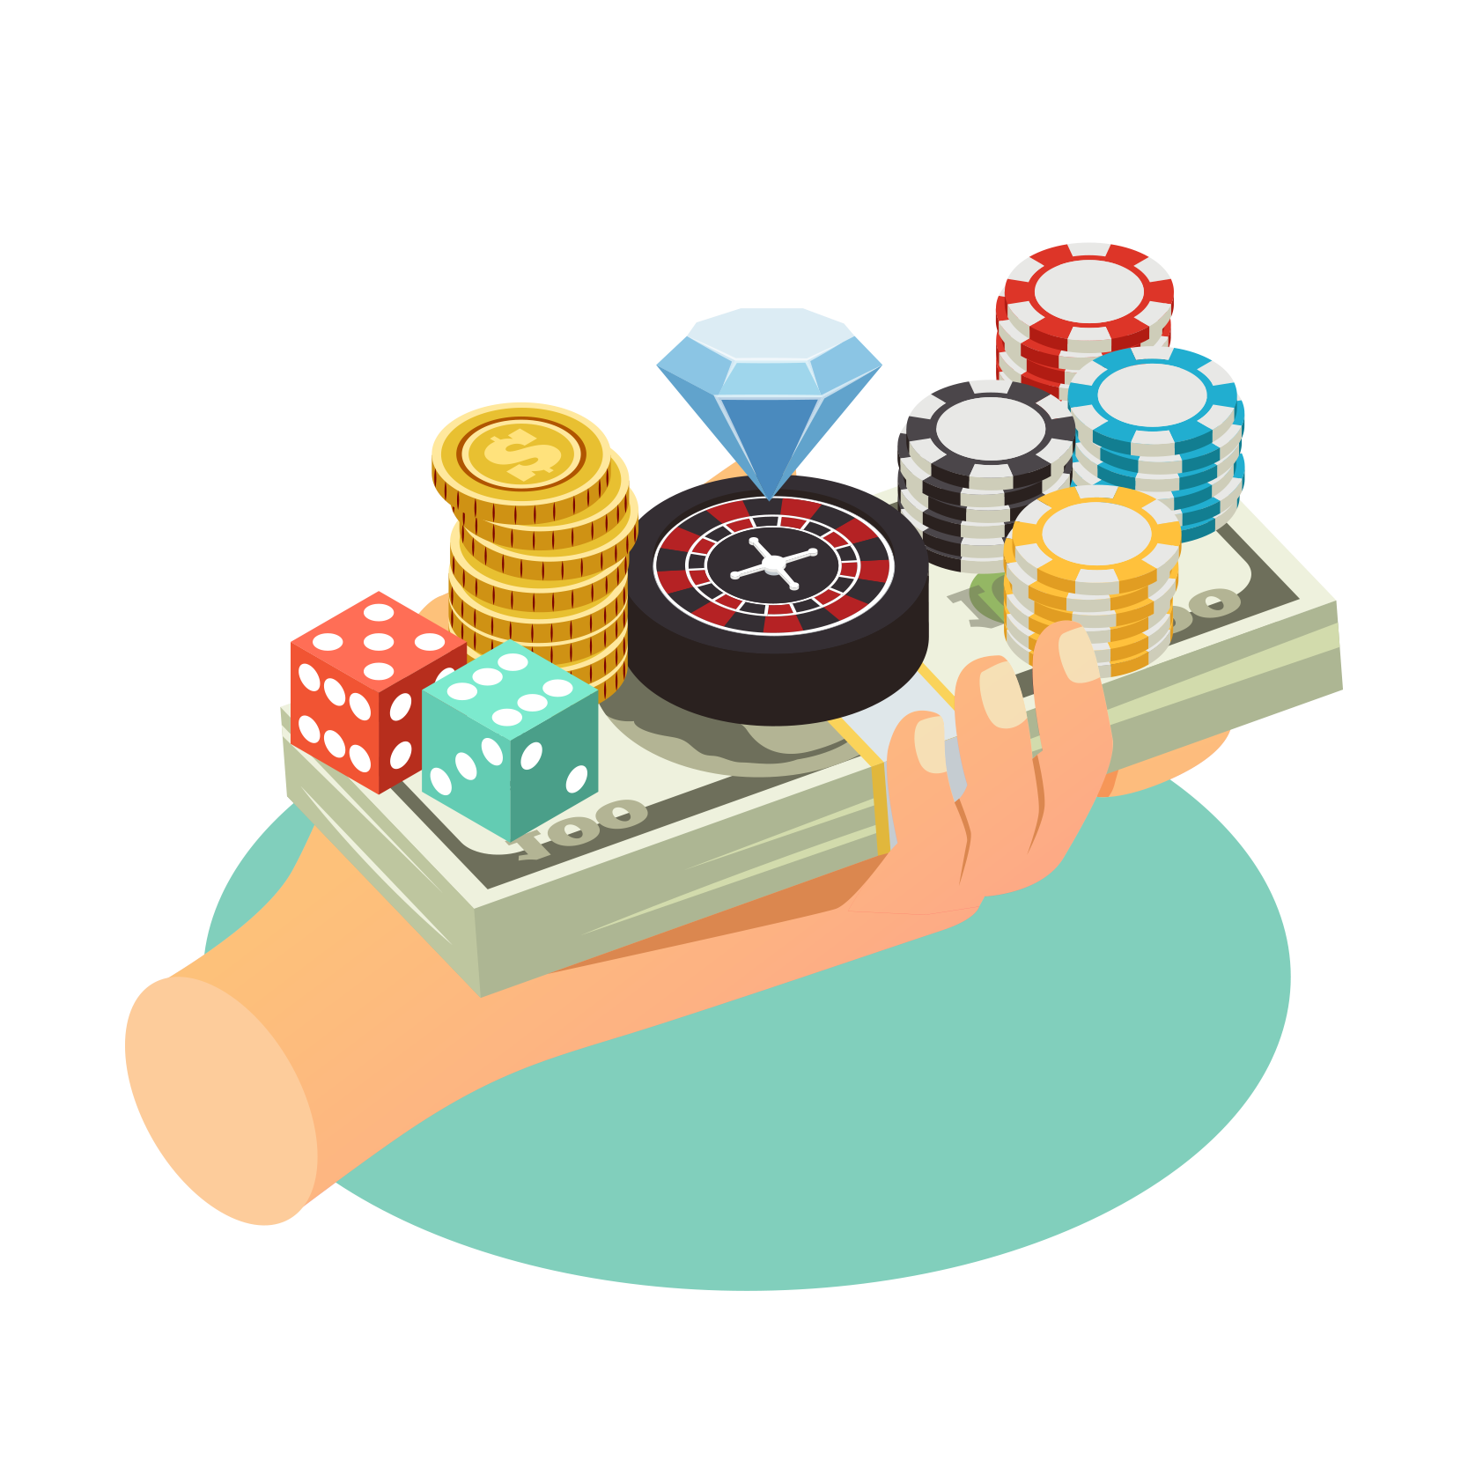
DEFINE GAMBLING. (WHAT DOES IT MEAN TO YOU?)
YEAR 8 / LESSON 5
©YGAM 2020: All rights reserved

Slide 45
ACTIVITY: WHAT’S THE CHANCES?
YEAR 8 / LESSON 5
You have three minutes... using your dictionary, provide a definition for both probability and luck. What role do you think these play in gambling?
In groups order the events from most likely to least likely. What do you think the odds would be for the most and the least likely event?
Now match the odds to the events. Discuss and share your answers.
Are there any surprises? How does this make you feel?

Slide 46
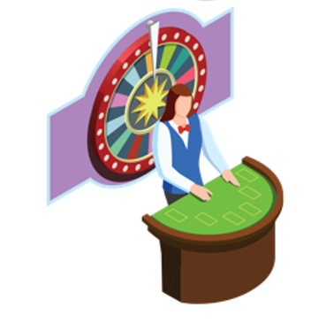
ACTIVITY: UNDERSTANDING THE ODDS
YEAR 8 / LESSON 5
The House always wins.
What does this mean and how does this impact those who participate?
Do you think people know all the facts?
Why do you think people gamble and what might the outcome be?
Where can people go for help if they are worried their relationship with gambling?
Prepare a five-minute presentation on this topic.

Slide 47
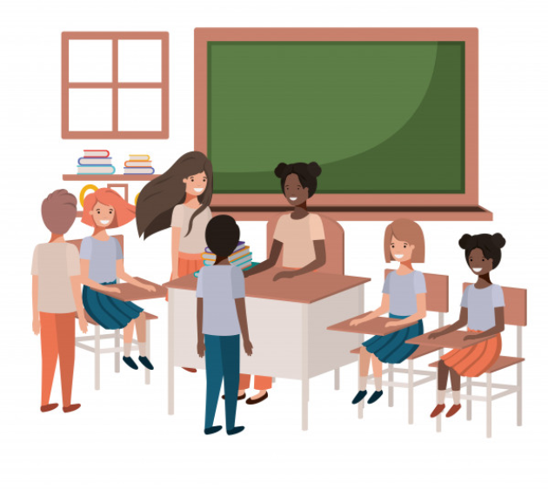
ACTIVITY: TIME TO PRESENT
YEAR 8 / LESSON 5
Deliver your presentation to the class.
Take questions and consider how we safeguard people.

Slide 48
If you need help…
YEAR 8 / LESSON 5
If you are worried about any of the content today you can talk to a teacher or member of staff. For additional support relating to your own or someone else’s relationship with gambling/gaming you can contact Childline or GamCare.
YoungPeopleService@gamcare.org.uk
T: 02030926964

Slide 49
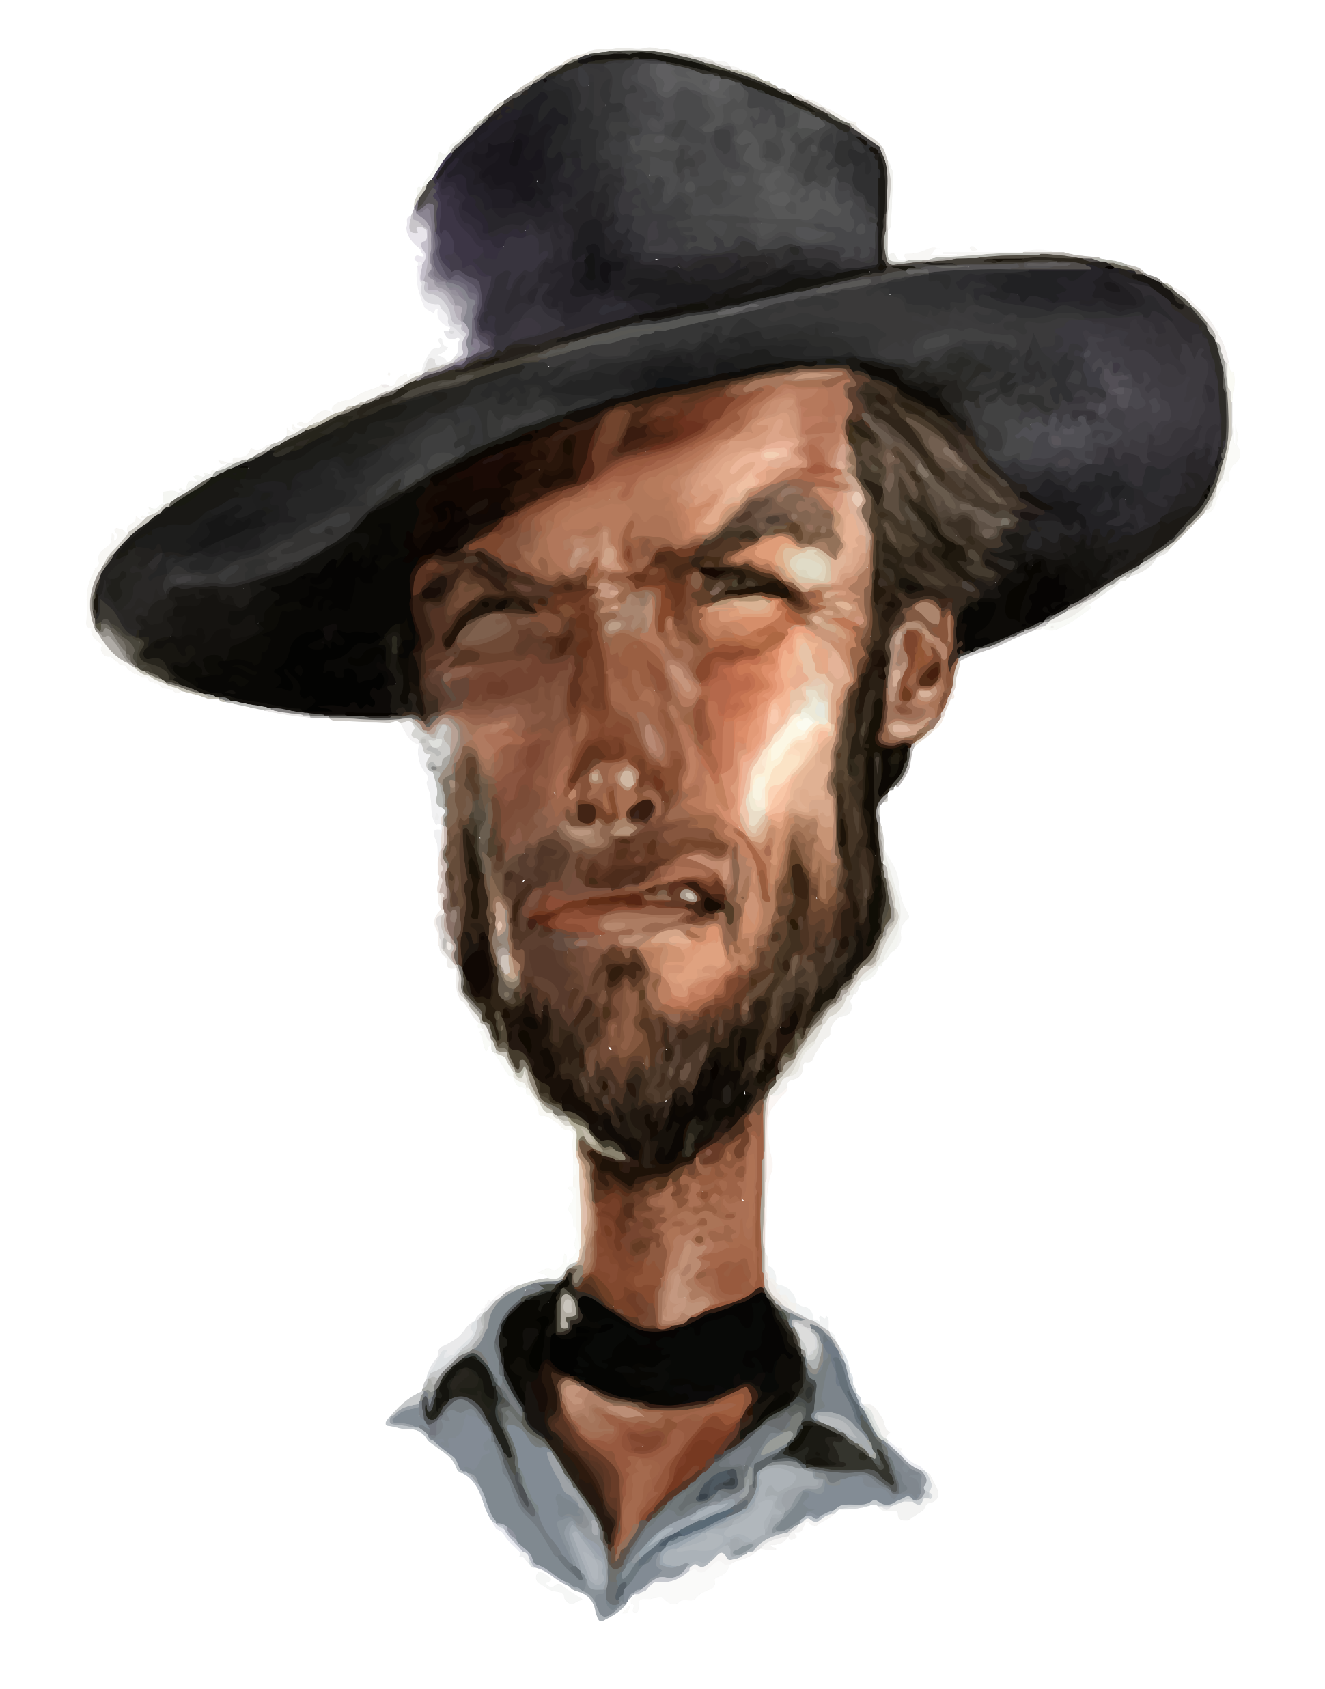
GAMING: THE GOOD, THE BAD AND THE MISUNDERSTOOD
YEAR 8 / LESSON 6

Slide 50
CHALLENGE
YEAR 8 / LESSON 6
Produce a documentary, blog or booklet on the different types of video games, exploring the consequences of spending too much time and money.

Slide 51
LEARNING OBJECTIVES
YEAR 8 / LESSON 6
To understand the positive and negative aspects of gaming
To be able to identify and articulate the risks posed to players
To be able to use your knowledge and skills to create a
useful resource

Slide 52
LEARNING OUTCOMES
YEAR 8 / LESSON 6
I understand the positives and negatives of playing video games
I can talk about the risks people may experience
I can research and use my knowledge to create a resource

Slide 53
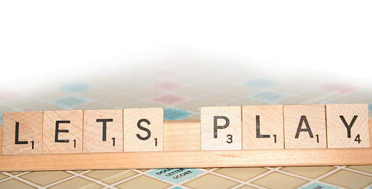
ACTIVITY: LET’S PLAY
YEAR 8 / LESSON 6
In teams, using the letters GAMING think of as many words linked to gaming as you can. You have 3 minutes.
©YGAM 2020: All rights reserved

Slide 54
ACTIVITY: EXAMPLE
YEAR 8 / LESSON 6
Game play, GG (good game)
G
Action, adds, aggro
A
Macro, MMO (massive multiplayer online game)
M
Influencer, item level, inventory
I
Nerf, newbie, noob (mistakes made by a newbie)
N
Goods, gear (in game equipment)
G

Slide 55
ACTIVITY: GAMING RESOURCES
YEAR 8 / LESSON 6
Create a resource to present the risks of gaming. You will want to include both positives and negative aspects of gaming and how people can reduce the risk of harm.
You could create:
A blog
A leaflet
A poster
A film (script/story board)
A documentary
Consider who your resource is aimed at and the content you should include.

Slide 56
ACTIVITY: I PROUDLY PRESENT
YEAR 8 / LESSON 6
Share your resource with the class.
Reflection: What have you learned today?
How can you apply this to:
Your own gaming behaviour?
Your interaction with peers whilst gaming?
Understanding and acting upon risks whilst gaming?

Slide 57
If you need help…
YEAR 8 / LESSON 6
If you are worried about any of the content today you can talk to a teacher or member of staff. For additional support relating to your own or someone else’s relationship with gambling/gaming you can contact Childline or GamCare.
YoungPeopleService@gamcare.org.uk
T: 02030926964

Slide 58
WHY DO SOME YOUNG PEOPLE GAMBLE?
YEAR 9 / LESSON 1
©YGAM 2020: All rights reserved

Slide 59
CHALLENGE
YEAR 9 / LESSON 1
Consider the motivations of young people who gamble and explore the potential risks involved. Explore the research and discuss why young people may gamble. Create learning materials to inform young people about the risks.

Slide 60
LEARNING OBJECTIVES
YEAR 9 / LESSON 1
To recognise how gambling might impact health and wellbeing
To understand why some young people may gamble
To understand the risk associated with gambling
To be able to identify how to get help
To be able to research topics and share information in a suitable manner

Slide 61
LEARNING OUTCOMES
YEAR 9 / LESSON 1
I know how gambling can impact on health and well being
I understand why some people choose to gamble
I understand the risks associated with gambling
I know where to get help if I am worried about my own or someone else’s relationship with gambling
I can research topics and share information

Slide 62
ACTIVITY: YOUNG PEOPLE DON’T GAMBLE; DO THEY?
YEAR 9 / LESSON 1
How old do you need to be to gamble?
How many people aged 11-16 do you think gamble? Consider why?
Discuss and share your thoughts with the class
Using post-it notes to create a graffiti board, list the reasons why you think young people might gamble.

Slide 63
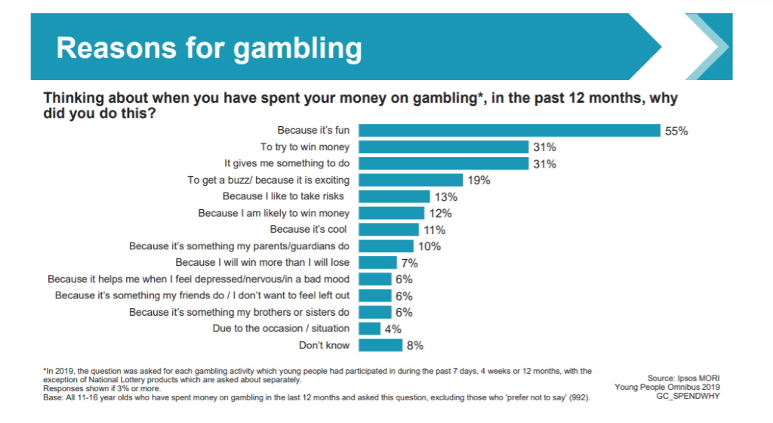
ACTIVITY: REASONS FOR GAMBLING
YEAR 9 / LESSON 1
Gambling Commission: Young people Gambling Report 2019

Slide 64
ACTIVITY: WHAT’S THE RISK?
YEAR 9 / LESSON 1
Gambling Risks
In pairs, list the gambling related risks young people may be exposed to.
Create a resource to inform younger children about the potential risks of gambling. This could be a flyer/poster, a story board for an advert, web page, blog, video or app.
First risk
Second risk
Third risk
!

Slide 65
ACTIVITY: I PROUDLY PRESENT…
YEAR 9 / LESSON 1
Gambling Risks
Share and discuss your resources with the class.
What are the key points?
First risk
Second risk
Third risk
!

Slide 66
If you need help…
YEAR 9 / LESSON 1
If you are worried about any of the content today you can talk to a teacher or member of staff. For additional support relating to your own or someone else’s relationship with gambling/gaming you can contact Childline or GamCare.
YoungPeopleService@gamcare.org.uk
T: 02030926964

Slide 67
WHAT ARE THE RISKS?
YEAR 9 / LESSON 2

Slide 68
CHALLENGE
YEAR 9 / LESSON 2
Choose 10 images you associate with gambling. Create a collage and share your thoughts, use key words to support your images.

Slide 69
LEARNING OBJECTIVES
YEAR 9 / LESSON 2
To recognise how gambling might impact health and wellbeing
To understand why some young people may gamble
To understand the risk associated with gambling
To be able to identify how to get help
To be able to research topics and share information in a suitable manner

Slide 70
LEARNING OUTCOMES
YEAR 9 / LESSON 2
I know how gambling can impact on health and well being
I understand why some people choose to gamble
I understand the risks associated with gambling
I know where to get help if I am worried about my own or someone else’s relationship with gambling
I can research topics and share information

Slide 71
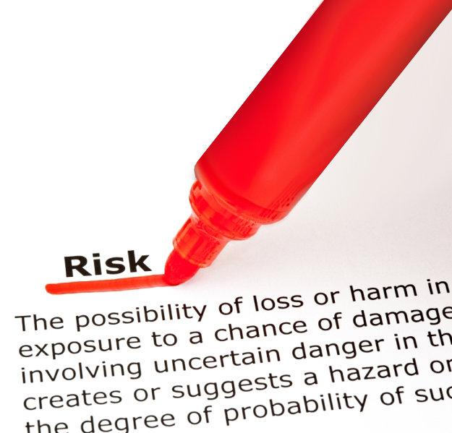
ACTIVITY: ASSESS THE RISK
YEAR 9 / LESSON 2
Definition of risk: A situation involving exposure to danger. The possibility that something unpleasant or unwelcome will happen.
In groups, explore the images and order them from the highest risk to the lowest risk.
Share your order with the rest of the class, explaining your thought process behind it.

Slide 72
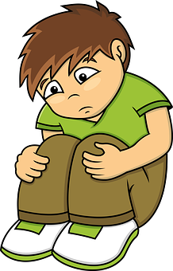
ACTIVITY: GAMBLING AND MENTAL WELL-BEING
YEAR 9 / LESSON 2
How might gambling affect someone’s mental well-being?
Discuss and share your ideas.
Create a collage of the things you associate with gambling related harm.

Slide 73
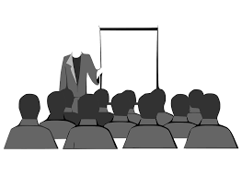
ACTIVITY: I PROUDLY PRESENT
YEAR 9 / LESSON 2
Option 1:
Share and discuss your work with the class
Option 2:
Move around the room exploring each other’s work

Slide 74
If you need help…
YEAR 9 / LESSON 2
If you are worried about any of the content today you can talk to a teacher or member of staff. For additional support relating to your own or someone else’s relationship with gambling/gaming you can contact Childline or GamCare.
YoungPeopleService@gamcare.org.uk
T: 02030926964

Slide 75
THE BLURRED LINES
YEAR 9 / LESSON 3

Slide 76
CHALLENGE
YEAR 9 / LESSON 3
Explore the games you play. Do they encourage you to buy items or advertise gambling related products? How does this impact you? How do you think this would impact a younger student? Produce a booklet on the different types of video games and information sheet for KS2 students and their parents to help inform them of the potential harms in some of the products. Do you have any tips to help them stay safe?
©YGAM 2020: All rights reserved

Slide 77
LEARNING OBJECTIVES
YEAR 9 / LESSON 3
To recognise how gaming might impact health and wellbeing
To understand why some young people may game
To understand the risk associated with gaming and the blurred lines in to gambling
To be able to research topics and share information in a suitable manner

Slide 78
LEARNING OUTCOMES
YEAR 9 / LESSON 3
I know how gaming and gambling can impact health and wellbeing
I understand the risks associated with gaming and he blurred lines with gambling
I can research topics and share information

Slide 79
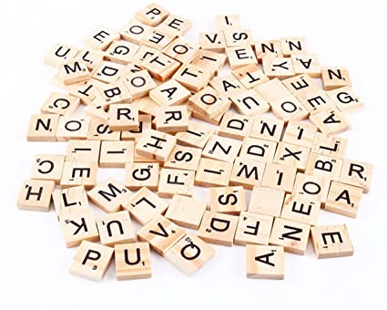
ACTIVITY: THE A-Z OF GAMING
YEAR 9 / LESSON 3
List as many words as you can think of associated with gaming using letters from the alphabet e.g.
Adrenaline, action, anxiety
Battle pass, boredom
Controller, candy crush

Slide 80
ACTIVITY: BLURRED LINES
YEAR 9 / LESSON 3
What games do you play?
What features do games have to keep you playing?
Do you buy items within the games?
Discuss and share your responses with the class.
In small groups, create a resource to inform, educate and safeguard young people about the potential risks of gaming.
What type of device to use to play?
Do you play video games?
Some games have gambling mechanisms in them

Slide 81
ACTIVITY: KEY ADVICE
YEAR 9 / LESSON 3
Choose 3 things to share with the class.
What advice would you give to your younger self about staying safe when playing video games?

Slide 82
If you need help…
YEAR 9 / LESSON 3
If you are worried about any of the content today you can talk to a teacher or member of staff. For additional support relating to your own or someone else’s relationship with gambling/gaming you can contact Childline or GamCare.
YoungPeopleService@gamcare.org.uk
T: 02030926964

Slide 83
THE HOUSE EDGE
YEAR 9 / LESSON 4

Slide 84
CHALLENGE
YEAR 9 / LESSON 4
Is there such a thing as luck in gambling and what is meant by the house always wins or the house edge? Design and carry out a coin toss to test the rules of probability. Record the rules of play and analyse the odds of different outcomes.

Slide 85
LEARNING OBJECTIVES
YEAR 9 / LESSON 4
To understand the rules of probability
To understand how probability relates to gambling
To be able to test the rules of probability and analyse findings
To identify gambling related harm
To be able to research topics and share information in a suitable manner

Slide 86
LEARNING OUTCOMES
YEAR 9 / LESSON 4
I understand what is meant by probability and luck
I understand how probability relates to gambling
I can test the rules of probability and analyse my findings
I can identify gambling related harm
I can research topics and share information

Slide 87
ACTIVITY: STAND UP IF…
YEAR 9 / LESSON 4
If you have ever placed a bet
If you have ever played a game of cards or a board game for money
If you have ever played a game such as penny up/coin toss/pitch and toss
If there’s a betting shop near your home
If you’ve ever chosen numbers for a family member on the lottery
If you’ve ever picked a horse on a horse racing event
If you can identify two examples of gambling related harm
If you can provide an example of how gambling might affect mental health
If you can give an example of where to get help
If you know what is meant by the house edge
If you know what is meant by luck
If you know what is meant by probability

Slide 88
ACTIVITY: HOUSE EDGE
YEAR 9 / LESSON 4
Task 1: Probability matching cards
Task 2: Coin toss / Card game
Working in small groups, conduct a coin toss game or a card game to test the rules of probability. Explore the likelihood of a variety of outcomes. e.g. calling a head five times in a row, of getting head/tail consistently etc.

Slide 89
ACTIVITY: HOW DOES PROBABILITY APPLY TO GAMBLING?
YEAR 9 / LESSON 4
How do gambling companies make their money?
Are young people aware of the probability of them winning?
Do you think this would impact the likelihood of them participating?
Discuss and share your thoughts.

Slide 90
If you need help…
YEAR 9 / LESSON 4
If you are worried about any of the content today you can talk to a teacher or member of staff. For additional support relating to your own or someone else’s relationship with gambling/gaming you can contact Childline or GamCare.
YoungPeopleService@gamcare.org.uk
T: 02030926964

Slide 91
GAMBLING, MONEY & DEBT
YEAR 9 / LESSON 5

Slide 92
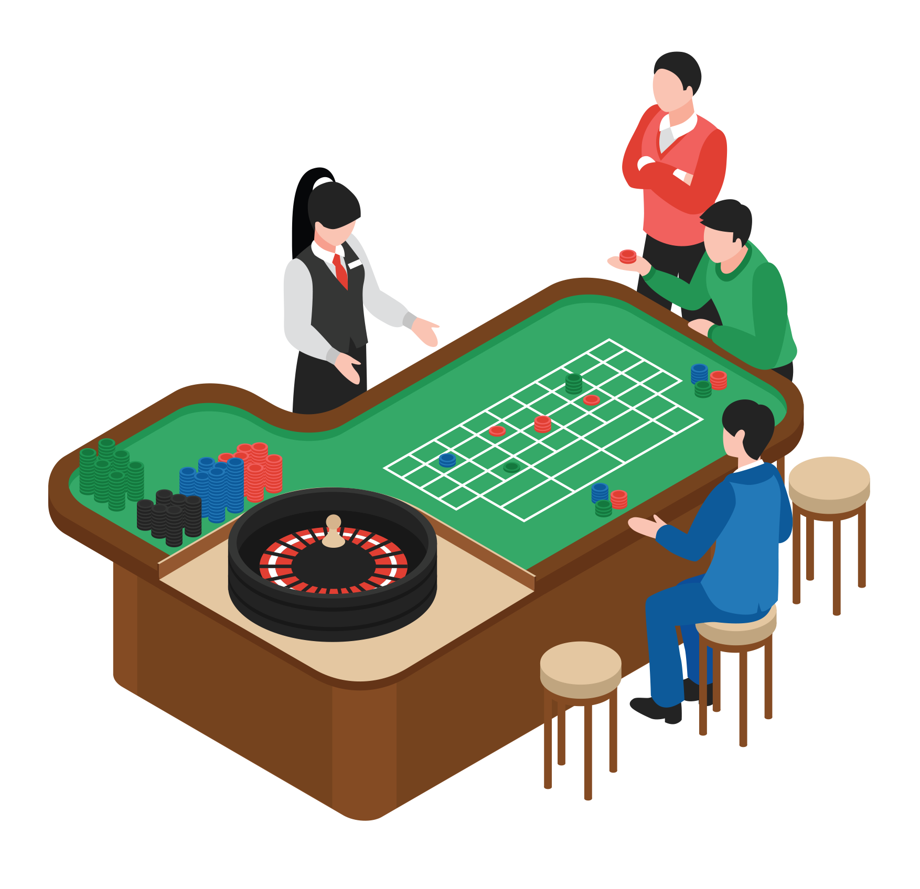
CHALLENGE
YEAR 9 / LESSON 5
How much money does the online gambling market make each year? Investigate.

Slide 93
LEARNING OBJECTIVES
YEAR 9 / LESSON 5
To understand how the gambling industry works
To understand the financial risks of gambling
To be able to research topics and share information in a suitable manner

Slide 94
LEARNING OUTCOMES
YEAR 9 / LESSON 5
I understand how the gambling industry work
I understand the financial risks of gambling
I can research topics and share information

Slide 95
ACTIVITY: DO’S AND DON’TS MIND MAP
YEAR 9 / LESSON 5
Using sticky notes, write down ideas for what individuals can do to safeguard themselves against gambling harms
Using different colour sticky notes, write down ideas for what the industry/operators could do to safeguard consumers against gambling harms
List your top three ideas for both categories and explain why.

Slide 96
ACTIVITY: WHERE DOES ALL THE MONEY GO?
YEAR 9 / LESSON 5
Use the newspaper articles/links or an internet search engine to help you think about and answer the following questions:
How much money does the Gambling Industry make?
Where does the money come from?
Where does the money go?

Slide 97
ACTIVITY: LET’S QUIZ
YEAR 9 / LESSON 5
QUESTION
ANSWERS
1
What is the age limit for category D fruit machines?
A
No age limit
B
16
C
18
2
How many children in the UK are classified as problem gamblers
A
20,000
B
48,000
C
55,000
3
What percentage of 11-16 year olds who gamble are with their parents at the time?
A
10
B
67
C
48
4
What was the average amount of money spent by 11-16 year olds who have gambled in the last week?
A
£10
B
£17
C
£22
5
What percentage of 11-16 year olds had been stopped from gambling because they looked too young?
A
15%
B
30%
C
45%
6
How many premier league football teams in Season 21/22 carried a betting logo on their shirts
A
5
B
9
C
17

Slide 98
ACTIVITY: LET’S QUIZ - ANSWERS
YEAR 9 / LESSON 5
QUESTION
ANSWERS
1
What is the age limit for category D fruit machines?
A
No age limit
B
16
C
18
2
How many children in the UK are classified as problem gamblers
A
20,000
B
48,000
C
55,000
3
What percentage of 11-16 year olds who gamble are with their parents at the time?
A
10
B
67
C
48
4
What was the average amount of money spent by 11-16 year olds who have gambled in the last week?
A
£10
B
£17
C
£22
5
What percentage of 11-16 year olds had been stopped from gambling because they looked too young?
A
15%
B
30%
C
45%
6
How many premier league football teams in Season 21/22 carried a betting logo on their shirts
A
5
B
9
C
17
Source: Gambling commission 2019.

Slide 99
ACTIVITY: TIME TO SHARE
YEAR 9 / LESSON 5
Share two things that you have learnt today that have surprised or interested you.

Slide 100
If you need help…
YEAR 9 / LESSON 5
If you are worried about any of the content today you can talk to a teacher or member of staff. For additional support relating to your own or someone else’s relationship with gambling/gaming you can contact Childline or GamCare.
YoungPeopleService@gamcare.org.uk
T: 02030926964

Slide 101
THE GAMBLING ACT
YEAR 9 / LESSON 6

Slide 102
CHALLENGE
YEAR 9 / LESSON 6
Explore the Gambling Act. What measures are put in place to protect young and vulnerable people. Should it include Loot boxes in online games?

Slide 103
LEARNING OBJECTIVES
YEAR 9 / LESSON 6
To understand the purpose of the Gambling Act and the legislation to protect young and vulnerable people
To understand what is meant by consumer protection and safeguarding
To use researching skills to find information and share findings and opinion

Slide 104
LEARNING OUTCOMES
YEAR 9 / LESSON 6
I understand what is meant by consumer protection and safeguarding
I can define safeguarding
I can recognise key features of the Gambling Act
I can research a topic and share my opinion and findings

Slide 105
ACTIVITY: CONSUMER PROTECTION MAP
YEAR 9 / LESSON 6
What is meant by consumer?
Use the post it notes to create a map of all the people/organisations involved in safeguarding the consumer against harmful gambling.
1) What measures can they take?
2) Does education play a part in safeguarding? Explain your answer

Slide 106
ACTIVITY: THE BIG DEBATE
YEAR 9 / LESSON 6
Explore the document ‘Children, young people and gambling.’ What measures are in place to protect children and young people? Is this enough?
Explain your answer: Is there any more that could be done? What do you suggest?
Now think about the ways children and young people are protected from harm relating to loot boxes. Are there any measures in place?

Slide 107
ACTIVITY: THE GAMBLING ACT: THE BIG DEBATE CONTINUED…
YEAR 9 / LESSON 6
Prepare an argument for or against for the inclusion of Loot boxes within the gambling act.
You will have 5 minutes to put your point across and a further 1 minute to take any questions.
You can use the suggested newspaper articles and research documents to support your argument.

Slide 108
ACTIVITY: WHAT MORE CAN BE DONE?
YEAR 9 / LESSON 6
Use sticky notes to attach two additional things that could be done to protect consumers. You could attach it to one of those identified in the first activity.

Slide 109
If you need help…
YEAR 9 / LESSON 6
If you are worried about any of the content today you can talk to a teacher or member of staff. For additional support relating to your own or someone else’s relationship with gambling/gaming you can contact Childline or GamCare.
YoungPeopleService@gamcare.org.uk
T: 02030926964

Slide 110
WHY PEOPLE GAME
YEAR 10 / LESSON 1
V1.0/June 21

Slide 111
CHALLENGE
YEAR 10 / LESSON 1
Consider the motivations of people who game. Look at both the positive and negative aspects of gaming, what are the risks? How can we mitigate these risks?

Slide 112
LEARNING OBJECTIVES
YEAR 10 / LESSON 1
To understand the motivations for people participating in gaming
To understand the positive and negatives of professional gaming, e.g. Esports
To explore the potential risks of gaming and how to keep safe

Slide 113
LEARNING OUTCOMES
YEAR 10 / LESSON 1
List
I can list the reasons why people game
Identify
I can identify positive and negative aspects of the gaming profession, exploring case studies
Use
I can use the internet or other relevant sources of information to research the gaming profession.

Slide 114
ACTIVITY: WHAT GAMES DO YOU PLAY?
YEAR 10 / LESSON 1
What games do you play?
How do you play them?
How often / how long to you play them for?
What’s the most popular method of play?
Why do you play games?

Slide 115
ACTIVITY: THE GOOD AND THE BAD
YEAR 10 / LESSON 1
Task 1: Make a list
In groups, discuss and research both the positive and negative things that can be gained from gaming and why people may enjoy it. Make a list to document both aspects of gaming.
Task 2: Esports: Health and Well-being
What risks might an Esports Professional be exposed to? What could they do to look after their health? Using the resources provided and your own research, explore the potential risks and see if you can offer an opportunity to reduce each risk.

Slide 116
ACTIVITY: LET’S DEBATE
YEAR 10 / LESSON 1
Safer than going to the park?
Gaming online is safer than hanging out with my friends in the park/on the street at night?
List opinions for and against then discuss your thoughts.
Create a class list to explore personal safety online and offline
Safer than hanging out at night?
Safer than hanging on the street with friends?

Slide 117
If you need help…
YEAR 10 / LESSON 1
If you are worried about any of the content today you can talk to a teacher or member of staff. For additional support relating to your own or someone else’s relationship with gambling/gaming you can contact Childline or GamCare.
YoungPeopleService@gamcare.org.uk
T: 02030926964

Slide 118
SOCIAL AND MORAL VIEWPOINTS
YEAR 10 / LESSON 2

Slide 119
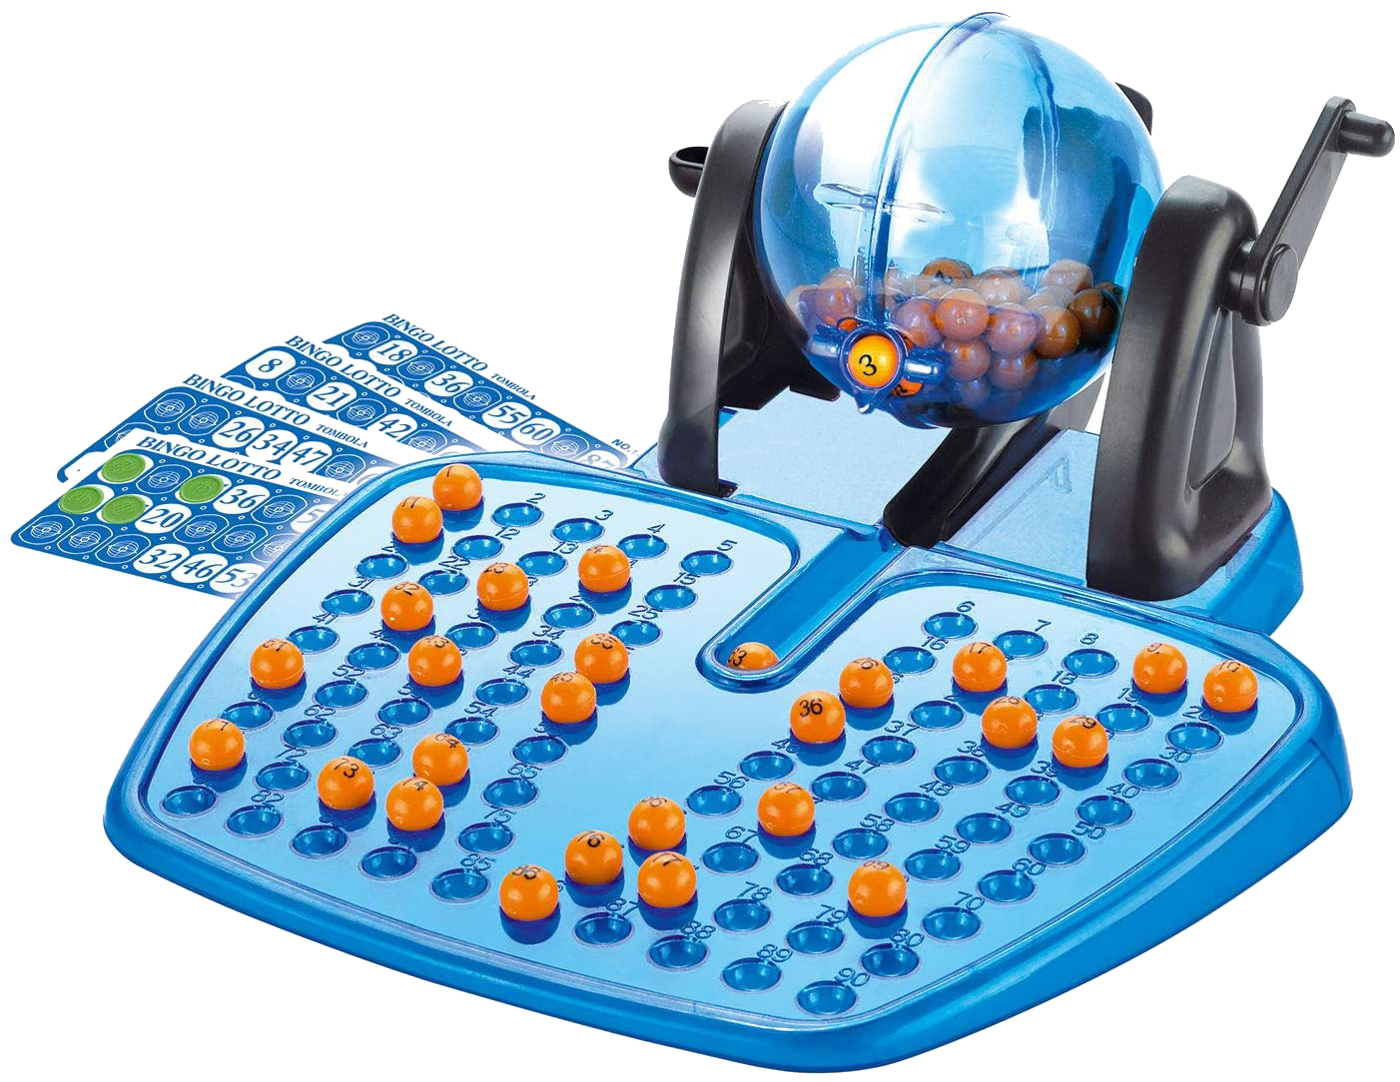
CHALLENGE
YEAR 10 / LESSON 2
There is a perception that some forms of gambling are more socially acceptable than others, but should this be the case?
Debate.
Has it been normalised? Discuss the moral and legal issues.

Slide 120
LEARNING OBJECTIVES
YEAR 10 / LESSON 2
To understand the potential risks of gambling and how this applies to you
Understand why people might gamble
Understand what is meant by gambling related harm

Slide 121
LEARNING OUTCOMES
YEAR 10 / LESSON 2
I can list the reasons why people might gamble
I can identify the risks associated with gambling
I understand what is meant by gambling related harm
I know where to get help if I am worried about my own or someone else’s relationship with gambling
I can think critically about gambling and social norms

Slide 122
ACTIVITY: ARE SOME FORMS OF GAMBLING MORE SOCIALLY ACCEPTABLE THAN OTHERS?
YEAR 10 / LESSON 2
Are some forms of gambling more acceptable than others? Why do you think that? Do you think gambling has been normalised? How might this impact the young and vulnerable? Take two minutes to discuss this on your table and share your main ideas with the class.
Bookmakers, Lottery, Horse Racing, Private Poker Game, Casino games, Sports Bet, Scratch Card, Fruit machines, Penny slots, Casino app, Bingo.

Slide 123
ACTIVITY: LET’S DEBATE
YEAR 10 / LESSON 2
During lockdown 2020, MP Carolyn Harris was quoted as saying:
"Gambling has been normalised to such an extent that young people grow up thinking this is a harmless activity. Those who are targeted today will be the problem gamblers of tomorrow. It’s time [gambling firms] realised the harm they’re doing via this indoctrination.”
Source: https://www.gizmodo.co.uk/2020/03/gambling-could-increase-during-lockdown/
How far do you agree with this statement? Write down your views on the matter. What can and should be done to minimise harm?
Consider the advertising around you and any social/cultural norms you’re aware of. You can also use the suggested articles /online research to help form your argument.
©YGAM 2020: All rights reserved

Slide 124
ACTIVITY: LET’S SHARE
YEAR 10 / LESSON 2
Share your argument with the class.

Slide 125
ACTIVITY: AGREE/DISAGREE
YEAR 10 / LESSON 2
AGREE | DISAGREE
Gambling should be illegal?
All Gambling should be 18+, including seaside arcades?
Gambling adverts within computer games and on social media should be banned.
Gambling advertising on TV should be banned, just like tobacco.
Gambling firms should pay money towards the prevention, treatment and research of gambling related harm.
Random purchases in computer games should be regulated under the gambling act.

Slide 126
If you need help…
YEAR 10 / LESSON 2
If you are worried about any of the content today you can talk to a teacher or member of staff. For additional support relating to your own or someone else’s relationship with gambling/gaming you can contact Childline or GamCare.
YoungPeopleService@gamcare.org.uk
T: 02030926964

Slide 127
MICROTRANSACTIONS
YEAR 10 / LESSON 3

Slide 128
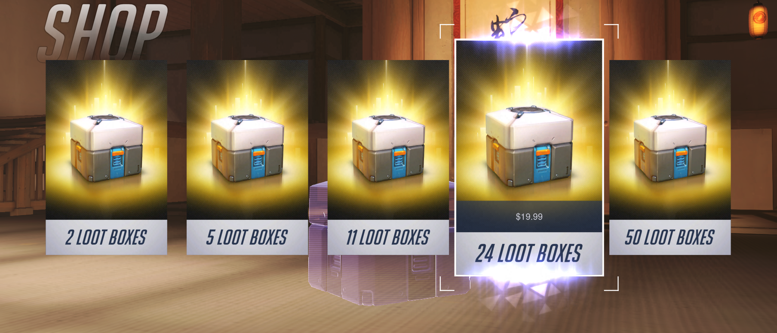
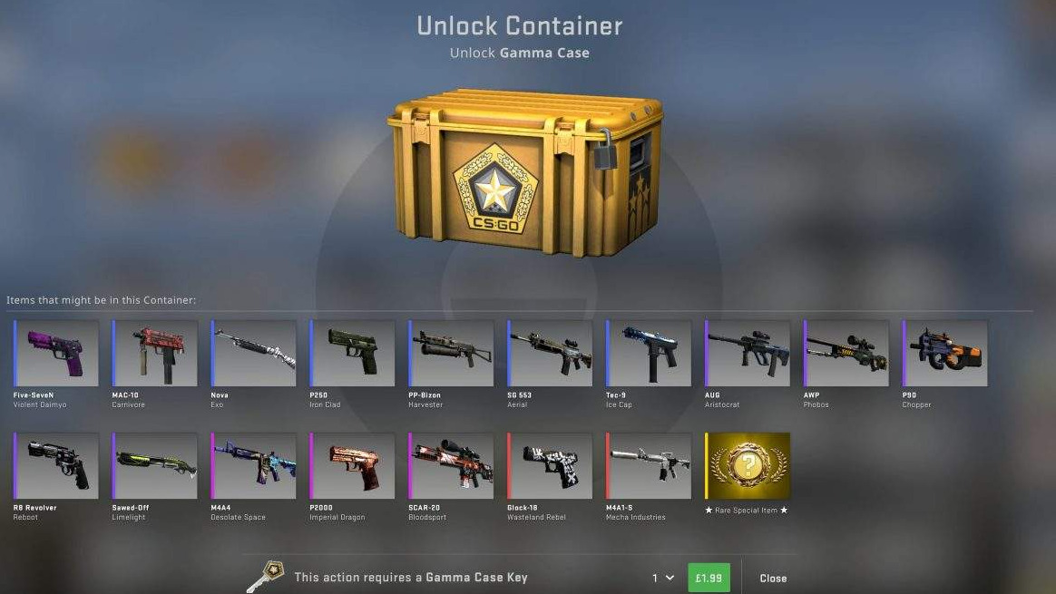
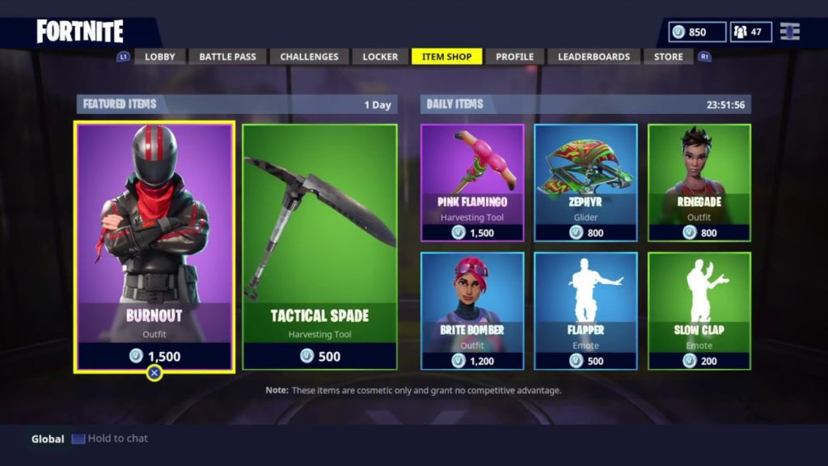
CHALLENGE
YEAR 10 / LESSON 3
What are the different types of microtransactions in games? Are there any risks associated with these? Do they make games more or less appealing? Present your findings.

Slide 129
LEARNING OBJECTIVES
YEAR 10 / LESSON 3
To understand the term and definition of microtransaction
To understand why games include microtransactions and the intent in these
To understand why people make microtransactions
Understand what is meant by gaming and gambling related harm

Slide 130
LEARNING OUTCOMES
YEAR 10 / LESSON 3
I can define microtransactions
I understand why microtransactions feature in games
I understand why people might make microtransactions
I understand what is meant by gaming and gambling related harm
Research and manage information effectively

Slide 131
ACTIVITY: MICROTRANSACTIONS THOUGHT SHOWER
YEAR 10 / LESSON 3
Take 5 minutes to list/create a thought shower identifying the types of microtransactions you are aware of.
A definition: A microtransaction is anything you pay extra for in a video game outside of the initial purchase.
Check this out: https://www.gamespot.com/articles/microtransactions-explained-heres-what-you-need-to/1100-6456995/
Add any additional information to your thought shower, have you seen them in the games you play? How do they make you feel?

Slide 132
ACTIVITY: RESEARCH AND PRESENT
YEAR 10 / LESSON 3
Let’s explore the world of microtransactions within games.
Research the types of microtransactions.
Why do gaming companies use them?
How much revenue do they bring in?
What are the pros and cons for the player/consumer?
What are the laws/regulations associated with these?
What’s your opinion regarding microtransactions?
Present and discuss your findings.

Slide 133
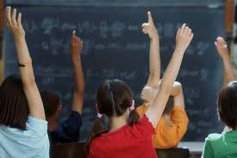
ACTIVITY: WHAT ADVICE WOULD YOU GIVE?
YEAR 10 / LESSON 3
Think of five pieces of advice you could give to a younger child about microtransactions.

Slide 134
If you need help…
YEAR 10 / LESSON 3
If you are worried about any of the content today you can talk to a teacher or member of staff. For additional support relating to your own or someone else’s relationship with gambling/gaming you can contact Childline or GamCare.
YoungPeopleService@gamcare.org.uk
T: 02030926964

Slide 135
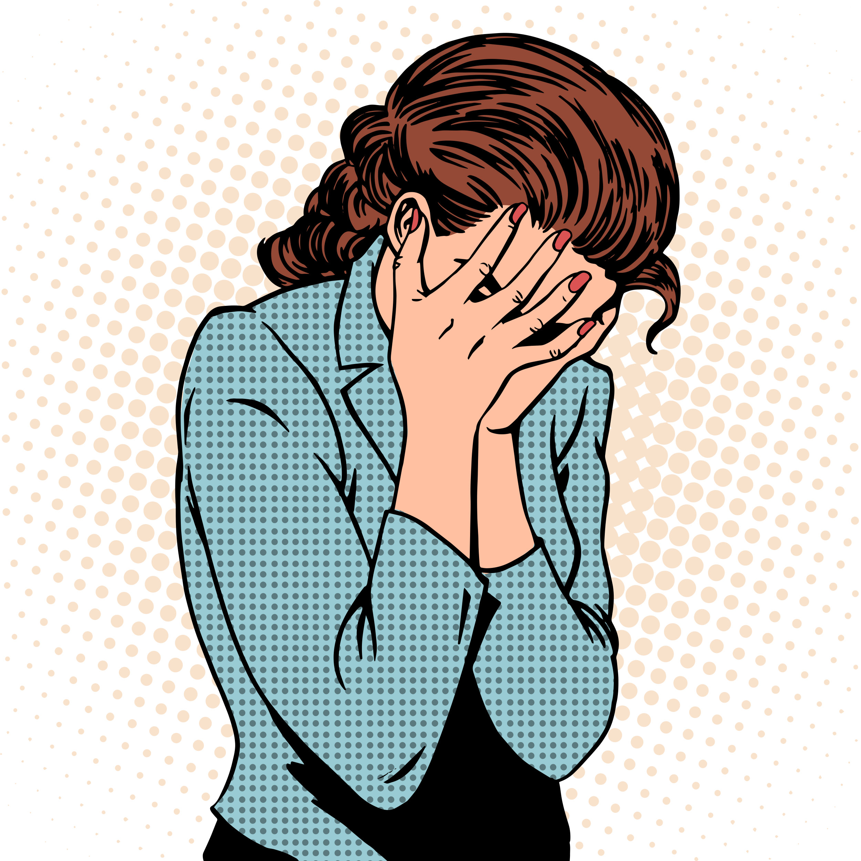
WHAT’S THE PROBLEM?
YEAR 10 / LESSON 4
©YGAM 2020: All rights reserved

Slide 136
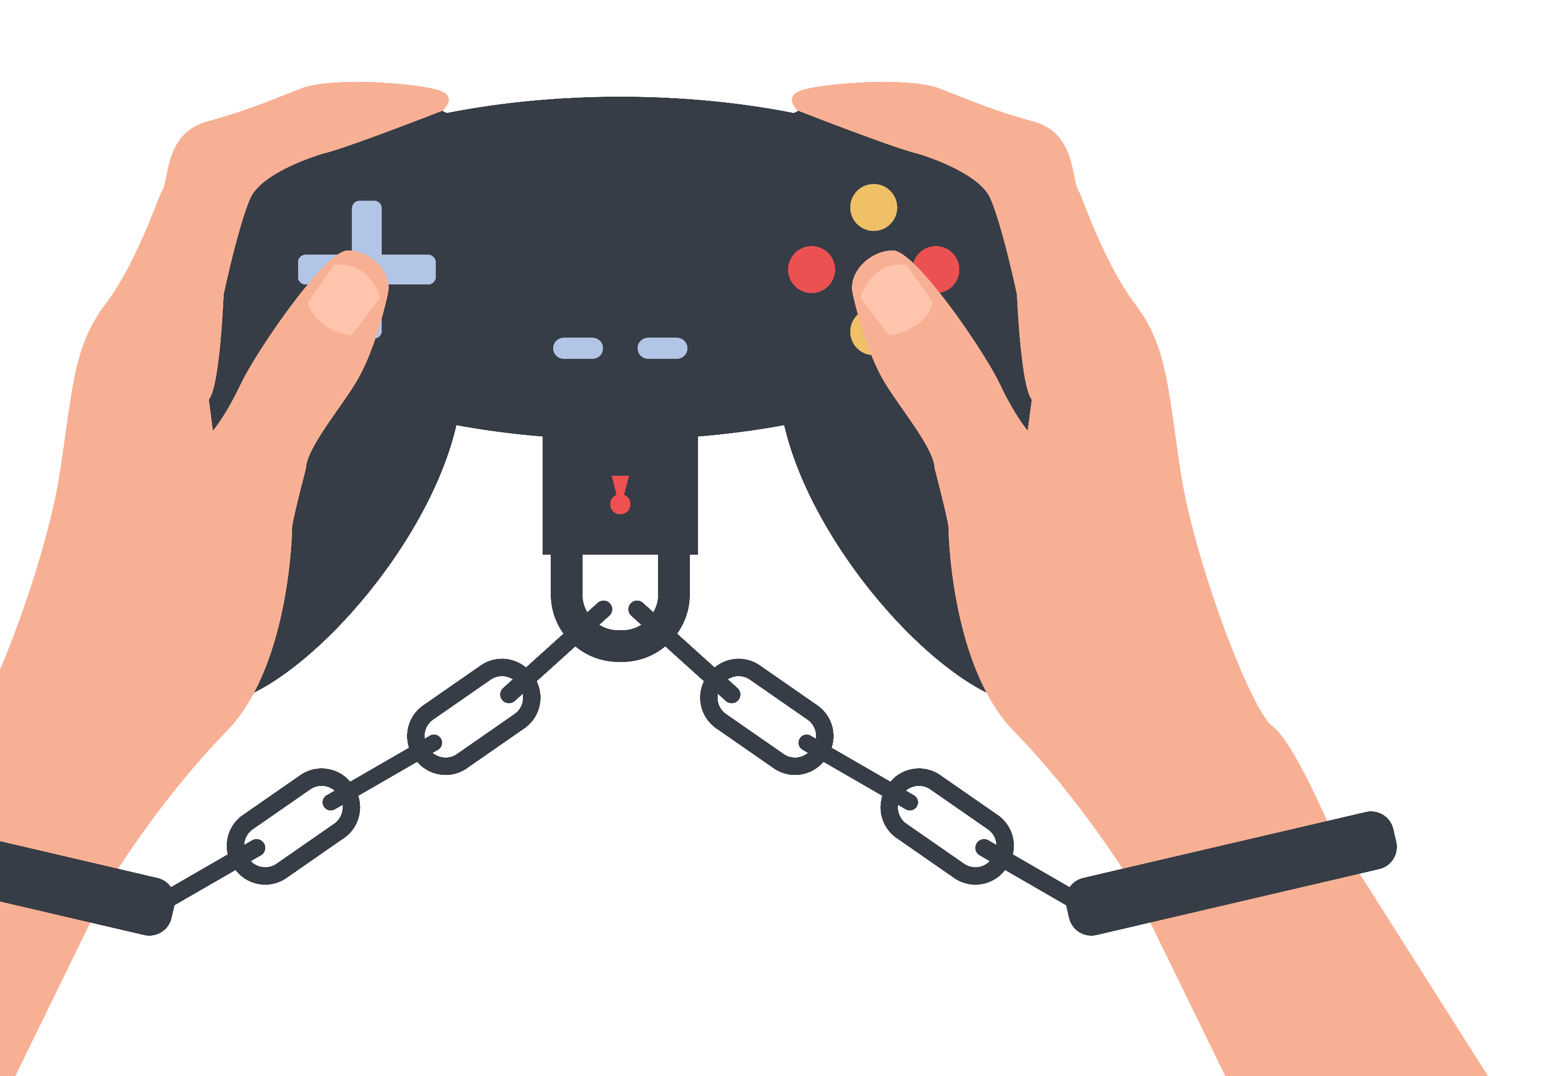
CHALLENGE
YEAR 10 / LESSON 4
When does gaming and gambling become problematic? What does it look like?

Slide 137
LEARNING OBJECTIVES
YEAR 10 / LESSON 4
To understand what is meant by gambling and gaming related harm
To understand the wider impact of gambling and gaming related harm
To recognise the signs of gaming and gambling related harm
To be able to identify how and where to get help

Slide 138
LEARNING OUTCOMES
YEAR 10 / LESSON 4
I can define gambling and gaming related harm
I understand the impact of gambling and gaming related harm
I can recognise signs of gambling and gaming related harm
I know where to get help if I am worried about my own or someone else’s relationship with gambling or gaming.

Slide 139
ACTIVITY: LOOKING FOR SIGNS
YEAR 10 / LESSON 4
In groups, discuss the following:
What does gambling and gaming related harm look like?
Can you tell if someone is experiencing gambling or gaming related harm?
Using the resource provided, look at the different signs of gaming/gambling harm and sort into the correct heading. What are the similarities /differences?
Gaming related harm
Gambling related harm

Slide 140
ACTIVITY: SPOTTING THE SIGNS
YEAR 10 / LESSON 4
Task 1:
Working in pairs, read each scenario card and consider if the person is experiencing harm. Place your card on the traffic light as appropriate and discuss your reasoning.
Red - experiencing harm
Amber - at risk
Green - not experiencing harm and not at risk
Task 2:
Do you think it is easier or more difficult to recognise the signs of gambling/gaming related harm compared to harm from drugs, alcohol or tobacco? Are there any similarities or differences? Explain your thoughts.

Slide 141
ACTIVITY: A HELPING HAND
YEAR 10 / LESSON 4
Discuss and share your thoughts:
Do they think you would spot the signs of gambling/gaming related harm within friends?
Is it easier or more difficult to spot compared to the other things that could cause harm e.g. alcohol, tobacco, illegal drugs.
Think of five places you could go for help if you are worried about your own or someone else's relationship with gaming or gambling.

Slide 142
If you need help…
YEAR 10 / LESSON 4
If you are worried about any of the content today you can talk to a teacher or member of staff. For additional support relating to your own or someone else’s relationship with gambling/gaming you can contact Childline or GamCare.
YoungPeopleService@gamcare.org.uk
T: 02030926964

Slide 143
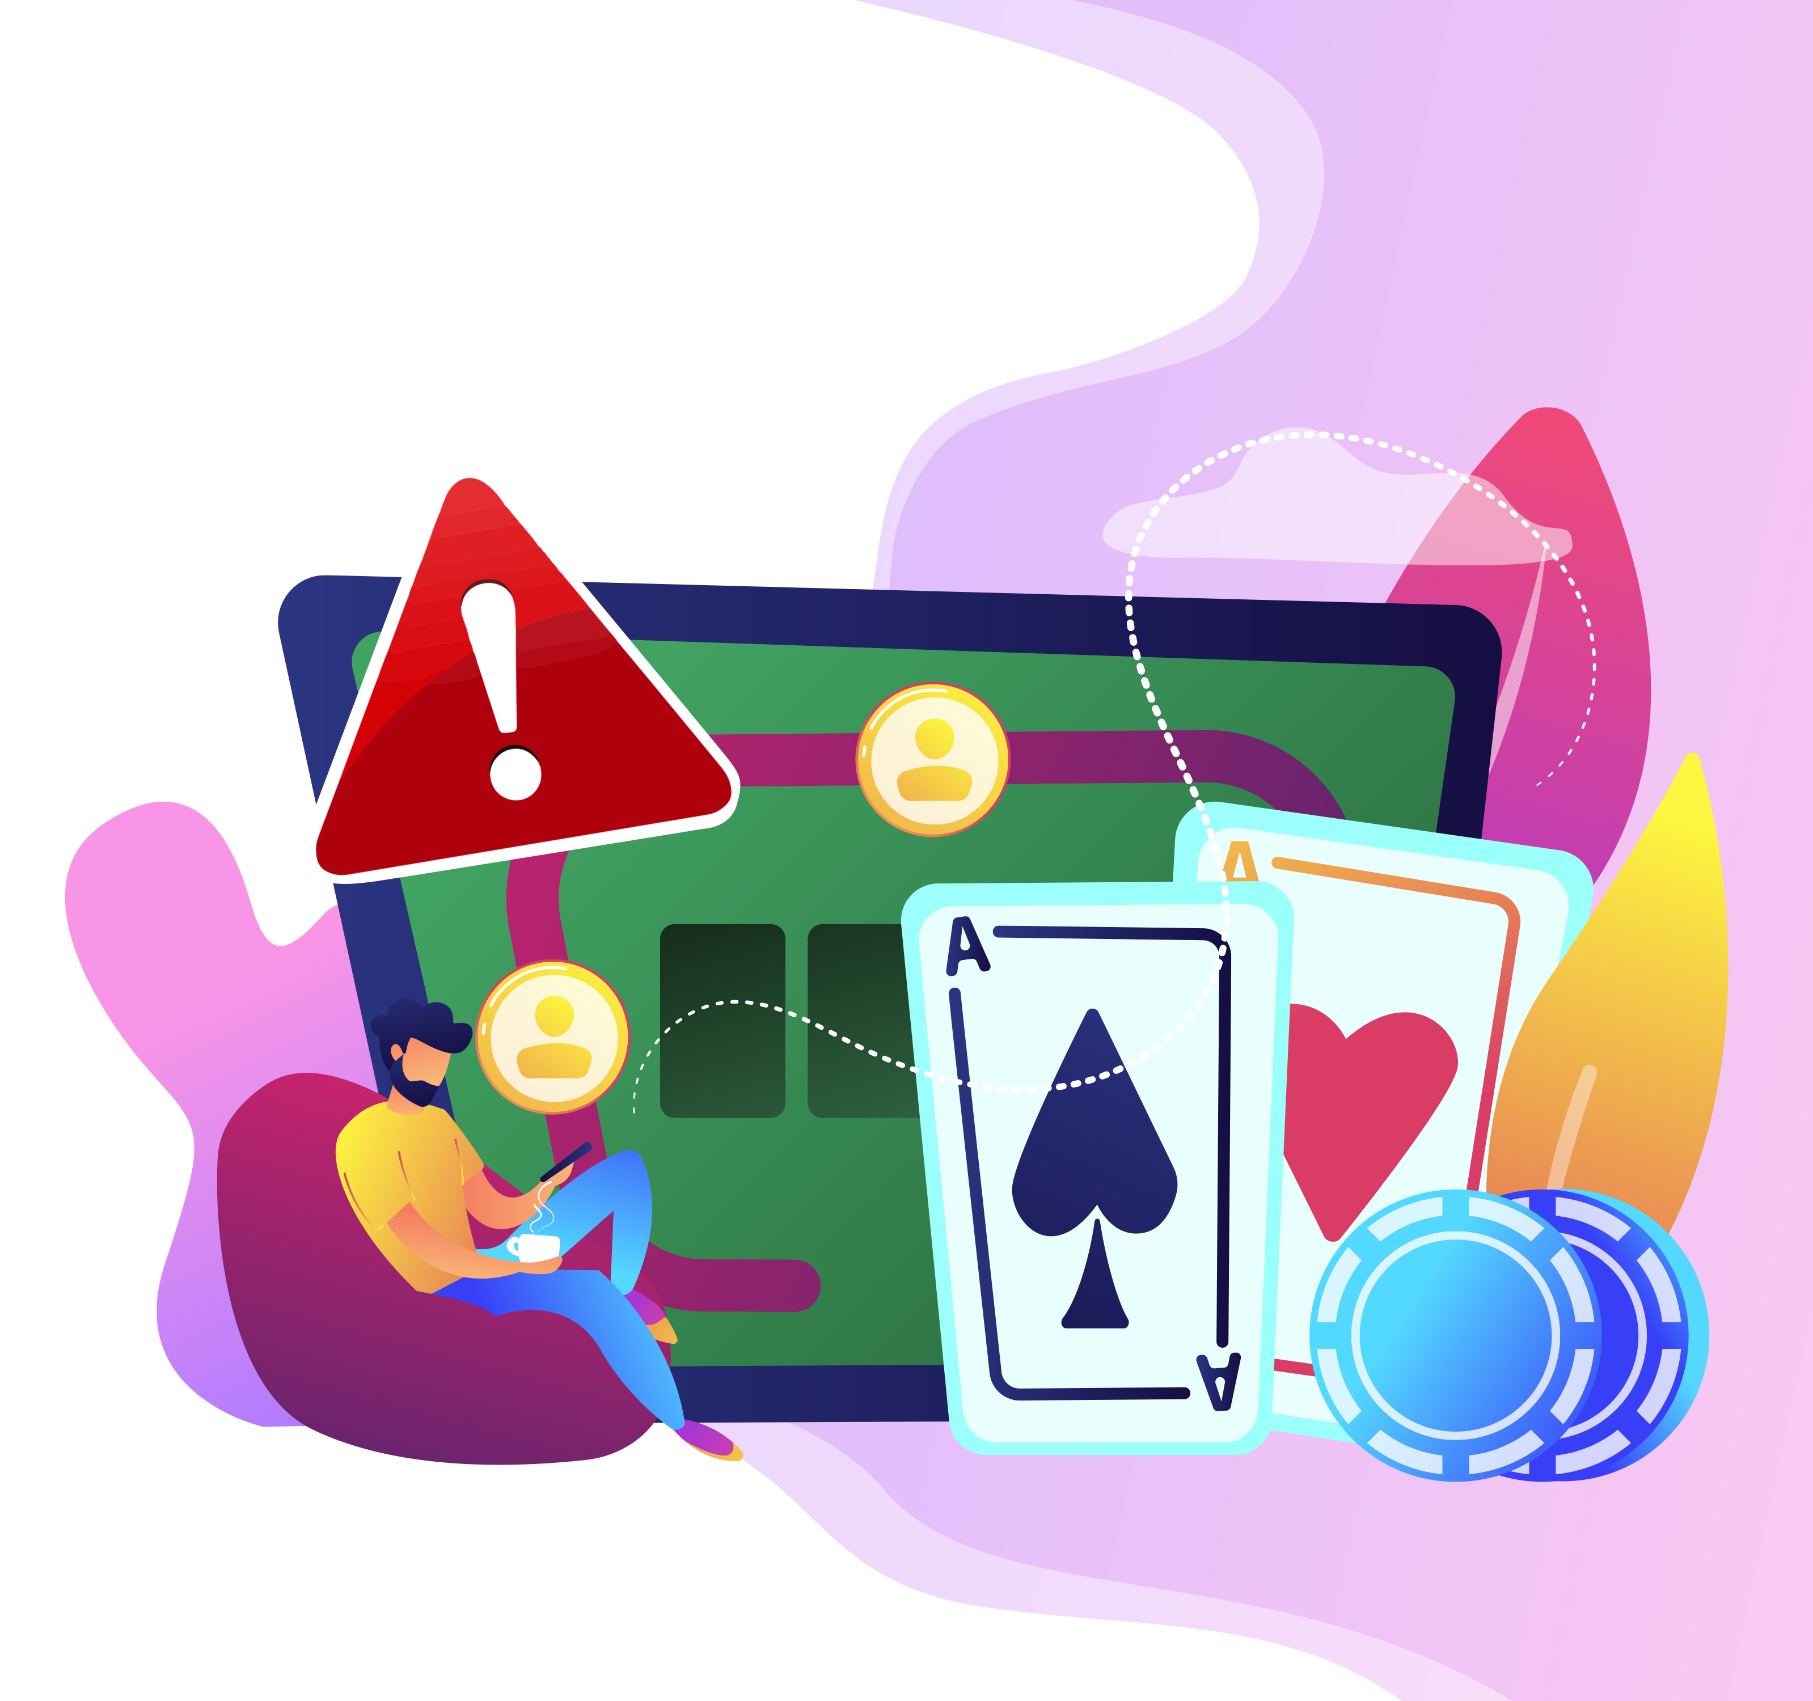
GAMBLING AND GAMING, THE POTENTIAL FOR HARM
YEAR 10 / LESSON 5

Slide 144
CHALLENGE
YEAR 10 / LESSON 5
Learn about health issues associated with gambling and/or gaming related harm by young people. Create a resource to help inform, educate and safeguard people from harm.

Slide 145
LEARNING OBJECTIVES
YEAR 10 / LESSON 5
To understand what is meant by gambling and gaming related harm
To understand the health issues that may arise from gambling and gaming related harm
To develop a resource to educate others
To be able to identify how and where to get help

Slide 146
LEARNING OUTCOMES
YEAR 10 / LESSON 5
I can define gambling and gaming related harm
I understand the health issues which may arise from gambling and gaming related harm
I can research information and use my knowledge to create a resource for others
I know where to get help if I am worried about my own or someone else’s relationship with gambling or gaming.

Slide 147
ACTIVITY: STAYING HEALTHY
YEAR 10 / LESSON 5
Health risks
How do you think gaming and gambling could effect your health?
List as many things as you can think of for gaming
List as many things as you can think of for gambling
Share and discuss your thoughts.
Gaming
Gambling
Sitting still for too long
Not taking enough breaks
Putting gaming in-front of real life
Getting into debt
Stealing to continue gambling Lying to friends and family

Slide 148
ACTIVITY: TIME TO TEACH
YEAR 10 / LESSON 5
In groups, create a resource to inform people about the potential health problems associated with gambling or gaming related harm.
You can choose who your resource is to be targeted at e.g. adults, teachers, parents, your peers or a younger age group.
You may wish to make a short film so you could write a script, create an app, write a blog, design a leaflet/poster etc.
Think about how can you prevent harm.

Slide 149
ACTIVITY: I AM PROUD TO PRESENT
YEAR 10 / LESSON 5
Option 1: Share your resource with the rest of the class
Option 2: Move around the class, exploring the work of each group

Slide 150
If you need help…
YEAR 10 / LESSON 5
If you are worried about any of the content today you can talk to a teacher or member of staff. For additional support relating to your own or someone else’s relationship with gambling/gaming you can contact Childline or GamCare.
YoungPeopleService@gamcare.org.uk
T: 02030926964

Slide 151
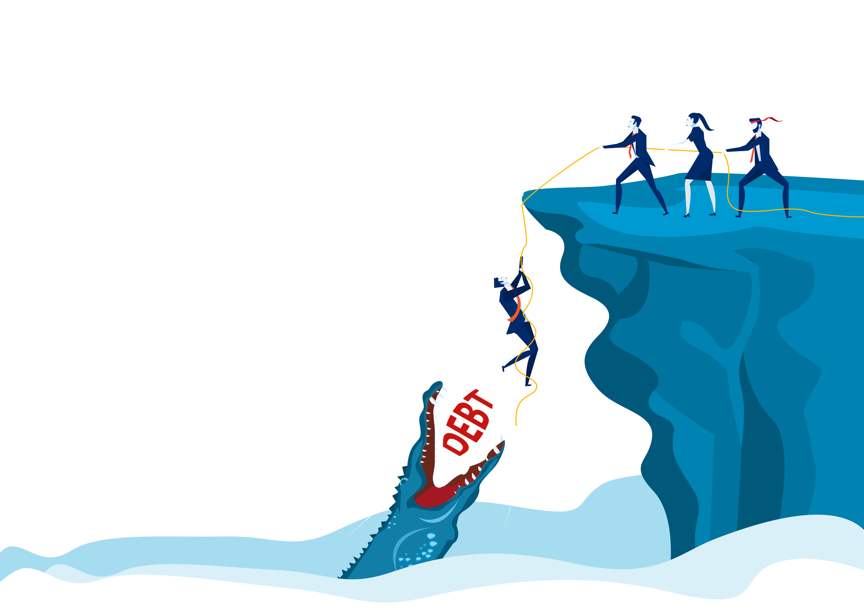
MONEY AND DEBT
YEAR 10 / LESSON 6

Slide 152
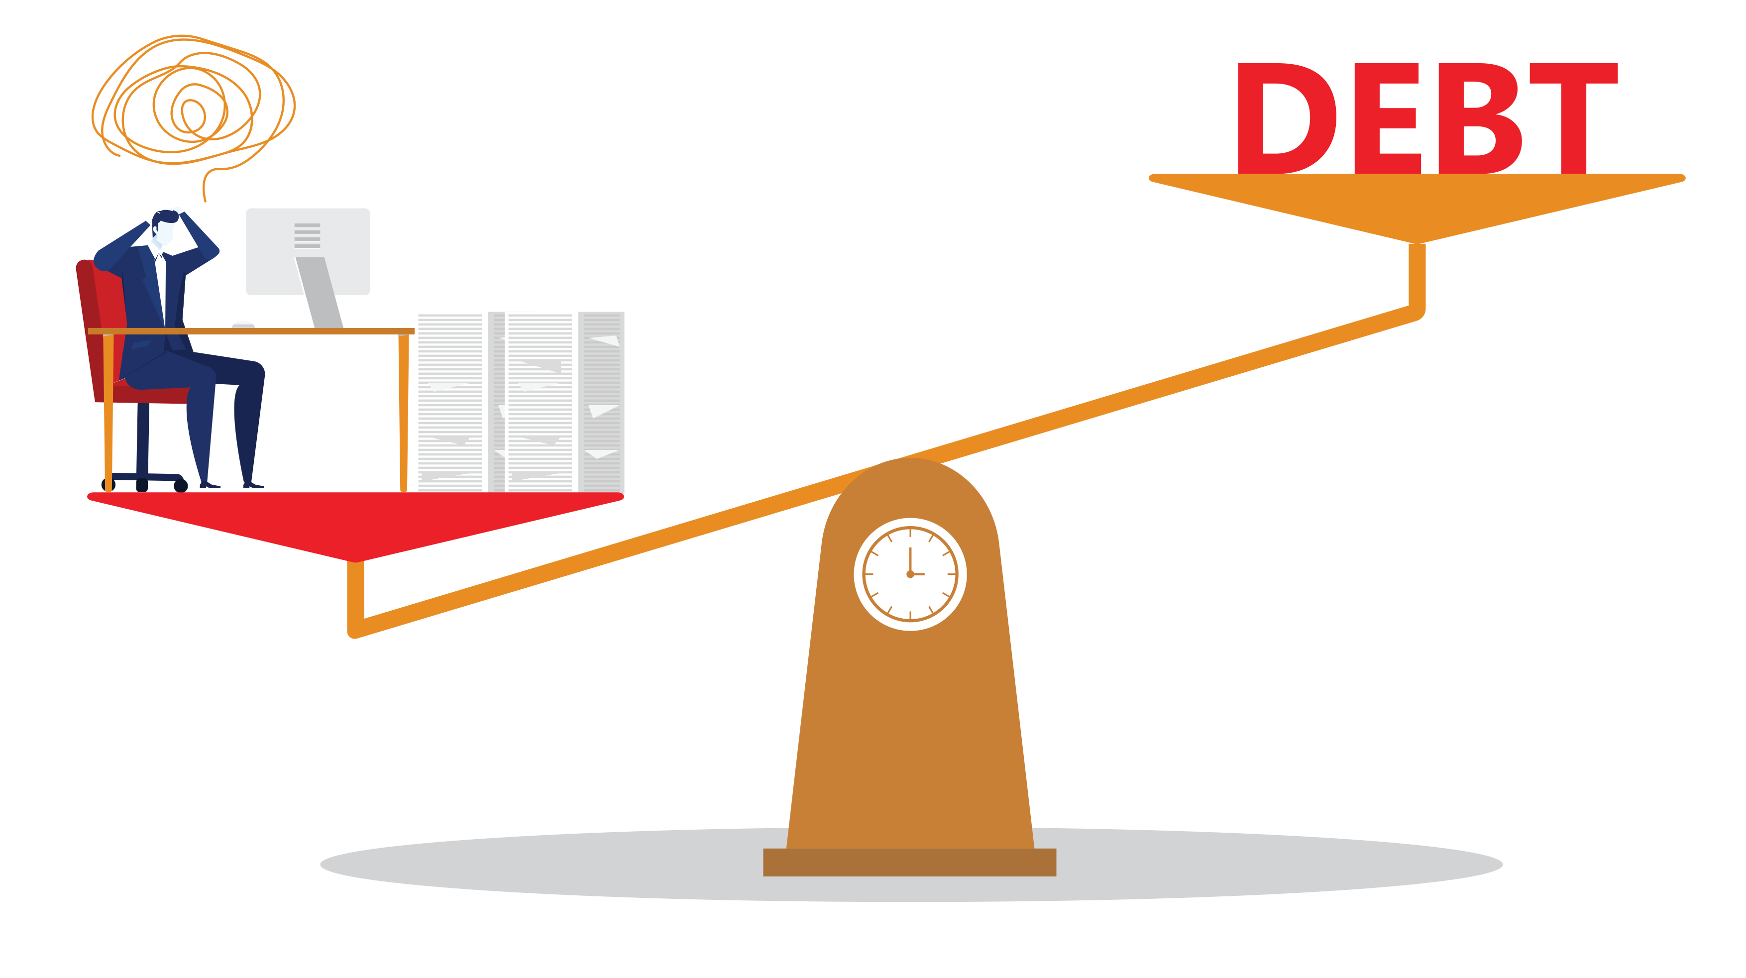
CHALLENGE
YEAR 10 / LESSON 6
Create a vocabulary list related to the risks of getting into debt

Slide 153
LEARNING OBJECTIVES
YEAR 10 / LESSON 6
To understand the term debt
To understand risks and consequences of getting into debt
To recognise that gambling and gaming could lead to debt problems
To be able to identify how and where to get help

Slide 154
LEARNING OUTCOMES
YEAR 10 / LESSON 6
I can define debt
I understand the risk and consequences of getting into debt
I understand that gambling and gaming can lead to debt problems
I know where to get help if I am worried about my own or someone else’s relationship with gambling or gaming.

Slide 155
ACTIVITY: AGREE / DISAGREE
YEAR 10 / LESSON 6
Stand up/sit down if you agree/disagree with the following statements:
Debt is part of life/being an adult
Borrowing money to gamble or game is okay
Saving money to spend on and in games is a responsible way to buy the items you want
Using your parents card to buy in-game items is fine.
Spending all your wages in one weekend on gambling or gaming is fine if you are careful the following month.
Taking out a loan to cover/consolidate your debt is a good idea.
You can have good and bad debt.

Slide 156
ACTIVITY: WHAT’S THE CONSEQUENCES?
YEAR 10 / LESSON 6
Task 1: 2-minute scribble.
List as many words/thoughts associated with the following questions. You have 2 minutes per question.
How many words related to money and debt you can think of?
What is debt?
Is debt ever acceptable?
What would you consider ‘acceptable’ debt?
What would you consider to be unacceptable debt?
What are the immediate consequences are debt?

Slide 157
ACTIVITY: WHAT’S THE CONSEQUENCES CONTINUED…
YEAR 10 / LESSON 6
Consequences
Task 2: Money and Debt definitions.
Write a definition for your responses in Task 1, Q1. Use a dictionary or IT to support you.
Task 3: What are the risks?
What are the risks of getting into debt?
List five risks, explaining what the consequences
are and the impact they may have on the
individual and their family/friends/community,
if applicable.
Money & Debt
Risks
Debt:
A sum of money that is owed or due
Unpaid bills
Unpaid rent

Slide 158
ACTIVITY: HEALTHY FINANCIAL HABITS
YEAR 10 / LESSON 6
List five things you think you could do to keep your finances in control.
Share your ideas.
1
3
5
2
4

Slide 159
If you need help…
YEAR 10 / LESSON 6
If you are worried about any of the content today you can talk to a teacher or member of staff. For additional support relating to your own or someone else’s relationship with gambling/gaming you can contact Childline or GamCare.
YoungPeopleService@gamcare.org.uk
T: 02030926964

