Slide 1
Gaming and Gambling: Bias and Ethics
KS5 / LESSON 1
V1.2/April21

Slide 2
CHALLENGE
KS5/ LESSON 1
How does gambling advertising work? Investigate the different types of advertising and the processes involved. How have things changed over time? Share your findings using photographs and/or diagrams.

Slide 3
LEARNING OBJECTIVES
KS5/ LESSON 1
To understand what is meant by the terms ‘the house always wins ’ and ‘House Edge’
To explore how marketing and advertising shifts might influence the perception of success.

Slide 4
LEARNING OUTCOMES
KS5/ LESSON 1
You can explain and define the terms ‘the house always wins’ and ‘House Edge’.
You can explore different marketing and advertising strategies
You can discuss the implications of marketing and advertising and share your own opinions

Slide 5
ACTIVITY: POST IT
KS5/ LESSON 1
How are games/gambling activities advertised and marketed?
Write your thoughts on post-its and post them on the board.

Slide 6
ACTIVITY: LET’S TALK ABOUT MARKETING AND ADVERTISING
KS5/ LESSON 1
What impact does marketing and advertising through sport have?
What impact do influencers and celebrity endorsements have?
What role does social media play? What’s the impact?
Do these advertisements ever show failure/losses? (for both gaming and gambling?)
Is gambling advertised in games? How are young people safeguarded?
Think of the games you play/have played are they set up with a fair chance of winning?

Slide 7
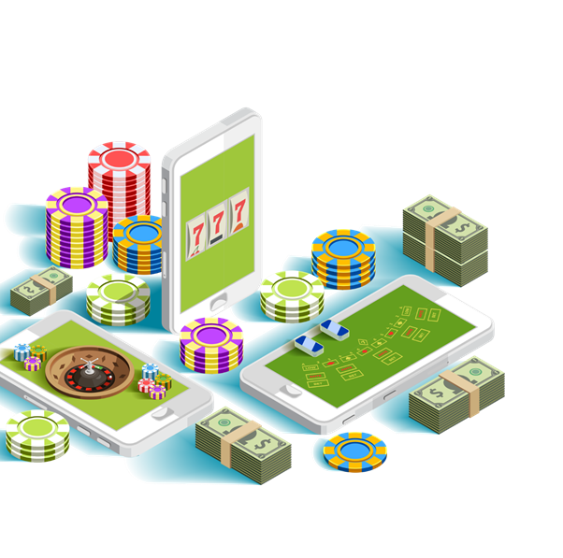
ACTIVITY: THE HOUSE ALWAYS WINS
KS5/ LESSON 1
Define the term ‘House Edge.’ What do people mean when they say the house always wins’? Does this apply to all forms of gambling?
This is the mathematical advantage that the gambling product and therefore, the gambling firm/venue has over the player. This advantage results in an assured percentage return.
(Casino.org)

Slide 8
ACTIVITY: LET’S DEBATE
KS5/ LESSON 1
Are the ads directly targeting children?
Children have reported seeing gambling adverts in the mobile games they play. Is this ethical?
There should be better legislation
The companies should be doing more
Should children be supervised?
Could there be more parental controls?

Slide 9
ACTIVITY: RAISING AWARENESS
KS5/ LESSON 1
In your groups, create a poster/leaflet/video to inform your peers of the impact of gaming and gambling advertising.
Consider:
What is the message of the advertising?
Who is the target audience?
Are young people protected?
How much is too much?
How can young people make informed choices?
What should the developers/industry owners be doing to safeguard people?
Group 1: Games
Group 2: Social media and influencers
Group 3: Sports

Slide 10
ACTIVITY: I PLEDGE…
KS5/ LESSON 1
As a team, create a pledge to share your work with one key audience e.g. in assemblies, around school, in the community, on social media etc.

Slide 11
If you need help…
KS5 / LESSON 1
If you are worried about any of the content today you can talk to a teacher or member of staff. For additional support relating to your own or someone else’s relationship with gambling/gaming you can contact Childline or GamCare.
YoungPeopleService@gamcare.org.uk
T: 02030926964

Slide 12
Gaming and Gambling: Safeguarding
KS5 / LESSON 2

Slide 13
LEARNING OBJECTIVES
KS5/ LESSON 2
To understand the current regulations and proposed recommendations
To explore safeguarding in relation to gambling and gaming

Slide 14
LEARNING OUTCOMES
KS5/ LESSON 2
Describe
01
You can describe current regulations and proposed recommendations
Explore
02
You can explore each industry’s role and responsibilities
Put forward
03
You can put forward justified arguments to your peers

Slide 15
ACTIVITY: CARD SORT
KS5/ LESSON 2
A) Sort the statements into two groups:
B) Discuss:
Are any of the answers surprising?
Is enough being done?
Who is responsible for putting regulations in place and monitoring them?
Who is responsible for safeguarding consumers, children and young people?
Card sort
Current regulations
Proposed regulations

Slide 16
ACTIVITY: LET’S INVESTIGATE
KS5/ LESSON 2
Each group has an industry card. Create a presentation of the following:
What is your industry currently doing to support safer gaming/gambling?
What issues are still present within the industry?
What do you plan to do to improve upon current regulations?

Slide 17
ACTIVITY: WE PROUDLY PRESENT
KS5/ LESSON 2
Present your findings and pledges to the wider group.
Each group should take positive and constructive feedback.

Slide 18
If you need help…
KS5 / LESSON 2
If you are worried about any of the content today you can talk to a teacher or member of staff. For additional support relating to your own or someone else’s relationship with gambling/gaming you can contact Childline or GamCare.
YoungPeopleService@gamcare.org.uk
T: 02030926964

Slide 19
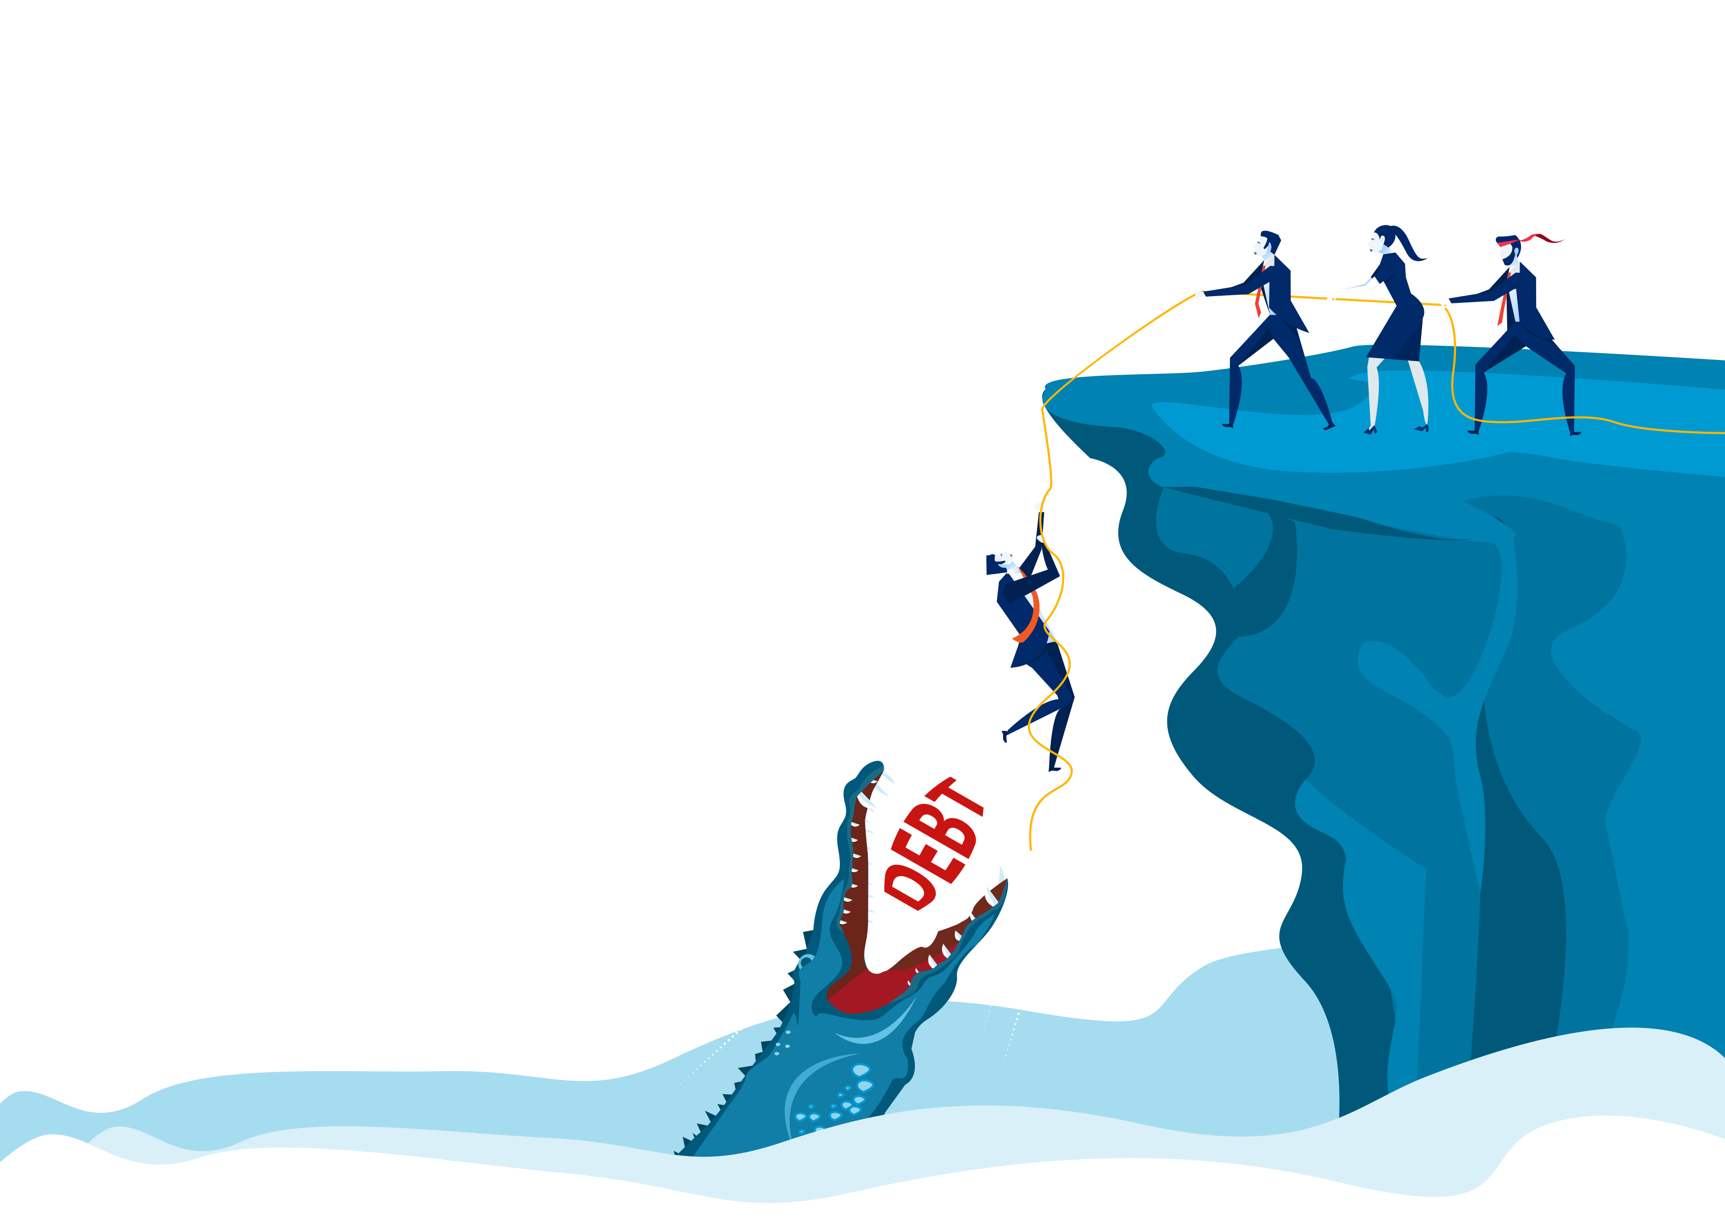
Finances, Debt and Support
KS5 / LESSON 3

Slide 20
LEARNING OBJECTIVES
KS5/ LESSON 3
To understand the potential impact of debt and how to manage personal finances
To explore the term safeguarding and understand the need to safeguard at risk people/ groups

Slide 21
LEARNING OUTCOMES
KS5/ LESSON 3
Describe
You can describe the risks and the impacts of debt
Identify
You can identify ways to manage your personal finances
Explore
You can explore safeguarding in relation to gambling and at-risk people

Slide 22
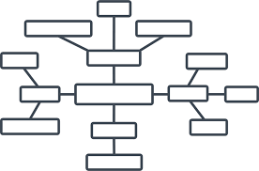
ACTIVITY: MIND MAP
KS5/ LESSON 3
Create a mind map of the risks/impacts of debt. Consider the impacts on the individual and the wider community, both in the present and the future.
How might young people spend their money? Do they ever mismanage their money? What would this look like, what might they do ?
How might young people find themselves in debt?

Slide 23
ACTIVITY: GROUP CHAT
KS5/ LESSON 3
Discuss the following:
What can individuals do to manage their finances?
Who else is responsible for supporting financial management e.g. banks, financial advisors, education, apps, suppliers etc.? What about in relation to gambling? What duty of care do the providers have to the individual?

Slide 24
ACTIVITY: FINANCIAL PLANNING
KS5/ LESSON 3
In groups, read your scenario card and create a financial plan that includes both individual and industry-based interventions.
Consider key industry interventions.

Slide 25
ACTIVITY: WE PROUDLY PRESENT
KS5/ LESSON 3
Present your financial plan to the wider group.

Slide 26
If you need help…
KS5 / LESSON 3
If you are worried about any of the content today you can talk to a teacher or member of staff. For additional support relating to your own or someone else’s relationship with gambling/gaming you can contact Childline or GamCare.
YoungPeopleService@gamcare.org.uk
T: 02030926964

Slide 27
Gaming, Gambling and Mental Health
KS5 / LESSON 4

Slide 28
LEARNING OBJECTIVES
KS5/ LESSON 4
To understand how to identify gaming and gambling related harm
To explore strategies for maintaining physical and mental well being

Slide 29
LEARNING OUTCOMES
KS5/ LESSON 4
You can differentiate between healthy and harmful relationships with gaming/gambling
1
You can empathise with someone experiencing gaming/gambling related harm
2
You can identify a range of strategies for maintain positive mental health
3

Slide 30
ACTIVITY: STAND UP IF…
KS5/ LESSON 4
When your teacher reads out the activities, stand up if you have ever taken part in the activity. If you haven’t, stay seated.

Slide 31
ACTIVITY: HEALTH VS. HARM
KS5/ LESSON 4
Create a mind-map of the signs and symptoms of gaming and gambling related harm
addiction
debt
anger

Slide 32
ACTIVITY: IN THEIR SHOES
KS5/ LESSON 4
In groups, use the scenario you have been given to create a short radio/ written interview, playing the role stated on the cards.
Consider:
the behaviours of someone experiencing gaming/gambling related harm
the wider impact on their mental health
the impact on those around them
strategies for maintaining/rebuilding positive mental health and wellbeing

Slide 33
ACTIVITY: POST IT
KS5/ LESSON 4
On post-its, post strategies for maintaining positive mental health.

Slide 34
If you need help…
KS5 / LESSON 4
If you are worried about any of the content today you can talk to a teacher or member of staff. For additional support relating to your own or someone else’s relationship with gambling/gaming you can contact Childline or GamCare.
YoungPeopleService@gamcare.org.uk
T: 02030926964

Slide 35
Esports and Professional Gaming
KS5 / LESSON 5

Slide 36
LEARNING OBJECTIVES
KS5/ LESSON 5
To explore the career opportunities within the gaming industry
To evaluate the impact of Esports on mental health and wellbeing

Slide 37
LEARNING OUTCOMES
KS5/ LESSON 5
You can identify a range of career opportunities in gaming
You can explain the benefits and risks of pursuing a career in professional gaming
You can identify a range of strategies to maintain and promote physical and mental wellbeing

Slide 38
ACTIVITY: WHAT JOBS ARE OUT THERE?
KS5/ LESSON 5
List as many job opportunities within the gaming sector as you can think of. Examples include programmers, artists, voice actors, commentators, e-sports athlete etc.
Esports are one of the fastest growing sectors in the UK, meaning opportunities are growing rapidly.
GAMING SECTOR JOBS
Artist
Voice actor
Programmer
Athlete

Slide 39
ACTIVITY: LET’S ADVERTISE
KS5/ LESSON 5
Choose a job from the starter task and create a quick job advertisement with the relevant requirements.

Slide 40
ACTIVITY: BENEFITS AND RISKS
KS5/ LESSON 5
What are the risks of applying for gaming jobs?
As a whole group, let’s discuss…
How can young people mitigate these risks?
What are the benefits of applying for gaming jobs?

Slide 41
ACTIVITY: FINAL THOUGHTS
KS5/ LESSON 5
Has the session changed your mind with regards to careers?
What are your thoughts on today’s session?
Has anything surprised you?

Slide 42
If you need help…
KS5 / LESSON 5
If you are worried about any of the content today you can talk to a teacher or member of staff. For additional support relating to your own or someone else’s relationship with gambling/gaming you can contact Childline or GamCare.
YoungPeopleService@gamcare.org.uk
T: 02030926964

Slide 43
Let’s Open Up On Loot Boxes!
KS5 / LESSON 6

Slide 44
LEARNING OBJECTIVES
KS5/ LESSON 6
To understand the nature of microtransactions and loot boxes in particular
To evaluate current and proposed legislation

Slide 45
LEARNING OUTCOMES
Describe
You can describe microtransactions and loot boxes
Research
You can research the current legislation
Evaluate
You can evaluate the proposed legislation
KS5/ LESSON 6

Slide 46
ACTIVITY: CAROUSEL
KS5/ LESSON 6
Carousel
Devices used to play games
Gambling style features in games
In game purchases/
items
Ways to purchase things within games
Move around the room and add to each mind map as part of a carousel.
Devices used to play games
Gambling style features in games
In game purchases/items
Ways to purchase things within a game

Slide 47
ACTIVITY: LET’S DEBATE
KS5/ LESSON 6
Does it reduce the overall cost of games, therefore giving more people access?
Is spending money online acceptable?
Option 1) Loot boxes should be prohibited to those over 18 years of age .
Option 2) In-app purchases should be banned from games all together.
Should there be a spending limit?
Is it different to buying card packs in shops e.g. football stickers?

Slide 48
ACTIVITY: POST IT
KS5/ LESSON 6
Post a Tweet or Hashtag to sum up the session on loot boxes and in-game purchases.

Slide 49
If you need help…
KS5 / LESSON 6
If you are worried about any of the content today you can talk to a teacher or member of staff. For additional support relating to your own or someone else’s relationship with gambling/gaming you can contact Childline or GamCare.
YoungPeopleService@gamcare.org.uk
T: 02030926964

