Slide 1
KS4 PSHE DROP DOWN DAY – ACTIVITIES
©YGAM 2020: All rights reserved
Using this document
We recognise each school is different and the time allocated for PSHE delivery differs as well as the method of delivery.
This document has four options for delivery of Gaming and Gambling Education for KS4 and takes the form of optional drop down activities. There is a 1 hour, 2 hour, half day and full day session available. The notes to support you in your delivery can be found in the KS4 folder. These are suggested activities but you may wish to create your own.
You could also use these sessions to compliment the SOW we have for KS4.
V1.1/Dec20

Slide 2
PSHE DROP DOWN DAY
KS4 PSHE DROP DOWN DAY – 1 HOUR
KS4 1 HOUR ACTIVITY

Slide 3
HOW IS GAMBLING ADVERTISED AND MARKETED?
KS4 PSHE DROP DOWN DAY – 1 HOUR
KS4 1 HOUR ACTIVITY

Slide 4
TODAY’S AIMS
KS4 PSHE DROP DOWN DAY – 1 HOUR
The aim of today is to:
Increase your awareness of gambling related harm.
Increase understanding of how gambling is advertised and marketed.
You should be able to:
I understand what gambling is.
I can identify different advertising and marketing strategies used by gambling companies.

Slide 5
WHAT DO WE KNOW?
KS4 PSHE DROP DOWN DAY – 1 HOUR
What is Gambling?
What might harm look like?
Discuss in your group and agree a definition.

Slide 6
WHAT IS GAMBLING?
KS4 PSHE DROP DOWN DAY – 1 HOUR

Slide 7
60 SECOND SCRIBBLE
KS4 PSHE DROP DOWN DAY – 1 HOUR
You have 60 seconds to write down as many marketing strategies you can think of that may be used by a gambling or gaming brand.
Let’s hear some of your ideas.

Slide 8
HOW ADVERTISING HAS CHANGED
KS4 PSHE DROP DOWN DAY – 1 HOUR

Slide 9
HOW ADVERTISING HAS CHANGED
KS4 PSHE DROP DOWN DAY – 1 HOUR
Sheffield University
Goldsmiths University.
Premier League Teams 19/20. 50% shirt sponsorship=Gambling company.

Slide 10
CURRENT LEGISLATION
KS4 PSHE DROP DOWN DAY – 1 HOUR
In 2005, the Gambling Act was introduced. This aimed to protect young and vulnerable people, as well as regulate gambling companies. However, it also allowed gambling companies to advertise more freely. In 2019 the Whistle to whistle ban was introduced which means that 5 minutes before, during and 5 minutes after a game on (before watershed) gambling adverts are not allowed to feature. This does not extend to radio.

Slide 11
ACTIVITY: MARKETING- RESEARCH.
YEAR 11 / LESSON 5
Discuss these key facts with the person next to you.
Ipsos Mori published a report in March 2020 on behalf of GambleAware.
It found:
96% of the 11-24 year old participants had been exposed to gambling marketing messages in the last month.
More than four out of five (85%) aged 11-24 reported seeing gambling advertising on TV (including national lottery adverts).
70% of children and young people noticed gambling adverts in betting shops on the high street, window displays as well as promotions on shop floors and near tills.
Two-thirds (66%) reported seeing gambling promotions on their social media channels
Source: https://www.ipsos.com/sites/default/files/ct/publication/documents/2020-03/gambling-marketing-advertising-effect-young-people-final-report.pdf
What are your immediate observations?

Slide 12
YOUR TASK TODAY
KS4 PSHE DROP DOWN DAY – 1 HOUR
Split into teams and prepare to debate the following statement: ‘ALL ADVERTISING OF GAMBLING PRODUCTS SHOULD BE BANNED IN ORDER TO SAFGUARD CHILDREN AND YOUNG PEOPLE’
Your Teacher will put you in to groups and assign FOR or AGAINST.
You should spend time developing your arguments and discussing how you will respond to the arguments of the opposing teams.

Slide 13
IF YOU NEED HELP:
KS4 PSHE DROP DOWN DAY – 1 HOUR
If you are worried about any of the content today you can talk to a teacher or member of staff. For additional support relating to your own or someone else’s relationship with gambling/gaming you can contact Childline or BigDeal.

Slide 14
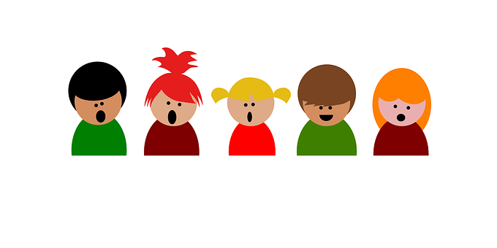
REFLECTIONS:
KS4 PSHE DROP DOWN DAY – 1 HOUR
Who do you feel holds the responsibility of ensuring young and vulnerable people are protected against gambling harms?
Where can you go for help?
?

Slide 15
PSHE DROP DOWN DAY
KS4 PSHE DROP DOWN DAY – 2 HOUR
KS4 2 HOUR Activity

Slide 16
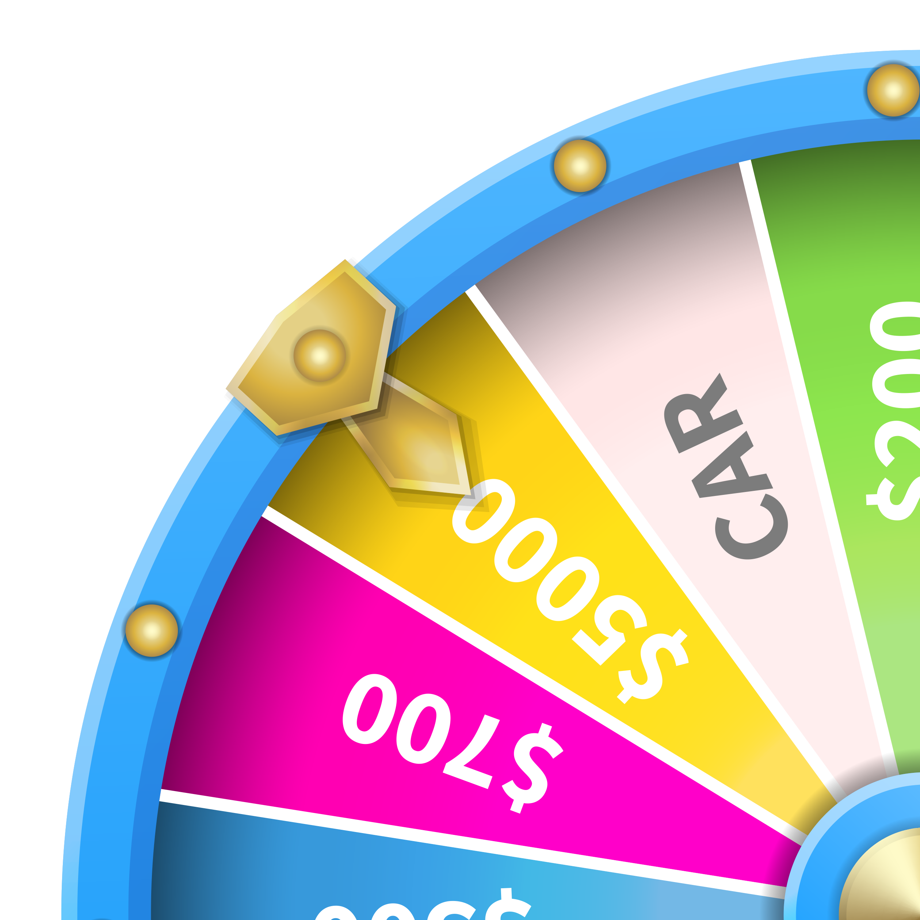
PROBABILITY AND LUCK
KS4 PSHE DROP DOWN DAY – 2 HOUR
KS4 2 HOUR ACTIVITY

Slide 17
TODAY’S AIMS
KS4 PSHE DROP DOWN DAY – 2 HOUR
The aim of today is to:
Understand the meaning of terms: ‘the Gambler’s Fallacy’ and the ‘House Edge.’
Understand the nature of probability and odds.
You should be able to:
Describe what is meant by ‘the Gambler’s Fallacy’ and ‘House Edge’
Understand how probability and luck play a role in gambling and gaming.
Understand the term ‘The house always wins’.
Explain the bias nature of gambling.

Slide 18
STAND UP IF…
KS4 PSHE DROP DOWN DAY – 2 HOUR
You know what probability means
You know what luck means
You have a lucky number
You have a lucky item or token e.g. to get you through exams
Someone you know plays the same ‘lucky’ numbers on the lottery each week
You think some people are born lucky

Slide 19
THINK, PAIR, SHARE
KS4 PSHE DROP DOWN DAY – 2 HOUR
In pairs, think about and discuss what you think the following two terms mean.
‘Probability’
‘Luck’
As a group, create and agree upon a definition for each term.

Slide 20
THE GAMBLER’S FALLACY
KS4 PSHE DROP DOWN DAY – 2 HOUR
The Gambler’s Fallacy: The false belief that something is more likely to happen based on what has happened by chance previously e.g. “I’ve flipped two tails, the next one must be heads”.

Slide 21
INVESTIGATING PROBABILITY
KS4 PSHE DROP DOWN DAY – 2 HOUR
What is the probability of getting heads? And tails?
If I toss the coin 3 times in a row, could I get heads each time?
If I toss the coin 300 times in a row, could I get heads each time?

Slide 22
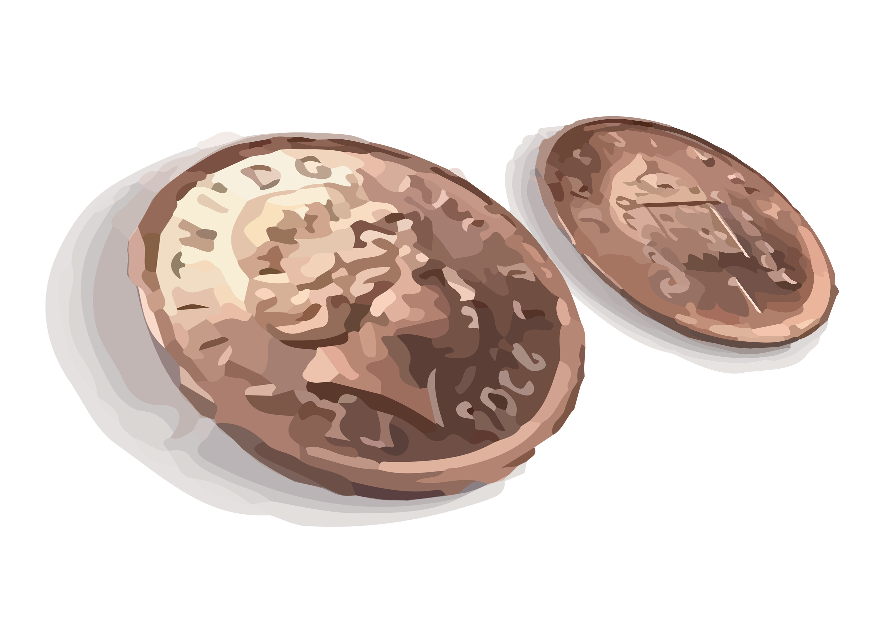
INVESTIGATING PROBABILITY
KS4 PSHE DROP DOWN DAY – 2 HOUR
A coin is being passed around the room. When it is your turn, toss the coin and tell us your result. We will record all the results and see what the average result is.
Consider does one outcome determine the next?

Slide 23
INVESTIGATING PROBABILITY
KS4 PSHE DROP DOWN DAY – 2 HOUR
The more we toss the coin, the more likely the overall results will be around 50/50. This is called the ‘law of averages’. This law applies to all gambling also.

Slide 24
LET’S DISCUSS!
KS4 PSHE DROP DOWN DAY – 2 HOUR
Do you think consumers have a fair chance of winning?
Discuss and share you thoughts.

Slide 25
LET’S DISCUSS!
KS4 PSHE DROP DOWN DAY – 2 HOUR
Their products never give the player a fair chance of winning
The gambling industry is a business. The income comes from people who play and lose money. The phrase ‘the house always wins’ is used to describe this advantage; they are always more likely to win.
No!
I think most people expect to lose so it’s a bonus if they do win something.

Slide 26
YOUR TASK TODAY
KS4 PSHE DROP DOWN DAY – 2 HOUR
In pairs or groups, create a short activity that demonstrates how probability, odds and luck work. You will be able to test this activity out on another pair or group.
Ideas: Card game, dice game, coloured counters, player cards etc.

Slide 27
TEST YOUR ACTIVITY
KS4 PSHE DROP DOWN DAY – 2 HOUR
Share you activity with the rest of the group.

Slide 28
IF YOU NEED HELP…
KS4 PSHE DROP DOWN DAY – 2 HOUR
If you are worried about any of the content today you can talk to a teacher or member of staff. For additional support relating to your own or someone else’s relationship with gambling/gaming you can contact Childline or BigDeal.

Slide 29
REFLECTIONS:
KS4 PSHE DROP DOWN DAY – 2 HOUR
What do we mean by ‘Gambler’s Fallacy’?
Is it OK for gambling companies to make the odds in their favour? Why/why not?
Where can you go for help?
?

Slide 30
PSHE DROP DOWN DAY
KS4 PSHE DROP DOWN DAY – HALF DAY
KS4 HALF DAY ACTIVITY

Slide 31
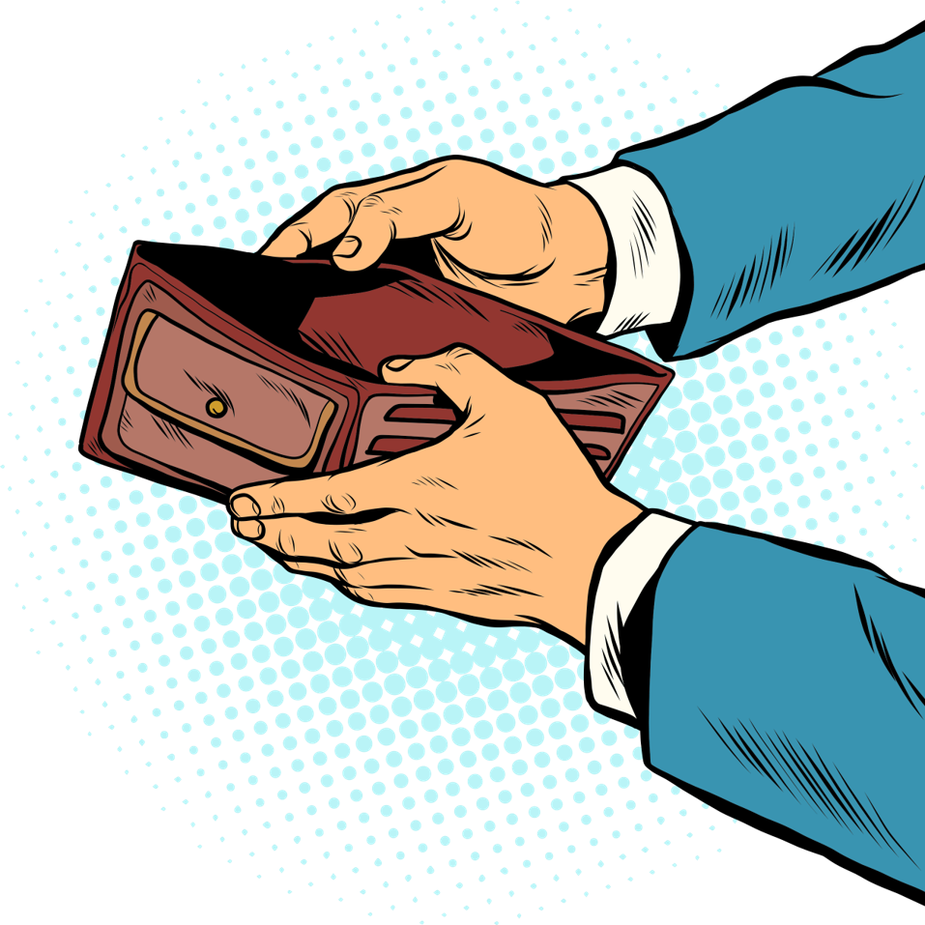
GAMBLING AND GAMING: MONEY AND DEBT
KS4 PSHE DROP DOWN DAY – HALF DAY
KS4 HALF DAY ACTIVITY

Slide 32
TODAY’S AIMS
KS4 PSHE DROP DOWN DAY – HALF DAY
The aim of today is to:
Increase your awareness of gaming and gambling related harm.
To understand how gambling can affect finances.
To identify ways to manage personal finances.
You should be able to:
Describe the link between gambling and finances.
Explore other activities and ways to spend money.
Identify ways to manage finances.
Reflect upon current and future spending.
Know where to get help.

Slide 33
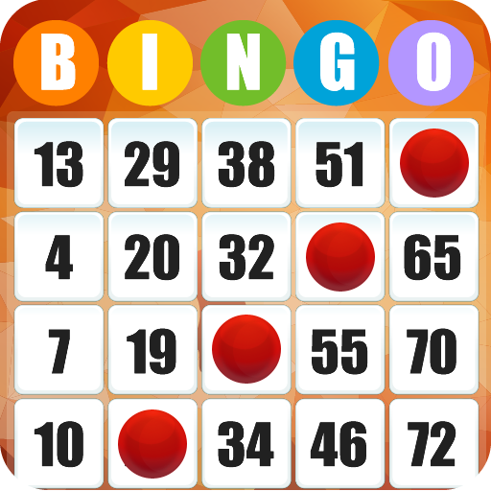
PEOPLE BINGO
KS4 PSHE DROP DOWN DAY – HALF DAY
has spent money on a loot box
has spent money on a slot machine e.g. at seaside arcades
has put a bet on a sports event
has gambled with friends on a game
has spent more than £10 on a bet
has spent more than £25 on an in-app purchase
has used their parent/carer’s card to pay for a bet or in-app purchase
has used their pocket money to gamble
Has never gambled

Slide 34
THE FACTS
KS4 PSHE DROP DOWN DAY – HALF DAY
The Gambling Commission ‘Young People and Gambling 2019’ survey.
11% of 11-16 year olds have spent their own money on gambling in the last week.
private bets,fruit machines, and scratch cards are the most common forms of gambling within young people.
Young people who gamble spend an average of £17 per week.
Boys are around twice as likely to gamble as girls (13% v 7%)
44% have paid money to open a loot box
6% have bet with in-game items.
6% have used their parents account to gamble

Slide 35
GAMBLING AND MONEY: LET’S DISCUSS
KS4 PSHE DROP DOWN DAY – HALF DAY
Do you think that it is easy to spend money on gambling as a young person? Why might they do it?
How might they do it?
Why not?
Why?

Slide 36
GAMBLING AND MONEY: LET’S DISCUSS
KS4 PSHE DROP DOWN DAY – HALF DAY
A large number of 11-16 year olds own their own phone
On these devices we can play 100s games for free, but many feature gambling mechanisms such as roulette wheels or slot machines and microtransactions
These games are not classed as gambling because they use virtual currency, however users are encouraged to BUY virtual currency/ or items with real currency.
What are your views on microtransactions?

Slide 37
GAMBLING AND DEBT: LET’S DISCUSS
KS4 PSHE DROP DOWN DAY – HALF DAY
When does spending money on gambling become a problem?
Do you have to spend a lot before it becomes an issue?

Slide 38
RESPONSIBLE SPENDING
KS4 PSHE DROP DOWN DAY – HALF DAY
In pairs or groups, create a mind map of alternate ways to spend money as a young person.
THOUGHT SHOWER

Slide 39
YOUR TASK TODAY
KS4 PSHE DROP DOWN DAY – HALF DAY
In small groups, write and perform a drama piece around debt brought on by gambling problems for a young person or young people. You can base this on money and debt issues or other appropriate financial problems.
Consider how the young person may recover from debt
How else might a young person spend their money?
Let’s perform our drama pieces!

Slide 40
YOUR TASK TODAY
KS4 PSHE DROP DOWN DAY – HALF DAY
Let’s share our work

Slide 41
IF YOU NEED HELP…
KS4 PSHE DROP DOWN DAY – HALF DAY
If you are worried about any of the content today you can talk to a teacher or member of staff. For additional support relating to your own or someone else’s relationship with gambling/gaming you can contact Childline or BigDeal.

Slide 42
PSHE DROP DOWN DAY
KS4 PSHE DROP DOWN DAY – FULL DAY
KS4 FULL DAY ACTIVITY

Slide 43
GAMBLING/GAMING: ADDICTION AND MENTAL HEALTH
KS4 PSHE DROP DOWN DAY – FULL DAY
KS4 FULL DAY ACTIVITY

Slide 44
TODAY’S AIMS
KS4 PSHE DROP DOWN DAY – FULL DAY
The aim of today is to:
Increase your awareness of gaming and gambling related harm.
Recognise the signs of gambling/gaming related harm.
Understand how where to go for support.
You should be able to:
Recognise the signs of a gaming and gambling-related harm
Identify different strategies to prevent gaming or gambling related harm.
Know where to go for help.

Slide 45
60 SECOND SCRIBBLE
KS4 PSHE DROP DOWN DAY – FULL DAY
Define gambling.
Define gaming.
Define gaming and gambling related harm.
Note: Not all gambling and gaming is problematic, however there is risk with both activities.

Slide 46
DRAW IT!
KS4 PSHE DROP DOWN DAY – FULL DAY
Discuss and annotate the images with the key signs that someone has a problem with gambling or gaming.
Share your work with the group.

Slide 47
SPOTTING THE SIGNS: PROBLEMATIC GAMBLING
KS4 PSHE DROP DOWN DAY – FULL DAY

Slide 48
SPOTTING THE SIGNS: GAMING DISORDER
KS4 PSHE DROP DOWN DAY – FULL DAY

Slide 49
THE RISK LADDER
KS4 PSHE DROP DOWN DAY – FULL DAY
You have been given several cards, each with a different gambling or gaming scenario.
Place the scenarios on the risk ladder, with least risky at the bottom and most risky at the top.
What could be done to reduce harm?

Slide 50
RISK LADDER
KS4 PSHE DROP DOWN DAY – FULL DAY
Share your work with the group.

Slide 51
YOUR TASK TODAY
KS4 PSHE DROP DOWN DAY – FULL DAY
Use the rest of the day to design a campaign to raise young people’s awareness around debt and other harms brought on by gambling and/ or gaming.
Key areas to focus on:
Title/Slogan
Medium used to deliver campaign (YouTube, Instagram, poster, podcast…)
Audience (primary, secondary, youth club, sports club)
Key information
Signposting to support services such as BigDeal
Hashtag or Twitter Handle

Slide 52
PRESENTATION TIME
KS4 PSHE DROP DOWN DAY – FULL DAY
Present your campaign to the group.

Slide 53
IF YOU NEED HELP…
KS4 PSHE DROP DOWN DAY – FULL DAY
If you are worried about any of the content today you can talk to a teacher or member of staff. For additional support relating to your own or someone else’s relationship with gambling/gaming you can contact Childline or BigDeal.

Slide 54
REFLECTIONS:
KS4 PSHE DROP DOWN DAY – FULL DAY
What are the signs of a gambling related harm?
What are the signs of gaming disorder?
Where can you go for help?
?

