Slide 1
KS3 PSHE DROP DOWN DAY – ACTIVITIES
©YGAM 2020: All rights reserved
Using this document
We recognise each school is different and the time allocated for PSHE delivery differs as well as the method of delivery.
This document has four options for delivery of Gaming and Gambling Education for KS3 and takes the form of optional drop down activities. There is a 1 hour, 2 hour, half day and full day session available. The notes to support you in your delivery can be found in the KS3 folder. These are suggested activities but you may wish to create your own.
You could also use these sessions to compliment the SOW we have for KS3.
V1.2/April21

Slide 2
PSHE DROP DOWN DAY
KS3 PSHE DROP DOWN DAY – 1 HOUR
KS3 1 HOUR (Optional)

Slide 3
DOES GAMING SIMULATE GAMBLING?
KS3 PSHE DROP DOWN DAY – 1 HOUR
KS3 1 HOUR ACTIVITY

Slide 4
TODAY’S AIMS
KS3 PSHE DROP DOWN DAY – 1 HOUR
The aim of today is to:
Increase your awareness of gaming and gambling related harm
To increase your understanding of how probability and luck are related to gaming and gambling
You should be able to:
Recognise the subtle links between gaming and gambling
Understand how probability and luck relate to gaming and gambling
Know where to go for help

Slide 5
STAND UP IF…
KS3 PSHE DROP DOWN DAY – 1 HOUR
You have a lucky number
You have ever been given a scratch card
You ate breakfast before coming to school
You know the name of a bookmakers
You have a sister
You play football
You know what a loot box is
You know what is meant by probability
You’ve ever paid to open a lootbox

Slide 6
60 SECOND SCRIBBLE
KS3 PSHE DROP DOWN DAY – 1 HOUR
You have 60 seconds to scribble down as many ideas related to each of the following:
Some people are luckier than others
Microtransaction in games are just like gambling

Slide 7
WHAT IS GAMBLING?
KS3 PSHE DROP DOWN DAY – 1 HOUR
BETTING
GAMING
LOTTERY

Slide 8
WHAT IS GAMING?
KS3 PSHE DROP DOWN DAY – 1 HOUR
Playing electronic games, whether through consoles, computers, mobile phones etc

Slide 9
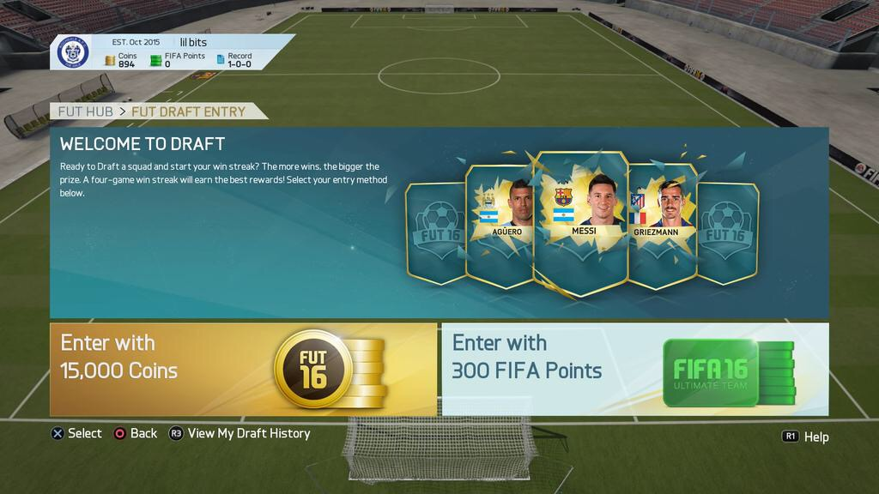
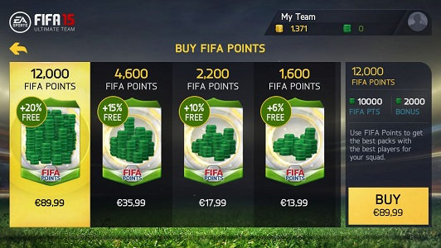
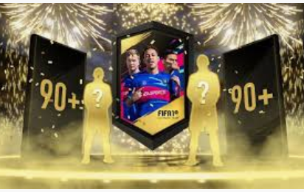
MICROTRANSACTIONS
KS3 PSHE DROP DOWN DAY – 1 HOUR
Anything you pay extra for in a video game outside the cost of the initial purchase.
Examples: loot boxes, Fifa Packs, skins and customisations etc.

Slide 10
WHAT ARE THE CHANCES?
KS3 PSHE DROP DOWN DAY – 1 HOUR
Did you know the probability of you ever getting Ronaldo (gold card) are:
1 out of 150’000 Source: Goal.com Information true as of April 2020.

Slide 11
THE BLURRED LINES
KS3 PSHE DROP DOWN DAY – 1 HOUR
10 games out of 22 met criteria to be considered as gambling (Massay University)
"Because they require no player skill and have a randomly determined outcome or prize, they function similarly to scratch tickets or gambling slot machines.“ Belgium Gambling Commission.

Slide 12
YOUR TASK TODAY
KS3 PSHE DROP DOWN DAY – 1 HOUR
Design a leaflet for people receiving their first ever gaming console/tablet for gaming. The leaflet would be in the box and users could read it before they play.
What tips would you provide to help them stay safe?

Slide 13
IF YOU NEED HELP…
KS3 PSHE DROP DOWN DAY – 1 HOUR
If you are worried about any of the content today you can talk to a teacher or member of staff. For additional support relating to your own or someone else’s relationship with gambling/gaming you can contact Childline or GamCare.
YoungPeopleService@gamcare.org.uk
T: 02030926964

Slide 14
REFLECTIONS
KS3 PSHE DROP DOWN DAY – 1 HOUR
Do you think there are any links between gaming and gambling?
Where can you go for help?
?

Slide 15
PSHE DROP DOWN DAY
KS3 PSHE DROP DOWN DAY – 2 HOUR
KS3 2 HOUR ACTIVITY

Slide 16
WHAT’S THE RISK?
KS3 PSHE DROP DOWN DAY – 2 HOUR
KS3 2 HOUR ACTIVITY

Slide 17
TODAY’S AIMS
KS3 PSHE DROP DOWN DAY – 2 HOUR
The aim of today is to:
Increase your awareness of gambling related harm
Help you to spot the signs
Give you the tools and information to get help
You should be able to:
Recognise why some young people may gamble
Understand what is meant by gambling related harm
Know what signs to look for
Know where to go for help

Slide 18
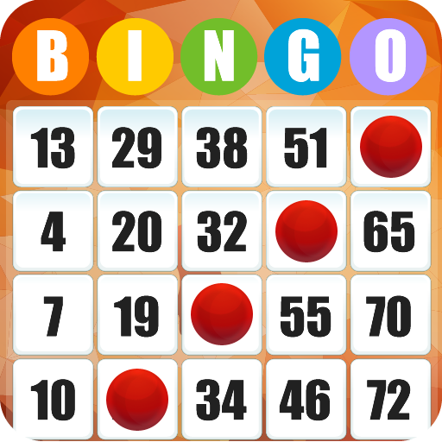
PEOPLE BINGO: FIND SOMEONE WHO..
KS3 PSHE DROP DOWN DAY – 2 HOUR
Has ever won a prize in bingo
Has two siblings
Has been given a scratch card
Has chosen a horse for the grand national or similar event
Has had breakfast before coming to school
Had paid to open a loot box
Has visited seaside arcades and put money in the fruit machines
Knows someone who has won money on the national lottery
Whose favourite food is Pizza
Has played cards for money
Has never gambled

Slide 19
WHY MIGHT YOUNG PEOPLE GAMBLE?
KS3 PSHE DROP DOWN DAY – 2 HOUR
Work in pairs and list the reasons you think young people might gamble?

Slide 20
LET’S THINK ABOUT THE RISKS?
KS3 PSHE DROP DOWN DAY – 2 HOUR
Create a thought shower: What does gambling -related harm look like?
Are there any physical signs? Is it easy/difficult to see?
THOUGHT SHOWER

Slide 21
WHAT’S THE IMPACT?
KS3 PSHE DROP DOWN DAY – 2 HOUR
Work in groups of 3 to 4. Think about how gambling could impact on the following people/categories:
The individual
The family
The wider social network
Your community
Share your responses.

Slide 22
YOUR TASK TODAY
KS3 PSHE DROP DOWN DAY – 2 HOUR
Work in groups of 4-5. Discuss:
1) have you ever/do you gamble, Why/Why not?
2) how much do you/have you spent?
3) work out the average spend per week in your group.
Did you know in a 2019 Study by the Gambling commission they found the average amount of money spent in the last 7 days by children/young people age 11-16 was £17.00
Can you work out how much your group could save in:
1 month
1 year
5 years
How would you choose to spend that money? You could write an individual response or a group response

Slide 23
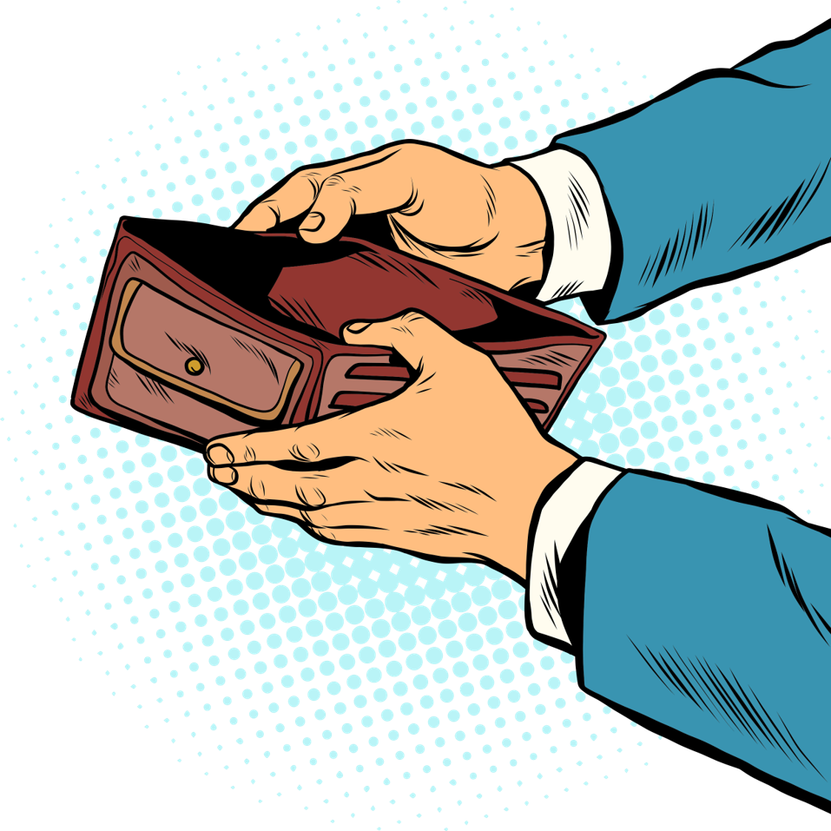
LET’S SHARE
KS3 PSHE DROP DOWN DAY – 2 HOUR
Share how you/your group might spend the money.

Slide 24
IF YOU NEED HELP…
KS3 PSHE DROP DOWN DAY – 2 HOUR
If you are worried about any of the content today you can talk to a teacher or member of staff. For additional support relating to your own or someone else’s relationship with gambling/gaming you can contact Childline or GamCare.
YoungPeopleService@gamcare.org.uk
T: 02030926964

Slide 25
REFLECTIONS
KS3 PSHE DROP DOWN DAY – 2 HOUR
Why do young people gamble?
What are the risks?
Where can you go for help?
?

Slide 26
PSHE DROP DOWN DAY
KS3 PSHE DROP DOWN DAY – HALF DAY
KS3 HALF DAY ACTIVITY

Slide 27
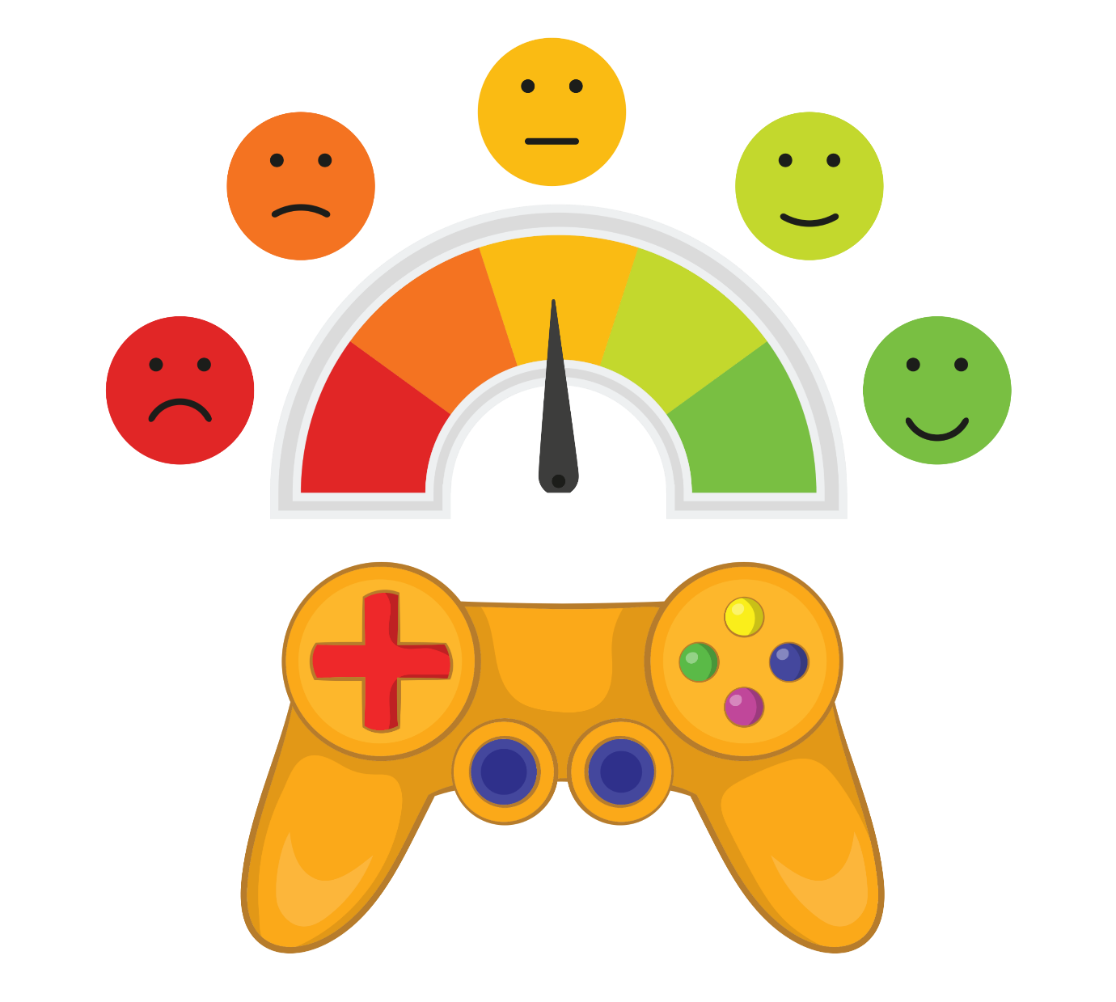
GAMING AND YOUR HEALTH AND WELL-BEING
KS3 PSHE DROP DOWN DAY – HALF DAY
KS3 HALF DAY ACTIVITY

Slide 28
TODAY’S AIMS
KS3 PSHE DROP DOWN DAY – HALF DAY
The aim of today is to:
Increase your awareness of the risks associated with gaming
You should be able to:
Recognise why gaming is such a popular sport/hobby
List the positive and negative aspects of gaming
Recognise key aspects of health and well-being, including mental well being
Know where to go for help

Slide 29
AGREE / DISAGREE AND REASON
KS3 PSHE DROP DOWN DAY – HALF DAY
Adults biggest worry about kids gaming is the time they spend online
Gaming can lead to gambling
Gaming companies should always tell you the odds of winning items in microtransactions
In-game purchases should not feature in games children play
It must be great to be a professional gamer
Adults biggest worry about kids gaming is strangers talking to young people online
Gaming is a risk-free activity
Most adults disapprove of gaming

Slide 30
WHY DO PEOPLE GAME?
KS3 PSHE DROP DOWN DAY – HALF DAY
Working in small teams create a thought shower listing all the reasons why young people might choose to game. You could use your own experiences of gaming, if you do so.
THOUGH SHOWER

Slide 31
GAMING IS MUCH SAFER THAN HANGING AROUND WITH FRIENDS ON AN EVENING
KS3 PSHE DROP DOWN DAY – HALF DAY
In groups you should debate for or against: Gaming is a much safer than hanging around with friends on an evening.
For each you will need to consider the risks. You should also consider what can be done to mitigate the risks.
Prepare for a 3 minute debate with 1 minute for questions. You will be timed.

Slide 32
WHEN DOES A HOBBY BECOME AN ISSUE? WHAT MIGHT GAMING-RELATED HARM LOOK LIKE?
KS3 PSHE DROP DOWN DAY – HALF DAY
List the signs you might be able to identify if someone is experiencing gaming related harm.

Slide 33
SPOTTING THE SIGNS: GAMING DISORDER
KS3 PSHE DROP DOWN DAY – HALF DAY

Slide 34
HOW CAN GAMING BE PART OF A HEALTHY BALANCED LIFESTYLE
KS3 PSHE DROP DOWN DAY – HALF DAY
What measures could be put in place to safeguard physical and mental health?
In pairs look at the risks, how could you overcome these? Record your answers.

Slide 35
WORK IN SMALL GROUPS TO CREATE ONE OF THE FOLLOWING
KS3 PSHE DROP DOWN DAY – HALF DAY
a resource for parents to provide them with the pros and cons of gaming, the potential risks and what they can do to support their child.
a resource for children to help them think about the balancing gaming with other activities and hobbies

Slide 36
IF YOU NEED HELP…
KS3 PSHE DROP DOWN DAY – HALF DAY
If you are worried about any of the content today you can talk to a teacher or member of staff. For additional support relating to your own or someone else’s relationship with gambling/gaming you can contact Childline or GamCare.
YoungPeopleService@gamcare.org.uk
T: 02030926964

Slide 37
REFLECTIONS:
KS3 PSHE DROP DOWN DAY – HALF DAY
Why do people game?
Can you list one positive and one negative?
Can you list an example of a sign of gaming related harm?
Do you know how and where to get help?
?

Slide 38
PSHE DROP DOWN DAY
KS3 PSHE DROP DOWN DAY – FULL DAY
KS3 FULL DAY ACTIVITY

Slide 39
GAMING, GAMBLING AND EVERYTHING IN BETWEEN
KS3 PSHE DROP DOWN DAY – FULL DAY
KS3 FULL DAY ACTIVITY

Slide 40
TODAY’S AIMS
KS3 PSHE DROP DOWN DAY – FULL DAY
The aim of today is to:
Increase your understanding and awareness of gaming and gambling related harm
empower you with the tools to recognise risk and know how to mitigate risk
Enable you to get help if you are worried about your own or someone else's relationship with gaming and gambling
You should be able to:
Recognise risk and suggest ways to minimise or mitigate
Recognise that gaming and gambling have the potential to cause harm
Know how and where to get help if you are worried about gaming or gambling
Recognise the signs of gaming disorder and gambling harm

Slide 41
GAMBLING NAME GAME
KS3 PSHE DROP DOWN DAY – FULL DAY
NAME GAME
Say your first name and a word starting with the same letter related to gambling OR gaming
Gambling or Gaming
Name
BEN
FIONA
PETER
SARAH
BINGO
FIFA
POKER
SOLITARE

Slide 42
HUMAN BINGO - ANSWERS
KS3 PSHE DROP DOWN DAY – FULL DAY
What’s the minimum age for buying a lottery ticket? 16 | What is the minimum age to go into a casino? 18 | How many clocks are there in total in Las Vegas Casinos? 0
What is a microtransaction? In a nutshell- any purchase made during a game | Can name 3 bookies PaddyPower/Ladbrookes Coral/ BetFred/ Wiliam Hill | Can list a risk associated with of gambling Relationships/family struggles Debts, Mental ill health
Can list somewhere to get help for gaming or gambling-related harm Teacher, childline, GamCare, NHS/GP | Can name 3 gaming companies Nintendo, Sony, Microsoft, Tencent, Apple, EA, Nintendo, Namco, Ubisoft | Can list a risk associated with of gaming mental ill health, carpel tunnel syndrome/ sleeping difficulties/ challenges with/ school work

Slide 43
RISKY BEHAVIOUR
KS3 PSHE DROP DOWN DAY – FULL DAY
Look at images below. Working in pairs, identify the risk and then order the risks from least to most ‘risky.’
Share your thoughts, why have you put them in that order? What’s the potential harm?
Is there a way that you could reduce the risk for each activity? Write down one suggestion for each activity. Does that change the ordering at all?

Slide 44
HOW WOULD YOU FEEL
KS3 PSHE DROP DOWN DAY – FULL DAY
Polly’s fondest memories growing up were visiting his grandparents in the school holidays. They would often take her to the arcades to play games. She would play on the penny slots and sometimes on the fruit machine with her Grandma. She remembers her Grandma winning a lot of money on the fruit machine, she was so happy, and Polly felt amazing, they jumped around and celebrated. Polly loved seeing how happy she was, and she had a great day spending the winnings with her. She could not wait to go back and win more money.
At home, she struggled. School was a constant challenge and Polly felt like she didn’t have any friends or anyone to talk to. She didn’t want to worry her parents and so kept things to herself. To keep her spirits up she often reminisced of the time at her grandparents and counted down the days until the next school holidays. Polly wanted to experience the same feelings of winning, the excitement and fun. She began thinking about playing the slot machines all the time. She wondered if she could do it online and if she would feel the same.

Slide 45
PUT YOURSELF IN THEIR SHOES
KS3 PSHE DROP DOWN DAY – FULL DAY
What behaviours might they exhibit?
What behaviours do they exhibit?
How do they feel?
What might they say?
What might they say?
What are they thinking?
What might they hear?
Share your work

Slide 46
AWARENESS CAMPAIGN
KS3 PSHE DROP DOWN DAY – FULL DAY
Use the rest of the day to design a campaign to raise awareness about the potential harm of gaming and or gambling.
Work in teams to consider how you:
Get your message out to your audience
What key message you want to include
What medium your campaign will be delivered in. E.g. Via social media, an educational film, podcast, posters/billboard
You will need:
A title
A slogan
And a #

Slide 47
SHARE YOUR CAMPAIGN
KS3 PSHE DROP DOWN DAY – FULL DAY

Slide 48
IF YOU NEED HELP…
KS3 PSHE DROP DOWN DAY – FULL DAY
If you are worried about any of the content today you can talk to a teacher or member of staff. For additional support relating to your own or someone else’s relationship with gambling/gaming you can contact Childline or GamCare.
YoungPeopleService@gamcare.org.uk
T: 02030926964

Slide 49
REFLECTIONS
KS3 PSHE DROP DOWN DAY – FULL DAY
What are the potential risks of gaming and gambling?
What are the signs of gambling/gaming related harm?
Where can you go for help?
EXIT TICKET- what has been the most useful thing that you have learned?
?

