Slide 1
V1.0/Mar21
NCS 2HR ACTIVITIES
The Following PowerPoint Activities relate to the 2 hour activities and session plans which can be located in the NCS resource section. All resources can be found alongside the lesson plans. We have mapped each session to the NCS Programme Quality Framework and the core curriculum topics as well as the Skills Builder Framework.
CONTENTS:
Case Studies
Addiction and Mental Health
Legislation
Blurred Lines
Gaming
Safeguarding
©YGAM 2021: All rights reserved

Slide 2
NCS/2HOUR OPTION 1
V1.0/Mar21
GAMBLING: CASE STUDIES
CASE STUDIES
Cause and Consequence?
NCS. Option 1
©YGAM 2021: All rights reserved

Slide 3
NCS/2HOUR OPTION 1
V1.0/Mar21
AIMS AND OUTCOMES
AIMS
Understand what gambling is and why some people do it
Understand how addiction may impact an individual and those around them
Recognise the signs of harm and understand what support is available
OUTCOMES
You understand why some young people may/may not gamble
You understand how addiction may impact an individual and those around them
You understand what support is available and you know how to seek help
You can explore case studies and identify signs of harm
©YGAM 2021: All rights reserved

Slide 4
NCS/2HOUR OPTION 1
V1.0/Mar21
DISCUSSION: WHY SOME YOUNG PEOPLE GAMBLE
Research from the Gambling Commission 2019 found that 350,000 11-16 year olds had gambled in the last week.
TASK: using Post it notes, identify all the reasons why young people may/may not gamble
©YGAM 2021: All rights reserved

Slide 5
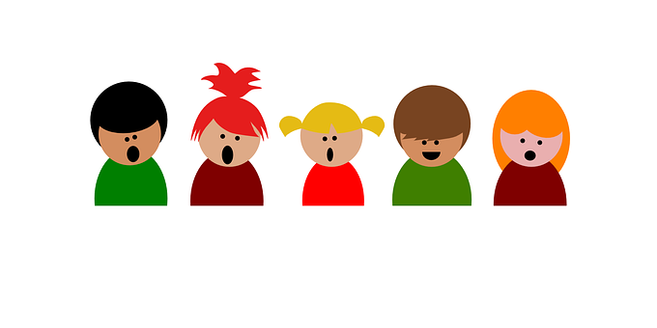
NCS/2HOUR OPTION 1
V1.0/Mar21
DISCUSSION: WHY SOME YOUNG PEOPLE GAMBLE
MY PARENTS / GUARDIAN DO IT
10%
IT’S COOL
11%
I LIKE TO TAKE RISKS
13%
PEER PRESSURE
6%
IT’S FUN
55%
Gambling Commission 2019
©YGAM 2021: All rights reserved

Slide 6
NCS/2HOUR OPTION 1
V1.0/Mar21
DISCUSSION: ANY SURPRISES?
In small groups, discuss the reasons some young people identified for gambling.
Does any of this surprise you?
Consider that most gambling is restricted to over 18s
What are the risks to young people, now and in the future?
Think of reasons people choose not to gamble.
©YGAM 2021: All rights reserved

Slide 7
NCS/2HOUR OPTION 1
V1.0/Mar21
ACTIVITY: CASE STUDY RESEARCH
OPTION 1:
Listen to the Podcast
OPTION 2:
Resource: Sam’s Story.
This will be printed for you.
Research the reasons why young people gamble and the impact on their health and wellbeing. In small groups, use the material to help create an educational podcast or resource.
©YGAM 2021: All rights reserved

Slide 8
NCS/2HOUR OPTION 1
V1.0/Mar21
ACTIVITY: CAUSE AND CONSEQUENCE
Explore the causes and consequences of gambling addiction:
Are there any other influences/factors, e.g. advertising, social norms, promotions by the industry etc?
What might the consequences of harmful gambling be? Categorise these under the headers below
OPTION 1:
Use of IT / Internet
Health and Wellbeing
Financial
Crime
©YGAM 2021: All rights reserved

Slide 9
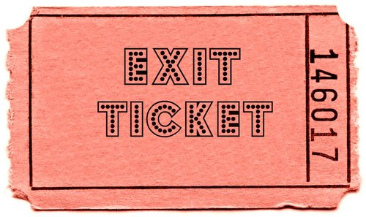
NCS/2HOUR OPTION 1
V1.0/Mar21
ACTIVITY: EXIT TICKET
OPTION 1:
Use of IT / Internet
What advice would you give to someone who might be struggling with gambling?
©YGAM 2021: All rights reserved

Slide 10
NCS / 2HOUR: OPTION 1
V1.0/Mar21
SIGNPOSTING OPTIONS
Speak to a member of staff
Young People Support service:
YoungPeopleService@gamcare.org.uk
T: 02030926964
National Gaming Clinic and Gambling Clinics
©YGAM 2021: All rights reserved

Slide 11
NCS/2HOUR OPTION 2
V1.0/Mar21
ADDICTION AND MENTAL HEALTH
ADDICTION AND MENTAL HEALTH
How might gambling affect our wellbeing?
NCS. Option 2
©YGAM 2021: All rights reserved

Slide 12
NCS/2HOUR OPTION 2
V1.0/Mar21
AIMS AND OUTCOMES
Understand why physical and mental health are important to our wellbeing
Recognise the signs of gambling addiction
AIMS
OUTCOMES
You can articulate how physical and mental health are important to your wellbeing
You understand that gambling can affect mental wellbeing
You are able to recognise the signs of gambling addiction and related harms
You can create a timeline which might map an individual’s journey
©YGAM 2021: All rights reserved

Slide 13
NCS/2HOUR OPTION 2
V1.0/Mar21
DISCUSSION: GAMBLING
SPEND 5 MINUTES DISCUSSING:
What is gambling?
What are the risks to young people?
What is addiction?
How might addiction affect mental and physical health?
©YGAM 2021: All rights reserved

Slide 14
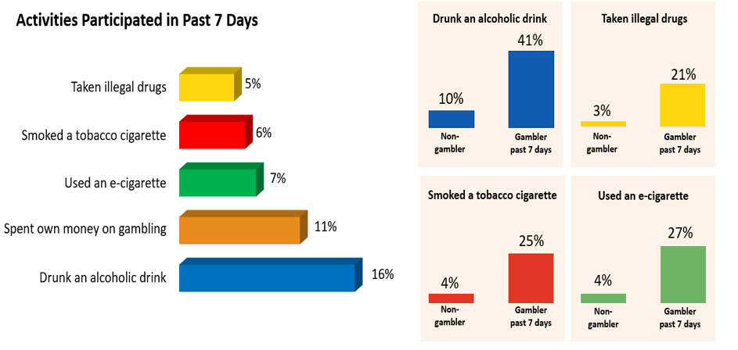
NCS/2HOUR OPTION 2
V1.0/Mar21
YOUNG PEOPLE AND RISKS
What does this research show us?
How does gambling compare to other risky behaviours?
How might these risky behaviours affect young people?
If a young person was experiencing issues with alcohol/drugs would it be easier to spot than gambling?
Gambling Commission 2019
©YGAM 2021: All rights reserved

Slide 15
NCS/2HOUR OPTION 2
V1.0/Mar21
ACTIVITY CAROUSEL
TASK 1: Create a collage /mood board to show how addiction impacts well being.
TASK 2: Create a storyboard and or short film to demonstrate how gambling addiction might affect a young person.
TASK 3: Create an information sheet to highlight the potential risks for young people. Ensure you provide signposting options.
SHARE YOUR WORK WITH THE REST OF THE GROUP
©YGAM 2021: All rights reserved

Slide 16
NCS/2HOUR OPTION 2
V1.0/Mar21
ACTIVITY: POST-IT
On post-it notes, write down one thing you are going to do this week to look after your mental health and one thing to look after your physical health.
Tweet responses to @YGAMuk with the hashtags:
#MentalHealth
#PhysicalHealth
#Wellbeing
©YGAM 2021: All rights reserved

Slide 17
NCS / 2HOUR: OPTION 2
V1.0/Mar21
SIGNPOSTING OPTIONS
Speak to a member of staff
Young People Support service:
YoungPeopleService@gamcare.org.uk
T: 02030926964
National Gaming Clinic and Gambling Clinics
©YGAM 2021: All rights reserved

Slide 18
NCS/2HOUR OPTION 3
V1.0/Mar21
LEGISLATION
LEGISLATION
Past, Present, Future
NCS. Option 3
©YGAM 2021: All rights reserved

Slide 19
NCS/2HOUR OPTION 3
V1.0/Mar21
AIMS AND OUTCOMES
AIMS
Understand how gambling is regulated
Understand the current recommendations
OUTCOMES
You understand gambling legislation and how organisations are regulated
You will be able to understand recommendations to improve safety and offer your own viewpoint
©YGAM 2021: All rights reserved

Slide 20
NCS/2HOUR OPTION 3
V1.0/Mar21
ACTIVITY: QUIZ TIME
The first iPhone was released in 2017
TRUE
The Gambling Act was published in 2005
TRUE
50,000 CYP are classified as problem gamblers
FALSE
The majority of young people first gambled with their parents
TRUE
14% students who gambled considered dropping out of university
FALSE
1 in 4 students at risk of developing a problem with gambling
TRUE
The House of Lords Select Committee called for loot boxes to be regulated under the Gambling Act in Summer 2020
TRUE
©YGAM 2021: All rights reserved

Slide 21
NCS/2HOUR OPTION 3
V1.0/Mar21
DISCUSSION: THE GAMBLING ACT
The 2005 Gambling Act:
Removed the membership requirements for casinos and bingo halls
Allowed casinos, bookmakers and online betting sites to advertise their services on TV and radio in the UK for the first time
Permitted UK-based companies to offer online gambling services
The Gambling Act Review:
The Government announced on 8th December 2020 that the Gambling Act will be reviewed
A 16-week call for evidence ended on 31st March 2021
©YGAM 2021: All rights reserved

Slide 22
NCS/2HOUR OPTION 3
V1.0/Mar21
RESEARCH: THE GAMBLING ACT
Explore the document ‘Young People and Gambling.’
What current measures are in place to protect children and young people? Is this enough?
Explain your answer: Is there any more that could be done? What do you suggest? What were the new proposals?
Now think about loot boxes. What measures are in place?
What about games which simulate gambling but only involve virtual currency?
©YGAM 2021: All rights reserved

Slide 23
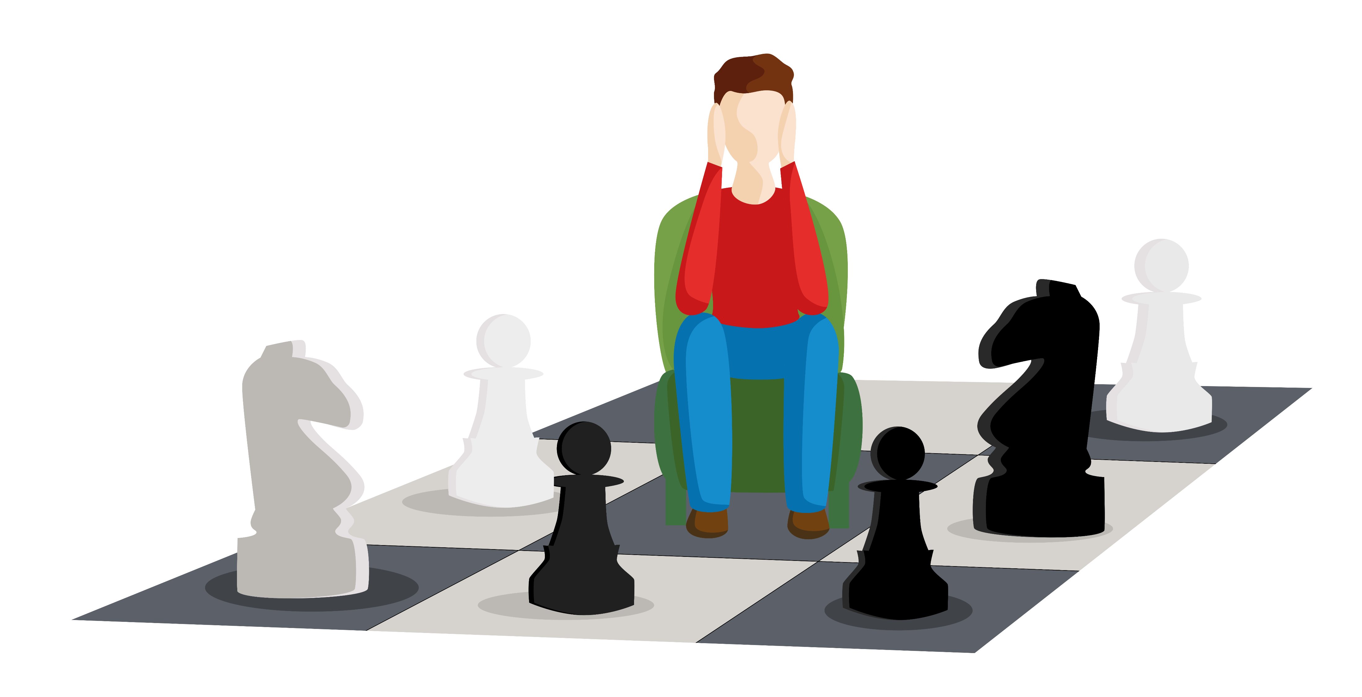
NCS/2HOUR OPTION 3
V1.0/Mar21
ACTIVITY: DEBATE
Mobile games that include simulated gambling do not require any
legislation because they’re not real gambling; it’s only virtual money.
How far do you agree/disagree with the above statement? Write a response to the above statement.
CONSIDER:
-microtransactions
-advertising
-age rating
-false sense of success
-links to gambling
-normalisation of gambling
-the risks they pose
©YGAM 2021: All rights reserved

Slide 24
NCS/2HOUR OPTION 3
V1.0/Mar21
ACTIVITIES: KNOWLEDGE CONSOLIDATION
TASK 1
Design a fact sheet to inform parents about games young people might play and the potential links to gambling.
What do they need to be aware of?
TASK 2
Childwise research in 2020 revealed that 53% of 7-year-olds own a smart phone and 90% of 11-year-olds have their own phone.
Provide 10 top tips to staying safe.
TASK 3
What role does Social Media play in influencing YP? Discuss in your group and consider:
Have you seen gambling advertised on Social Media?
Have you seen people talking about gambling wins or promoting it?
©YGAM 2021: All rights reserved

Slide 25
NCS/2HOUR OPTION 3
V1.0/Mar21
ACTIVITIES: RECCOMENDATION
Gambling operators should no longer be allowed to advertise on the shirts of sports teams or any other visible part of their kit. There should also be no gambling advertising in or near any sports grounds or sports venues.
Problem gambling is a common mental health disorder, and the NGS has the same duty to treat it as to treat any other disorder. Last year the NHS promised to open 15 new clinics. It should do this before 2023 and establish a comparable number within the following few years.
The Gambling Commission must explain the minimum steps which operators should take when considering customer affordability, and make clear that it is for the operator to take the steps which will enable them to identify customers who are betting more than they can afford.
These are 3 recommendations by the House of Lords (2020).
In pairs pick one and explain why you have chosen it.
Consider:
Who will it benefit/protect/safeguard?
How might it be implemented?
©YGAM 2021: All rights reserved

Slide 26
NCS / 2HOUR: OPTION 3
V1.0/Mar21
SIGNPOSTING OPTIONS
Speak to a member of staff
Young People Support service:
YoungPeopleService@gamcare.org.uk
T: 02030926964
National Gaming Clinic and Gambling Clinics
©YGAM 2021: All rights reserved

Slide 27
NCS/2HOUR OPTION 4
V1.0/Mar21
BLURRED LINES
BLURRED LINES
The convergence of gaming and gambling
NCS. Option 4
©YGAM 2021: All rights reserved

Slide 28
NCS/2HOUR OPTION 4
V1.0/Mar21
AIMS AND OUTCOMES
Understand the blurred lines between gaming and gambling
Recognise the signs of harm and understand what support is available
AIMS
OUTCOMES
You understand the blurred lines between gaming and gambling and recognise how this occurs
You recognise the signs of harm and know how to get further support
You can articulate your own thoughts and ideas
©YGAM 2021: All rights reserved

Slide 29
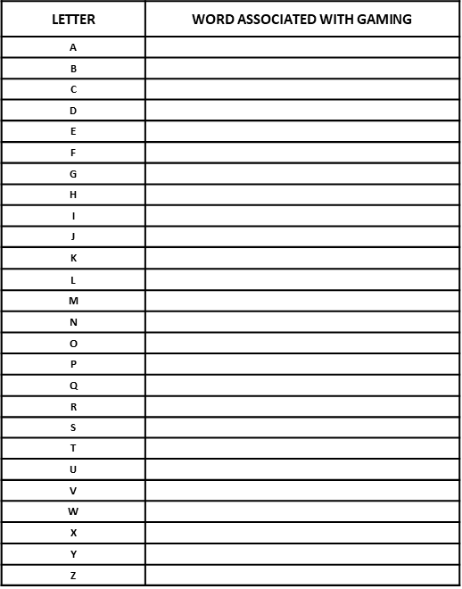
NCS/2HOUR OPTION 4
V1.0/Mar21
ACTIVITY: WORD ASSOSCIATION
Think of as many words as you can associated with the word GAMING
2 points for a unique word no one else has thought of
1 point for any other word
©YGAM 2021: All rights reserved

Slide 30
NCS/2HOUR OPTION 4
V1.0/Mar21
ACTIVITY: LOOT BOX DEFENITION
In pairs/small groups. Discuss loot boxes. What are they? Why might young people be interested in them? Agree a definition and share it with the group.
Loot boxes are virtual items that can purchased in games using real money or in-game currency. Once purchased and opened, users will find a randomised selection of items that customise or alter the user’s experience of the game. The user will not receive any physical objects in the offline world.
Loot boxes can be purchased with virtual or real-life currency.
SOURCE: www.saferinternet.org.uk
Microtransactions, are where users can purchase virtual goods. Microtransactions are often used in free-to-play games to provide a revenue source for the developers.
SOURCE: statista.com
©YGAM 2021: All rights reserved

Slide 31
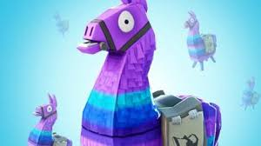
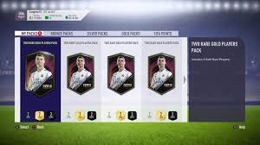
NCS/2HOUR OPTION 4
V1.0/Mar21
DISCUSSION: BLURRED LINES
Think about the games you have played, these can be mobile, PC and console. Do those games ever cross boundaries in to gambling? Work in groups and discuss. You may wish to consider:
Products
Mechanisms within the game
PEGI RATING
Microtransactions inc loot boxes
Advertising and pop ups
Endorsements and influencers
Shirt sponsorships (e.g. FIFA)
Betting in/on games
©YGAM 2021: All rights reserved

Slide 32
NCS/2HOUR OPTION 4
V1.0/Mar21
ACTIVITIES: LET’S DEBATE
“Loot boxes are a form of gambling and should be restricted
to those over the age of 18.”
Group 1: You will debate in favour
Group 2: you will vote against
You have 10 minutes to discuss and formulate your argument.
10 Min
©YGAM 2021: All rights reserved

Slide 33
NCS/2HOUR OPTION 4
V1.0/Mar21
ACTIVITY: HOW DO THEY FEEL?
Look at the below comments from Young People. Work in pairs, describe how each person might be feeling, what motivates them and is there any advice you might give them?
“You feel like it’s a waste of money… and then you open more.”
Nick, 16 (FIFA player)
“If you’re a default skin, people think you’re trash.”
Nina, 10 (Fortnite player)
“It’s like gambling – you could lose your money and not get anyone good, or get someone really good.”
Tim, 16 (FIFA player)
Gaming the system 2019: Children’s Commissioner
Gaming the system 2019: Children’s Commissioner
Gaming the system 2019: Children’s Commissioner
©YGAM 2021: All rights reserved

Slide 34
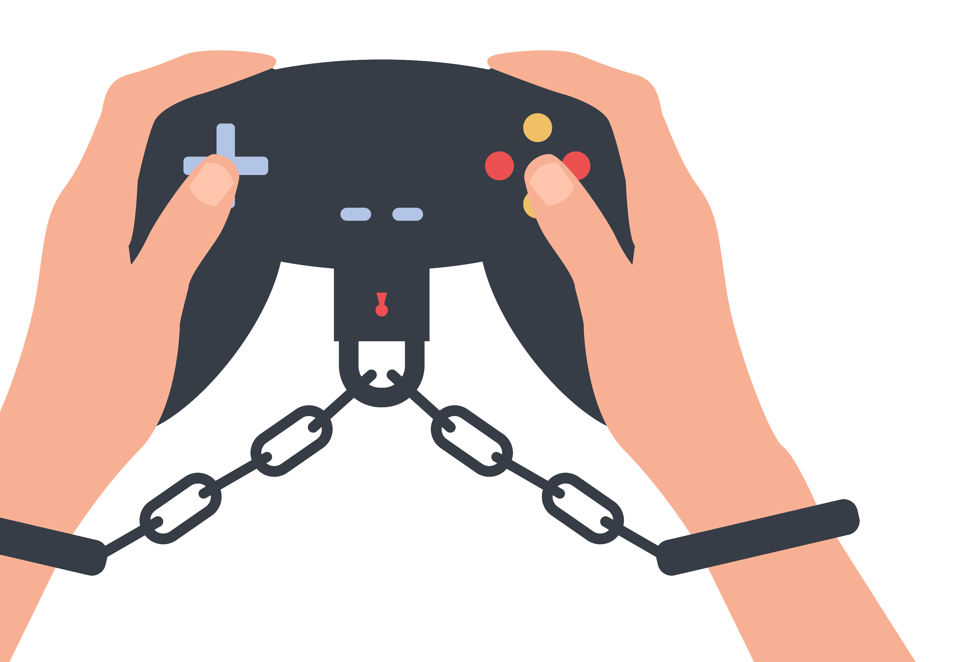
NCS/2HOUR OPTION 4
V1.0/Mar21
DISCUSSION: ADDITONAL RISKS
Are there any additional risks that children and young people should be made aware of?
©YGAM 2021: All rights reserved

Slide 35
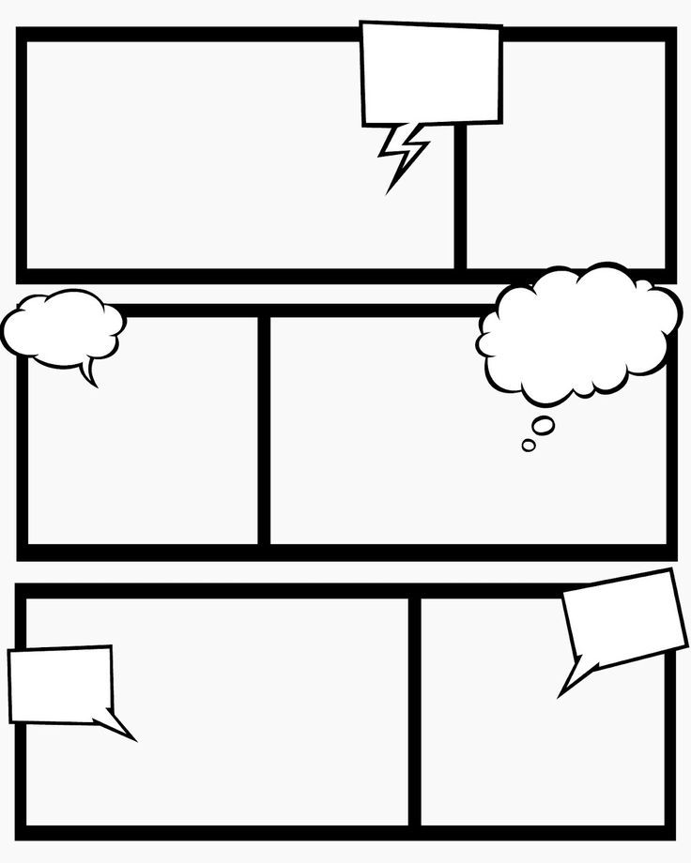
NCS/2HOUR OPTION 4
V1.0/Mar21
ACTIVITY: STORY BOARD
Create a short story on how a young person's relationship with gaming may lead to harm (gaming and gambling). What are the risks? Where might they go for support?
Consider how behaviours and influences could lead to a harmful relationship with gambling when they reach the age of 18.
Make notes of what could be done differently at each point in the story to avoid potential harms in the future. Consider the individual, the family/community, the industry, financial services, support services.
EXTENSION: Consider what should the gaming industry do to safeguard young people.
©YGAM 2021: All rights reserved

Slide 36
NCS/2HOUR OPTION 4
V1.0/Mar21
ACTIVITY: EXIT TICKET
Write down one piece of advice you would give a young person who needs support.
©YGAM 2021: All rights reserved

Slide 37
NCS / 2HOUR: OPTION 4
V1.0/Mar21
SIGNPOSTING OPTIONS
Speak to a member of staff
Young People Support service:
YoungPeopleService@gamcare.org.uk
T: 02030926964
National Gaming Clinic and Gambling Clinics
©YGAM 2021: All rights reserved

Slide 38
NCS/2HOUR OPTION 5
V1.0/Mar21
GAMING: GOOD/BAD/MISUNDERSTOOD
GAMING:
The Good, the Bad and the Misunderstood
NCS. Option 5
©YGAM 2021: All rights reserved

Slide 39
NCS/2HOUR OPTION 5
V1.0/Mar21
AIMS AND OUTCOMES
Understand the positive and negative aspects of gaming
Recognise the potential risks associated with gaming
Recognise the signs of harm and understand what support is available
AIMS
OUTCOMES
You will understand and be able to discuss the positive and negative aspects of gaming
You will recognise the potential risks and you will be able to recognise the signs of harm and understand what support is available
You can create an informative campaign
©YGAM 2021: All rights reserved

Slide 40
NCS/2HOUR OPTION 5
V1.0/Mar21
ACTIVITY: CAROUSEL
There are 3 heading around the room. Visit each one and list as many things you can think of relating to gaming and the header provided.
10 Min
The Good:
The Bad:
The Misunderstood:
©YGAM 2021: All rights reserved

Slide 41
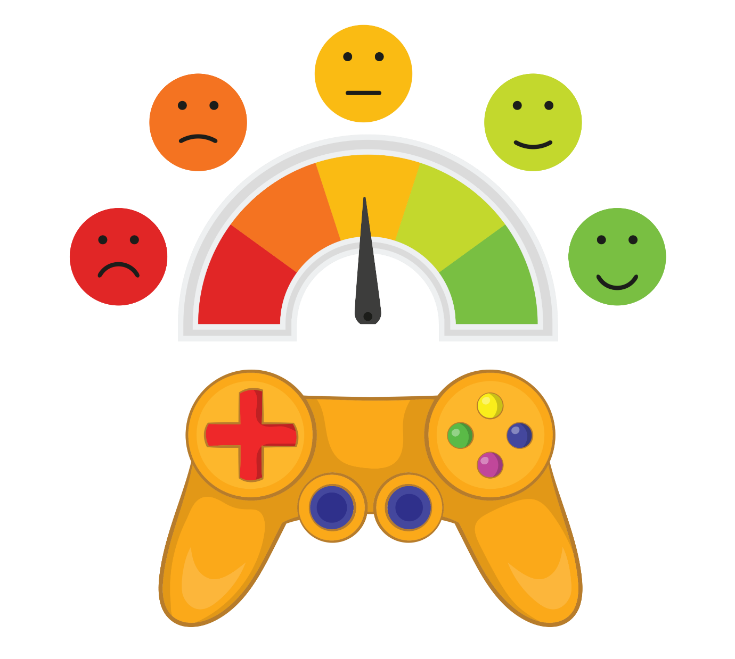
NCS/2HOUR OPTION 5
V1.0/Mar21
ACTIVITY: GAME SAFELY
What are the risks of gaming? In pairs/ small groups discuss.
What can be done to remove/reduce the risks?
©YGAM 2021: All rights reserved

Slide 42
NCS/2HOUR OPTION 5
V1.0/Mar21
ACTIVITY: LET’S EDUCATE
GROUP ONE: Children/Young People
Create an educational resource for the category you’re assigned to. What messages do you need to convey? What support/advice should you provide? You might want to choose from the below ideas
GROUP TWO: Teachers/Youth Leaders
GROUP THREE: Parents/Carers
An educational game
A leaflet
A poster
A film /script/story board
A documentary
©YGAM 2021: All rights reserved

Slide 43
NCS/2HOUR OPTION 5
V1.0/Mar21
ACTIVITY: RESEARCH THE SECTOR
GAMING SECTOR JOBS
Research employment opportunities within Esports
Research the potential harms of Esports
Create an Information Sheet for a young person who wants to pursue a career in Esports. What can they do to look after their wellbeing? What can the industry do to support them?
Artist
Voice actor
Programmer
Athlete
©YGAM 2021: All rights reserved

Slide 44
NCS/2HOUR OPTION 5
V1.0/Mar21
ACTIVITY: PRESENTATION
Share your ideas with the rest of the group. Respond to any questions.
©YGAM 2021: All rights reserved

Slide 45
NCS/2HOUR OPTION 5
V1.0/Mar21
ACTIVITY: EXIT TICKET
On a Post-It note, write down the best piece of advice you might give to a young person looking to become a professional Esports athlete.
©YGAM 2021: All rights reserved

Slide 46
NCS / 2HOUR: OPTION 5
V1.0/Mar21
SIGNPOSTING OPTIONS
Speak to a member of staff
Young People Support service:
YoungPeopleService@gamcare.org.uk
T: 02030926964
National Gaming Clinic and Gambling Clinics
©YGAM 2021: All rights reserved

Slide 47
NCS/2HOUR OPTION 6
V1.0/Mar21
SAFEGUARDING
SAFEGUARDING
What is it and who has the duty of care?
NCS. Option 6
©YGAM 2021: All rights reserved

Slide 48
NCS/2HOUR OPTION 6
V1.0/Mar21
AIMS AND OUTCOMES
Understand the importance of safeguarding and how if affects you
Understand the term duty of care
Recognise the potential risks of gaming and how people can be safeguarded
AIMS
OUTCOMES
You will understand what is meant by safeguarding and duty of care
You will understand how safeguarding affects you
You will recognise the potential risks of gaming and be able to identify how people can be safeguarded
©YGAM 2021: All rights reserved

Slide 49
NCS/2HOUR OPTION 6
V1.0/Mar21
ACTIVITY: STAND UP/SIT DOWN
If you have ever…
Played pitch and toss / penny up / coin game at school
Seen a gambling advert
Bought or been given a scratch card
Lied to people about money spent on gaming/gambling
Played on a penny slot machine
Picked a horse for someone when betting on the horse racing
Played bingo
Supported someone experiencing bullying
Lied about your age
Stayed out later than you should have
Picked an outcome for someone betting on Esports
Played an online free game that has gambling-style features
©YGAM 2021: All rights reserved

Slide 50
NCS/2HOUR OPTION 6
V1.0/Mar21
ACTIVITY: IDENTIFYING RISK
Mind Map: What are the risks CYP face when gaming?
Ill Health
Content
Bad Language
Finance
Gambling Links
Bullying
Advertising
Grooming
©YGAM 2021: All rights reserved

Slide 51
NCS/2HOUR OPTION 6
V1.0/Mar21
ACTIVITY: IDENTIFYING SAFEGUARDS
In groups, create a list exploring all those who are responsible for safeguarding young people who game.
Split into FOUR teams and put a plan together on how the role you have been assigned can safeguard young people against the potential harms related to gaming.
What methods can your assigned role use to ensure young people are protected?
Present back your plans to the group.
Parents/Carers/Family
Government
Gaming Companies
Teachers/Youth Workers/Community
©YGAM 2021: All rights reserved

Slide 52
NCS/2HOUR OPTION 6
V1.0/Mar21
ACTIVITY: PEGI
Explore the PEGI website and specifically the “PEGI Labels & Content Descriptors” – https://pegi.info/what-do-the-labels-mean
Create a speech or statement on why PEGI ratings are important in the safeguarding of children when they game. Think about some of the games you play and why the ratings apply.
©YGAM 2021: All rights reserved

Slide 53
NCS/2HOUR OPTION 6
V1.0/Mar21
ACTIVITY: INFORM, EDUCATE & SAFEGUARD
In small groups create a film to educate young people about the risks of gaming and what things they need to know so they can stay safe.
©YGAM 2021: All rights reserved

Slide 54
NCS/2HOUR OPTION 6
V1.0/Mar21
ACTIVITY: HOW FAR DO YOU AGREE?
If you balance your time gaming, it is a risk-free activity.
Consider the statement. How far do you agree/disagree? Are there any other factors you should be concerned about?
©YGAM 2021: All rights reserved

Slide 55
NCS / 2HOUR: OPTION 6
V1.0/Mar21
SIGNPOSTING OPTIONS
Speak to a member of staff
Young People Support service:
YoungPeopleService@gamcare.org.uk
T: 02030926964
National Gaming Clinic and Gambling Clinics
©YGAM 2021: All rights reserved

