Slide 1
V1.0/Mar21
NCS 20 MINUTE ACTIVITIES
The Following PowerPoint Activities relate to the 20 minute activities and session plans which can be located in the NCS resource section. All resources can be found alongside the lesson plans. We have mapped each session to the NCS Programme Quality Framework and the core curriculum topics as well as the Skills Builder Framework.
CONTENTS:
Mental Health and Wellbeing
Statistics and Key Information
Gambling Related Harm
Gaming Related Harm
Microtransactions
Money & Debt
©YGAM 2021: All rights reserved

Slide 2
NCS / 20 MIN: OPTION 1
V1.0/Mar21
MENTAL HEALTH & WELLBEING
Mental Health and Wellbeing.
How Might Gambling Impact Our Health?
NCS. Option 1
©YGAM 2021: All rights reserved

Slide 3
NCS / 20 MIN: OPTION 1
V1.0/Mar21
AIMS AND OUTCOMES
AIMS
OUTCOMES
Understand the term addiction
Understand the link between addiction and mental health
You can define addiction
You recognise the link between addiction and mental health
©YGAM 2021: All rights reserved

Slide 4
NCS / 20 MIN: OPTION 1
ADDICTION
What is Addiction?
Share your thoughts? What words do you associate with addiction and what kind of things are people addicted to?
Compulsion: An irresistible urge to behave in a certain way.
Addiction: is a disease in which a person finds themselves unable to stop using a substance or engaging in a behaviour.
https://www.nhs.uk/live-well/healthy-body/addiction-what-is-it/
©YGAM 2021: All rights reserved

Slide 5
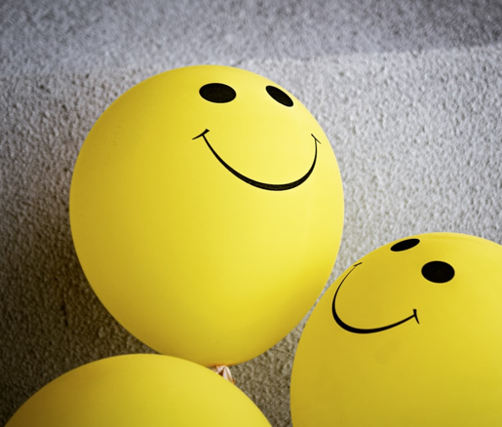
NCS / 20 MIN: OPTION 1
V1.0/Mar21
MENTAL HEALTH
Mental health includes our emotional, psychological, and social wellbeing. It affects how we think, feel, and act. It also helps determine how we handle stress, relate to others, and make choices.
Source:
https://www.mentalhealth.gov/basics/what-is-mental-health
©YGAM 2021: All rights reserved

Slide 6
NCS / 20 MIN: OPTION 1
ACTIVITY: THE HARMS ASSOCIATED WITH GAMBLING
In pairs, write down the harms a compulsive gambler may experience, using the headings below:
FINANCIAL | RELATIONSHIPS | HEALTH
Financial
Relationships
Health and Wellbeing
©YGAM 2021: All rights reserved

Slide 7
NCS / 20 MIN: OPTION 1
V1.0/Mar21
ACTIVITY: AGREE/DISAGREE
“Looking after your Mental Health is just as important as looking after your Physical Health.”
Think about the above statement and provide a response with reasoning.
Can you have one without the other?
What do you think?
Physical wellbeing promotes mental wellbeing
Mental health will impact physical health
©YGAM 2021: All rights reserved

Slide 8
NCS / 20 MIN: OPTION 1
V1.0/Mar21
SIGNPOSTING OPTIONS
Speak to a member of staff
Young People Support service:
YoungPeopleService@gamcare.org.uk
T: 02030926964
National Gaming Clinic and Gambling Clinics
©YGAM 2021: All rights reserved

Slide 9
NCS / 20 MIN: OPTION 1
V1.0/Mar21
STATISTICS & KEY INFORMATION
Statistics and Key Information.
What are the risks and what is the impact?
NCS. Option 2
©YGAM 2021: All rights reserved

Slide 10
NCS / 20 MIN: OPTION 2
V1.0/Mar21
AIMS AND OUTCOMES
AIMS
OUTCOMES
Understand how gambling might cause harm to some people
Recognise key facts
You are able to discuss how gambling has the potential to cause harm
You can recognise key facts
You can discuss ways to raise awareness of the potential harms
©YGAM 2021: All rights reserved

Slide 11
NCS / 20 MIN: OPTION 1
ACTIVITY: TRUE OR FALSE
1. 11% (approx. 350,000) of 11-16 year olds spent their own money on gambling in the last 7 days
TRUE
2. You have a 1 in 14 million chance of winning the UK National Lottery Jackpot
FALSE
3. 67% of children were with their parents the first time they gambled
TRUE
4. More than 200,000 16 and 17 year olds regularly play the National Lottery and/or buy scratch cards
TRUE
5. There are 55,000 young people classified as problem gamblers in the UK
TRUE
6.Gambling is seen on average 12 times in an episode of Match of the Day
FALSE
©YGAM 2021: All rights reserved

Slide 12
NCS / 20 MIN: OPTION 1
ACTIVITY: RAISING AWARENESS
In pairs, pick one key fact. Describe how you might raise awareness about this issue. Explain your choices.
Who will you need to engage with?
What will you raise awareness of/ What do you want to achieve?
How will you get your message out there?
How will young people be impacted positively from your message?
EShare your ideas with the group.
©YGAM 2021: All rights reserved

Slide 13
NCS / 20 MIN: OPTION 2
V1.0/Mar21
SIGNPOSTING OPTIONS
Speak to a member of staff
Young People Support service:
YoungPeopleService@gamcare.org.uk
T: 02030926964
National Gaming Clinic and Gambling Clinics
©YGAM 2021: All rights reserved

Slide 14
NCS / 20 MIN: OPTION 3
V1.0/Mar21
GAMBLING RELATED HARM
Gambling Related Harm.
Who is affected and what’s the impact?
NCS. Option 3
©YGAM 2021: All rights reserved

Slide 15
NCS / 20 MIN: OPTION 3
V1.0/Mar21
AIMS AND OUTCOMES
AIMS
Understand who might be impacted by gambling related harm
Recognise and understand the term ‘affected others’
OUTCOMES
You are able to discuss how gambling has the potential to cause harm
You can define the term ‘affected others’ and discuss the potential impacts of gambling harm
©YGAM 2021: All rights reserved

Slide 16
NCS / 20 MIN: OPTION 3
V1.0/Mar21
60-SECOND SCRIBBLE
What is gambling?
When does it become harmful/problematic?
60
59
58
57
56
55
54
53
52
51
50
49
48
47
46
45
44
43
42
41
40
39
38
37
36
35
34
33
32
31
30
29
28
27
26
25
24
23
22
21
20
19
18
17
16
15
14
13
12
11
10
9
8
7
6
5
4
3
2
1
0
©YGAM 2021: All rights reserved

Slide 17
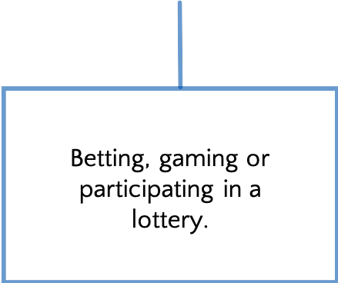
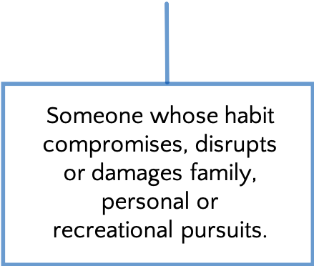
NCS / 20 MIN: OPTION 3
V1.0/Mar21
WHAT IS GAMBLING?
What is gambling?
What is problem gambling?
What is a problem gambler?
BBetting, gaming, participating in a lottery
GGambling to a degree that compromises, disrupts or damages family, personal or recreational pursuits
Gambling Related Harms are the adverse impacts from gambling on the health and wellbeing of individuals, families, communities and society.
(Gambling Commission)
©YGAM 2021: All rights reserved

Slide 18
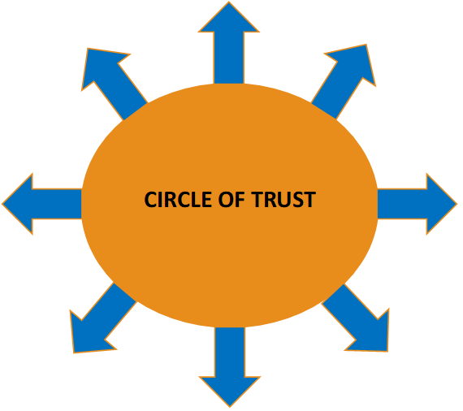
NCS / 20 MIN: OPTION 3
V1.0/Mar21
ACTIVITY: CIRCLE OF TRUST
Working in pairs, identify all the different people who could potentially be affected by an individual’s addiction to gambling
Provide a brief description of how each person is affected
Present your findings back to the group
Tweet your work to @YGAMuk with the hashtags #affectedothers #gamblingrelatedharm
©YGAM 2021: All rights reserved

Slide 19
NCS / 20 MIN: OPTION 3
V1.0/Mar21
ACTIVITY: CIRCLE OF TRUST
SShare your ideas with the group.
What should be done to support the individual and affected others?
What might the impact be for the wider society.
#affected others @YGAMuk
©YGAM 2021: All rights reserved

Slide 20
NCS / 20 MIN: OPTION 3
V1.0/Mar21
SIGNPOSTING OPTIONS
Speak to a member of staff
Young People Support service:
YoungPeopleService@gamcare.org.uk
T: 02030926964
National Gaming Clinic and Gambling Clinics
©YGAM 2021: All rights reserved

Slide 21
NCS / 20 MIN: OPTION 4
V1.0/Mar21
GAMING RELATED HARM
Gaming Related Harm.
What are the signs?
NCS. Option 4
©YGAM 2021: All rights reserved

Slide 22
NCS / 20 MIN: OPTION 3
V1.0/Mar21
AIMS AND OUTCOMES
AIMS
Recognise when gaming becomes harmful
Recognise the physical and emotional signs of gaming harm
Recognise how and where to get help
OUTCOMES
You are able to discuss and provide examples of how gaming might become harmful
You can recognise physical and emotional signs of gaming related harm and you know where to get help
©YGAM 2021: All rights reserved

Slide 23
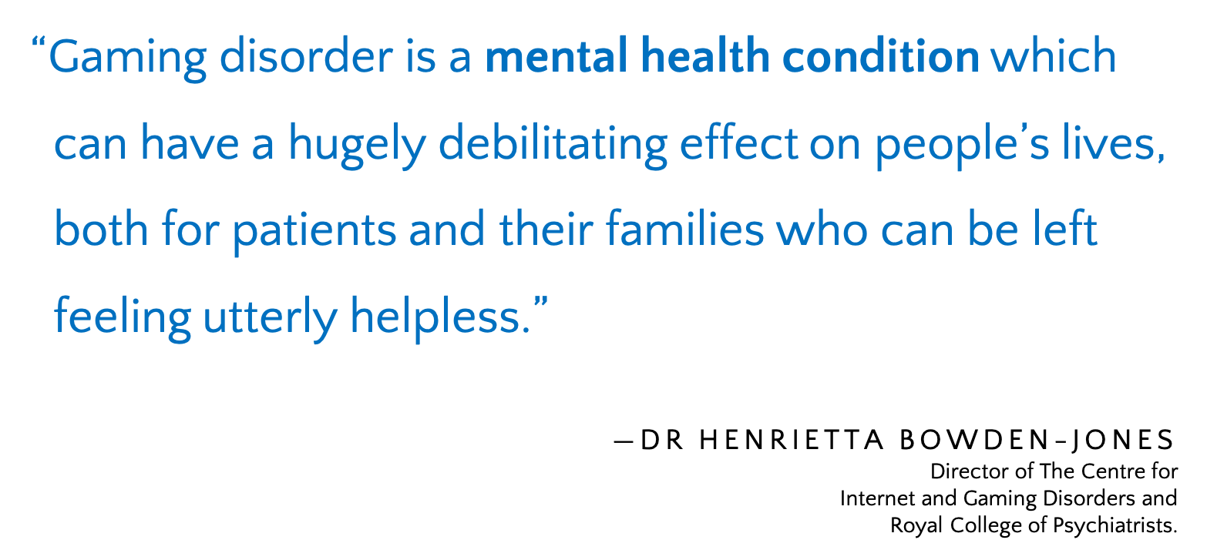
NCS / 20 MIN: OPTION 4
V1.0/Mar21
GAMING DISORDER
©YGAM 2021: All rights reserved

Slide 24
NCS / 20 MIN: OPTION 4
V1.0/Mar21
SIGNS OF HARM
Split into two teams
Team A – Identify the PHYSICAL SIGNS of Gaming Disorder
Team B – Identify the EMOTIONAL SIGNS of Gaming Disorder
Use Flipchart paper to create a mind map and present your findings back to the group.
©YGAM 2021: All rights reserved

Slide 25
NCS / 20 MIN: OPTION 4
V1.0/Mar21
SIGNS OF HARM
©YGAM 2021: All rights reserved

Slide 26
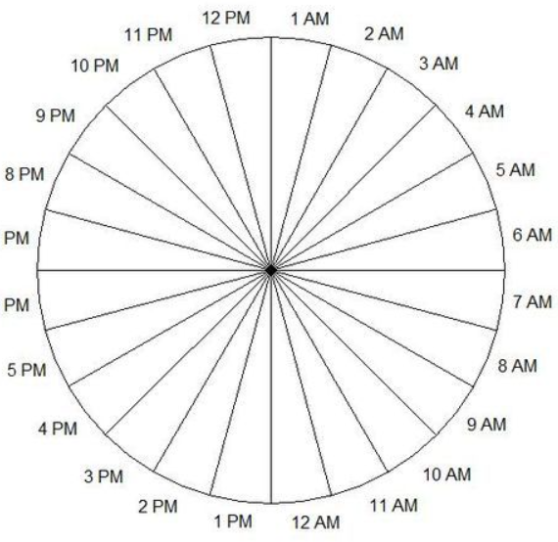
NCS / 20 MIN: OPTION 4
V1.0/Mar21
ACTIVITY: 24 HOUR CLOCK
Using different colour pens, shade in the time you spend:
Sleeping
At school / college/ work
Doing homework
With family and friends
Hobbies
Watching TV / Netflix etc
How much time do you have left for Gaming?
Did you know many UK children/young people spend 3hrs plus per day gaming?
(Children’s Commissioner, 2019)
©YGAM 2021: All rights reserved

Slide 27
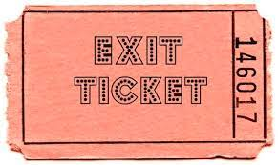
NCS / 20 MIN: OPTION 4
V1.0/Mar21
EXIT TICKET
What have you learnt today?
What would you like to learn more about?
List 1 reflection on how you spend your time.
©YGAM 2021: All rights reserved

Slide 28
NCS / 20 MIN: OPTION 4
V1.0/Mar21
SIGNPOSTING OPTIONS
Speak to a member of staff
Young People Support service:
YoungPeopleService@gamcare.org.uk
T: 02030926964
National Gaming Clinic and Gambling Clinics
©YGAM 2021: All rights reserved

Slide 29
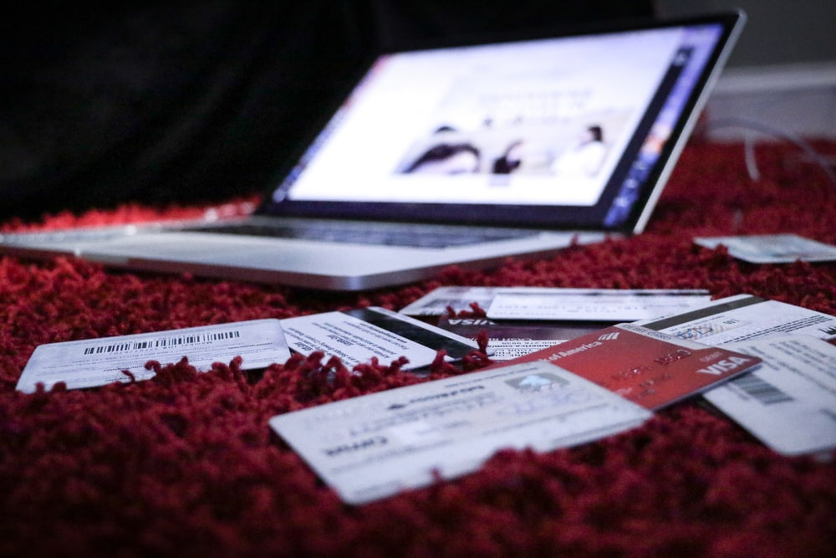
NCS / 20 MIN: OPTION 5
V1.0/Mar21
MICROTRANSACTIONS
Microtransactions.
Do gaming and gambling ever become blurred?.
NCS. Option 5
©YGAM 2021: All rights reserved

Slide 30
NCS / 20 MIN: OPTION 5
V1.0/Mar21
AIMS AND OUTCOMES
AIMS
OUTCOMES
Understand what microtransaction appear in
games
Understand what loot boxes are and how they’re
used in games
Recognise the potential blurred lines between
gaming and gambling
You can define and recognise the different microtransactions in games
You know what loot boxes are and what role they play in games
You can discuss the blurred lines between gaming and gambling
©YGAM 2021: All rights reserved

Slide 31
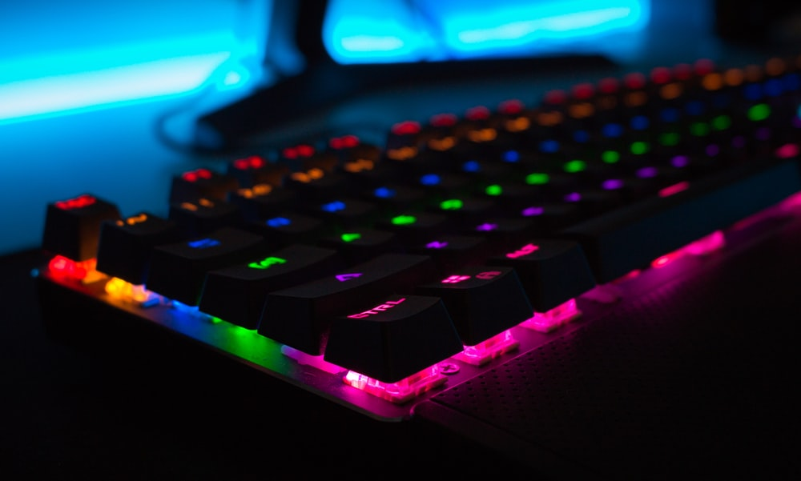
NCS / 20 MIN: OPTION 6
V1.0/Mar21
MICROTRANSACTIONS: DEFINITONS
What are microtransactions?
What are loot boxes?
Work in pairs and agree a definition.
©YGAM 2021: All rights reserved

Slide 32
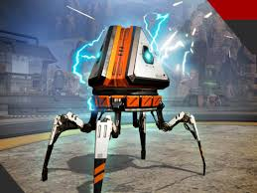
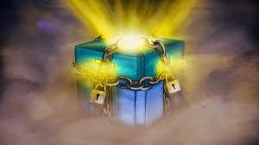
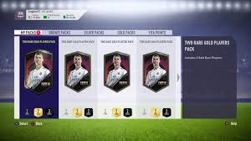
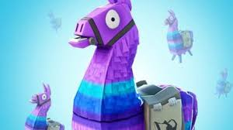
NCS / 20 MIN: OPTION 6
V1.0/Mar21
MICROTRANSACTIONS AND LOOT BOXES
Microtransactions:
Anything you pay extra for in a video game outside the initial purchase.
www.gamespot.com
Lootbox:
Loot boxes are virtual items that can purchased in games using real money or in-game currency. Once purchased and opened, users will find a randomised selection of items that customise or alter the user’s experience of the game. The user will not receive any physical objects in the offline world
www.saferinternet.org.uk
©YGAM 2021: All rights reserved

Slide 33
NCS / 20 MIN: OPTION 6
V1.0/Mar21
POST-IT
Using post-it notes, identify all the games you’re aware of that include microtransactions
Place your post-it notes on the wall at the front of the room
©YGAM 2021: All rights reserved

Slide 34
NCS / 20 MIN: OPTION 6
V1.0/Mar21
DISCUSSION: LOOT BOXES
Why might young people buy loot boxes? What are the pros/cons?
In-game advantage?
Expensive
Aesthetics
Don’t usually get what you want
©YGAM 2021: All rights reserved

Slide 35
NCS / 20 MIN: OPTION 6
V1.0/Mar21
DEBATE: LOOT BOXES
Loot boxes are just like gambling and therefore should be regulated like gambling. How far do you agree/disagree with this statement? Write a response and explain your reasoning.
©YGAM 2021: All rights reserved

Slide 36
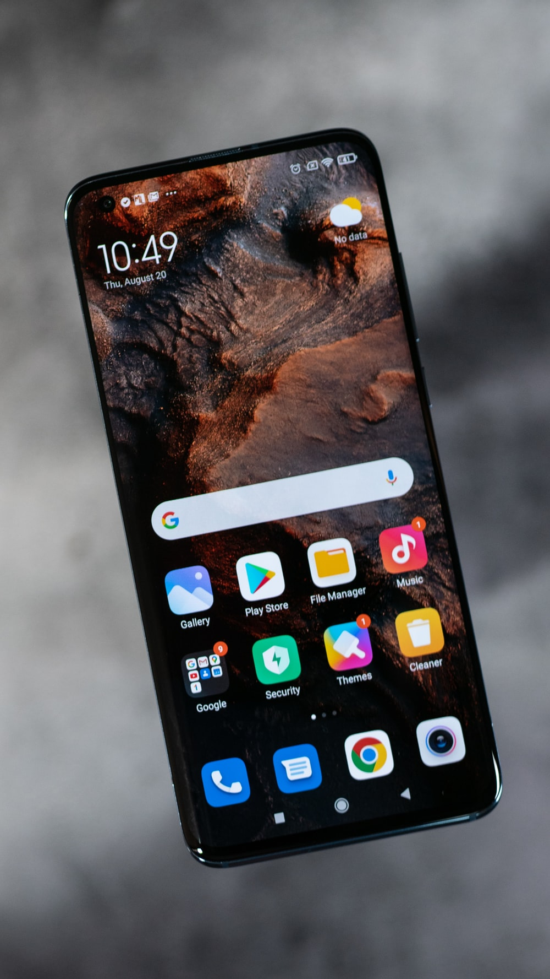
NCS / 20 MIN: OPTION 6
V1.0/Mar21
EXTENSION: MICROTRANSACTIONS - LET’S TALK
Do you pay for microtransactions in any of the games you play?
Do you buy loot boxes?
Do you feel pressured to buy items within games? By your peers? The gaming companies? Marketing?
What advice would you give to someone who is worried about microtransactions and/or loot boxes?
©YGAM 2021: All rights reserved

Slide 37
NCS / 20 MIN: OPTION 5
V1.0/Mar21
SIGNPOSTING OPTIONS
Speak to a member of staff
Young People Support service:
YoungPeopleService@gamcare.org.uk
T: 02030926964
National Gaming Clinic and Gambling Clinics
©YGAM 2021: All rights reserved

Slide 38
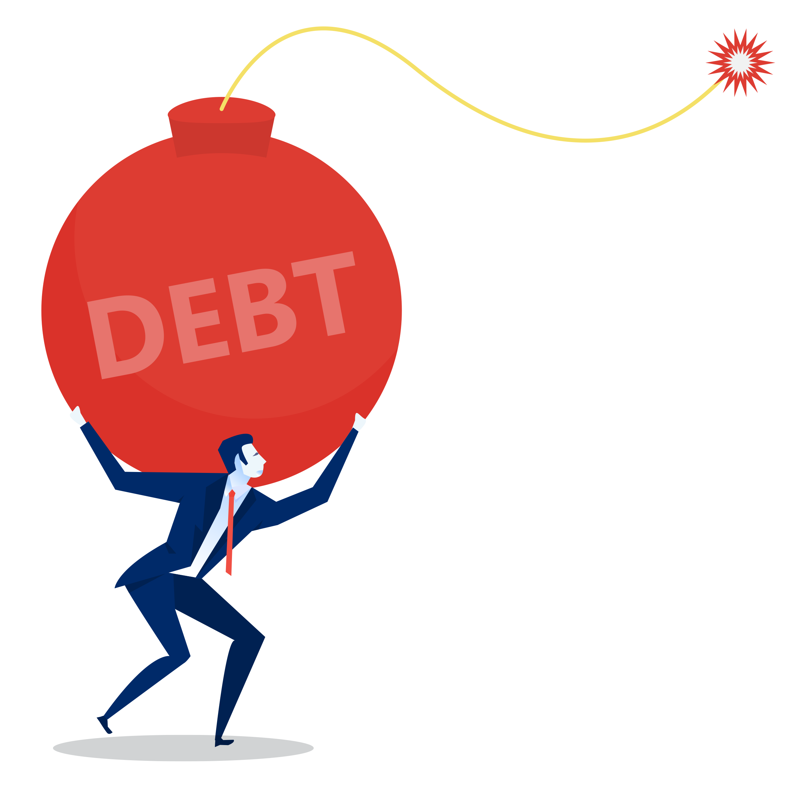
NCS / 20 MIN: OPTION 6
V1.0/Mar21
MONEY AND DEBT
Debt.
How much do you spend?
NCS. Option 6
©YGAM 2021: All rights reserved

Slide 39
NCS / 20 MIN: OPTION 6
V1.0/Mar21
AIMS AND OUTCOMES
AIMS
Understand the term debt
Recognise how debt might impact wellbeing
Recognise how and where to get help
OUTCOMES
You understand how gaming and or gambling may lead to debt issues
You understand how debt might impact wellbeing
You can identify how and where to get help
©YGAM 2021: All rights reserved

Slide 40
NCS / 20 MIN: OPTION 6
V1.0/Mar21
ACTIVITY: CURRENT SPENDING
How much do you spend?
Gaming/gambling
In-app purchases
Food/drinks
Travel
Clothes
Travel
Charity
Savings
Anything else?
Work out your monthly spend and create a chart to represent your findings.
Do you have any money left at the end of the month?
Is there anything you would like to change? Could you make any savings?
How much would that saving afford you over 1 year/ 5 years?
©YGAM 2021: All rights reserved

Slide 41
NCS / 20 MIN: OPTION 6
V1.0/Mar21
ACTIVITY: CASE STUDIES
Whenever Mo gets pocket money or Birthday/Christmas money, he spends most of it on his computer games. He plays FIFA Ultimate Team and hopes to get Mbappé. His mates say it’s a waste of money, but Mo doesn’t mind, it’s his money and he doesn’t have much else to spend it on anyway.
What might you say to Mo?
©YGAM 2021: All rights reserved

Slide 42
NCS / 20 MIN: OPTION 6
V1.0/Mar21
ACTIVITY: CASE STUDIES
I first started gambling when I was 16 but this was simply giving my Dad a few quid every weekend to have a bet on the football. I may have been underage but I never felt there was any harm in what I was doing. I didn’t ever have any money to go our with my mates though.
What might you say to Adam?
©YGAM 2021: All rights reserved

Slide 43
NCS / 20 MIN: OPTION 6
V1.0/Mar21
ACTIVITY: CASE STUDIES
Sarah uses her credit card to buy loot boxes and other microtransactions. It’s so easy to pay using her card but she has no idea how much she has spent. At the end of every month she doesn’t have enough money left for everything she needs. She often feels guilty and wishes she had someone to talk to about it.
What might you say to Sarah?
©YGAM 2021: All rights reserved

Slide 44
NCS / 20 MIN: OPTION 6
V1.0/Mar21
EXIT TICKET
What have you learnt today?
What would you like to learn more about?
List 1 reflection on how you spend your time.
©YGAM 2021: All rights reserved

Slide 45
NCS / 20 MIN: OPTION 6
V1.0/Mar21
SIGNPOSTING OPTIONS
Speak to a member of staff
Young People Support service:
YoungPeopleService@gamcare.org.uk
T: 02030926964
National Gaming Clinic and Gambling Clinics
©YGAM 2021: All rights reserved

