Slide 1
V1.0/Mar21
NCS 60 MINUTE ACTIVITIES
The Following PowerPoint Activities relate to the 60 minute activities and session plans which can be located in the NCS resource section. All resources can be found alongside the lesson plans. We have mapped each session to the NCS Programme Quality Framework and the core curriculum topics as well as the Skills Builder Framework.
CONTENTS:
Help and Support
Influences
Gambling: Community Impact
Esports
Gaming Motivation
Loot Box
©YGAM 2021: All rights reserved

Slide 2
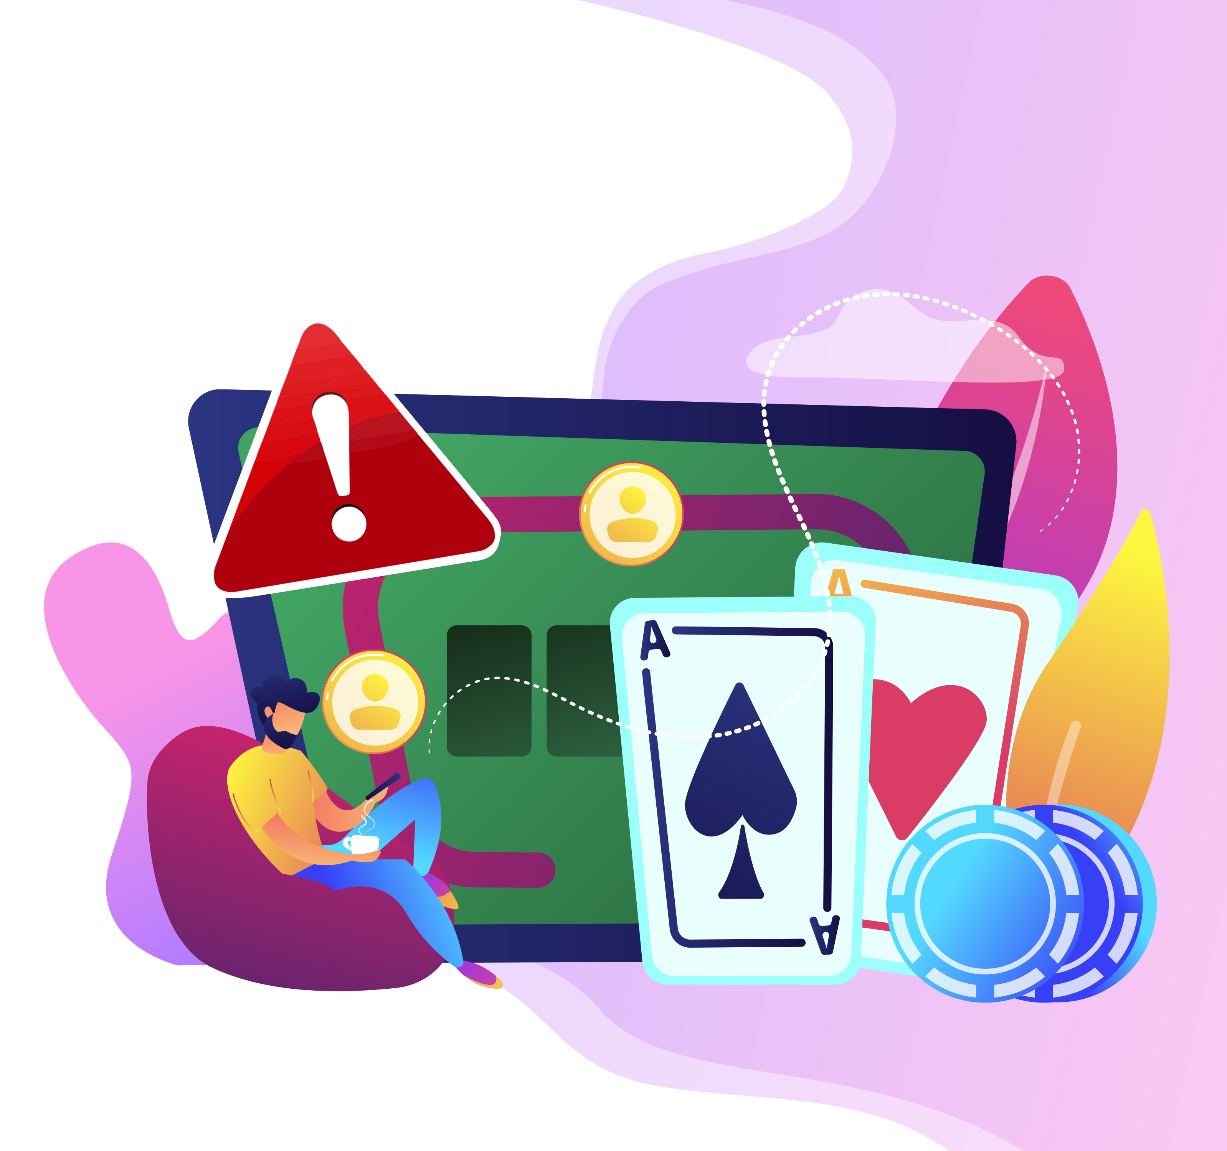
NCS/60 MIN OPTION 1
V1.0/Mar21
HELP AND SUPPORT
Help and support.
What support is available?
NCS. Option 1
©YGAM 2021: All rights reserved

Slide 3
NCS / 60 MIN: OPTION 1
V1.0/Mar21
AIMS AND OUTCOMES
AIMS
Understand what gambling is and why some people do it
Understand how addiction may impact an individual and those around them
Understand what support is available
OUTCOMES
You understand why some young people might gamble
You understand how addiction may impact an individual and those around them
You understand what support is available and you know how to seek help
©YGAM 2021: All rights reserved

Slide 4
NCS / 60 MIN: OPTION 1
V1.0/Mar21
ACTIVITY: STAND UP/SIT DOWN
If you have ever…
Played pitch and toss / penny up / coin game at school
Seen a gambling advert
Bought or been given a scratch card
to people about money spent on gaming/gambling
Played on a penny slot machine
Picked a horse for someone when betting on the horse racing
Supported someone experiencing bullying
You passed a bookmakers on your way here today
Picked an outcome for someone betting on Esports
Played an online free game that has gambling style features
©YGAM 2021: All rights reserved

Slide 5
NCS / 60 MIN: OPTION 1
V1.0/Mar21
WHY MIGHT YOUNG PEOPLE GAMBLE?
©YGAM 2021: All rights reserved

Slide 6
Why Might Young People Gamble?
Today’s Aims
Gambling Commission 2019
©YGAM 2021: All rights reserved

Slide 7
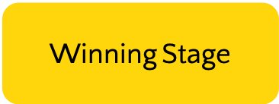
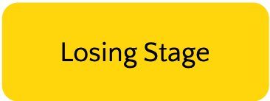
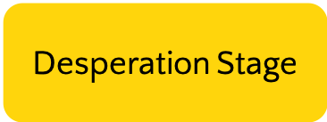
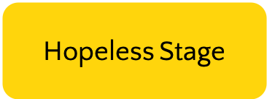
NCS / 60 MIN: OPTION 1
V1.0/Mar21
GAMBLING DISORDER AND MENTAL ILL HEALTH
List the emotions of the person experiencing each stage.
©YGAM 2021: All rights reserved

Slide 8
NCS / 60 MIN: OPTION 1
V1.0/Mar21
ACTIVITY: RESEARCH
Group 1:
What is meant by 'affected others'? Research gambling-related harms and explore how harm extends beyond the individual.
What support is there for friends and family? Create a poster or information sheet that raises awareness of the support services.
Group 2:
Research a support service or treatment provider from the list of organisations here… https://www.ygam.org/support-and-advice/
Create a poster or information sheet that raises awareness of what these organisations do.
©YGAM 2021: All rights reserved

Slide 9
NCS / 60 MIN: OPTION 1
V1.0/Mar21
SHARE YOUR IDEAS
Share your findings
What advice would you give to a friend if you were worried about them?
©YGAM 2021: All rights reserved

Slide 10
NCS / 60 MIN: OPTION 1
V1.0/Mar21
SIGNPOSTING OPTIONS
Speak to a member of staff
Young People Support service:
YoungPeopleService@gamcare.org.uk
T: 02030926964
National Gaming Clinic and Gambling Clinics
©YGAM 2021: All rights reserved

Slide 11
NCS / 60 MIN: OPTION 2
V1.0/Mar21
INFLUENCES
INFLUENCES.
Media, Advertising and Sports.
NCS. Option 2
©YGAM 2021: All rights reserved

Slide 12
NCS / 60 MIN: OPTION 2
V1.0/Mar21
AIMS AND OUTCOMES
Understand why people may/may not gamble
Understand what might influence people to gamble
Understand the role advertising plays in gambling
Define how advertising impacts you
AIMS
OUTCOMES
You understand why some people gamble and why people don’t
You will recognise some of the influences that might prompt someone to gamble
You will understand how advertising is used to promote gambling and the impact this has on young people
You can define how you feel about advertising
©YGAM 2021: All rights reserved

Slide 13
NCS / 60 MIN: OPTION 2
V1.0/Mar21
DISCUSSION: WHY SOME YOUNG PEOPLE GAMBLE
Research from the Gambling Commission 2019 found that 350,000 11-16 year olds had gambled in the last week.
TASK: Work in pairs and make a list of the reasons children and young people may or may not gamble.
©YGAM 2021: All rights reserved

Slide 14
NCS / 60 MIN: OPTION 2
WHY SOME YOUNG PEOPLE GAMBLE
Today’s Aims
Because it’s fun!
55%
Because I like to take risks
13%
It’s cool!
11%
My parents/guardian do it
10%
Peer pressure
6%
Gambling Commission 2019
©YGAM 2021: All rights reserved

Slide 15
NCS / 60 MIN: OPTION 2
V1.0/Mar21
DISCUSSION: ADVERTISING
The Gambling Act 2005 allowed advertising of gambling on TV and radio.
Have you seen any gambling adverts?
How does gambling advertising make you feel?
How might advertising influence people?
How can young people be safeguarded?
©YGAM 2021: All rights reserved

Slide 16
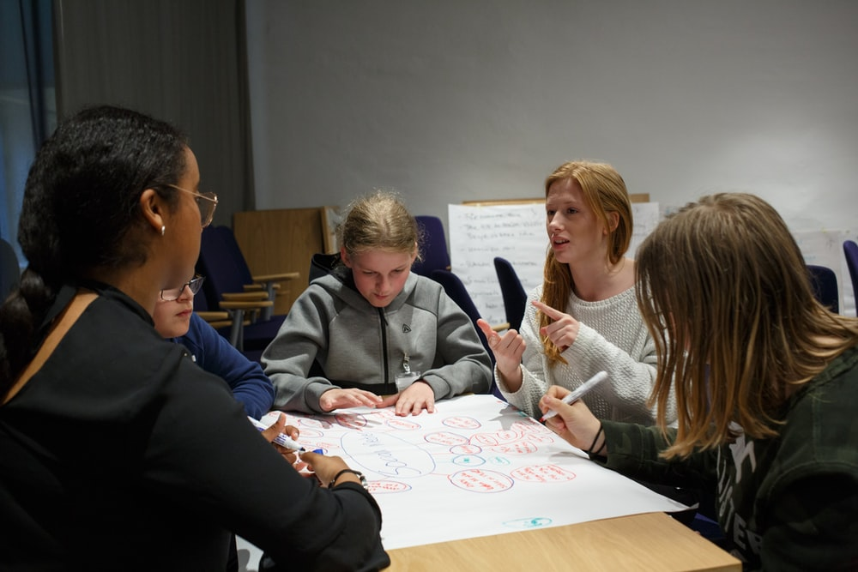
NCS / 60 MIN: OPTION 2
V1.0/Mar21
ACTIVITY: ADVERTISING DEBATE
Explore the research from the GambleAware Ipsos Mori report.
Work in teams and prepare a response to the statement: All gambling advertising should be abolished.
GROUP ONE
For the abolishment of all gambling advertising
GROUP TWO
Against the abolishment of gambling advertising
©YGAM 2021: All rights reserved

Slide 17
NCS / 60 MIN: OPTION 2
V1.0/Mar21
ACTIVITY: ADVERTISING DEBATE
Write a personal response to each of the following statements:
There are too many gambling adverts on TV
I feel targeted by gambling adverts on social media
Too much gambling advertising is dangerous to young people
Gambling advertising is fine in moderation and if restricted to over 18s
Gambling advertising on/during sports increases young people’s motivation to gamble
Gambling advertising makes me feel…
©YGAM 2021: All rights reserved

Slide 18
NCS / 60 MIN: OPTION 2
V1.0/Mar21
SIGNPOSTING OPTIONS
Speak to a member of staff
Young People Support service:
YoungPeopleService@gamcare.org.uk
T: 02030926964
National Gaming Clinic and Gambling Clinics
©YGAM 2021: All rights reserved

Slide 19
NCS/60 MIN: OPTION 3
V1.0/Mar21
GAMBLING: COMMUNITY IMPACT
GAMBLING: COMMUNITY IMPACT.
The wider impact of harm.
NCS. Option 3
©YGAM 2021: All rights reserved

Slide 20
NCS / 60 MIN: OPTION 3
V1.0/Mar21
AIMS AND OUTCOMES
Understand how gambling is featured within your home town/area
Recognise how gambling harm extends beyond the individual
Identify the ways that gambling harms can be reduced/prevented
AIMS
You can recognise how gambling is featured within your home town/area
You recognise that gambling harm extends beyond the individual
You can identify measures to reduce gambling related harm
OUTCOMES
©YGAM 2021: All rights reserved

Slide 21
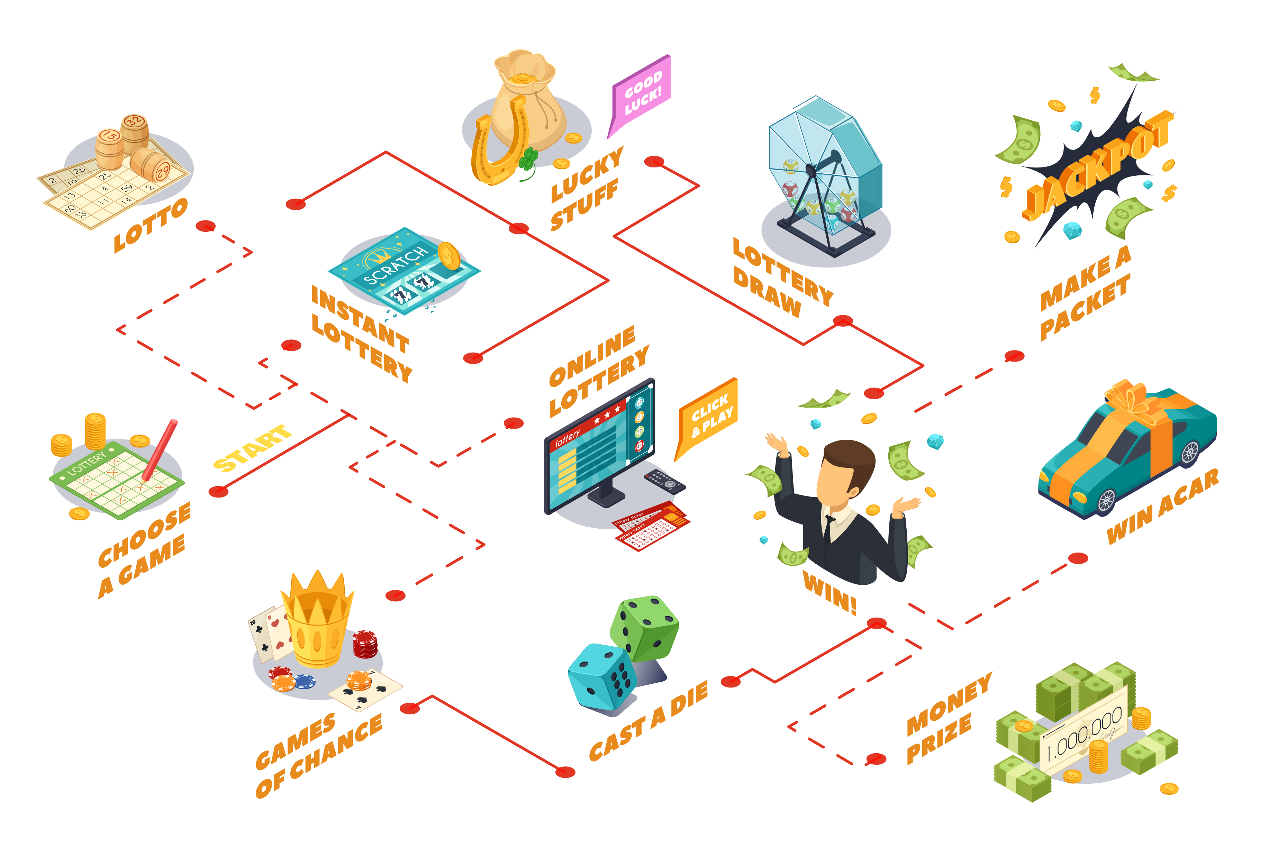
NCS / 60 MIN: OPTION 3
V1.0/Mar21
ACTIVITY: GAMBLING PREVALENCE
How prevalent is gambling in your town/area?
List all the types of gambling you see, this can include advertising.
How might this influence people?
NOTE: All forms of gambling carry risks and most forms of gambling have a legal age limit of 18+
©YGAM 2021: All rights reserved

Slide 22
NCS / 60 MIN: OPTION 3
V1.0/Mar21
DISCUSSION: GAMBLING PREVALENCE
Discuss your findings, how might this impact the views of young people?
I see advertising everywhere. Some people might think it’s normal
In pubs, you see slot machines, drinking alcohol might make you think you can win
We have an arcade, people think it’s fun because it looks like a family activity
I think gambling has become normalized to some people
We have loads of betting shops in my area
©YGAM 2021: All rights reserved

Slide 23
NCS / 60 MIN: OPTION 3
ACTIVITY: BUILD A CAMPAIGN
TASK: run a campaign to raise awareness around the potential harms of gambling with the intent of removing stigma. What can be done to reduce harm?
You will need to do your research and explore the wider impacts of harm and strategies to reduce harm.
Select a medium, e.g. social media campaign, film
Share your campaign with your group
Work in a group.
What is your message?
Title, slogan and hashtag
Who is your target
audience?
©YGAM 2020: All rights reserved

Slide 24
NCS / 60 MIN: OPTION 3
V1.0/Mar21
ACTIVITY: YGAM AMBASSADORS
Share your campaign with your peers
Share your work with @YGAMuk on Twitter with the hashtag #harmprevention
©YGAM 2021: All rights reserved

Slide 25
NCS / 60 MIN: OPTION 2
V1.0/Mar21
SIGNPOSTING OPTIONS
Speak to a member of staff
Young People Support service:
YoungPeopleService@gamcare.org.uk
T: 02030926964
National Gaming Clinic and Gambling Clinics
©YGAM 2021: All rights reserved

Slide 26
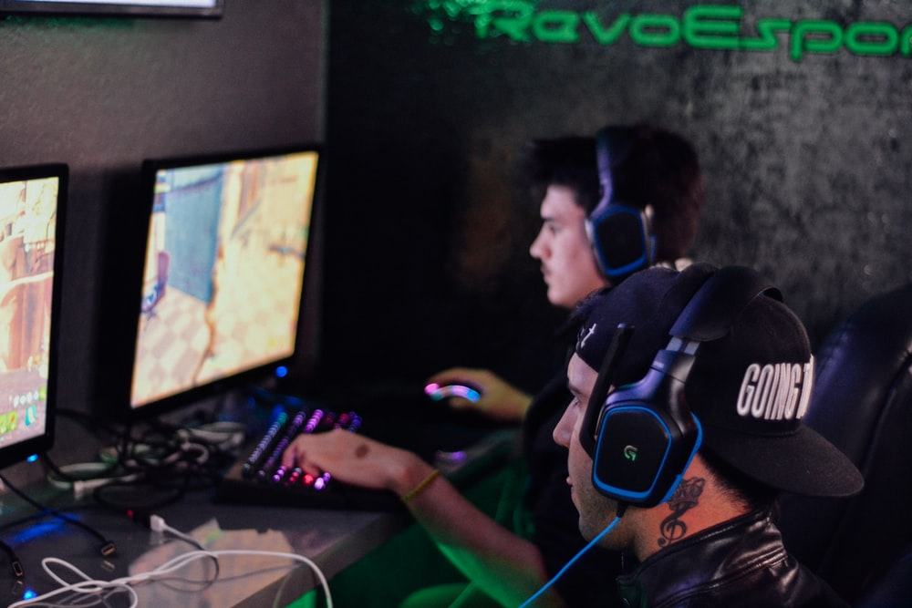
NCS / 60 MIN: OPTION 4
V1.0/Mar21
ESPORTS
ESPORTS
Health and Wellbeing.
NCS. Option 2
©YGAM 2021: All rights reserved

Slide 27
NCS / 60 MIN: OPTION 4
V1.0/Mar21
AIMS AND OUTCOMES
Understand the appeal of Esports
Identify how Esports professionals can look after their wellbeing
AIMS
You can define Esports
You understand why young people might find it appealing
You can identify how to safeguard wellbeing
OUTCOMES
©YGAM 2021: All rights reserved

Slide 28
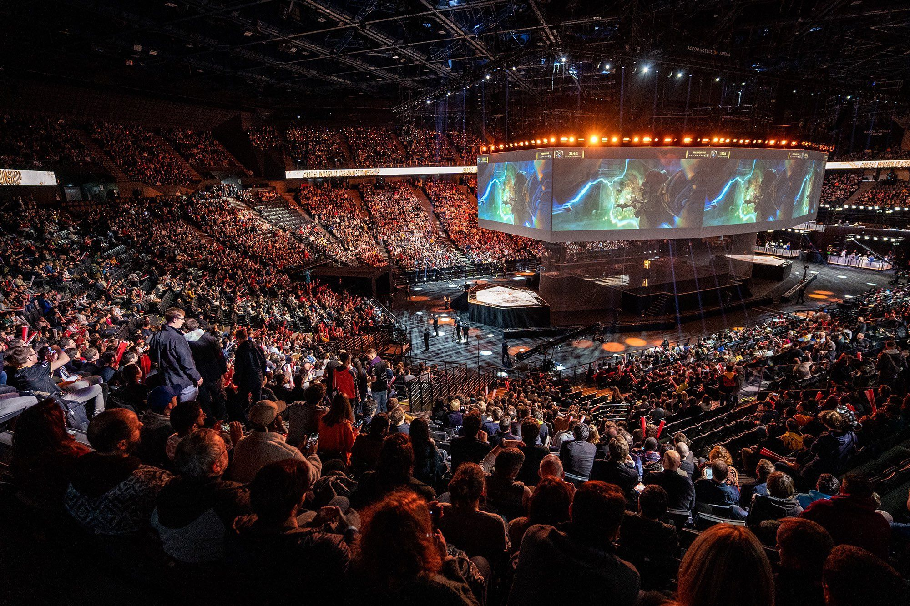
ACTIVITY: DEFINE ESPORTS
60 Second scribble. How many words can you think of associated with Esports?
60
59
58
57
56
55
54
53
52
51
50
49
48
47
46
45
44
43
42
41
40
39
38
37
36
35
34
33
32
31
30
29
28
27
26
25
24
23
22
21
20
19
18
17
16
15
14
13
12
11
10
9
8
7
6
5
4
3
2
1
0
Consider: How do gaming and Esports differ?
©YGAM 2021: All rights reserved

Slide 29
NCS / 60 MIN: OPTION 4
V1.0/Mar21
ACTIVITY: DEFINE ESPORTS
A multiplayer video game played competitively for spectators, typically by professional gamers.
GAMING is informal, usually a pastime and generally unstructured.
ESPORTS is formalised competition between two or more teams within a digital environments. Competitors are often referred to as Esports athletes.
Source: www.esports.co.uk
©YGAM 2021: All rights reserved

Slide 30
NCS / 60 MIN: OPTION 4
V1.0/Mar21
ACTIVITY: ESPORTS ATHLETES
Research the Esports athlete, Jaden Ashman.
Task 1: Consider how his success may influence other young people.
Task 2: Create a pros/cons list of life as a professional Esports athlete.
Think critically about the health and wellbeing aspects as well as the fame/monetary gain.
Task 3: Create a resource to promote young people wellbeing. You might choose:
https://theface.com/life/jaden-ashman-fortnite-championship-winner-volume-4-issue-002
A leaflet
A poster
A short film/ storyboard
©YGAM 2021: All rights reserved

Slide 31
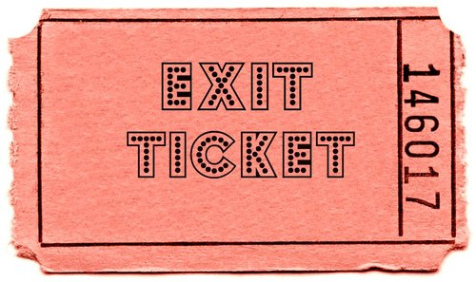
NCS / 60 MIN: OPTION 4
V1.0/Mar21
ACTIVITY: EXIT TICKET
CONSIDER:
1 thing you have learnt today.
1 piece of advice you would give to your younger self in relation to wellbeing.
1 thing you would like to know more about.
©YGAM 2021: All rights reserved

Slide 32
NCS / 60 MIN: OPTION 4
V1.0/Mar21
SIGNPOSTING OPTIONS
Speak to a member of staff
Young People Support service:
YoungPeopleService@gamcare.org.uk
T: 02030926964
National Gaming Clinic and Gambling Clinics
©YGAM 2021: All rights reserved

Slide 33
NCS/60 MIN: OPTION 5
V1.0/Mar21
GAMING MOTIVATION
GAMING MOTIVATION:
The good, the bad and the misunderstood.
NCS. Option 5
©YGAM 2021: All rights reserved

Slide 34
NCS / 60 MIN: OPTION 5
V1.0/Mar21
AIMS AND OUTCOMES
AIMS
Understand what gaming is and why some people do it
Understand the positive and negative aspects of gaming
OUTCOMES
You understand what gaming is and why people enjoy it
You understand the positives and negatives of gaming and can recognise risk
You understand what support is available and how to seek help
©YGAM 2021: All rights reserved

Slide 35
NCS / 60 MIN: OPTION 5
V1.0/Mar21
ACTIVITY: THE GAMES WE PLAY
TASK 1: In pairs/groups list all the different games you play/are aware of. Consider the methods of play, e.g. console, mobile & PC
©YGAM 2021: All rights reserved

Slide 36
NCS / 60 MIN: OPTION 5
V1.0/Mar21
ACTIVITY: THE GAMES WE PLAY
TASK 2: Discuss each of the following:
Why do you/don’t you play electronic games?
What device do you use?
What do you enjoy/dislike?
What would health vs. unhealthy gaming look like?
What are the risks of online gaming?
What worries parents/carers, professionals and young people about gaming? Are there any similarities/differences?
©YGAM 2021: All rights reserved

Slide 37
NCS / 60 MIN: OPTION 5
V1.0/Mar21
ACTIVITY: THE GAMES WE PLAY
TASK 3: Summarise your discussion
with the rest of the group.
©YGAM 2021: All rights reserved

Slide 38
NCS / 60 MIN: OPTION 5
V1.0/Mar21
DISCUSSION: WHY WE GAME
For entertainment
74%
Passes the time
60%
Reduces stress
48%
I enjoy the challenge
45%
Because my friends do
21%
Red Brick and YGAM 2019
©YGAM 2021: All rights reserved

Slide 39
NCS / 60 MIN: OPTION 5
V1.0/Mar21
DISCUSSION: WHY WE GAME
Dr David McClelland's Human Motivation Theory identified that; we seek 3 key needs:
Autonomy – The power of self-determination
Belonging – A feeling of fitting in
Competence – We want to feel that we are good at what we are doing
Consider the above. How might gaming help fulfil the 3 needs above?
Autonomy: You can pick and lead your own adventure
Belonging: They can play online with friends and build a community
Competence: Levelling up system and chance to unlock/showcase skills
©YGAM 2021: All rights reserved

Slide 40
NCS / 60 MIN: OPTION 5
V1.0/Mar21
DISCUSSION: THE GOOD/BAD/MISUNDERSTOOD
DISCUSS AND COLLATE: In groups, list as many things you can think of related to the below headings. You can create a collage to show your thoughts.
THE GOOD/POSITIVES
THE BAD/POTENIAL RISKS
MISUNDERSTOOD: HOW ARE GAMERS PORTRAYED
©YGAM 2021: All rights reserved

Slide 41
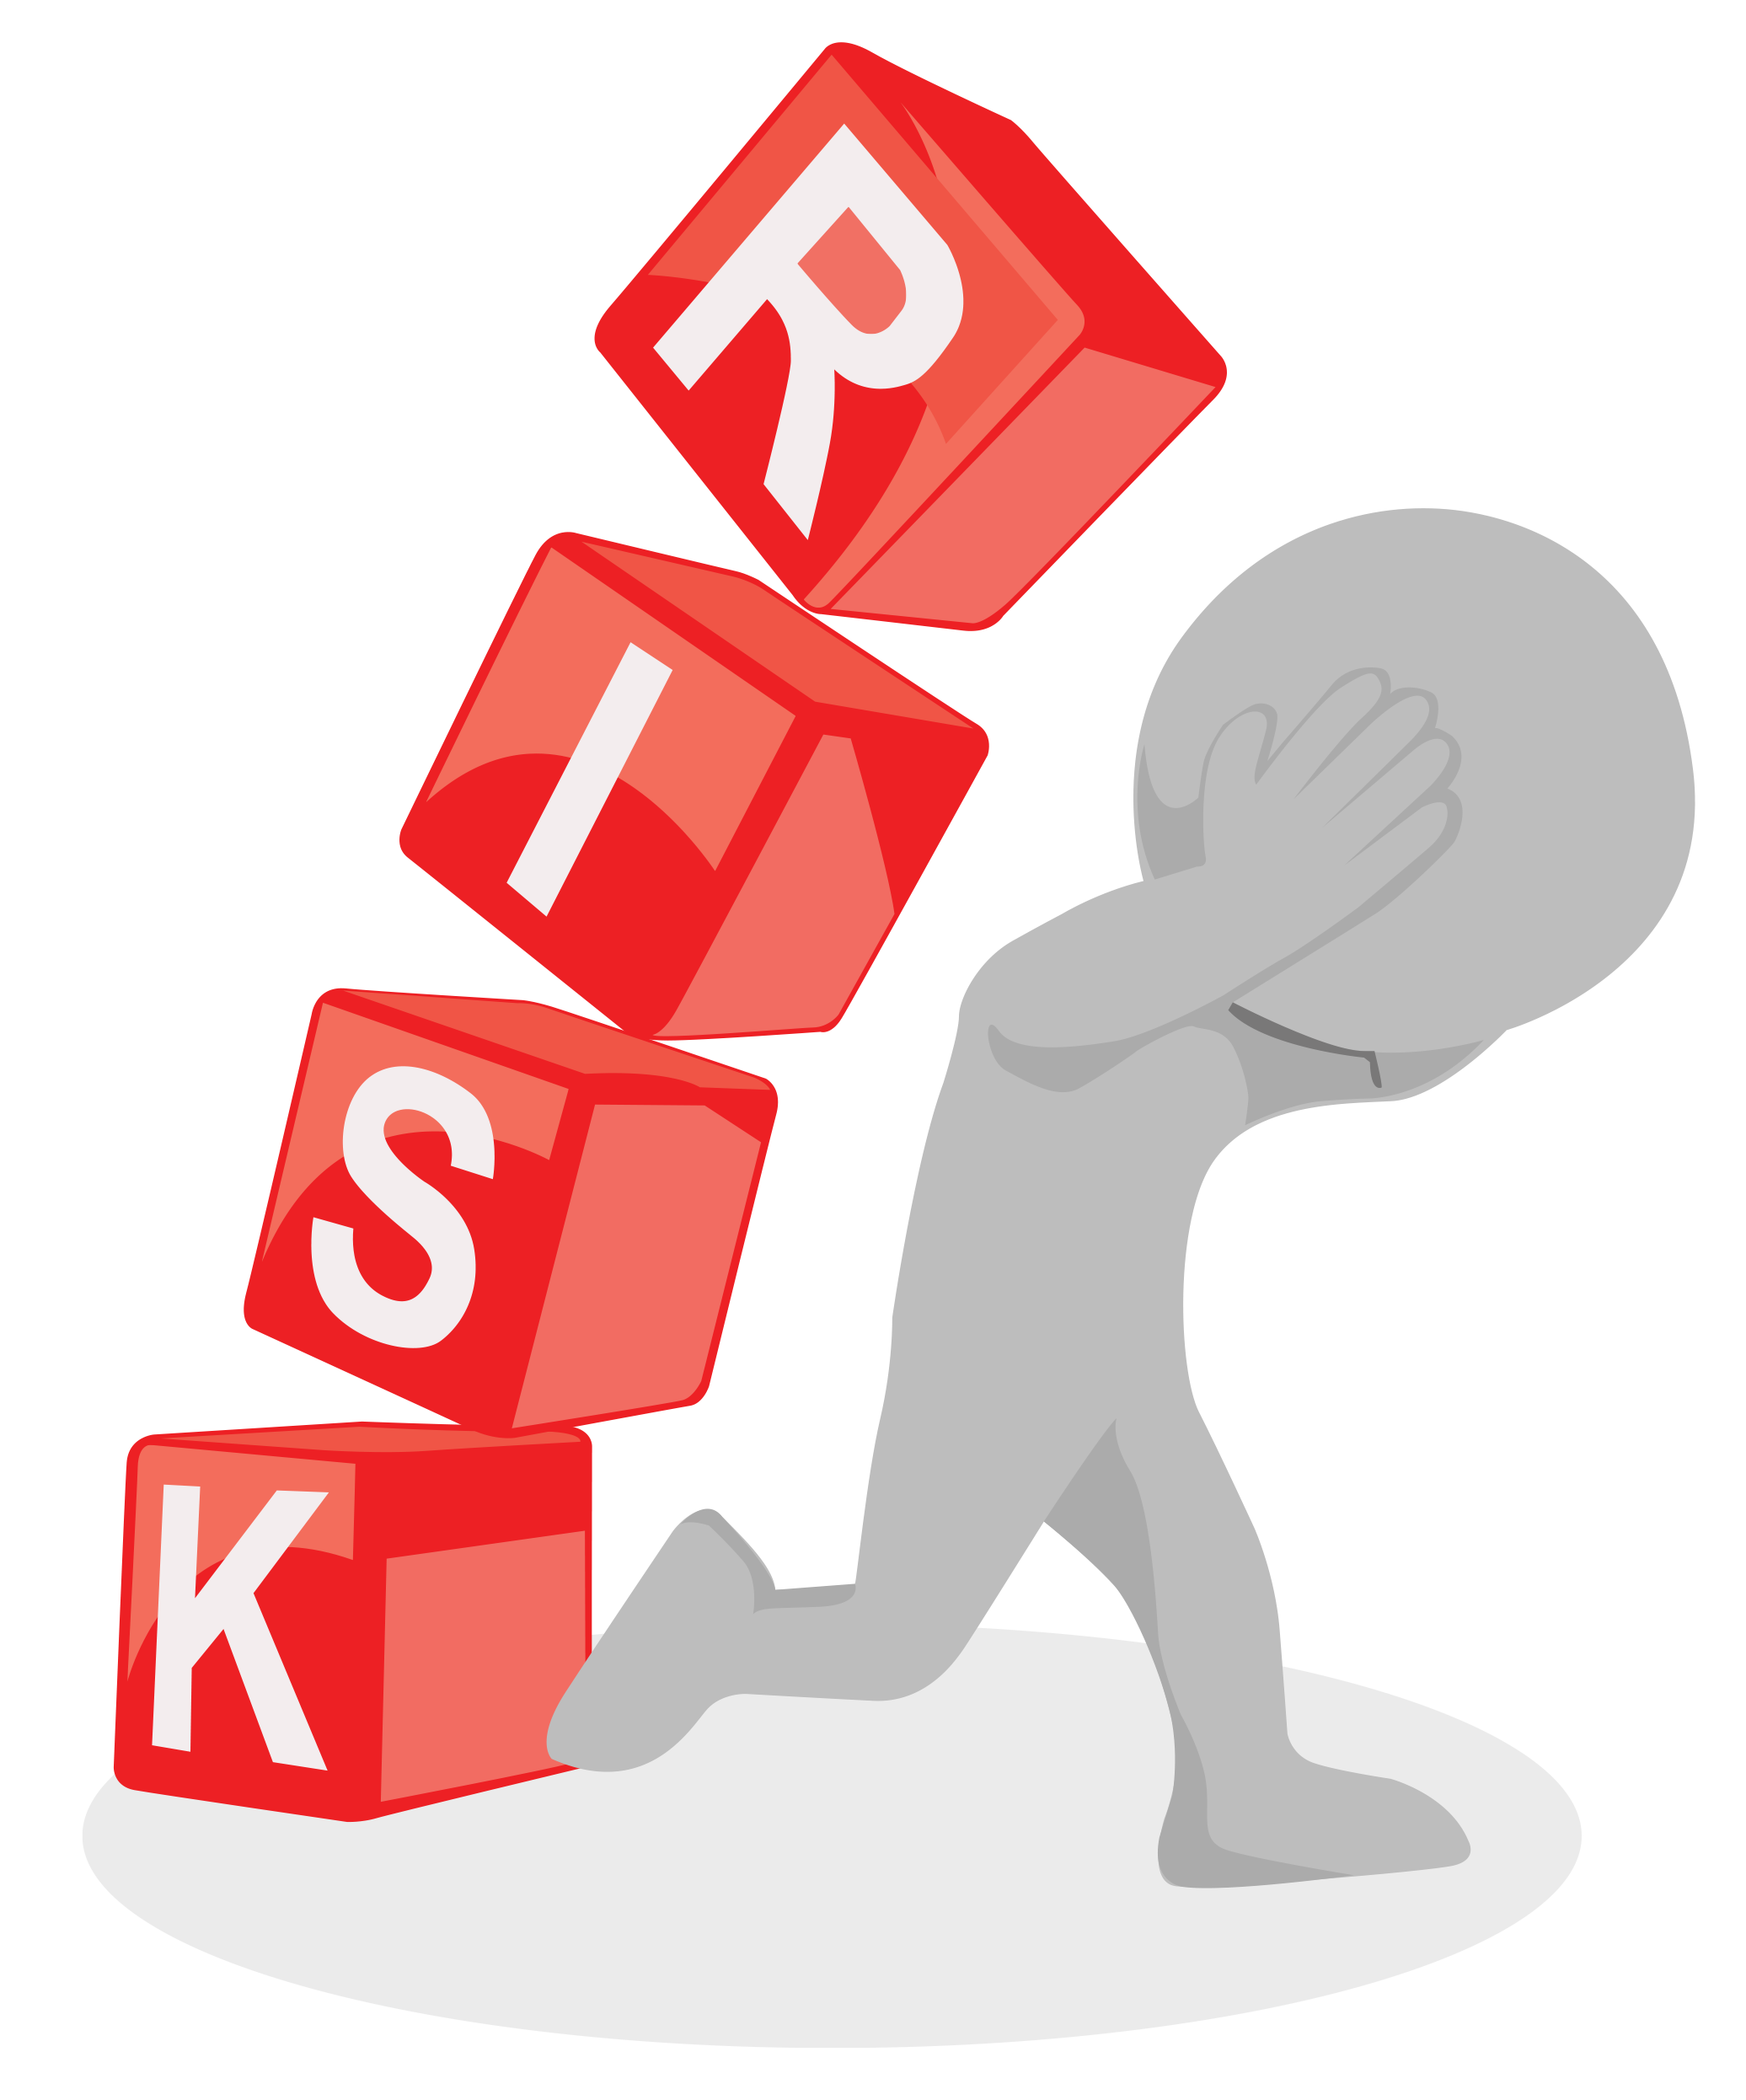
NCS / 60 MIN: OPTION 5
V1.0/Mar21
DISCUSSION: HOW TO REDUCE HARM
TASK: PICK 2-3 of the risks you identified. Is there anything that can be done to minimise the risk?
Share your ideas with the group.
©YGAM 2021: All rights reserved

Slide 42
NCS / 60 MIN: OPTION 5
V1.0/Mar21
SIGNPOSTING OPTIONS
Speak to a member of staff
Young People Support service:
YoungPeopleService@gamcare.org.uk
T: 02030926964
National Gaming Clinic and Gambling Clinics
©YGAM 2021: All rights reserved

Slide 43
NCS / 60 MIN: OPTION 6
V1.0/Mar21
LOOT BOX
LOOT BOX
What’s the fascination?
NCS. Option 6
©YGAM 2021: All rights reserved

Slide 44
NCS / 60 MIN: OPTION 6
V1.0/Mar21
AIMS AND OUTCOMES
AIMS
Understand and define 'loot box'
Recognise the contention surrounding loot boxes
OUTCOMES
You can provide a definition of 'loot box'
You understand why loot boxes are a contentious issue and can offer your own opinion
You can provide an argument for/against legislation
©YGAM 2021: All rights reserved

Slide 45
NCS / 60 MIN: OPTION 6
V1.0/Mar21
DISCUSS: LOOT BOX
What are loot boxes and why do people buy them?
Make your avatar look better
Some kids do it because of peer pressure
Items you can buy in games. Makes your players better
The suspense is part of the fun
©YGAM 2021: All rights reserved

Slide 46
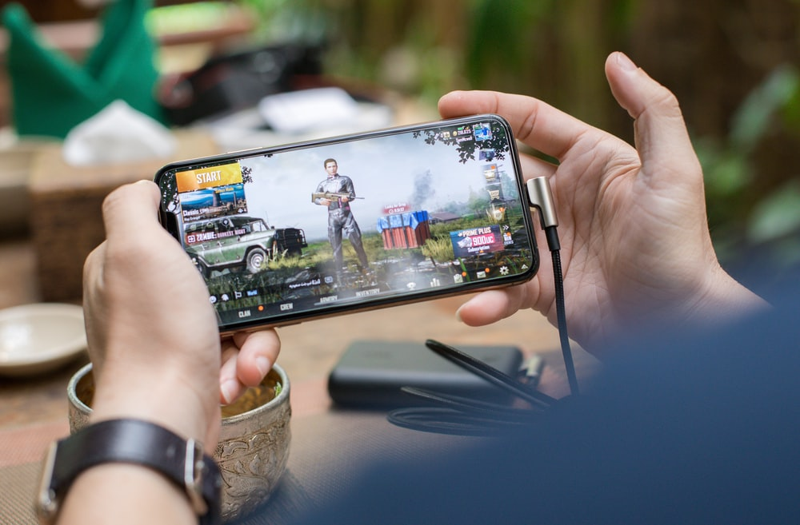
NCS / 60 MIN: OPTION 6
V1.0/Mar21
DISCUSS: LOOT BOX
Loot boxes are virtual items that can purchased in games using real money or in-game currency. Once purchased and opened, users will find a randomised selection of items that customise or alter the user’s experience of the game. The user will not receive any physical objects in the offline world.
SOURCE: www.saferinternet.org.uk
Loot boxes can be purchased with virtual or real-life currency.
©YGAM 2021: All rights reserved

Slide 47
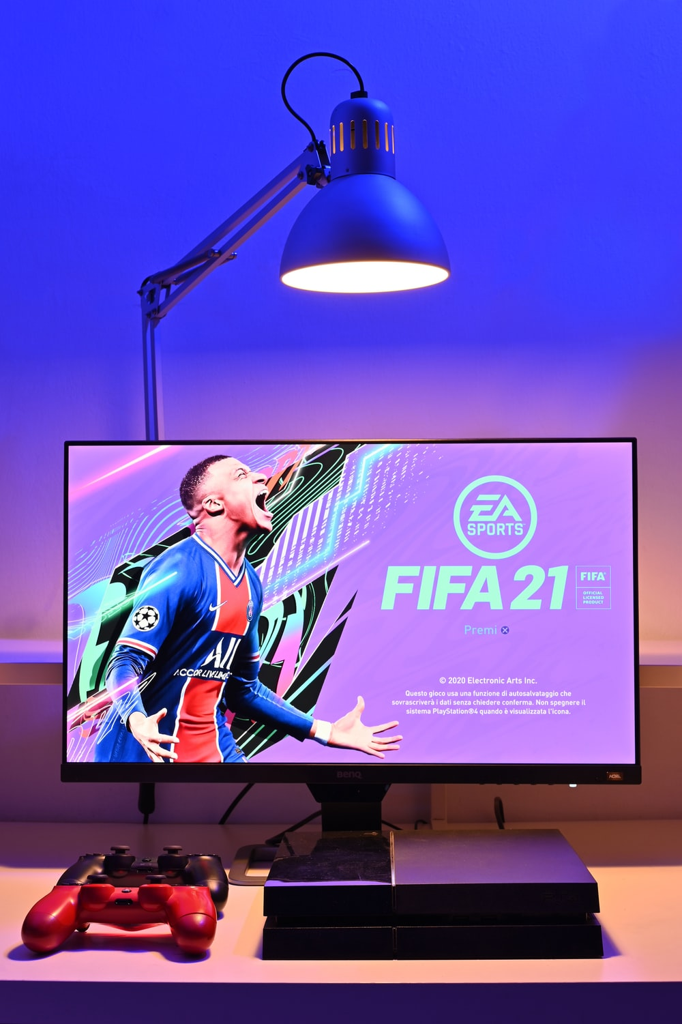
NCS / 60 MIN: OPTION 6
V1.0/Mar21
EXPLORE: LOOT BOX APPEAL
Watch the video:
https://www.youtube.com/watch?v=fSrXAp70RwM
EXPLORE:
How does it make you feel?
What do you notice about the colours and the sounds?
What would you compare it too?
Does it make you want to open another one?
How might they entice children to buy them?
©YGAM 2021: All rights reserved

Slide 48
NCS / 60 MIN: OPTION 6
V1.0/Mar21
YOUNG PEOPLE & LOOT BOXES
Gambling Commission 2019: Young People and Gambling Survey
52% of children knew what a loot box was
44% paid money to open a loot box
6% bet with in-game items
Our research suggests that either loot boxes cause problem gambling, or they exploit problem gambling amongst gamers to generate massive profits. (Dr Zendle)
©YGAM 2021: All rights reserved

Slide 49
NCS / 60 MIN: OPTION 6
V1.0/Mar21
ACTIVITY: LEGISLATION
AGREE/DISAGREE:
Write a statement explaining why you agree or disagree with the House of Lords recommendation.
Consider:
Age restrictions
Blurred lines of gambling
Tactics used to entice people to buy
Impact on young people
In-game enjoyment
Financial risk
Wellbeing
SHARE YOUR RESPONSES WITH THE GROUP AND AGREE WHICH HAS THE STRONGEST ARGUMENT.
“The Government must act immediately to bring loot boxes within the remit of gambling legislation and regulation.”
The House of Lords Select Committee on the Social and
Economic Impact of the Gambling Industry 2nd July 2020
©YGAM 2021: All rights reserved

Slide 50
NCS / 60 MIN: OPTION 6
V1.0/Mar21
SIGNPOSTING OPTIONS
Speak to a member of staff
Young People Support service:
YoungPeopleService@gamcare.org.uk
T: 02030926964
National Gaming Clinic and Gambling Clinics
©YGAM 2021: All rights reserved

