Slide 1
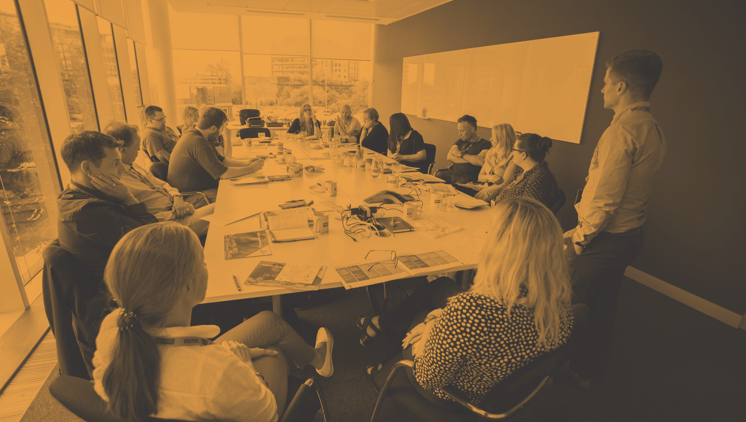
ITK / DRGSGP / 0819
In The Know - Digital Resilience in Gambling & Gaming
YGAM is a national charity with a social purpose to inform, educate, safeguard and build digital resilience amongst young and vulnerable people, helping them to make informed decisions and understand the consequences around gambling and gaming.

Slide 2
Introducing YGAM
NATIONAL GAMBLING HELPLINE 0808 8020 133

Slide 3
Introducing YGAM
We approach our social purpose in three ways:
to enhance the UK’s understanding of gambling and gaming-related harm specifically amongst young people
to help young people make informed choices through better understanding of gambling and gaming and the potential risks
increase awareness of youth gambling and gaming as public health issues with policy-makers, educators and key influencers
University &
Student
Engagement
We have three products:
Practitioner
Workshops
Research
NATIONAL GAMBLING HELPLINE 0808 8020 133

Slide 4
Today’s aims
The aim of today is to:
Increase your knowledge and understanding of gaming and gambling-related harm in the UK.
Provide material for immediate use in your setting.
Explore the YGAM programme, curriculum and resources.
NATIONAL GAMBLING HELPLINE 0808 8020 133

Slide 5
Education resources
Main education programme and resources for 11 – 25 age group
Primary school resources
Parental guidance and training
One-to-one materials
Training films
NATIONAL GAMBLING HELPLINE 0808 8020 133

Slide 6
Attitudes
What is the difference between gambling and gaming?
Why do people choose to gamble/game?
Is there a stereotypical gambler/gamer?
Is there a stigma associated with (i) gambling or (ii) problem gambling and if so, why?
NATIONAL GAMBLING HELPLINE 0808 8020 133

Slide 7
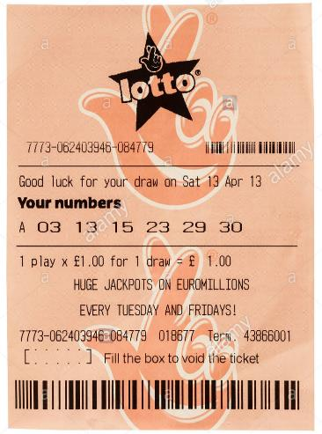
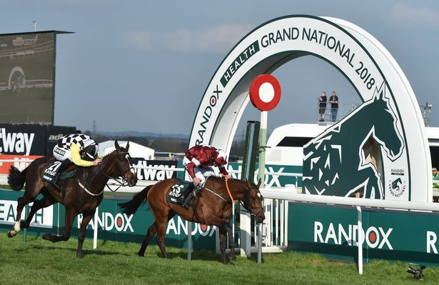
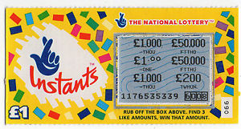
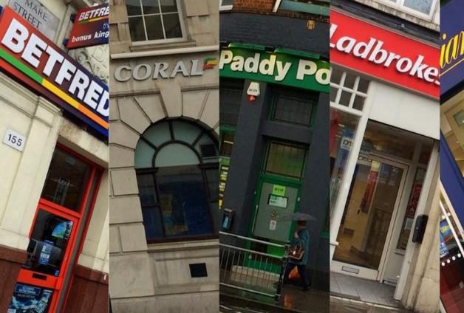
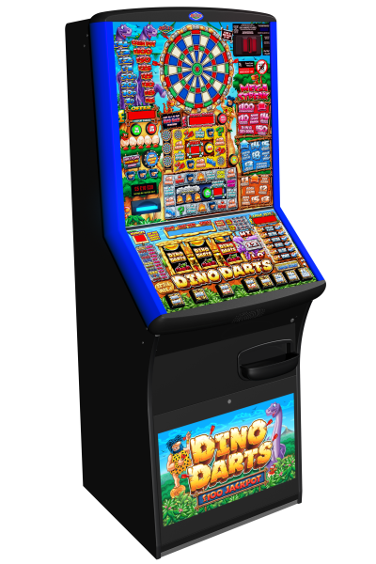
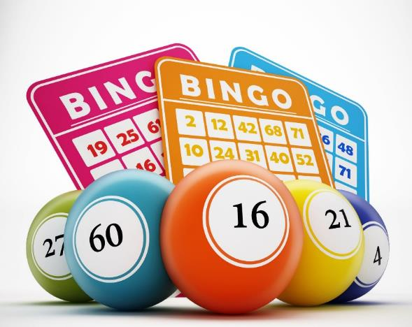
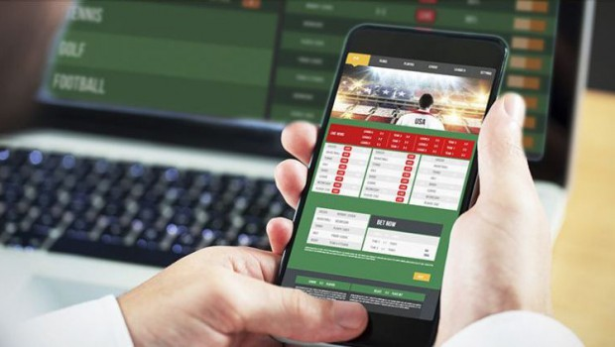
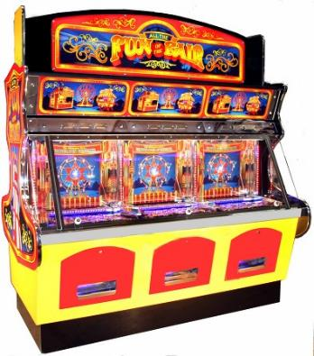
Getting to know you
Do you, or have you ever?
What is gambling?
Betting, gaming or participating in a lottery.
What is a problem gambler?
Someone whose habit compromises, disrupts or damages family, personal or recreational pursuits.
NATIONAL GAMBLING HELPLINE 0808 8020 133

Slide 8
NATIONAL GAMBLING HELPLINE 0808 8020 133

Slide 9
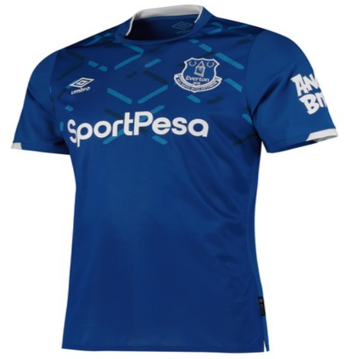
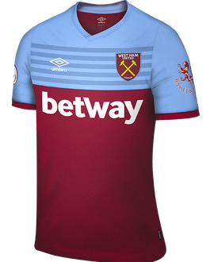
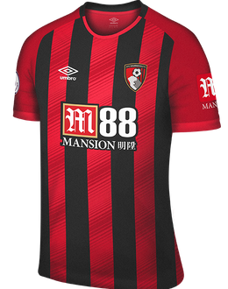
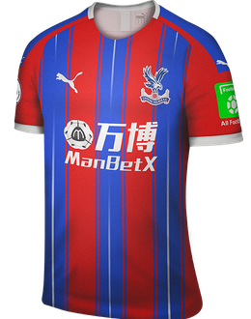
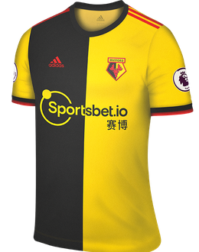
Advertising
“Betting is increasingly seen as a normal part of supporting your team or following a sport.”
- Professor Jim Orford, Gambling Watch UK
World Cup
90 minutes of adverts
200 Premier League games
televised live in the UK each season
Match Of The Day
241 times
NATIONAL GAMBLING HELPLINE 0808 8020 133

Slide 10
A short quiz
1. What % of 11-16 year olds spent their own money on gambling in the last 7 days?
2. Which activity was most popular amongst 11-16 year olds over the last 12 months?
3. What is the chance of winning the National Lottery Jackpot?
4. How much is the UK gaming industry worth?
5. When did the gambling act become a piece of United Kingdom legislation?
a) 1.4% b) 4% c) 14% d) 0.14%
a) Fruit machines b) Private bet c) Playing cards d) Sports bet
a) 1 in 4 million b) 1 in 14 million c) 1 in 43 million d) 1 in 4 billion
a) £386m b) £6.83bn c) £683m d) £3.86bn
a) 1995 b) 2005 c) 2015 d) 1945
NATIONAL GAMBLING HELPLINE 0808 8020 133

Slide 11
Current Legislation
Gambling is regulated by the UK Gambling Commission
"Protecting children and other vulnerable persons from being harmed or exploited by gambling."
Already a number of protective measures:
Age controls
Marketing
Gaming?
Licensing Objectives (Gambling Act 2005)
NATIONAL GAMBLING HELPLINE 0808 8020 133

Slide 12
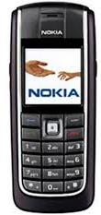
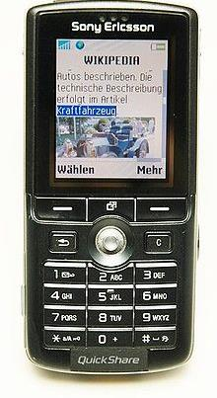
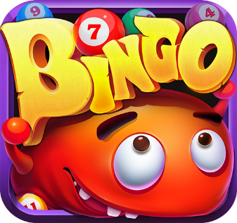
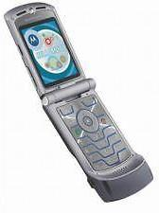
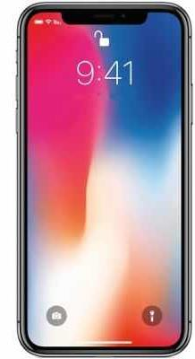
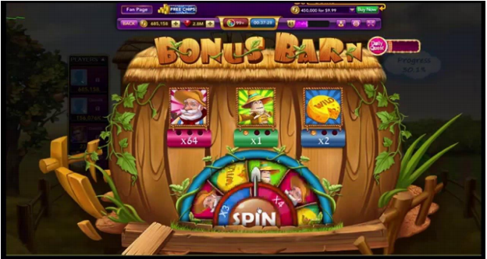
Current legislation
1000+ Apps
NATIONAL GAMBLING HELPLINE 0808 8020 133

Slide 13
Escaping Video Game Addiction
NATIONAL GAMBLING HELPLINE 0808 8020 133

Slide 14
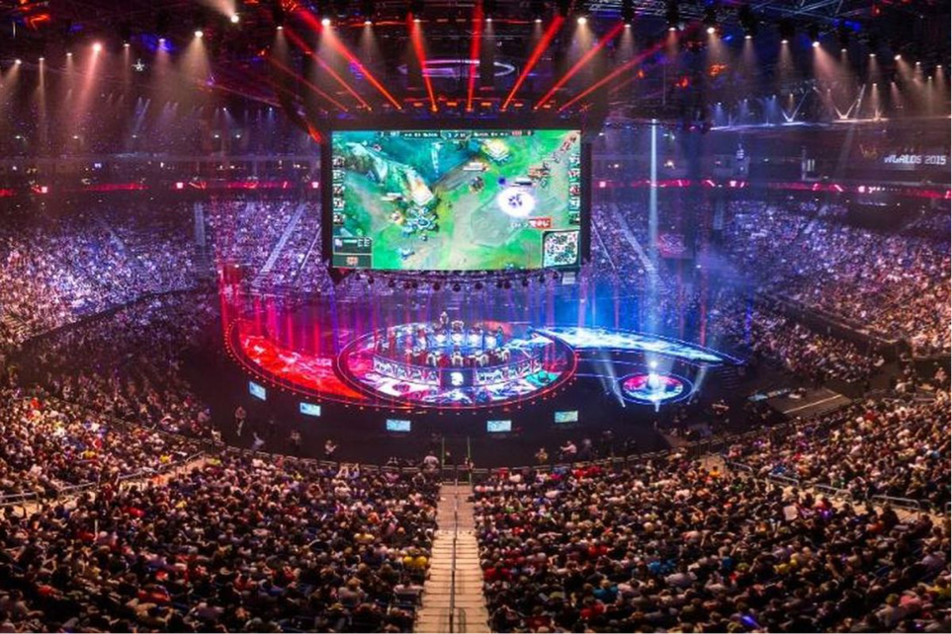
eSports
NATIONAL GAMBLING HELPLINE 0808 8020 133

Slide 15
eSports
$1.4bn
$905.6m
23.4
expected value of esports
by 2020
estimated value of eSports
average age of top
5 esports
players
385
million
$30m
$3.5m
Fortnite World Cup prize pool
global eSports audience
highest earning player
NATIONAL GAMBLING HELPLINE 0808 8020 133

Slide 16
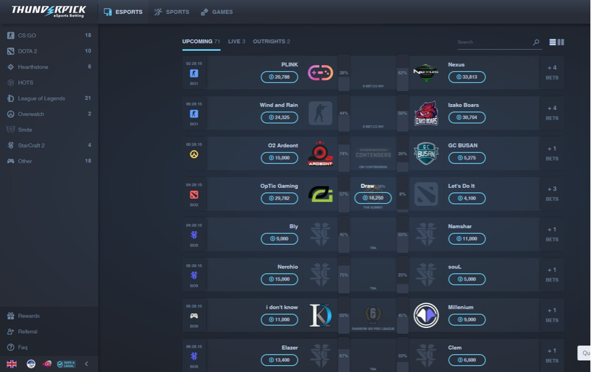
eSports
NATIONAL GAMBLING HELPLINE 0808 8020 133

Slide 17
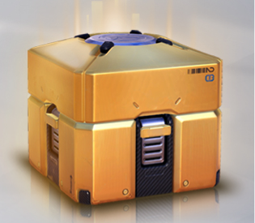
Getting to know you
Do you, or have you ever?
NATIONAL GAMBLING HELPLINE 0808 8020 133

Slide 18
Loot boxes
“Because they require no player skill and have a randomly determined outcome or prize, they function similarly to scratch tickets or gambling slot machines ” - Dr Daniel King, University of Adelaide
NATIONAL GAMBLING HELPLINE 0808 8020 133

Slide 19
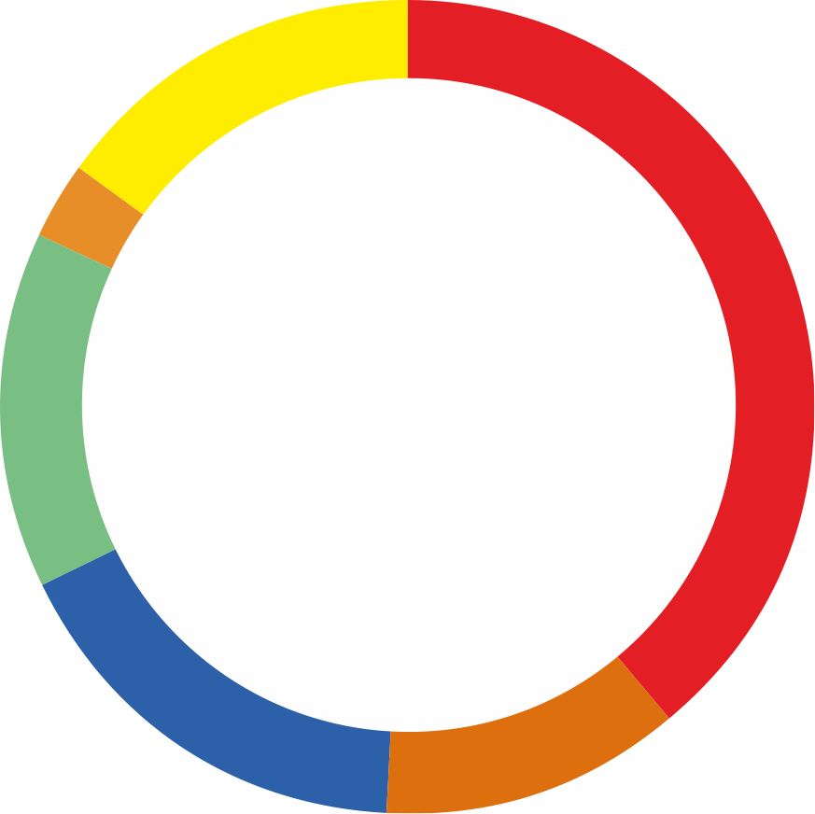
Money spent on gambling
Gambling Commission, Young People and Gambling (November 2018)
£50.01 or more
15%
Up to £2.00
39%
Average amount GIVEN
£20.01-£50.00
3%
£27
Money spent on gambling in the last seven days
£10.01-£20.00
14%
Average amount SPENT
£16
£5.01-£10.00
17%
£2.01-£5.00
12%
NATIONAL GAMBLING HELPLINE 0808 8020 133

Slide 20
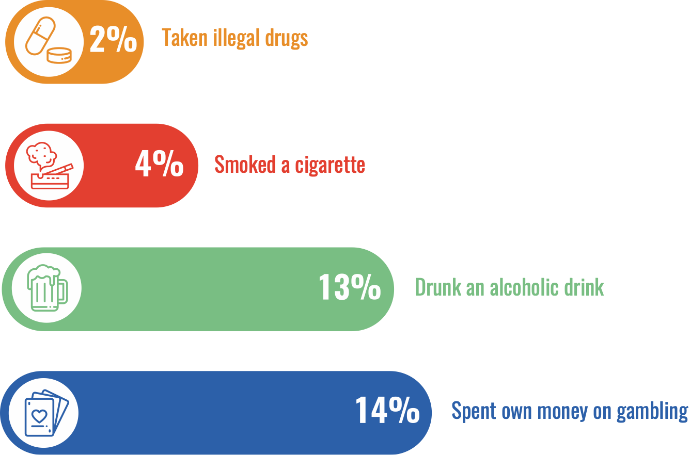
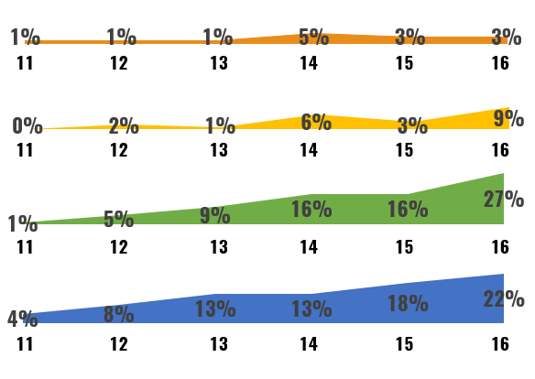
Activity participation and age breakdown
Gambling Commission, Young People and Gambling (November 2018)
Taken illegal drugs
Smoked a cigarette
Drunk an alcoholic drink
Spent own money on gambling
NATIONAL GAMBLING HELPLINE 0808 8020 133

Slide 21
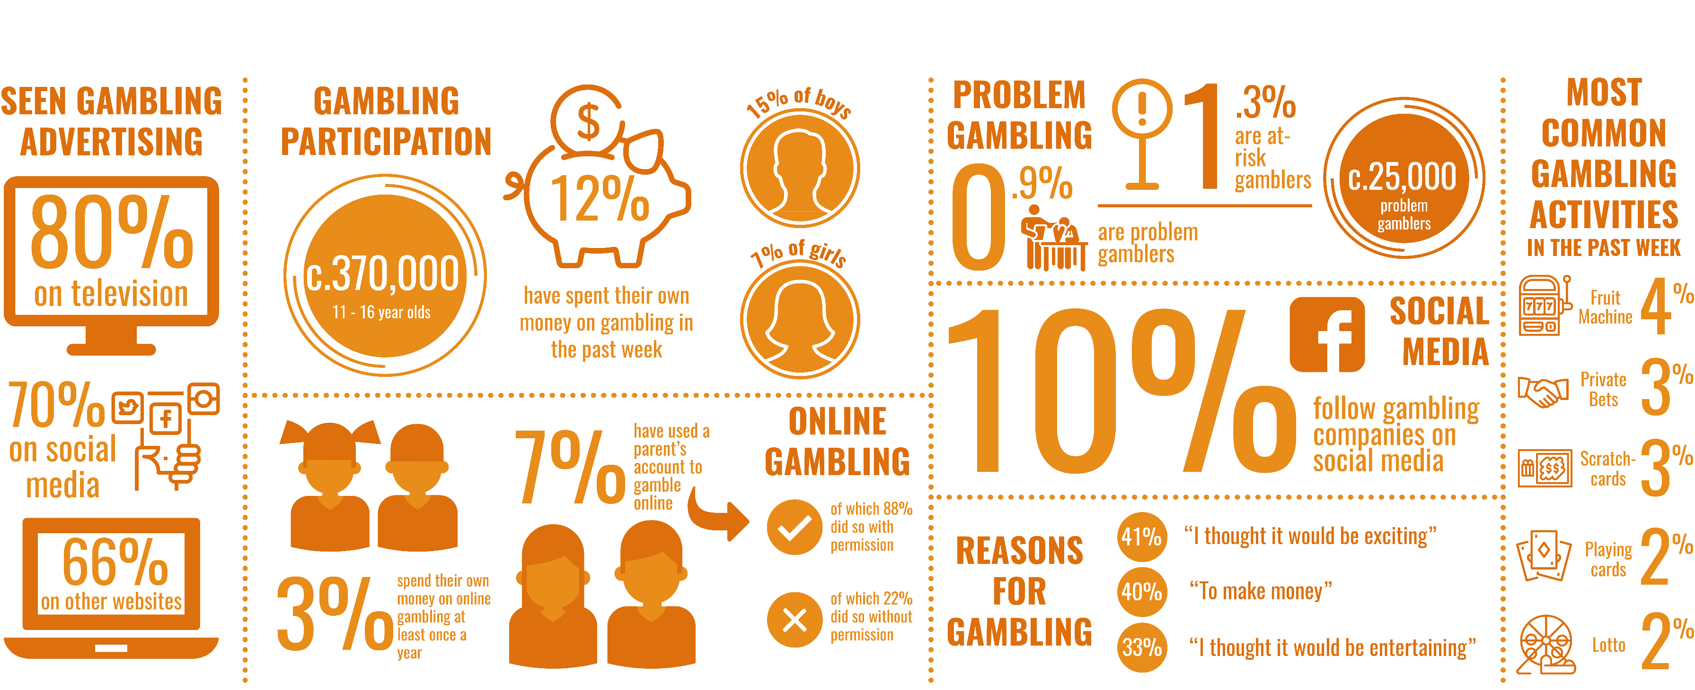
Young People and Gambling - 11-16 year olds
Source: Gambling Commission, 2017
NATIONAL GAMBLING HELPLINE 0808 8020 133

Slide 22
Signs of gaming addiction
NATIONAL GAMBLING HELPLINE 0808 8020 133

Slide 23
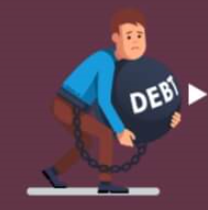
Signs of gambling addiction
Spending more money and time on gambling than you can afford
Finding it hard to manage or stop gambling
Arguing with family and friends about money and gambling
Gambling until all your money is gone
Chasing losses or gambling to get out of financial trouble
Always thinking or talking about gambling
Other signs:
Losing interest in usual activities or hobbies
Lying about gambling or hiding it from others
Borrowing money or selling possessions
Neglecting work, school, family or personal needs
Feeling anxious, worried, depressed or irritable
NATIONAL GAMBLING HELPLINE 0808 8020 133

Slide 24
Getting help
www.bigdeal.org.uk
www.youngminds.org.uk
www.childline.org.uk
krysallis.org.uk
www.monzo.com
www.gamcare.org.uk
www.scrabit.org
www.gamblersanonymous.org.uk
NATIONAL GAMBLING HELPLINE 0808 8020 133

Slide 25
Materials - 11-25 year olds
Why People Gamble?
Probability & Luck
The Gambling Industry
Money & Debt
Addiction & Mental Health
Gaming
NATIONAL GAMBLING HELPLINE 0808 8020 133

Slide 26
Materials - Primary Curriculum
Gaming Focus
Year 5 and 6 Focus
Digital Resilience Focus
Activities Booklet
Discussion Themes
NATIONAL GAMBLING HELPLINE 0808 8020 133

Slide 27
Materials - Parents & Families
Information Sessions
Online Access
Family Activities
Pro Forma Agreements
Family Focus Booklets
NATIONAL GAMBLING HELPLINE 0808 8020 133

Slide 28
The Activities
Leadership & Teamwork
Learning & Sharing
Creative Thinking & Exploration
Research & Presentation
Preparation & Discussion
NATIONAL GAMBLING HELPLINE 0808 8020 133

Slide 29
Certification and Quality Assurance
Student/young person certification available for 10 hours or more learning (optional).
Participation not qualification.
YGAM resources are quality-assured by the PSHE Association.
The YGAM training programme is accredited by City & Guilds and Pearson.
NATIONAL GAMBLING HELPLINE 0808 8020 133

Slide 30
How to do it
PSHE Provision | Gambling Awareness Day | Tutorial Programme
Responsible Gambling Week | Special Campaign | Online IT Focus
Financial Input | Skills Programme | Visit
NATIONAL GAMBLING HELPLINE 0808 8020 133

Slide 31
Choose a challenge
Pick a starting point, suitable for your centre or learners
Explain briefly:
Why you chose this?
How you would complete this?
Any other details
You CANNOT choose challenges 1.1 or 6.1
NATIONAL GAMBLING HELPLINE 0808 8020 133

Slide 32
YGAM Academy
Home to over 100 resources
Lesson plans
PowerPoints
Infographics
Letter to parents
Where to get help
NATIONAL GAMBLING HELPLINE 0808 8020 133

Slide 33
Building a campaign
Look at challenges 1.1 & 6.1
We want you to run an awareness campaign around gambling and/or gaming
What is the focus?
Give it a catchy title/slogan
What media will you use?
NATIONAL GAMBLING HELPLINE 0808 8020 133

Slide 34
Final thoughts & reflections
What have you learned?
What are the important lessons when delivering the programme?
Are you more confident delivering the content from YGAM?
What happens now?
Any other questions / comments?
NATIONAL GAMBLING HELPLINE 0808 8020 133

