Slide 1
Northern Ireland KS2 V2.0/March22
KS2: CONTENTS
The following PowerPoints relate to our KS2 Scheme of Work and Lesson Plans. Please can you complete our pre/post session surveys with your students to gauge learning. See: KS2 Pre/Post Session Survey
YEAR 5 | YEAR 6 | YEAR 7
Y5L1: FUN AND GAMES | Y6L1: THE POSITIVES AND NEGATIVES OF GAMING | Y7L1: AN INTRODUCTION TO GAMING
Y5L2: GAME PLAY | Y6L2: GAMING: WHO’S DOING WHAT? | Y7L2: GAME ON
Y5L3: LET’S KEEP GAMING FUN | Y6L3: GAME SAFELY | Y7L3: CHALLENGE EVERYTHING
Y5L4: WHAT DO WE NEED TO STAY HEALTHY? | Y6L4: LEVEL UP | Y7L4: GAMING OR GAMBLING. PART 1
Y5L5: WHAT DO WE NEED TO STAY HEALTHY? | Y6L5: GAMING AND THOSE AROUND US. PART 1 | Y7L5: GAMING OR GAMBLING. PART 2
Y5L6: A CAMPAIGN | Y6L6: GAMING AND THOSE AROUND US. PART 2 | Y7L6: THE BLURRED LINES

Slide 2
Survey: Teacher’s notes.
This document is intended to explore attitudes and behaviours prior to the delivery of our resources and then again at the end of delivery. It is aimed at KS2 and is optional, but we hope if you do use it that it can help us to gather information which will explore the impact of our resources. We may use the feedback to inform future practise. Please send responses to training@ygam.org. This document is also available electronically via Typeform:
Pre Session: https://form.jotform.com/212552605474353
Post Session: https://form.jotform.com/212553125669357
The survey includes the Pre-session survey, which asks 4 questions with the aim to understand children’s baseline knowledge. We ask them to rate their knowledge using the emojis scale. The sad face on the left is not very sure and the happy face on the right is very sure.
The Post-Session survey aims to reflect on those initial responses and gather information on their enjoyment of the content/sessions. The same scale is utilised in relation to the knowledge and information questions. If you are concerned about any young person we recommend you follow your internal safeguarding procedures; signposting options are highlighted at the end of each lesson.
©YGAM 2020: All rights reserved

Slide 3
KS2 Pre-Session Survey
School/Organisation
Class:
I understand why many people like to game. Please circle.
I understand the risks of gaming. Please circle.
I know where to get help if I am worried about gaming. Please circle.
I know how to stay safe when gaming. Please circle.
©YGAM 2020: All rights reserved

Slide 4
Post-Session Survey
School/Organisation
Class:
I understand why many people like to game. Please circle.
I understand the risks of gaming. Please circle.
I know where to get help if I am worried about gaming. Please circle.
I know how to stay safe when gaming. Please circle.
©YGAM 2020: All rights reserved

Slide 5
Post-Session Survey
School/Organisation
Class:
I enjoyed learning about this topic. Please circle.
I have a better understanding of how to stay safe after these lessons. Please circle.
The things I enjoyed the most about the lessons were: Please write your answer below.
Is this a topic all children should learn about? Please circle.
©YGAM 2020: All rights reserved

Slide 6
FUN AND GAMES
YEAR 5 / LESSON 1

Slide 7
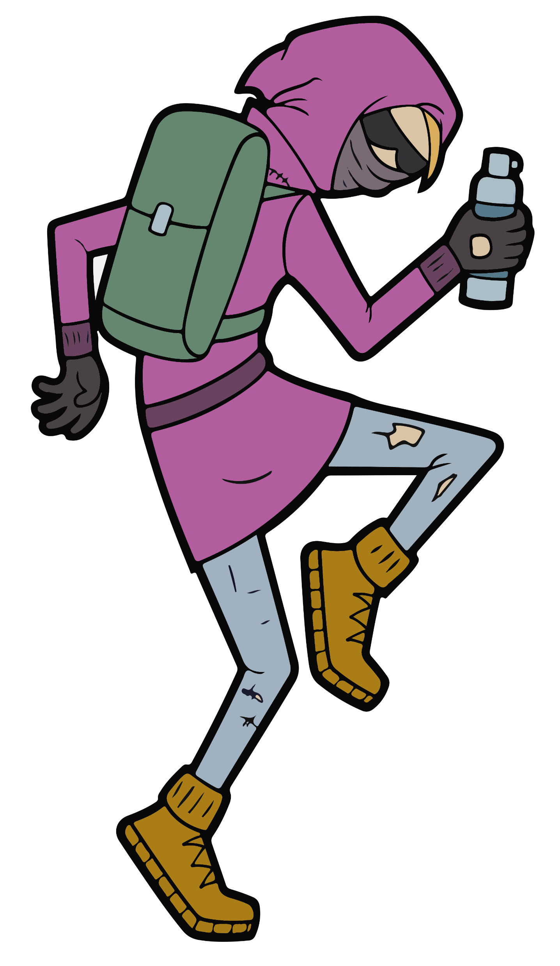
CHALLENGE
YEAR 5 / LESSON 1
Create a graffiti board based on the positive and negative emotions associated with gaming.

Slide 8
LEARNING OBJECTIVES
YEAR 5 / LESSON 1
To understand emotions that people have when gaming
To understand the ways to make gaming fun

Slide 9
LEARNING OUTCOMES
YEAR 5 / LESSON 1
I understand how gaming can make myself and others feel
I can explain the emotions people have when they game
I can think of ways we can make gaming fun

Slide 10
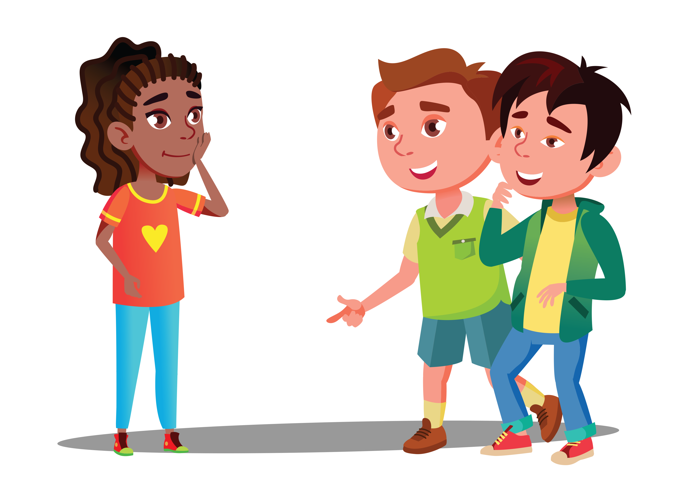
ACTIVITY: LET’S TALK GAMING
YEAR 5 / LESSON 1
What are the best parts and what are the worst parts?
How do you feel when you play and how do you feel when you have to stop?
What is gaming?

Slide 11
ACTIVITY: GRAFFITI BOARD. WHEN I GAME I FEEL...
YEAR 5 / LESSON 1
Each of you have post-it notes. Write down the feelings you have about gaming and what you feel when you play video games.
When you have finished, stick them on the graffiti board.

Slide 12
ACTIVITY: GRAFFITI BOARD. WHEN I GAME I FEEL...
YEAR 5 / LESSON 1
Which feelings are positive/good? Which are negative/bad?
Pick two things from the positive list and two things from the negative list and write a suggestion on how to ensure your time gaming is enjoyable.
PEACEFUL
HAPPY
ANGRY
ANXIOUS
UNBEATABLE
WINNER
POWERFUL
COMPETITIVE
ALIVE
FRUSTRATED
TIRED
HUNGRY

Slide 13
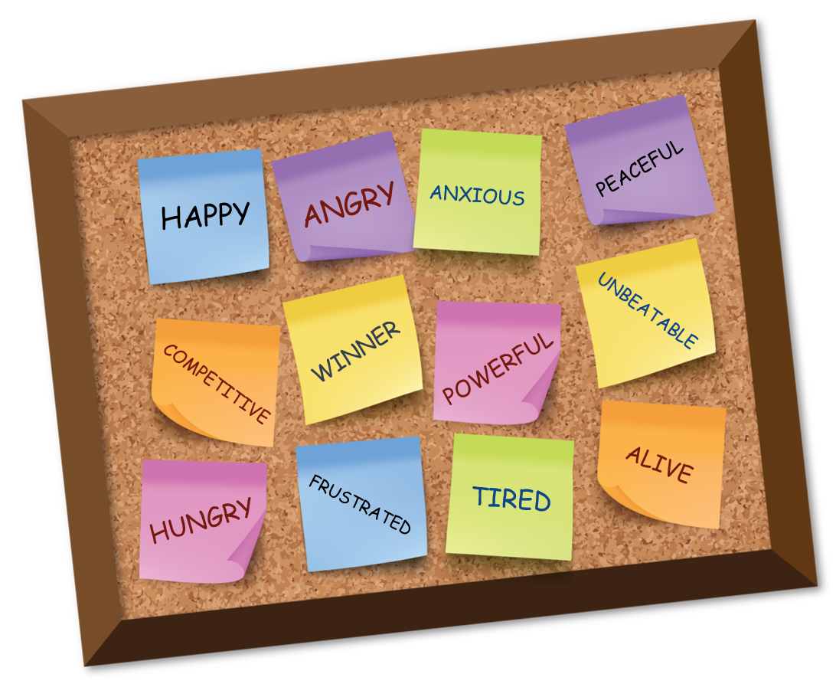
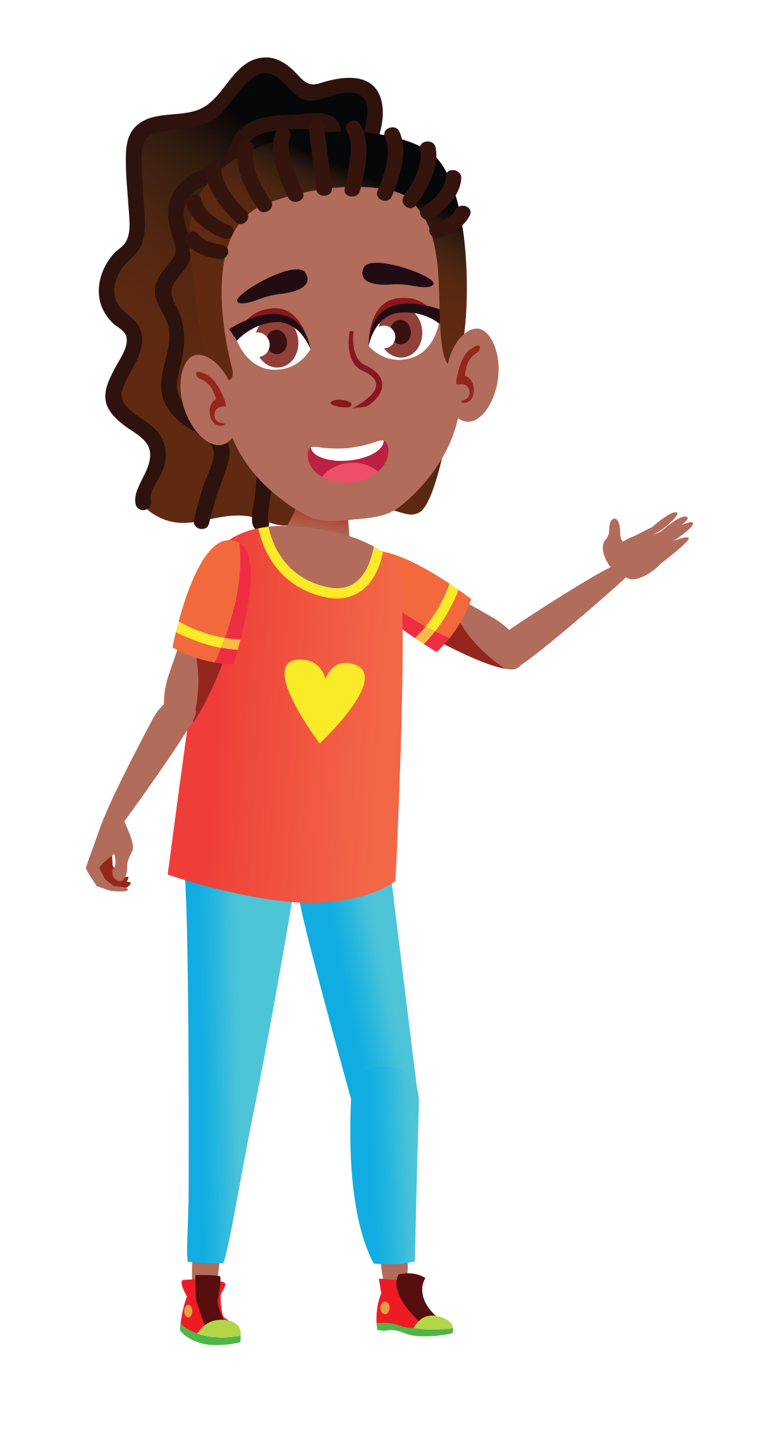
ACTIVITY: I PROUDLY PRESENT…
YEAR 5 / LESSON 1
Present your ideas to the rest of your class.

Slide 14
If you need help…
YEAR 5 / LESSON 1
If you are worried about any of the content today you can talk to a teacher or member of staff. For additional support relating to your own or someone else’s relationship with gambling/gaming you can contact Childline or GamCare.
YoungPeopleService@gamcare.org.uk
T: 02030926964

Slide 15
GAME PLAY
YEAR 5 / LESSON 2

Slide 16
CHALLENGE
YEAR 5 / LESSON 2
Build a survey focussed on the games young people play. How much time do they spend on these? Do they pay to play? Present your findings.

Slide 17
LEARNING OBJECTIVES
YEAR 5 / LESSON 2
To explore gaming behaviour amongst peers
To understand how to ensure gaming remains a fun and safe activity
To understand what is meant by responsibility and safety

Slide 18
LEARNING OUTCOMES
YEAR 5 / LESSON 2
I can take part in a survey and present the findings to my peers
I can make suggestions on how to ensure gaming remains safe and fun
I can define responsibility and safe game play

Slide 19
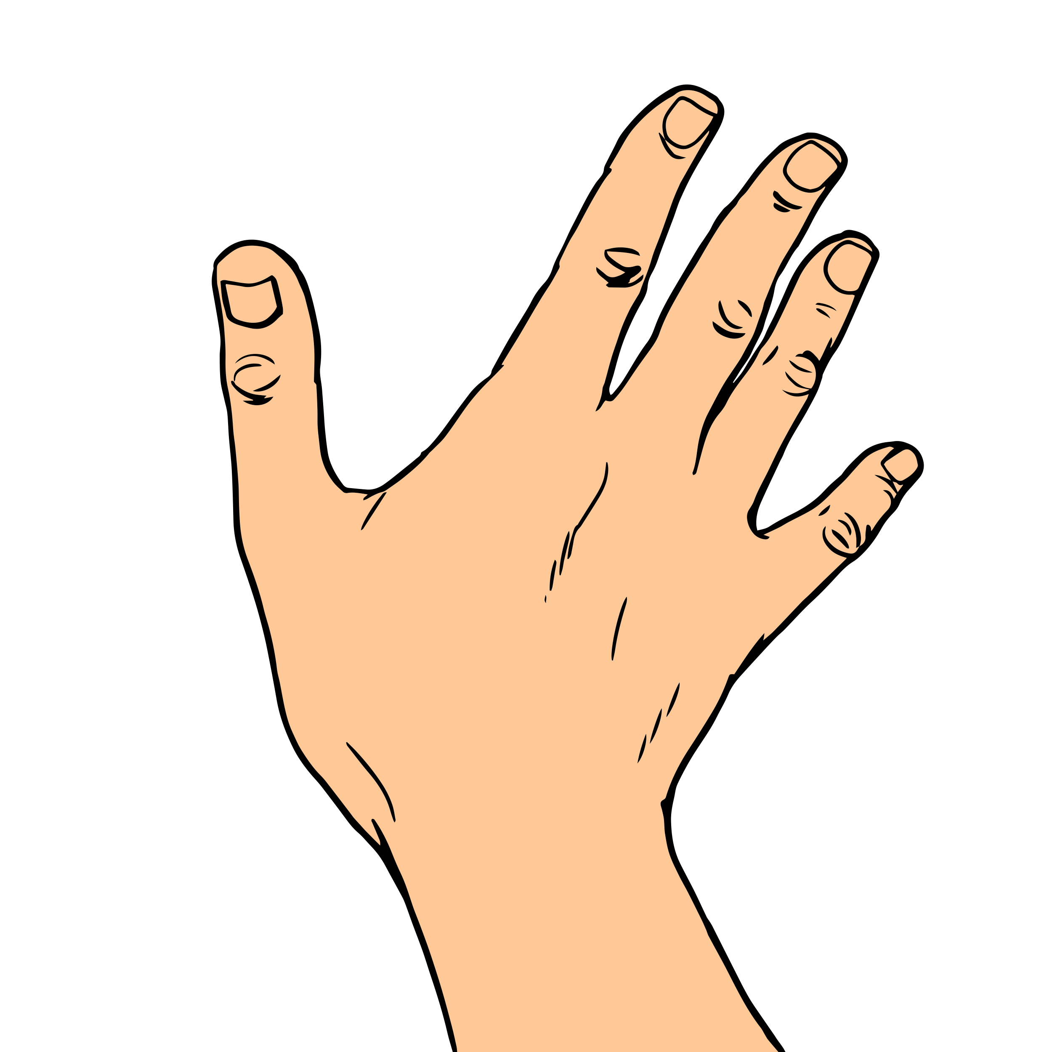
ACTIVITY: GIVE ME FIVE – WHAT GAMES DO YOU PLAY?
YEAR 5 / LESSON 2
List the games you play and think about the devices you use to play.
Add one answer to each finger.

Slide 20
ACTIVITY: SURVEY
YEAR 5 / LESSON 2
How old were you when you received your first device?
Are there any parent restrictions on your device?
Do you play games with an unsuitable PEGI rating?
What’s your top three favourite games to play?
Do you play online against friends?
Do you play online against strangers?
Do you spend money on in-game items? If so, who pays?
Who much money do you spend per month on games/in-game items?
How much time do you spend on gaming per month?

Slide 21
ACTIVITY: LET’S TALK - SAFETY
YEAR 5 / LESSON 2
Listen to our parents
What does it mean to be responsible?
Don’t neglect my health to play a computer game
Who can help us to stay safe?

Slide 22
ACTIVITY: POST-IT
YEAR 5 / LESSON 2
Don’t speak about personal matters with strangers in-game
Mute inappropriate chat in-game/ report
Don’t continue playing when tired
On your post-it, list one NEW thing you can do to stay safe when playing games.
Don’t sit too close to the screen
Drink plenty of liquids
Don’t spend too long in-game

Slide 23
ACTIVITY: PROJECT TIME
YEAR 5 / LESSON 2
You will be split into groups to work on different tasks.
Task 1
Using our survey results, create graphs to show the findings and illustrate to others.
Task 2
Consider who’s responsible for safe gaming? Work as a team to bring your ideas together and create an information leaflet about responsibility. Examples include manufacturer, themselves, parents government etc.
Task 3
Create a poster on the title of Safe Gaming

Slide 24
If you need help…
YEAR 5 / LESSON 2
If you are worried about any of the content today you can talk to a teacher or member of staff. For additional support relating to your own or someone else’s relationship with gambling/gaming you can contact Childline or GamCare.
YoungPeopleService@gamcare.org.uk
T: 02030926964

Slide 25
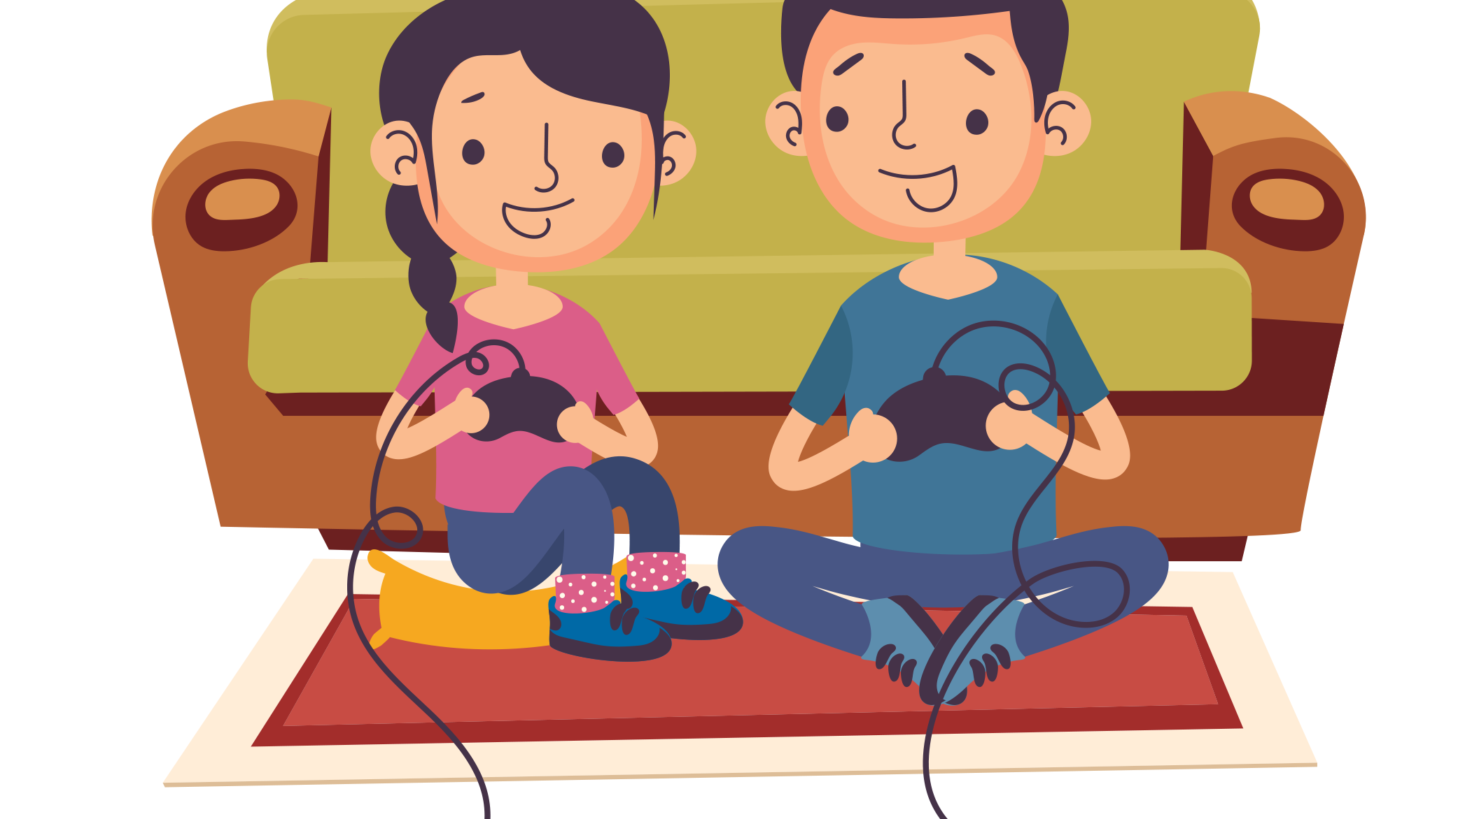
LET’S KEEP GAMING FUN
YEAR 5 / LESSON 3

Slide 26
CHALLENGE
YEAR 5 / LESSON 3
Produce a piece of art, write a play/poem or compose a piece of music inspired by the title ‘Keep Gaming Fun’.
Explain the inspiration behind your work.

Slide 27
LEARNING OBJECTIVES
YEAR 5 / LESSON 3
To understand the ways we can make sure gaming is a fun activity for all
To think of ways to prevent harm when playing games

Slide 28
LEARNING OUTCOMES
YEAR 5 / LESSON 3
I understand how to ensure gaming is a fun activity for everyone
I can list top tips to prevent harm
I can work as part of a team to discuss ideas and agree on the best options

Slide 29
ACTIVITY: LET’S KEEP GAMING FUN
YEAR 5 / LESSON 3
What can each person do to ensure games are fun and safe?
Parents
Teachers
Children
Extension: Who else should be on this list? Who are they and what could they do?

Slide 30
ACTIVITY: LET’S GET CREATIVE
YEAR 5 / LESSON 3
Produce a piece of art, write a play/poem or compose a piece of music inspired by the title ‘Keep Gaming Fun’.
Explain the inspiration behind your work.

Slide 31
ACTIVITY: TOP TIPS
YEAR 5 / LESSON 3
Looking back at our ideas at the start of the lesson, pick the top 3 tips for each person.

Slide 32
If you need help…
YEAR 5 / LESSON 3
If you are worried about any of the content today you can talk to a teacher or member of staff. For additional support relating to your own or someone else’s relationship with gambling/gaming you can contact Childline or GamCare.
YoungPeopleService@gamcare.org.uk
T: 02030926964

Slide 33
WHAT DO WE NEED TO STAY HEALTHY?
YEAR 5 / LESSON 4

Slide 34
CHALLENGE
YEAR 5 / LESSON 4
What can we do instead of gaming to balance our time and promote a healthy lifestyle?
Create a schedule that promotes a healthy balance.

Slide 35
LEARNING OBJECTIVES
YEAR 5 / LESSON 4
To understand how to be healthy
To recognise the importance of balancing activities and hobbies
To recognise the importance of physical and emotional wellbeing

Slide 36
LEARNING OUTCOMES
YEAR 5 / LESSON 4
I understand how to stay healthy
I can think of ideas to help others stay healthy
I know that it’s important to look after physical health and emotional health

Slide 37
ACTIVITY: POST-IT – HOW DO WE STAY HEALTHY?
YEAR 5 / LESSON 4
Take regular breaks
Make time to go outside and exercise
On post-it notes, list what we need to have a healthy lifestyle.
Think about ways to keep both physically and emotionally healthy.
Eat plenty of fruit
Don’t become obsessed with a game
Drink plenty of liquids
Avoid conflict

Slide 38
ACTIVITY: PHYSICAL AND EMOTIONAL NEEDS
YEAR 5 / LESSON 4
Using the words from the starter task, can you organise the words into
physical and emotional needs?
Don’t become obsessed with a game
Eat plenty of fruit
Take regular breaks
PHYSICAL
EMOTIONAL
Make time to go outside and exercise
Drink plenty of liquids
Avoid conflict

Slide 39
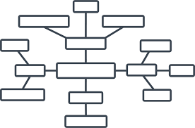
ACTIVITY: HOW DO PROFESSIONAL GAMERS STAY HEALTHY?
YEAR 5 / LESSON 4
Think about how a professional gamer may stay healthy.
What would they need to do to balance the time gaming with maintaining a healthy lifestyle?
Task 1
In groups, create a thought shower or mind-map of ideas.
Task 2
Create a schedule for a professional gamer to ensure they have a well-balanced lifestyle.
Make sure you can explain your ideas and reasoning.

Slide 40
ACTIVITY: TIME FOR SHARING
YEAR 5 / LESSON 4
..share their schedules..
Who would like to..
..and explain their reasoning?

Slide 41
If you need help…
YEAR 5 / LESSON 4
If you are worried about any of the content today you can talk to a teacher or member of staff. For additional support relating to your own or someone else’s relationship with gambling/gaming you can contact Childline or GamCare.
YoungPeopleService@gamcare.org.uk
T: 02030926964

Slide 42
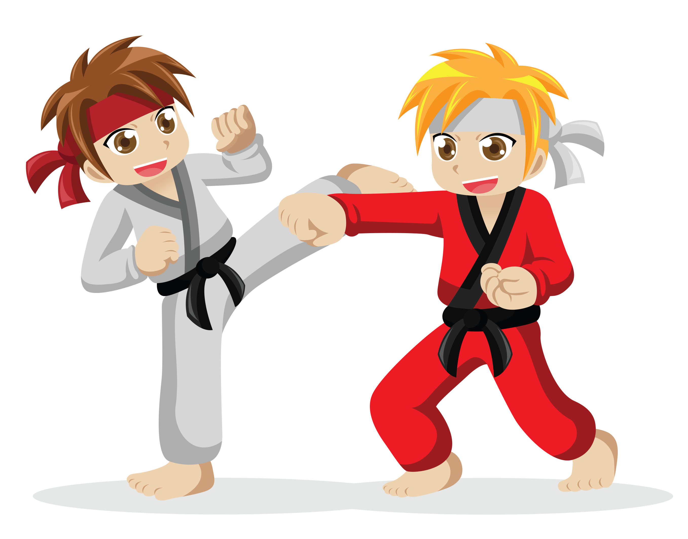
WHAT DO WE NEED TO STAY HEALTHY?
YEAR 5 / LESSON 5

Slide 43
CHALLENGE
YEAR 5 / LESSON 5
Design a safe game for other students. Consider how gaming sites are designed and how we are kept safe. Think of a new, exciting game which also protects the people that play.

Slide 44
LEARNING OBJECTIVES
YEAR 5 / LESSON 5
To understand what is meant by risk
To understand how risks can be reduced

Slide 45
LEARNING OUTCOMES
YEAR 5 / LESSON 5
I can define risk
I can suggest ways to reduce risks to myself and others

Slide 46
ACTIVITY: RISK
YEAR 5 / LESSON 5
What is meant by risk?
Each table has a set of behaviour statements. As a group, order them from high risk to low risk.

Slide 47
ACTIVITY: EDU-GAME
YEAR 5 / LESSON 5
Create a game or a quiz to educate people about staying safe when playing games.
Think about the risks and what you can do to keep people safe.

Slide 48
ACTIVITY: LET’S REVIEW
YEAR 5 / LESSON 5
Looking back at the risks we saw at the start of the lesson, what one is most risky, and why?
Write a sentence about it and explain why it is risky.
Can you think of ways to make it less risky?

Slide 49
If you need help…
YEAR / LESSON 5
If you are worried about any of the content today you can talk to a teacher or member of staff. For additional support relating to your own or someone else’s relationship with gambling/gaming you can contact Childline or GamCare.
YoungPeopleService@gamcare.org.uk
T: 02030926964

Slide 50
A CAMPAIGN
YEAR 5 / LESSON 6

Slide 51
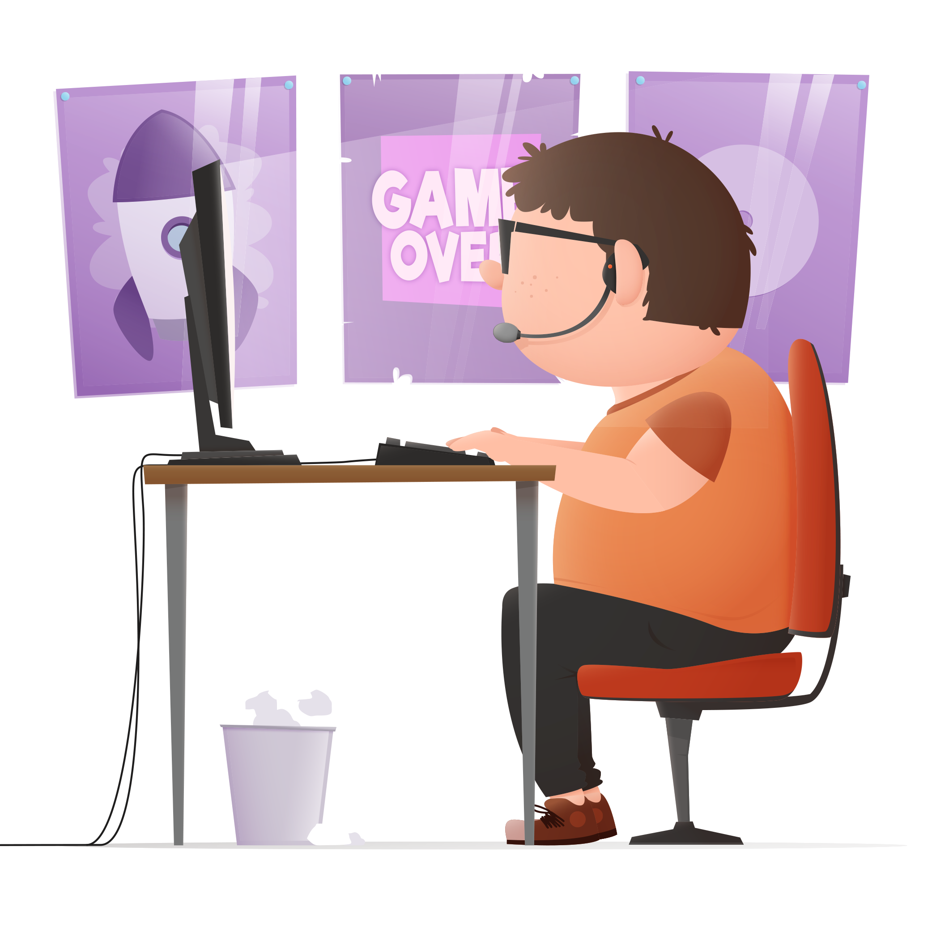
CHALLENGE
YEAR 5 / LESSON 6
Design an awareness campaign on how to spot the signs of gaming harm.

Slide 52
LEARNING OBJECTIVES
YEAR 5 / LESSON 6
To be able to identify what gaming harm might look like
To understand ways to deal with gaming harm and reduce risk

Slide 53
LEARNING OUTCOMES
YEAR 5 / LESSON 6
I can understand other people’s ideas and points of view
I can recognise what harm from gaming might look like
I can think of ways to reduce gaming harm

Slide 54
ACTIVITY: WHAT MAKES OUR PARENTS, CARERS AND GUARDIANS WORRY?
YEAR 5 / LESSON 6
Create a thought shower about the things your parents/carers/guardians might worry about when you play video games/online games.
Extension: What could parents/carers do to ease these worries and prevent risk?
Thought Shower

Slide 55
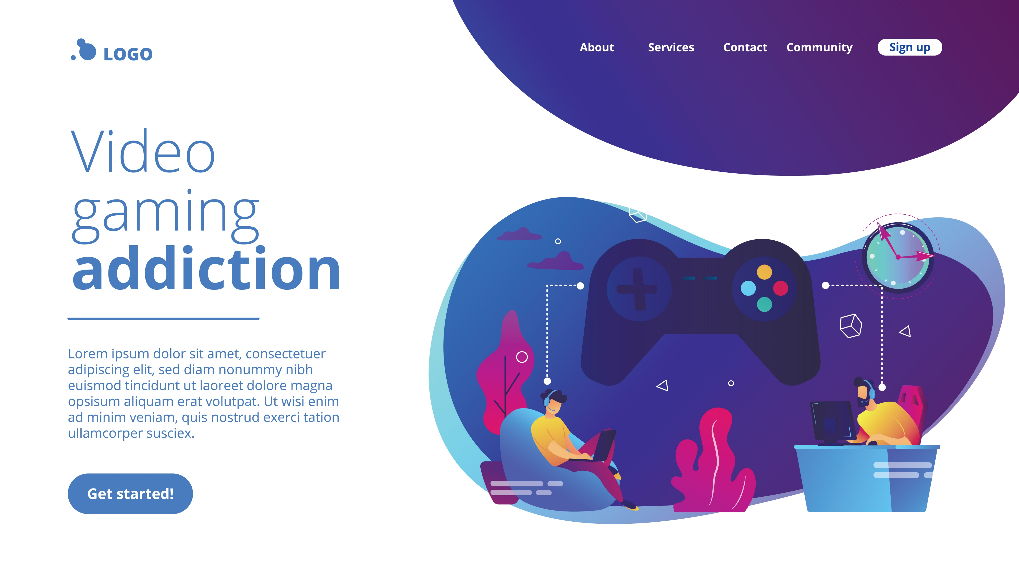
ACTIVITY: TIME TO CAMPAIGN
YEAR 5 / LESSON 6
What is meant by a campaign?
Create a campaign to help educate parents/carers/adults about harm caused by gaming. You will need to include a title and slogan.
Provide information on what signs parents/carers should look for and what they can do to prevent risk.
Idea station: You could make a video, poster, presentation (PPT or similar), a leaflet, role play, Tv commercial, hot seat activity etc.

Slide 56
ACTIVITY: TIME TO THINK
YEAR 5 / LESSON 6
Write down three things you have learnt in the lesson or over the course of the topic that will remind you about safe gaming.

Slide 57
If you need help…
YEAR 5 / LESSON 6
If you are worried about any of the content today you can talk to a teacher or member of staff. For additional support relating to your own or someone else’s relationship with gambling/gaming you can contact Childline or GamCare.
YoungPeopleService@gamcare.org.uk
T: 02030926964

Slide 58
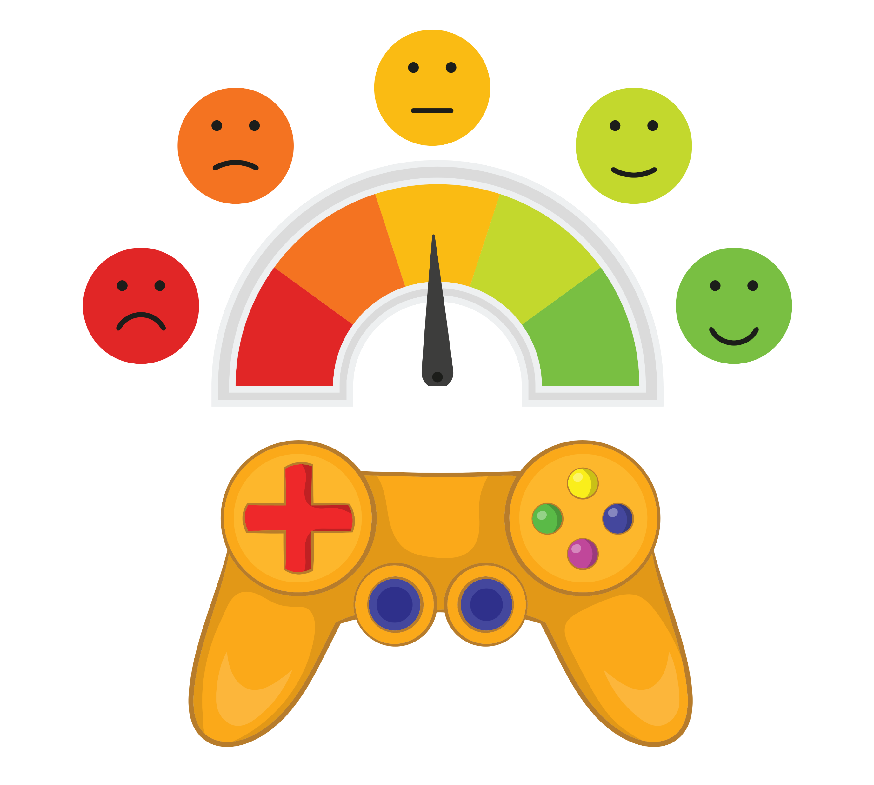
THE POSITIVES AND NEGATIVES OF GAMING
YEAR 6 / LESSON 1

Slide 59
CHALLENGE
YEAR 6 / LESSON 1
Collect images of gaming and the keywords associated with it. Create a wall display.

Slide 60
LEARNING OBJECTIVES
YEAR 6 / LESSON 1
To identify the positive aspects of gaming
To identify the negative aspects of gaming
To create an informative wall display

Slide 61
LEARNING OUTCOMES
YEAR 6 / LESSON 1
I can identify key words and images associated with gaming
I can discuss the positive and negative aspects of gaming
I can listen to other people’s points of view and be respectful of their views
I can work as a group to create an informative wall display

Slide 62
ACTIVITY: POST-IT
YEAR 6 / LESSON 1
You have two post-it notes. On one note write down a positive aspect of gaming and on the other note write down a negative aspect of gaming.
Come to the front and stick your notes on the board.
ENJOYMENT
FRUSTRATION

Slide 63
ACTIVITY: CREATE A WALL DISPLAY
YEAR 6 / LESSON 1
In groups, we are going to work together to create a wall display. There are several tasks that we need to complete.
TASK 1 POETRY ACROSTIC POEM: GAMING | TASK 2 IMAGE AND KEY WORD COLLECTION | TASK 3 POSITIVES AND NEGATIVES
Create an acrostic poem for the wall display using the word GAMING. | Collect 10 images of gaming and collect key words about gaming. This could be made into a word wall or a Wordle | Research and write down the positives and negatives of gaming.

Slide 64
ACTIVITY: LET’S TALK…
YEAR 6 / LESSON 1
The class is going to be split in half. Team A are going to debate the positives aspects of gaming and Team B are going to debate the negative aspects of gaming.
Remember, we must always allow one person to speak and we must always respect their viewpoint, even if we don’t always agree.
TEAM A
TEAM B

Slide 65
If you need help…
YEAR 6 / LESSON 1
If you are worried about any of the content today you can talk to a teacher or member of staff. For additional support relating to your own or someone else’s relationship with gambling/gaming you can contact Childline or GamCare.
YoungPeopleService@gamcare.org.uk
T: 02030926964

Slide 66
GAMING: WHO’S DOING WHAT?
YEAR 6 / LESSON 2
© YGAM 2020: All rights reserved

Slide 67
CHALLENGE
YEAR 6 / LESSON 2
Create a Questionnaire to explore how your school games? What are the issues?

Slide 68
LEARNING OBJECTIVES
YEAR 6 / LESSON 2
Understand the term ‘gaming’ and the feelings associated with it
Understand how to create a questionnaire to gather data and analyse results

Slide 69
LEARNING OUTCOMES
YEAR 6 / LESSON 2
I can describe the words and feelings associated with gaming
I know how to create a questionnaire to gather data
I can analyse and present my findings

Slide 70
ACTIVITY: GAMING A-Z
YEAR 6 / LESSON 2
A-Z Example
A.
B.
C.
D.
E.
F.
You have 5 minutes to list as many words and feelings as you can related to gaming.
Share and discuss ideas.
Adrenaline, Action
Battle Pass, BM (Bad Manners)
Console
D Pad
Esports
Fun

Slide 71
ACTIVITY: HOW DOES OUR SCHOOL GAME?
YEAR 6 / LESSON 2
We want to find out how our school games from Reception to Year 6!
Your task is to create a questionnaire so we can gather information for each year group.
Consider the questions you want to ask and how you will record the answers
Be specific
Ask one thing per question
Consider how you will collate this information

Slide 72
ACTIVITY: LET’S MAKE A DECISION
YEAR 6 / LESSON 2
Let’s agree on a class questionnaire we can share with all year groups.
What shall we use the data for?
An assembly, a leaflet, a newsletter, information for parents?
©YGAM 2020: All rights reserved

Slide 73
If you need help…
YEAR 6 / LESSON 2
If you are worried about any of the content today you can talk to a teacher or member of staff. For additional support relating to your own or someone else’s relationship with gambling/gaming you can contact Childline or GamCare.
YoungPeopleService@gamcare.org.uk
T: 02030926964

Slide 74
GAME SAFELY
YEAR 6 / LESSON 3

Slide 75
CHALLENGE
YEAR 6 / LESSON 3
Run a campaign about how to stay safe when gaming. What are the main issues?

Slide 76
LEARNING OBJECTIVES
YEAR 6 / LESSON 3
To understand the meaning and use of PEGI ratings
To evaluate the risks involved in gaming
To create a safer gaming campaign

Slide 77
LEARNING OUTCOMES
YEAR 6 / LESSON 3
I can explain what a PEGI rating is and why they are important
I can research the PEGI ratings of different games
I can identify the risks associated with playing games
I can discuss ways to make playing games safer
I can work as a group to create a safer gaming campaign
I can use different strategies to engage my peers and a wider audience

Slide 78
ACTIVITY: THINK, PAIR, SHARE
YEAR 6 / LESSON 3
What do you think these images are?

Slide 79
ACTIVITY: DEFINITIONS
YEAR 6 / LESSON 3
The PEGI rating is the rating a game is given based on its content and
the age group that it is suitable for.
Suitable for all ages
Suitable for age 7+, may contain mild violence
Suitable for 12+, contains violence, mild bad language & some gambling references
suitable for 16+, contains violence, bad language, gambling
Adult only game, severe violence and bad language, gambling
Discuss: Which games are the most popular?

Slide 80
ACTIVITY: CLASS DISCUSSION
YEAR 6 / LESSON 3
Does it have in-app purchases?
Where does your electronic device live at night?
What is the PEGI rating of the games you play?
What could you do instead of gaming?

Slide 81
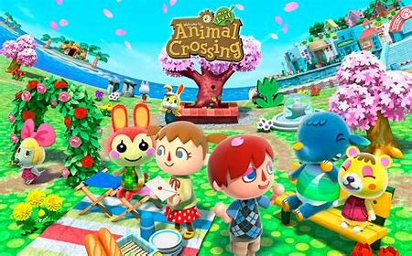
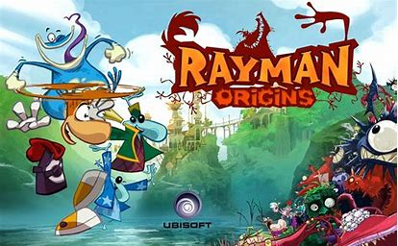
ACTIVITY: TOP TEN GAMES (non-IT option)
YEAR 6 / LESSON 3
Look at the ten games on your worksheet and assign
each game the PEGI rating you think it has.

Slide 82
ACTIVITY: TOP TEN GAMES (IT option)
YEAR 6 / LESSON 3
Look at the ten games on your worksheet and use a computer to research the PEGI rating of each game.

Slide 83
ACTIVITY: LET’S TALK…
YEAR 6 / LESSON 3
Would you want your younger sibling/cousin/friend playing games with an older PEGI rating?
Why do PEGI ratings exist?
What do you think the other risks are when playing online games? Think about in game purchases/loot boxes/crates/ playing in forums and against others (known/unknown).

Slide 84
ACTIVITY: SAFER GAMING CAMPAIGN POSTER
YEAR 6 / LESSON 3
Design a poster explaining how to stay safe when gaming. Your target audience for the poster is other primary school children.
Thinking points:
What are the main issues?
What will you need to do to get your point across?

Slide 85
ACTIVITY: BE THE TEACHER…
YEAR 6 / LESSON 3
Take the place of the teacher and teach the class about the risks of online games and how to play safely.

Slide 86
HOMEWORK ACTIVITY: KEEP A DIARY OF GAMING ACTIVITY
YEAR 6 / LESSON 3
Log your activity each day over a two-week period to monitor the time you spend on your electronic devices.

Slide 87
If you need help…
YEAR 6 / LESSON 3
If you are worried about any of the content today you can talk to a teacher or member of staff. For additional support relating to your own or someone else’s relationship with gambling/gaming you can contact Childline or GamCare.
YoungPeopleService@gamcare.org.uk
T: 02030926964

Slide 88
LEVEL UP
YEAR 6 / LESSON 4

Slide 89
CHALLENGE
YEAR 6 / LESSON 4
Investigate a game that is popular within your class. Explore the probability of buying a particular item/player. How likely are you to get the ‘dream item’? Create an information sheet to inform players on the probability of them gaining the coveted item.

Slide 90
LEARNING OBJECTIVES
YEAR 6 / LESSON 4
To understand how you and your classmates feel about in game purchases
To be able to research and present information about specific games and the probability of obtaining items within play.

Slide 91
LEARNING OUTCOMES
YEAR 6 / LESSON 4
I understand the options to buy/win items in games
I understand probability in relation to particular games
I can create an information sheet to inform and educate others
I can make informed decisions about my own gaming

Slide 92
ACTIVITY: TIME TO TALK – WHAT GAMES DO YOU PLAY?
YEAR 6 / LESSON 4
List the games you play and let’s discuss…
Does the desire to level up make you want to buy items within games?
How do you progress in game play?
Do you buy items to assist?
Do you pay to play online/in forums etc?
1 minute scribble…
What emotions do you experience when you game?

Slide 93
ACTIVITY: INVESTIGATE A POPULAR GAME WITHIN YOUR CLASS
YEAR 6 / LESSON 4
Investigate a game of your choice. Research the following:
Explore the probability of buying an item/player.
How likely are you to get the ‘dream item’?
Create an information sheet/poster to inform players on the probability of them gaining the coveted item.

Slide 94
ACTIVITY: THINK, PAIR, SHARE
YEAR 6 / LESSON 4
Let’s think about the probability of gaining a certain item - are you more or less likely to spend your money on these?
Cosmetic in-game items that costs real world money to purchase
New armour that you can only get by buying loot boxes

Slide 95
If you need help…
YEAR 6 / LESSON 4
If you are worried about any of the content today you can talk to a teacher or member of staff. For additional support relating to your own or someone else’s relationship with gambling/gaming you can contact Childline or GamCare.
YoungPeopleService@gamcare.org.uk
T: 02030926964

Slide 96
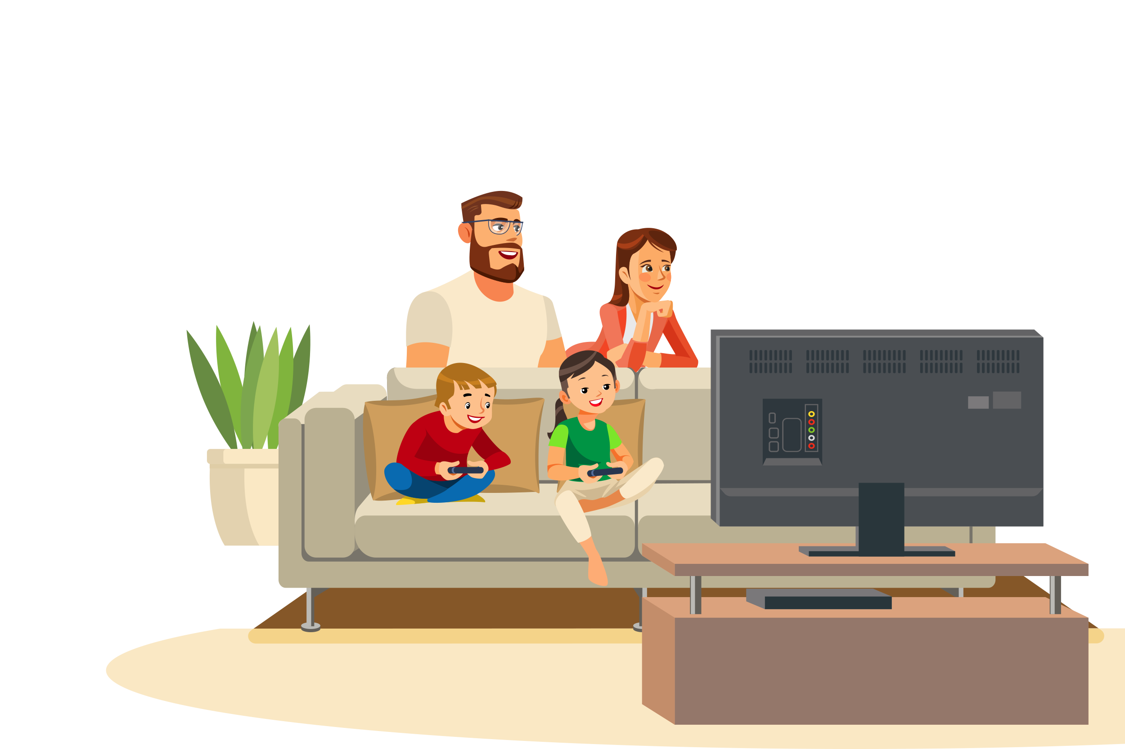
GAMING AND THOSE AROUND US. PART 1
YEAR 6 / LESSON 5

Slide 97
CHALLENGE
YEAR 6 / LESSON 5
Prepare a PowerPoint or similar for a class or year group assembly, focussing on the issues surrounding electronic device usage and social gaming.

Slide 98
LEARNING OBJECTIVES
YEAR 6 / LESSON 5
To identify the issues of gaming and electronic device usage for the individual
To identify the issues of gaming and electronic device usage for the family/community
To educate your peers on the issues that gaming can cause within the family/community

Slide 99
LEARNING OUTCOMES
YEAR 6 / LESSON 5
I can identify the key issues caused by gaming and electronic device usage
I can categorise issues into key themes such as money, friendships etc
I can work as a group to create an informative PowerPoint (or similar)
I can present information to a wider audience

Slide 100
ACTIVITY: GIVE ME FIVE…
YEAR 6 / LESSON 5
What might be the issues of gaming on the individual, friendships, families and communities?
Draw around your hand. Then write down five issues of gaming on those around you/the gamer. Write one issue on each finger.
Thinking points: Friendships, money etc.

Slide 101
ACTIVITY OPTION 1: CREATE A POWERPOINT
YEAR 6 / LESSON 5
In your groups, you will be assigned one of the ten issues on the board. Create a PowerPoint to inform your peers of the issue you have been given.
Extension: Can you offer solutions to the issue you have been given?

Slide 102
ACTIVITY OPTION 2: CREATE A POSTER OR BANNER
YEAR 6 / LESSON 5
In your groups, you will be assigned one of the ten issues on the board. Create a poster or banner to inform your peers of the issue you have been given.
Extension: Can you offer solutions to the issue you have been given?

Slide 103
ACTIVITY: I PROUDLY PRESENT…
YEAR 6 / LESSON 5
Present your work to one other group. The group will give you some feedback that you can use to make your work even better. Practise your presentation using their feedback.
You will be presenting your final work in assembly in order to educate your peers on the issues of gaming and electronic device usage.

Slide 104
If you need help…
YEAR 6 / LESSON 5
If you are worried about any of the content today you can talk to a teacher or member of staff. For additional support relating to your own or someone else’s relationship with gambling/gaming you can contact Childline or GamCare.
YoungPeopleService@gamcare.org.uk
T: 02030926964

Slide 105
GAMING AND THOSE AROUND US. PART 2
YEAR 6 / LESSON 6

Slide 106
CHALLENGE
YEAR 6 / LESSON 6
What can we do instead of gaming to balance our time and money? Create a diary/ itinerary for how you could spend your time.

Slide 107
LEARNING OBJECTIVES
YEAR 6 / LESSON 6
To identify ways of balancing our time
To consider and evaluate the different types of activities that could be an alternative to gaming.

Slide 108
LEARNING OUTCOMES
YEAR 6 / LESSON 6
I can reflect upon my time spent gaming alongside other hobbies
I can evaluate the different activities and prioritise activities that would interest me and my family/community.
I can present an action plan
I can record the time spent doing various activities and compare it to my previous diary record.

Slide 109
ACTIVITY: THINK, PAIR, SHARE...
YEAR 6 / LESSON 6
Think about and discuss any issues that may arise as a result of gaming.

Slide 110
ACTIVITY: LET’S DISCUSS…
YEAR 6 / LESSON 6
Consider what you would like to do as an alternative to gaming
Reflect upon the time you currently spend gaming.

Slide 111
ACTIVITY: ORDERING TASK
YEAR 6 / LESSON 6
Each group has been given a pack of 10 activities that we could try instead of gaming. As a group, you must work together to order the activities from most favourite to least favourite.
As a group, you must agree on the order. This means that you need to listen and respect each other, and you may need to problem solve in order to come to an agreement.
10
ACTIVITIES

Slide 112
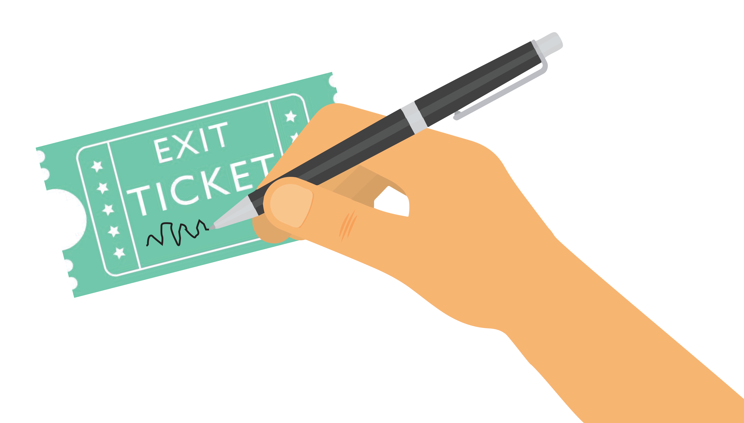
ACTIVITY: EXIT TICKETS
YEAR 6 / LESSON 6
On your exit ticket, pick your top three activities that you are going to try out instead of gaming this week.
Would anyone like to share their action plan for this week?

Slide 113
HOMEWORK ACTIVITY: KEEP A DIARY
YEAR 6 / LESSON 6
Create a diary of a typical week or for this coming week. Include a range of activities to balance time online/gaming.

Slide 114
If you need help…
YEAR 6 / LESSON 6
If you are worried about any of the content today you can talk to a teacher or member of staff. For additional support relating to your own or someone else’s relationship with gambling/gaming you can contact Childline or GamCare.
YoungPeopleService@gamcare.org.uk
T: 02030926964

Slide 115
AN INTRODUCTION TO GAMING
YEAR 7 / LESSON 1

Slide 116
CHALLENGE
YEAR 7 / LESSON 1
Traffic lights: When does gaming become harmful?

Slide 117
LEARNING OBJECTIVES
YEAR 7 / LESSON 1
Understand what is meant by the term ‘gaming’
Understand that Gaming Disorder is a Disorder classified by the World Health organisation
Understand how to stay safe when playing online games

Slide 118
LEARNING OUTCOMES
YEAR 7 / LESSON 1
I understand and can define Gaming Disorder
I understand how to balance my time playing video games with other activities
I know how to stay safe online
I know how to get help if I am worried about my gaming or somebody else’s

Slide 119
ACTIVITY: 2-MINUTE SCRIBBLE
YEAR 7 / LESSON 1
What is gaming?
What ways can you play these games? Think about the device(s) you may use.
What are the best things about computer games?
What are the worst things about computer games?

Slide 120
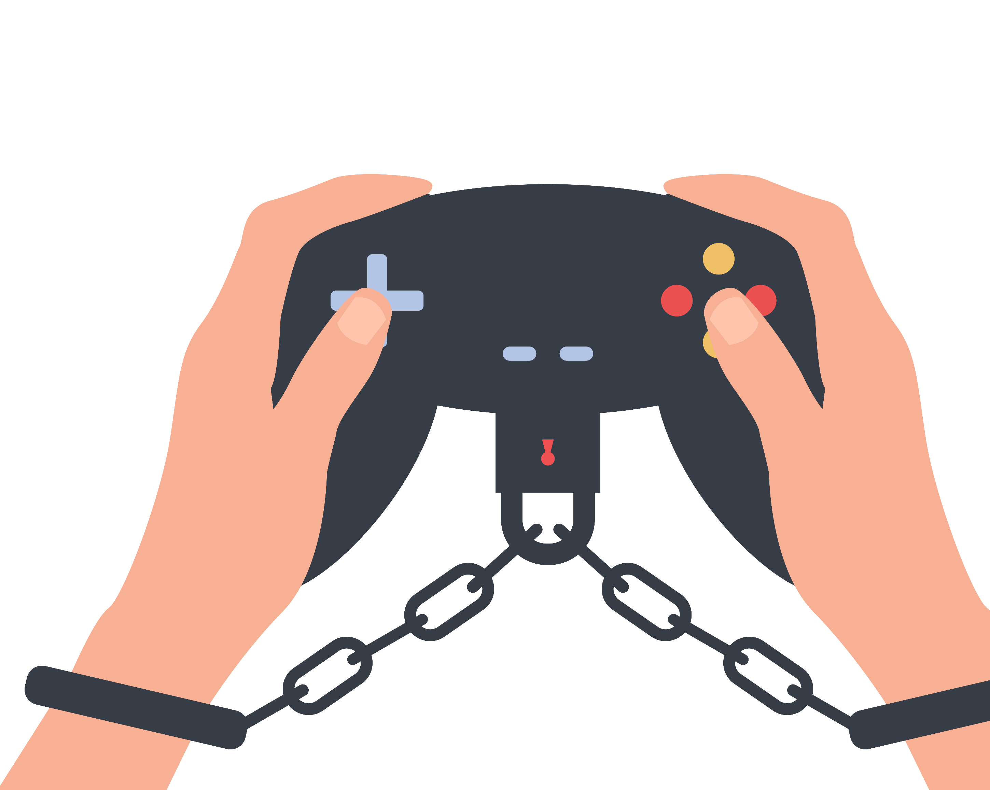
ACTIVITY: WHAT IS ADDICTION?
YEAR 7 / LESSON 1
Can you become addicted to video games?
Discuss with your table and share your agreed definition.
What does harm look like?
Discuss with your table and share your ideas.
©YGAM 2020: All rights reserved

Slide 121
YEAR 7 / LESSON 1
For gaming disorder to be diagnosed, the behaviour pattern must be of sufficient severity to result in significant impairment in personal, family, social, educational, occupational or other important areas of functioning and would normally have been evident for at least 12 months (WHO).
©YGAM 2020: All rights reserved

Slide 122
ACTIVITY: TRAFFIC LIGHTS
YEAR 7 / LESSON 1
Look at the scenario cards on your table. Read through each one and decide if this person is:
Red (at risk)
Amber (potential risk)
Green (not at risk)
Match them to the correct
traffic light.
POTENTIAL RISK
NOT AT RISK
AT RISK

Slide 123
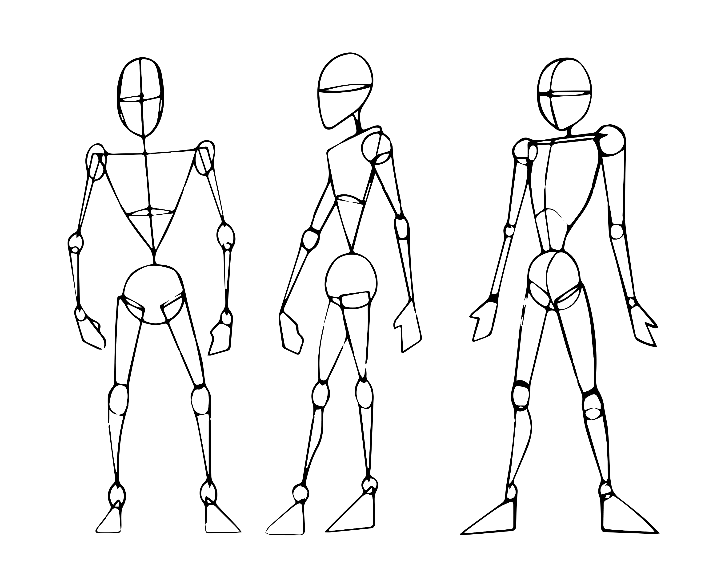
ACTIVITY: EXTENSION ACTIVITY
YEAR 7 / LESSON 1
Draw a picture of a human.
List the physical and psychological benefits and risks associated with gaming.

Slide 124
CLASS LIST
YEAR 7 / LESSON 1
Ways to keep safe
What can we do to keep ourselves safe when playing games online?
1.
2.
3.
4.
5.
Take regular breaks
Don’t game angry
Play outside
Don’t buy items in-game without first asking
Listen to my parents’ and teachers’ advice

Slide 125
If you need help…
YEAR 7 / LESSON 1
If you are worried about any of the content today you can talk to a teacher or member of staff. For additional support relating to your own or someone else’s relationship with gambling/gaming you can contact Childline or GamCare.
YoungPeopleService@gamcare.org.uk
T: 02030926964

Slide 126
GAME ON
YEAR 7 / LESSON 2

Slide 127
CHALLENGE
YEAR 7 / LESSON 2
Create a quiz to teach people about the importance of understanding money and debt with relevance to gaming.

Slide 128
LEARNING OBJECTIVES
YEAR 7 / LESSON 2
To understand what is meant debt
To understand how debt can affect people
To understand how children and young people pay for goods in games

Slide 129
LEARNING OUTCOMES
YEAR 7 / LESSON 2
I understand the term debt and I can offer a definition
I understand how debt might affect people
I understand microtransactions in games

Slide 130
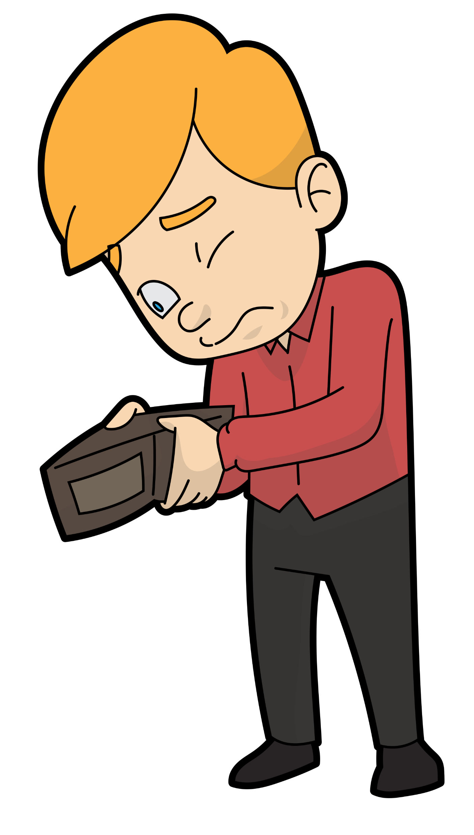
ACTIVITY: SCRIBBLE – WHAT IS DEBT?
YEAR 7 / LESSON 2
2 minute scribble…
What is debt?
Debt is an obligation that requires one person who owes another person or company money, to pay that money or another agreed-upon amount back within an agreed period of time
Let’s think about debt and the consequences of debt. What might happen if someone loses all their money?

Slide 131
ACTIVITY: AN INTERACTIVE QUIZ
YEAR 7 / LESSON 2
Let’s discuss what people need to be aware of in relation to money and debt.
What are the consequences of debt?
How might someone who games get into debt?
Are they always spending their own money?
What are the consequences of spending someone else’s money with/without consent?
In small groups create a quiz to teach people about the importance of understanding money and debt with relevance to gaming.
For example: How can you ensure you don't spend too much money on buying a game or within games?
QUIZ

Slide 132
ACTIVITY: I PROUDLY PRESENT…
YEAR 7 / LESSON 2
Present your quiz to the class.
QUIZ

Slide 133
If you need help…
YEAR 7 / LESSON 2
If you are worried about any of the content today you can talk to a teacher or member of staff. For additional support relating to your own or someone else’s relationship with gambling/gaming you can contact Childline or GamCare.
YoungPeopleService@gamcare.org.uk
T: 02030926964

Slide 134
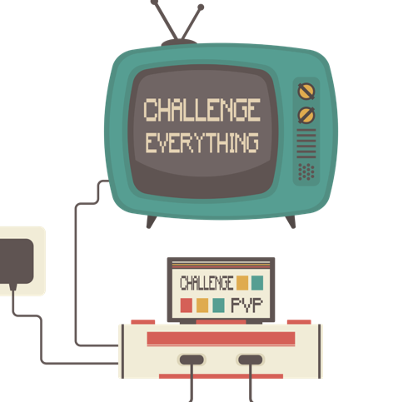
CHALLENGE EVERYTHING
YEAR 7 / LESSON 3

Slide 135
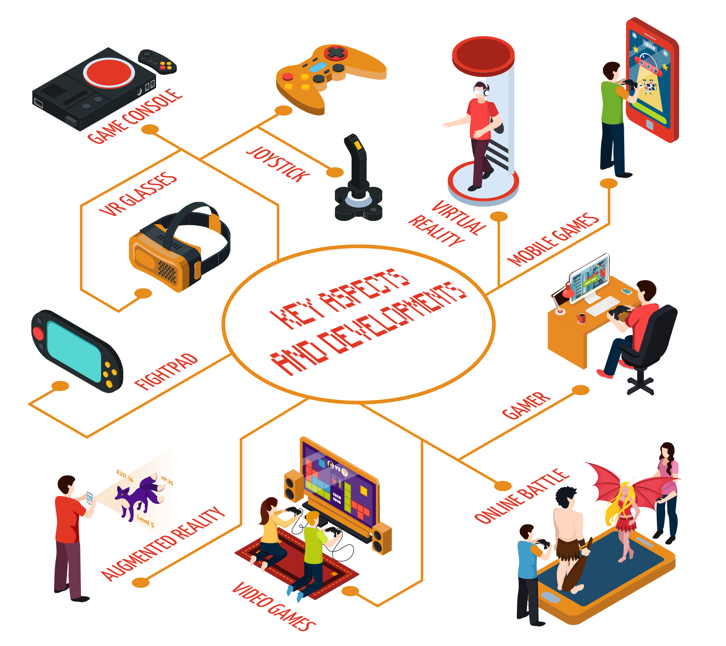
CHALLENGE
YEAR 7 / LESSON 3
Create a Gaming Act that sets out the rules and regulations for safer gaming.

Slide 136
LEARNING OBJECTIVES
YEAR 7 / LESSON 3
To understand what is meant by consumer
To understand what is meant by responsibility and whose responsibility it is to protect consumers/players
To be able to identify safeguarding measures

Slide 137
LEARNING OUTCOMES
YEAR 7 / LESSON 3
I understand what is meant by consumer
I can define responsibility
I can make suggestions to safeguard people
I can work with others to understand their point of view

Slide 138
ACTIVITY: WHO’S JOB IS IT ANYWAY?
YEAR 7 / LESSON 3
Discuss the following questions with your partner and write down any ideas that you have.
What protection is there for gaming online?
Whose is responsible for protecting people?

Slide 139
ACTIVITY: THE GAMING ACT
YEAR 7 / LESSON 3
We are going to write a Gaming Act. This is an official document that states the rules that need to be followed.
Think about the following areas:
Responsibility of manufacturer?
Gaming platforms/streaming platforms?
Age verifications?
In game purchases?
Probability of gaining certain items?
Yes or no to loot boxes?
Time spent on games?
PEGI ratings?
Consumer/Customer?

Slide 140
ACTIVITY: I PROUDLY PRESENT…
YEAR 7 / LESSON 3
Present your Act to the class.

Slide 141
If you need help…
YEAR 7 / LESSON 3
If you are worried about any of the content today you can talk to a teacher or member of staff. For additional support relating to your own or someone else’s relationship with gambling/gaming you can contact Childline or GamCare.
YoungPeopleService@gamcare.org.uk
T: 02030926964

Slide 142
GAMING OR GAMBLING. PART 1
YEAR 7 / LESSON 4

Slide 143
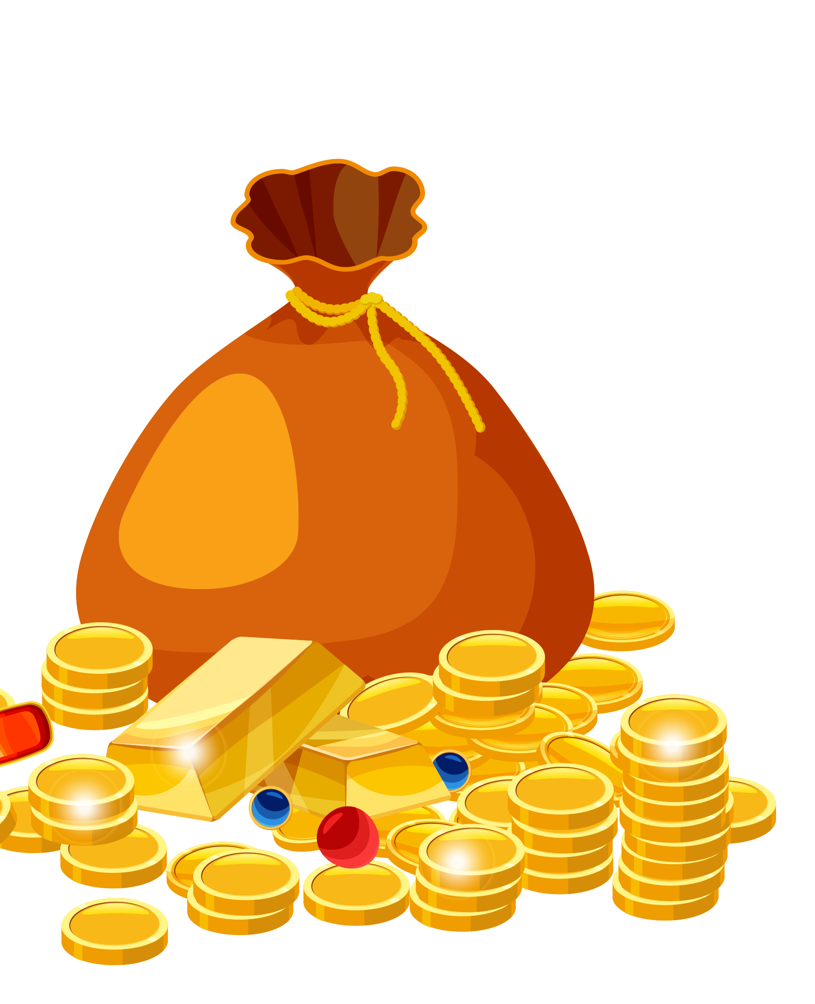
CHALLENGE
YEAR 7 / LESSON 4
Calculate your spend. How much does our class spend on gaming?

Slide 144
LEARNING OBJECTIVES
YEAR 7 / LESSON 4
To understand what gambling is
To understand how games can contain gambling-like features
To be able to calculate mode, mean, median and calculate average spend for the class.

Slide 145
LEARNING OUTCOMES
YEAR 7 / LESSON 4
I can define gambling
I understand how gambling and games can be linked
I can calculate mode, mean and median

Slide 146
ACTIVITY: WHAT IS GAMBLING?
YEAR 7 / LESSON 4
Create a thought shower to show your knowledge and understanding of gambling.
Thought
Shower
Share your thoughts and ideas.

Slide 147
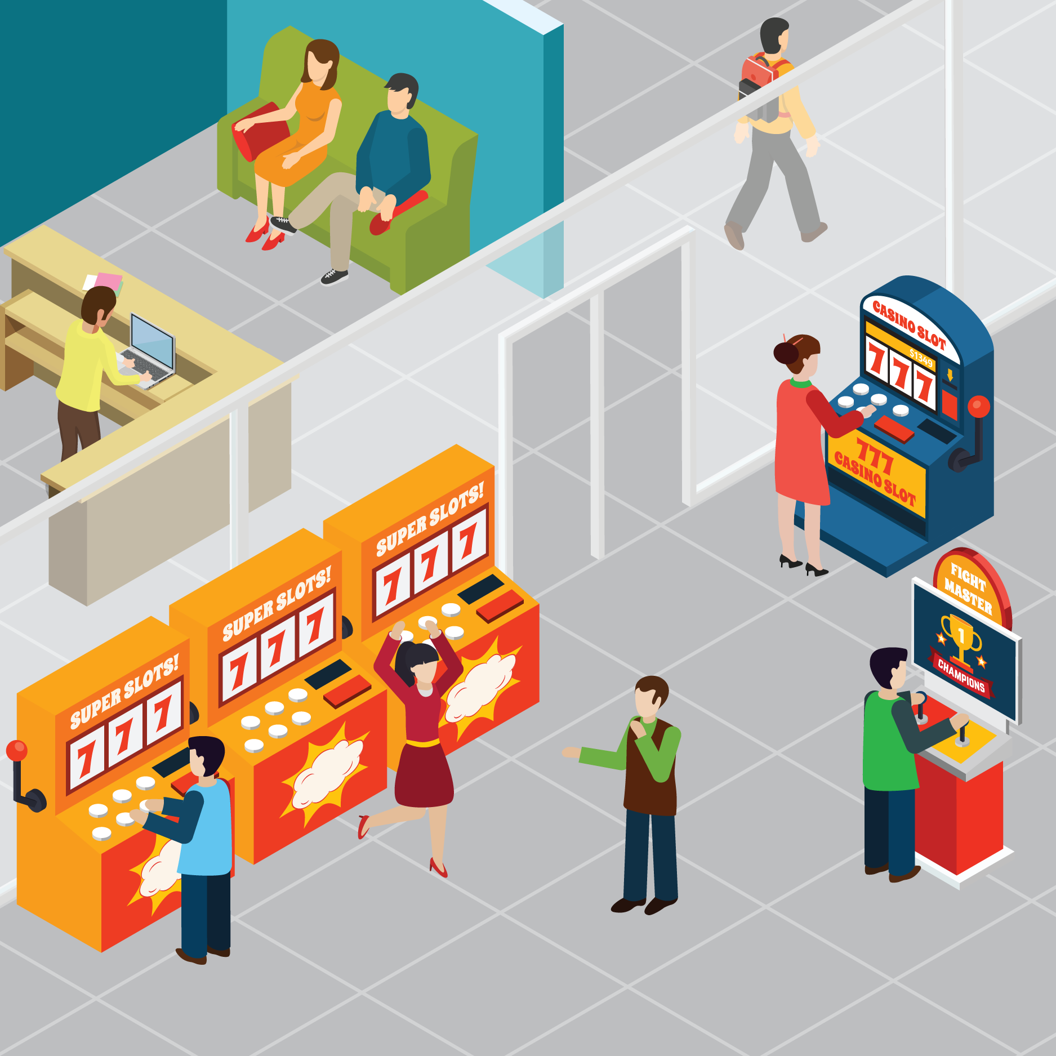
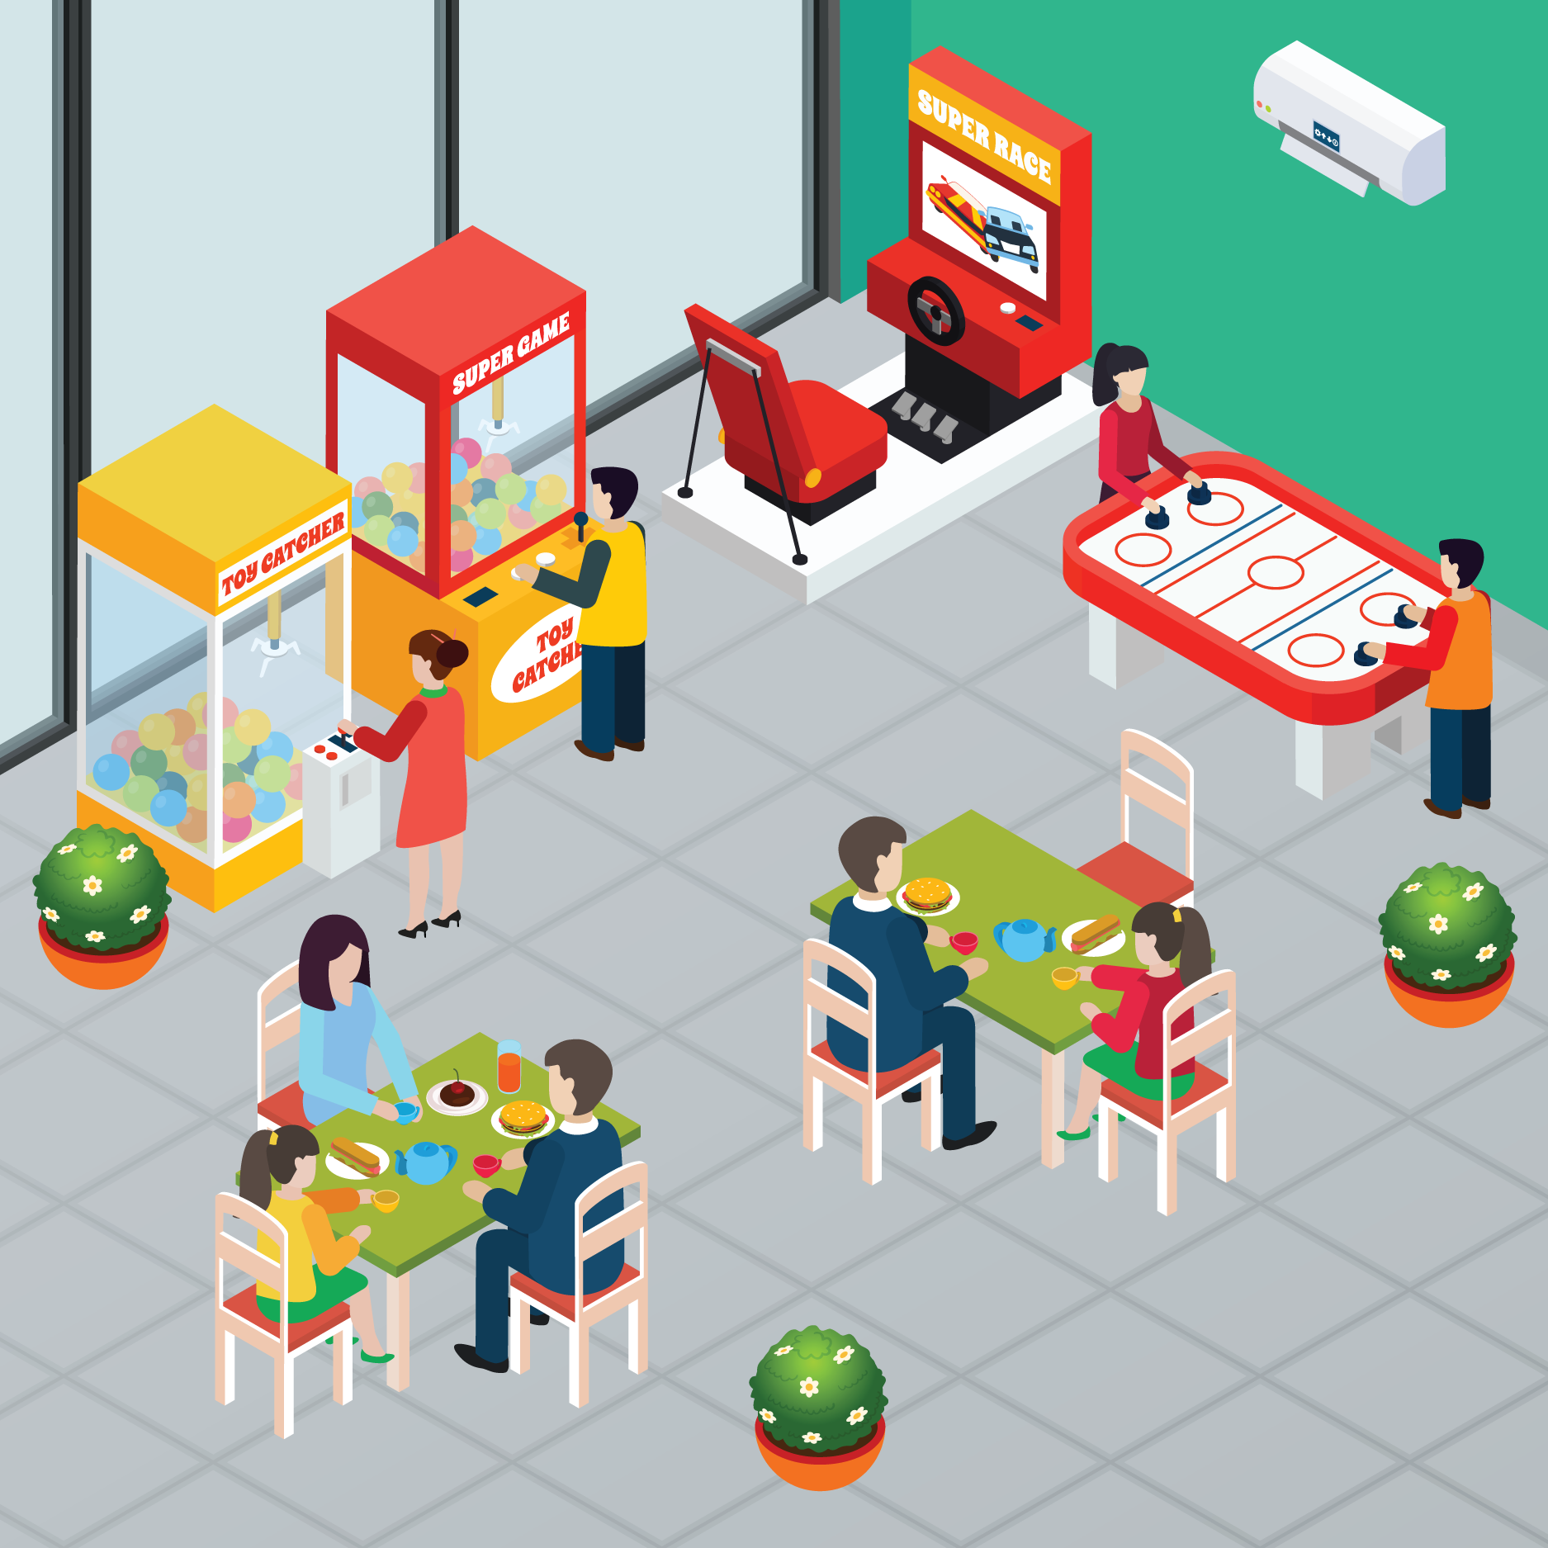
ACTIVITY: WHAT IS GAMBLING?
YEAR 7 / LESSON 4
What do think gambling is?
Can you list all the words you associate with gambling?
©YGAM 2020: All rights reserved

Slide 148
ACTIVITY: WHAT IS GAMBLING?
YEAR 7 / LESSON 4
The 1985 Order controls:
Betting on tracks and in bookmaking offices
Gaming including the use, supply and maintenance of gaming machines
Gaming in bingo clubs; small scale amusements with prizes; and lotteries.
The 1985 Order has remained largely unchanged since it was
introduced thirty-five years ago. As a result, gambling regulation
here has not kept up to date with the gambling industry and
technological advances e.g internet and mobile phones.
©YGAM 2020: All rights reserved

Slide 149
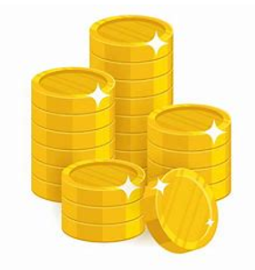
ACTIVITY: CAN GAMING BE LIKE GAMBLING?
YEAR 7 / LESSON 4
Think about the games you play.
Are there any things that are similar to gambling?
What games specifically.
©YGAM 2020: All rights reserved

Slide 150
ACTIVITY: DO YOU PAY TO PLAY?
YEAR 7 / LESSON 4
Thinking of the games you play. Have you/do you buy loot boxes/crates?
How much do you spend per week?

Slide 151
ACTIVITY: MODE, MEAN, MEDIAN
YEAR 7 / LESSON 4
MEAN
From the figures provided calculate the mean, mode and median.
With the mean, calculate how much you could save in a year and then in five years.
MODE
MEDIAN

Slide 152
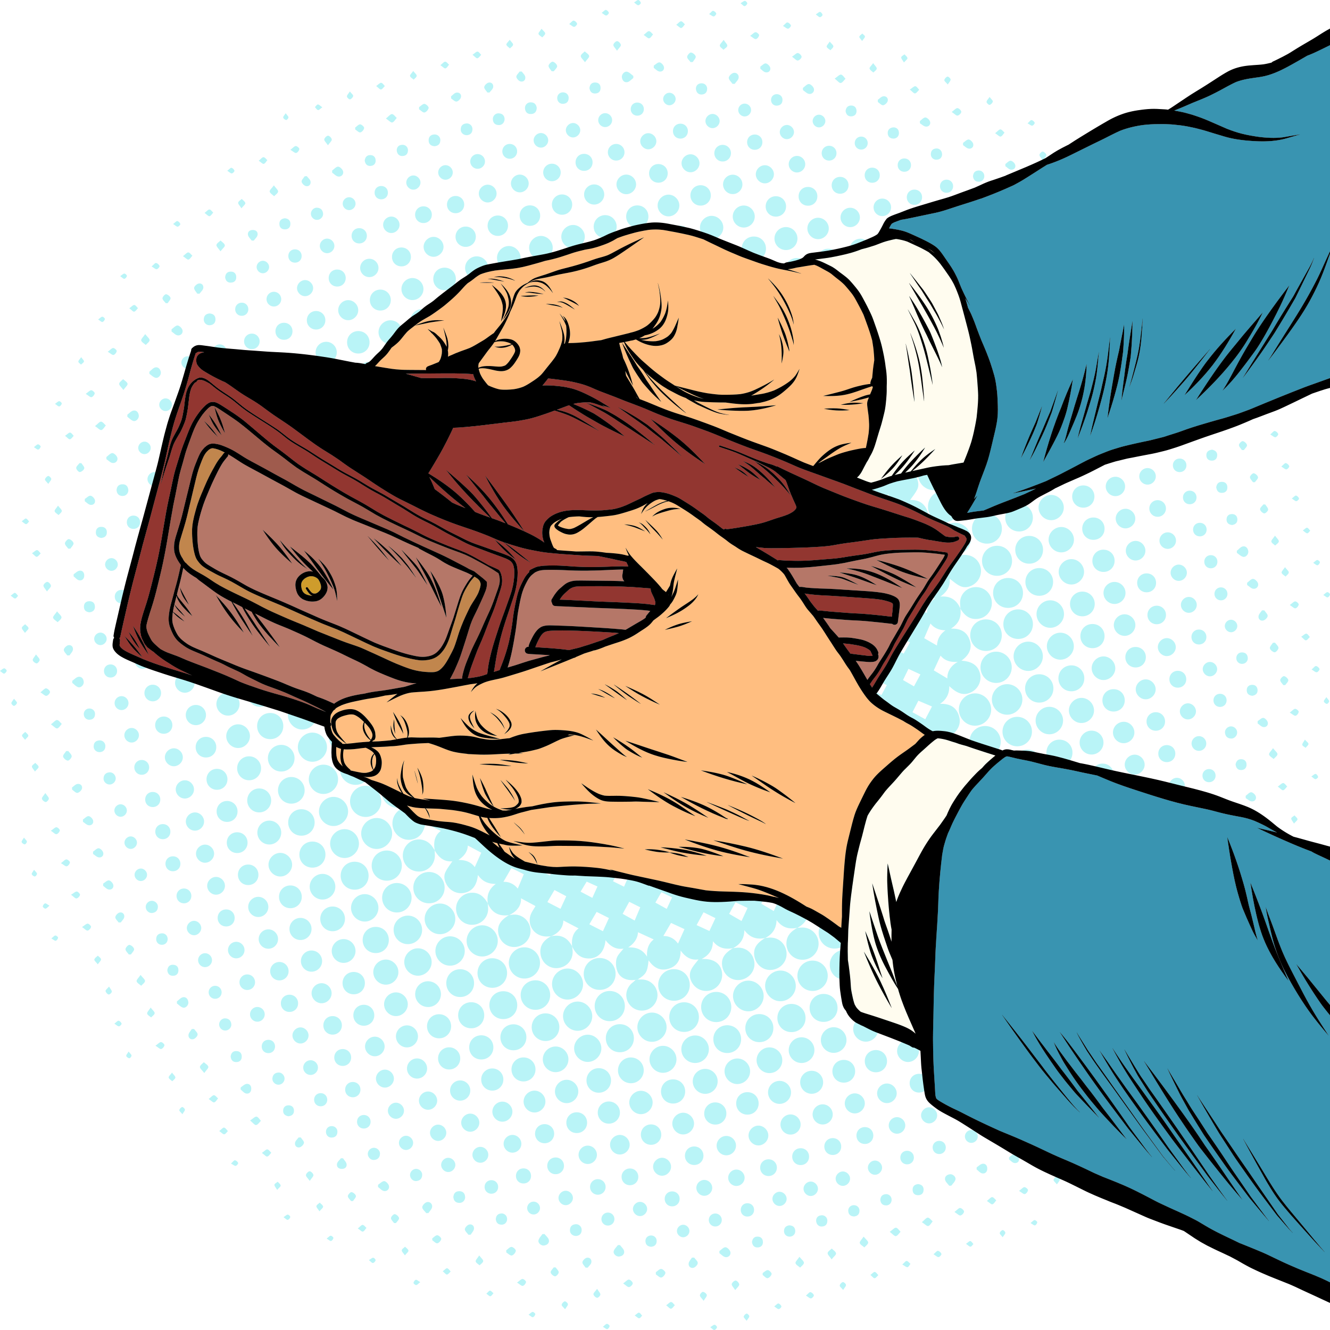
WHAT ELSE MIGHT YOU SPEND THAT MONEY ON?
YEAR 7 / LESSON 4
What would you do with that amount of money?
Does it make you reconsider how much you spend on and in games?

Slide 153
If you need help…
YEAR 7 / LESSON 4
If you are worried about any of the content today you can talk to a teacher or member of staff. For additional support relating to your own or someone else’s relationship with gambling/gaming you can contact Childline or GamCare.
YoungPeopleService@gamcare.org.uk
T: 02030926964

Slide 154
GAMING OR GAMBLING. PART 2
YEAR 7 / LESSON 5

Slide 155
CHALLENGE
YEAR 7 / LESSON 5
Build a campaign to raise awareness about gaming and the blurred lines with gambling.

Slide 156
LEARNING OBJECTIVES
YEAR 7 / LESSON 5
To understand the blurred lines between gaming and gambling
To recognise the signs of gaming and gambling harm
To create an awareness campaign

Slide 157
LEARNING OUTCOMES
YEAR 7 / LESSON 5
I can describe the blurred lines between gaming and gambling
I can recognise the signs of gaming and gambling harm
I can present information to create awareness

Slide 158
ACTIVITY: AGREE OR DISAGREE: STAND UP / SIT DOWN
YEAR 7 / LESSON 5
Gambling is immoral?
Gaming online should be banned?
Gaming online is completely safe?
Children should not be able to gamble?
Gambling is dangerous?
Loot boxes are just like gambling?
Gaming is dangerous?
Gaming is just a bit of fun?
AGREE
DISAGREE

Slide 159
ACTIVITY: GAMING AND GAMBLING HARM: WHAT ARE THE SIGNS?
YEAR 7 / LESSON 5
Organise the signs of harm in to three categories. Gambling Harm/ Gaming Harm / Both
Avoiding family and friends | Selling possessions
Feeling anxious or worried | Losing interest in your hobbies
Spending too much time and money doing it | Finding it hard to stop
Preoccupation with it | Lying
Downplaying the time you spend doing it | Chasing losses and suffering debt issues
Defensiveness | Neglecting hygiene
Eye strain/ migraines | Extreme fatigue
Arguing with family and friends about it | Gambling until you have nothing left
Unable to set time limits
!
GAMBLING HARM
!
BOTH
!
GAMING HARM

Slide 160
ACTIVITY: TIME TO CAMPAIGN
YEAR 7 / LESSON 5
Working in groups, build a campaign to raise awareness about gaming and the blurred lines with gambling.
GROUP 1
A campaign aimed at your peers
GROUP 2
A campaign aimed at younger children
GROUP 3
A campaign aimed at parents and carers

Slide 161
ACTIVITY: SHARE YOUR CAMPAIGN
YEAR 7 / LESSON 5

Slide 162
If you need help…
YEAR 7 / LESSON 5
If you are worried about any of the content today you can talk to a teacher or member of staff. For additional support relating to your own or someone else’s relationship with gambling/gaming you can contact Childline or GamCare.
YoungPeopleService@gamcare.org.uk
T: 02030926964

Slide 163
THE BLURRED LINES
YEAR 7 / LESSON 6

Slide 164
CHALLENGE
YEAR 7 / LESSON 6
The Great Debate: Gaming is a sociable and inclusive activity that comes without risk.

Slide 165
LEARNING OBJECTIVES
YEAR 7 / LESSON 6
To recognise and identify the positives and negatives of online gaming
To understand how you can stay safe whilst gaming online
To develop an argument for or against gaming being sociable and inclusive; without risk

Slide 166
LEARNING OUTCOMES
YEAR 7 / LESSON 6
I can identify positives and negatives of gaming online
I can explain how to stay safe when gaming online
I can develop an argument and participate in an a debate

Slide 167
ACTIVITY: DIAMOND 9
YEAR 7 / LESSON 6
Look at the 9 statements. Order them from most risky to least risky.
1
Not wanting to be involved in family activities so you can game for longer
4
Falling asleep at school
7
Skipping meals
2
Trouble sleeping
5
Losing track of time when gaming
8
Not wanting to spend time with friends
3
Mood swings
6
Failing to complete homework
9
Secretly spending money on loot boxes/crates/FUT

Slide 168
ACTIVITY: THE GREAT DEBATE
YEAR 7 / LESSON 6
Agree v Disagree: Gaming is a sociable and inclusive activity that comes without risk.
You will be assigned to a team - agree/disagree.
Create a thought shower to show your initial thinking.
Thought Shower
©YGAM 2020: All rights reserved

Slide 169
ACTIVITY: LET’S DEBATE
YEAR 7 / LESSON 6
Using the ideas from your thought shower prepare your debate. You should try to aim for it to last no more than 5 minutes.
Let’s debate.
I disagree. I think it’s completely safe because…
I think it’s risky because….
In my opinion…

Slide 170
ACTIVITY: LET’S SUMMARISE
YEAR 7 / LESSON 6
Is there a right or wrong answer?
How can we keep gaming inclusive and sociable and minimise risk?

Slide 171
If you need help…
YEAR 7 / LESSON 6
If you are worried about any of the content today you can talk to a teacher or member of staff. For additional support relating to your own or someone else’s relationship with gambling/gaming you can contact Childline or GamCare.
YoungPeopleService@gamcare.org.uk
T: 02030926964

