Slide 1
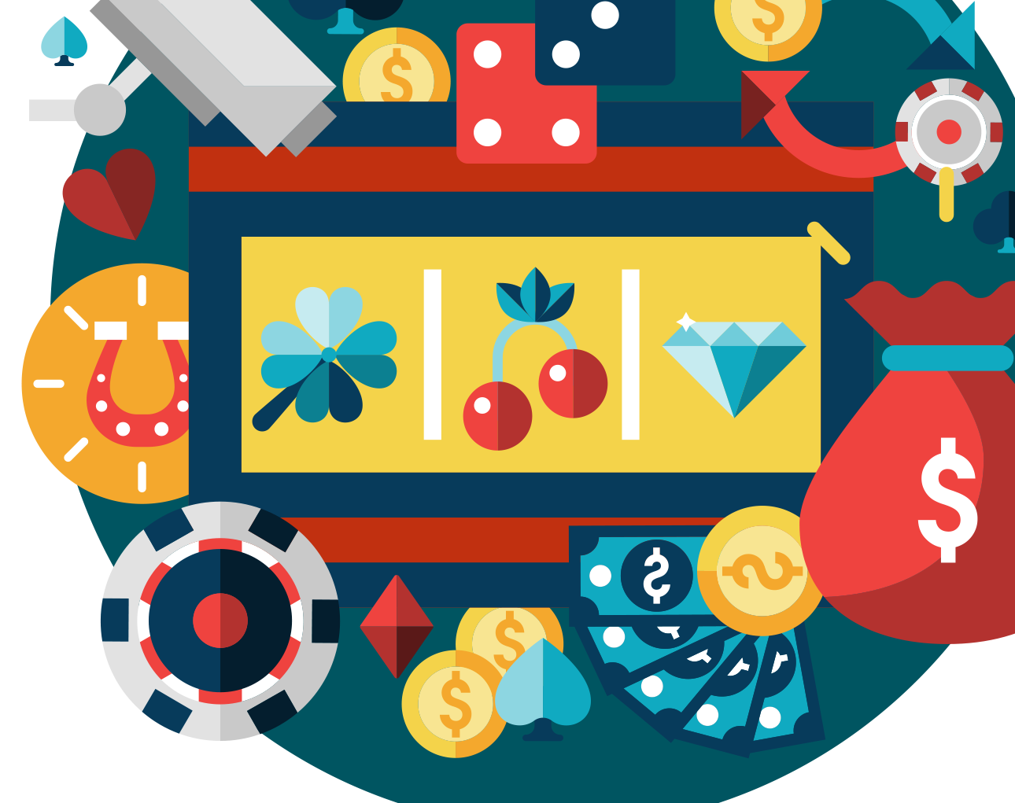
Gaming and Gambling: Bias and Ethics
POST-16 / LESSON 1
V1.0/August 21

Slide 2
LEARNING OBJECTIVES
POST-16/ LESSON 1
To explore gaming and gambling advertising and how this might influence young people
To understand what is meant by the terms ‘the house always wins ’ and ‘house edge’
To raise awareness on the impact of gaming and gambling advertising

Slide 3
LEARNING OUTCOMES
POST-16/ LESSON 1
You can explore different marketing and advertising strategies
You can explain and define the terms ‘the house always wins’ and ‘house edge’
You can plan and create a presentation/resource to raise awareness on the impact of gaming and gambling advertising

Slide 4
ACTIVITY: POST IT
POST-16/ LESSON 1
How are games/gambling activities advertised and marketed?
Write down your thoughts on post-it notes and stick on the board.
Share and discuss.

Slide 5
ACTIVITY: LET’S TALK ABOUT MARKETING AND ADVERTISING
POST-16/ LESSON 1
What impact does marketing and advertising through sport have?
What impact do influencers and celebrity endorsements have?
What role does social media play? What’s the impact?
Do these advertisements ever show failure/losses? (for both gaming and gambling)
Is gambling advertised in games? How are young people safeguarded?
Think of the games you play/have played are they set up with a fair chance of winning?

Slide 6
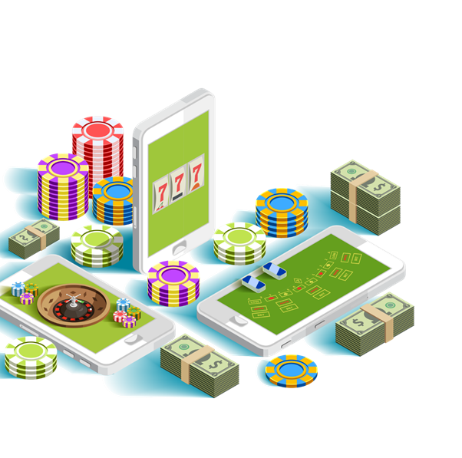
ACTIVITY: THE HOUSE ALWAYS WINS
POST-16/ LESSON 1
Define the term ‘house edge.’ What do people mean when they say the house always wins’? Does this apply to all forms of gambling?
This is the mathematical advantage that the gambling product and therefore, the gambling firm/venue has over the player. This advantage results in an assured percentage return.
(Casino.org)

Slide 7
ACTIVITY: LET’S DEBATE
POST-16/ LESSON 1
Are the ads directly targeting children?
Children have reported seeing gambling adverts in the mobile games they play. Is this ethical?
There should be better legislation
The companies should be doing more
Should children be supervised?
Could there be more parental controls?

Slide 8
ACTIVITY: RAISING AWARENESS
POST-16/ LESSON 1
In groups, create a presentation/resource to raise awareness on the impact of gaming and gambling advertising.
Consider:
What is the message of the advertising?
Who is the target audience?
Are young people protected?
How much is too much?
How can young people make informed choices?
What should the developers/industry be doing to safeguard people?
Group 1: Games
Group 2: Social media and influencers
Group 3: Sports

Slide 9
ACTIVITY: WE PLEDGE…
POST-16/ LESSON 1
Present your work/resource to the class.
Are there any questions or feedback?
We pledge….
Create a pledge to share your work/resource with one key audience e.g. in assemblies, around school, in the community, on social media etc.

Slide 10
If you need help…
POST-16 / LESSON 1
If you are worried about any of the content today you can talk to a teacher or member of staff. For additional support relating to your own or someone else’s relationship with gambling/gaming you can contact Childline or GamCare.
YoungPeopleService@gamcare.org.uk
T: 02030926964

Slide 11
Gaming and Gambling: Safeguarding
POST-16 / LESSON 2

Slide 12
LEARNING OBJECTIVES
POST-16/ LESSON 2
To understand the current regulations and proposed recommendations in relation to gaming and gambling
To explore safeguarding in relation to advertising, gambling and gaming
To research, evaluate and suggest further regulations to support safer gaming and gambling

Slide 13
LEARNING OUTCOMES
POST-16/ LESSON 2
You can describe current regulations and proposed recommendations in relation to gaming and gambling
You can explore each industry’s role and responsibilities
You can evaluate current regulations and suggest improvements
You can present information and justify findings to your peers

Slide 14
ACTIVITY: CARD SORT
POST-16/ LESSON 2
A) Sort the statements into two groups:
B) Discuss:
Are any of the answers surprising?
Is enough being done?
Who is responsible for putting regulations in place and monitoring them?
Who is responsible for safeguarding consumers, children and young people?
Card sort
Current regulations
Proposed regulations

Slide 15
ACTIVITY: LET’S INVESTIGATE
POST-16/ LESSON 2
In teams, create a presentation for your industry on the following:
What is your industry currently doing to support safer gaming/gambling?
What issues are still present within the industry?
What do you plan to do to improve upon current regulations?
What impact would this have on consumers, young people and the industry?
Advertising Industry
Gaming Industry
Gambling Industry

Slide 16
ACTIVITY: WE PROUDLY PRESENT
POST-16/ LESSON 2
Present your findings and pledges to the wider group.
Each team should take positive and constructive feedback.

Slide 17
If you need help…
POST-16 / LESSON 2
If you are worried about any of the content today you can talk to a teacher or member of staff. For additional support relating to your own or someone else’s relationship with gambling/gaming you can contact Childline or GamCare.
YoungPeopleService@gamcare.org.uk
T: 02030926964

Slide 18
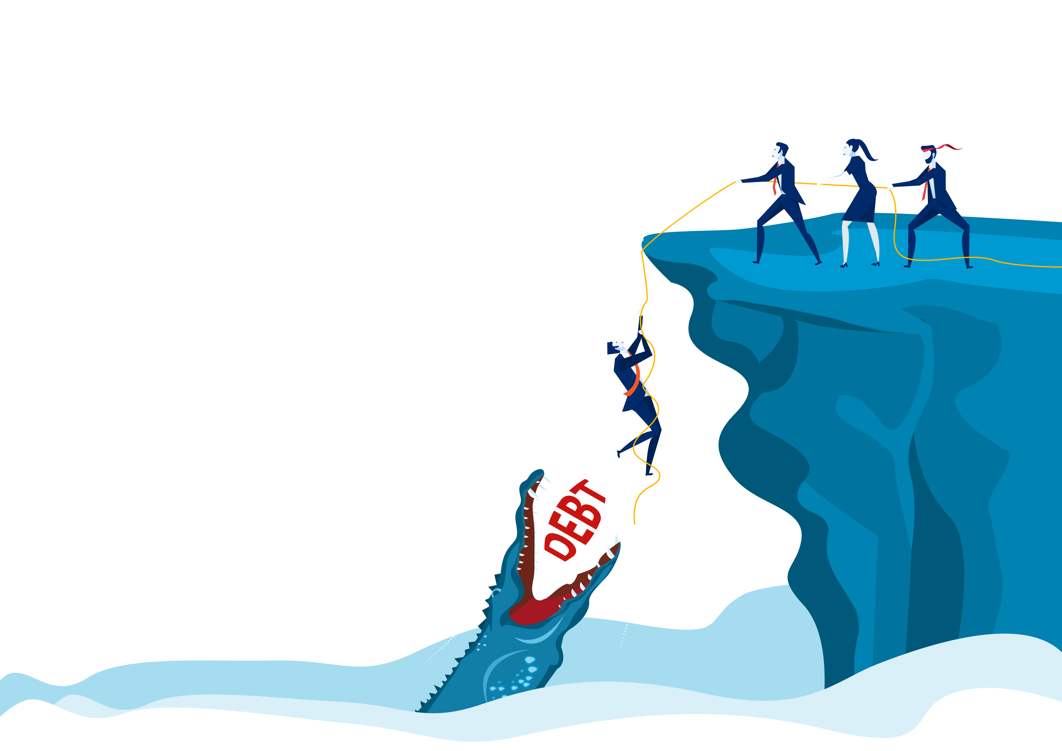
Finances, Debt and Support
POST-16 / LESSON 3

Slide 19
LEARNING OBJECTIVES
POST-16/ LESSON 3
To understand the potential impact of debt and how to manage personal finances
To explore the term safeguarding and understand the need to safeguard at risk people/groups

Slide 20
LEARNING OUTCOMES
POST-16/ LESSON 3
Describe
You can describe the risks and the impacts of debt
Identify
You can identify ways to manage personal finances
Explore
You can explore safeguarding in relation to gambling and at-risk people

Slide 21
ACTIVITY: MIND MAP
POST-16/ LESSON 3
Create a mind map of the risks/impacts of debt. Consider the impacts on the individual and the wider community, both in the present and the future.
How might young people spend their money?
Do they ever mismanage their money
What would this look like, what might they do?
How might young people find themselves in debt?
Mind Map

Slide 22
ACTIVITY: GROUP CHAT
POST-16/ LESSON 3
Discuss the following:
What can individuals do to manage their finances?
Who else is responsible for supporting financial management e.g. banks, financial advisors, education, apps, suppliers etc.?
In relation to gambling: What duty of care do the providers have to individuals?

Slide 23
ACTIVITY: FINANCIAL PLANNING
POST-16/ LESSON 3
In groups, read the scenario cards and create a financial plan that includes both individual and industry-based interventions.
Consider key industry interventions.

Slide 24
ACTIVITY: WE PROUDLY PRESENT
POST-16/ LESSON 3
Present your financial plans to the wider group.

Slide 25
If you need help…
POST-16 / LESSON 3
If you are worried about any of the content today you can talk to a teacher or member of staff. For additional support relating to your own or someone else’s relationship with gambling/gaming you can contact Childline or GamCare.
YoungPeopleService@gamcare.org.uk
T: 02030926964

Slide 26
Gaming, Gambling and Mental Health
POST-16/ LESSON 4

Slide 27
LEARNING OBJECTIVES
POST-16/ LESSON 4
To explore the difference between healthy and harmful gaming/gambling
To understand how to identify gaming and gambling related harm
To explore strategies for maintaining physical and mental well being

Slide 28
LEARNING OUTCOMES
POST-16/ LESSON 4
Differentiate
You can differentiate between healthy and harmful relationships with gaming/gambling
Empathise
You can empathise with someone experiencing gaming/gambling related harm
Identify
You can identify a range of strategies for maintaining positive mental health

Slide 29
ACTIVITY: STAND UP IF…
POST-16/ LESSON 4
Stand up if you have ever…
Played pitch and toss/penny up/coin game at school
Bet amongst friends
Bought and won on a scratch card
Lied to people about money spent on gaming/gambling
Played on the penny slot machines
Picked a horse for someone when betting on the horse racing
Played bingo
Played the national lottery
Picked an outcome for someone betting on Esports
Played a free online free game that has a roulette wheel
Borrowed money for a game/gambling activity

Slide 30
ACTIVITY: HEALTHY VS. HARMFUL
POST-16/ LESSON 4
Create a mind-map to explore healthy vs harmful gaming/gambling behaviours and the impact this may have.
Addiction
Debt
Anger
Fun
Social

Slide 31
ACTIVITY: IN THEIR SHOES
POST-16/ LESSON 4
In groups, use the scenario you have been given to create a short radio/video/written interview, playing the role stated on the cards. Consider:
- the behaviours of someone experiencing gaming/gambling related harm
- the wider impact on their mental health
- the impact on those around them
- strategies for maintaining/rebuilding positive mental health and wellbeing

Slide 32
ACTIVITY: POST IT
POST-16/ LESSON 4
On post-its, post strategies for maintaining positive mental health and wellbeing.

Slide 33
ACTIVITY: AWARENESS CAMPAIGN
POST-16/ LESSON 4
What is gaming/gambling? What is healthy vs harmful?
In groups, plan and deliver a Gaming or Gambling Awareness Campaign.
What are the signs of harm? Who can help?
Who are our target audience? What are our objectives?
Shall we include tips for keeping safe / maintaining positive mental health and wellbeing?
What methods should we use? Social media/ posters/videos/ presentations?

Slide 34
If you need help…
POST-16 / LESSON 4
If you are worried about any of the content today you can talk to a teacher or member of staff. For additional support relating to your own or someone else’s relationship with gambling/gaming you can contact Childline or GamCare.
YoungPeopleService@gamcare.org.uk
T: 02030926964

Slide 35
Esports and Professional Gaming
POST-16 / LESSON 5

Slide 36
LEARNING OBJECTIVES
POST-16/ LESSON 5
To explore the career opportunities available within the gaming industry
To evaluate the impact of Esports on mental health and wellbeing

Slide 37
LEARNING OUTCOMES
POST-16/ LESSON 5
You can identify a range of career opportunities in gaming
You can explain the benefits and risks of pursuing a career within the gaming industry
You can identify a range of strategies to maintain and promote physical and mental wellbeing

Slide 38
ACTIVITY: WHAT JOBS ARE OUT THERE?
POST-16/ LESSON 5
List as many job opportunities within the gaming sector as you can think of.
Examples include programmers, artists, voice actors, commentators, e-sports athlete etc.
Esports are one of the fastest growing sectors in the UK, meaning opportunities are growing rapidly.
GAMING SECTOR JOBS
Artist
Voice actor
Programmer
Athlete

Slide 39
ACTIVITY: LET’S ADVERTISE
POST-16/ LESSON 5
Option 1: Choose a job from the starter task and create a job advertisement with the relevant requirements.
Action: In pairs, swap your adverts and discuss/ feedback ideas.
Option 2: Find a gaming related job currently being advertised online. Use the job description and personal specification to write a personal statement.
Action: Research and create a career plan of what you need to do to meet the requirements of the role.

Slide 40
ACTIVITY: BENEFITS AND RISKS
POST-16/ LESSON 5
What are the risks of applying for jobs within the gaming industry?
How can young people mitigate these risks?
As a whole group, let’s discuss…
What are the benefits of applying for jobs within the gaming industry?

Slide 41
ACTIVITY: PROFESSIONAL GAMER
POST-16/ LESSON 5
Professional gaming is a good career choice.​
Research and prepare a five-minute argument for agree or disagree.
Discussion: What can professional gamers do to look after their physical and mental health?

Slide 42
ACTIVITY: FINAL THOUGHTS
POST-16/ LESSON 5
Has the session changed your mind with regards to careers?
What are your thoughts on today’s session?
Has anything surprised you?

Slide 43
If you need help…
POST-16 / LESSON 5
If you are worried about any of the content today you can talk to a teacher or member of staff. For additional support relating to your own or someone else’s relationship with gambling/gaming you can contact Childline or GamCare.
YoungPeopleService@gamcare.org.uk
T: 02030926964

Slide 44
Let’s Open Up On Loot Boxes!
POST-16 / LESSON 6

Slide 45
LEARNING OBJECTIVES
POST-16/ LESSON 6
To understand the nature of microtransactions, including loot boxes, within games.
To research and evaluate current/proposed legislation in regards loot boxes

Slide 46
LEARNING OUTCOMES
POST-16/ LESSON 6
Describe
You can describe microtransactions and loot boxes
Research
You can research current legislation
Evaluate
You can evaluate proposed legislation

Slide 47
ACTIVITY: CAROUSEL
POST-16/ LESSON 6
Carousel
Games featuring micro-transactions
Gambling style features within games
Types of in-games items and how to purchase them
Why do people buy in-game items/loot boxes?
Discussion: What are microtransactions/loot boxes?
Move around the room and add to each mind
map as part of a carousel.
Games featuring microtransactions
Gambling style features within games
Types of in-game items and how to purchase them
Why do people buy in-game items/loot boxes?

Slide 48
ACTIVITY: LET’S DEBATE
POST-16/ LESSON 6
Research current and proposed legislation on microtransactions, focussing on loot boxes.
Option 1: Microtransactions in games should be banned.
Option 2: Loot boxes are a form of gambling and should be regulated as so.
Create an argument for or against the above statements.
Is spending money online acceptable?
Should loot boxes have an age rating?
Should there be a spending limit?
Is it different to buying card packs in shops e.g. football stickers?

Slide 49
ACTIVITY: POST IT
POST-16/ LESSON 6
Suggest one regulation that should be considered in regards to microtransactions and loot boxes within games.
Share ideas with the class and vote on the top three proposals.

Slide 50
If you need help…
POST-16 / LESSON 6
If you are worried about any of the content today you can talk to a teacher or member of staff. For additional support relating to your own or someone else’s relationship with gambling/gaming you can contact Childline or GamCare.
YoungPeopleService@gamcare.org.uk
T: 02030926964

