Slide 1
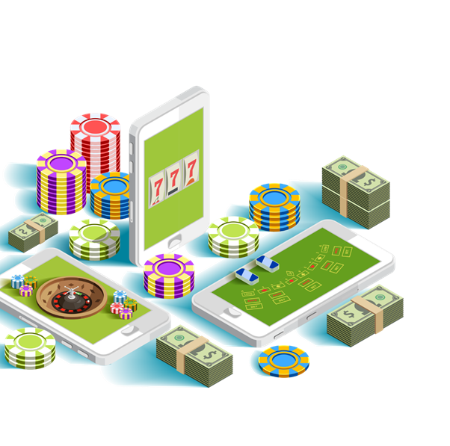
Why people gamble and gambling related harm
KS5/ Tutorial Activity 1
V1.1/Dec20

Slide 2
LEARNING OBJECTIVES
KS5/ TUTORIAL ACTIVITY 1
To explore the potential reasons why people may/may not gamble
To recognise the signs of gambling related harm
To explore the consequences of gambling related harm

Slide 3
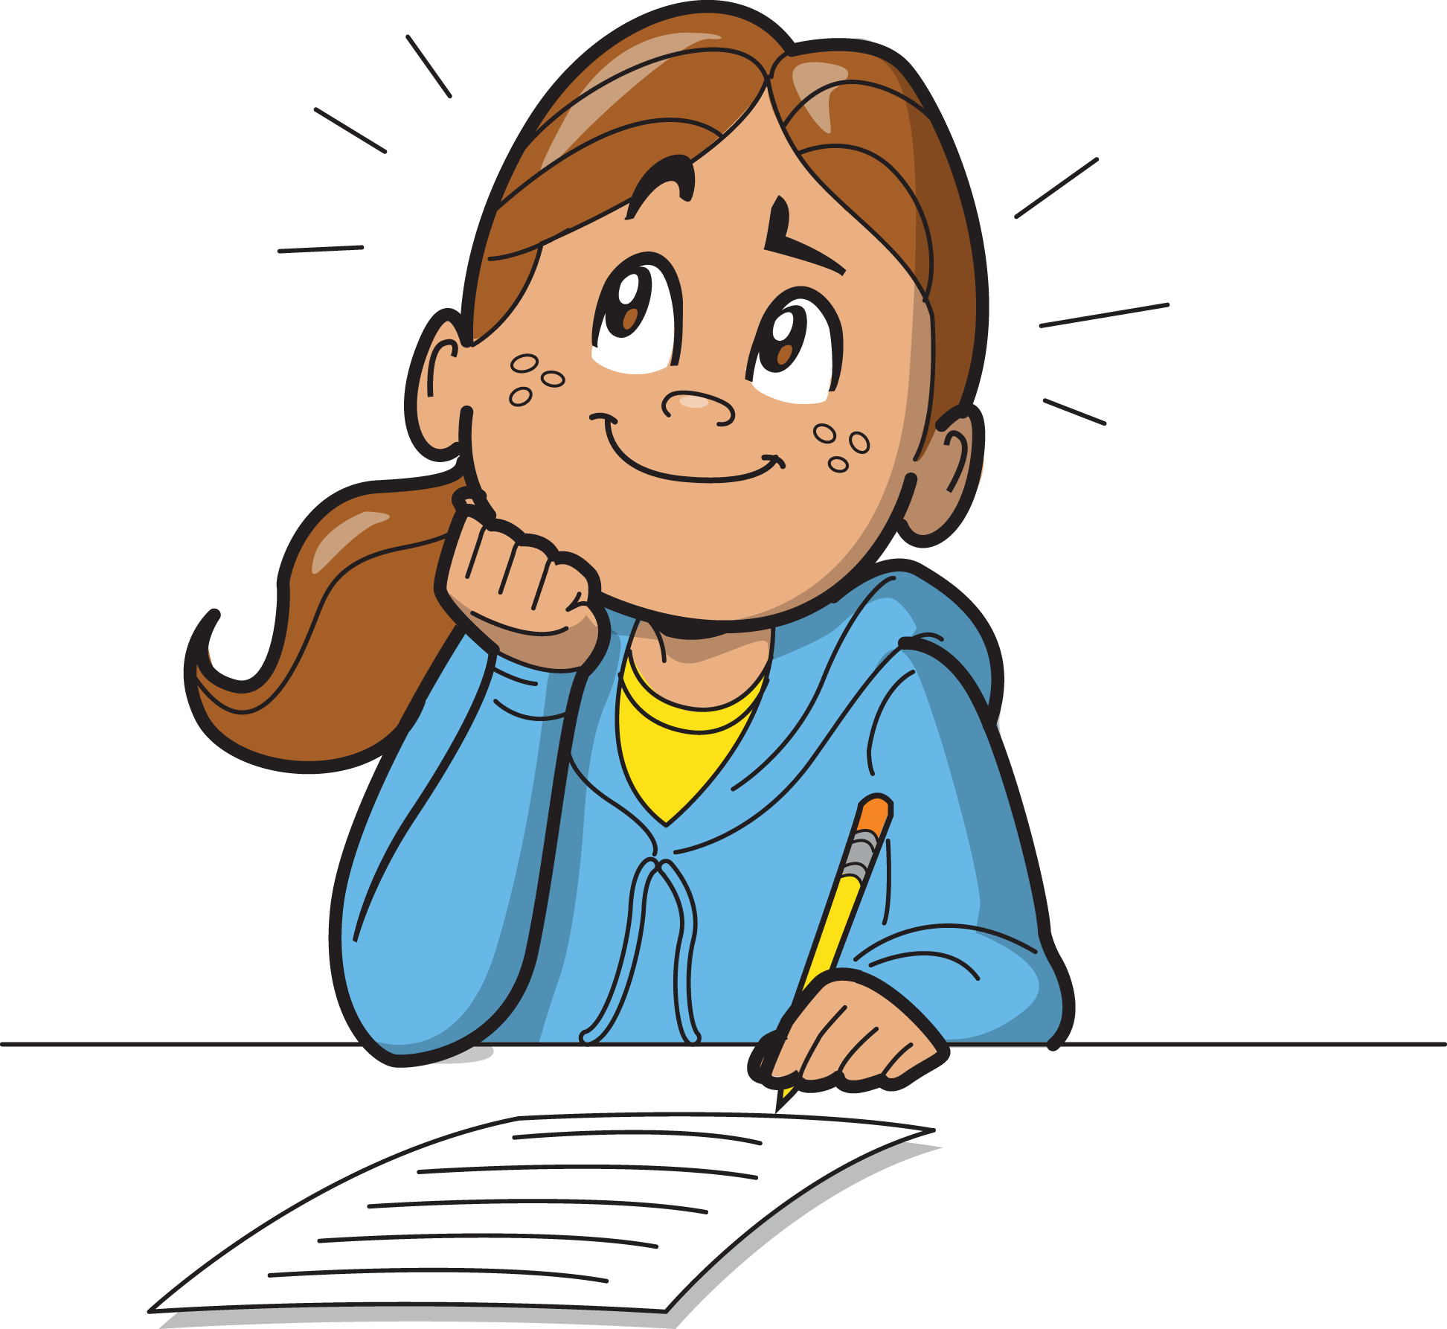
LEARNING OUTCOMES
KS5/ TUTORIAL ACTIVITY 1
I can identify several reasons why people may/may not gamble
I can recognise the signs of gambling related harm
I can identify explore the consequences of gambling related harm

Slide 4
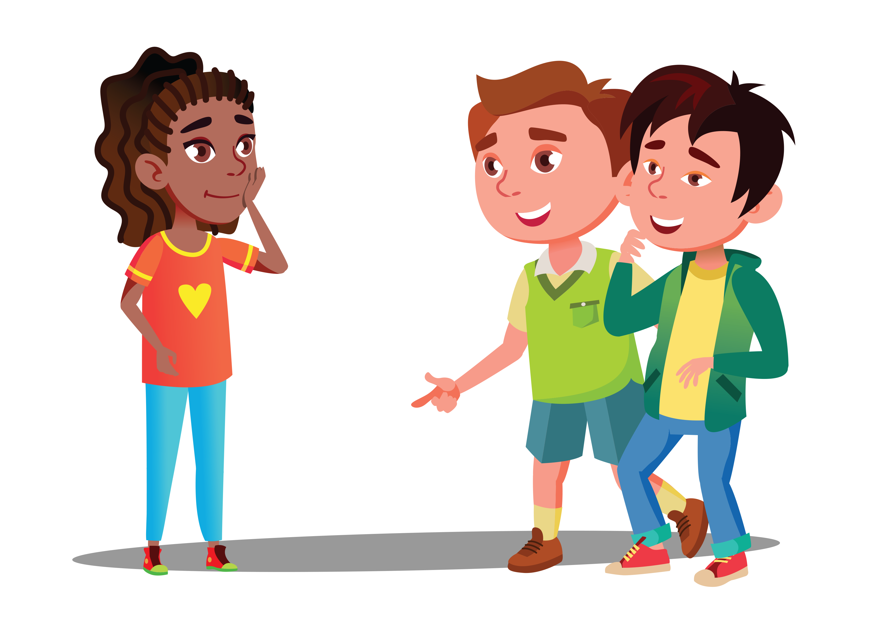
ACTIVITY: Group chat
KS5/ TUTORIAL ACTIVITY 1
Why might young people gamble?
Why might young people not gamble?
old pack (FIFA)
How does my culture view gambling?
Do I know people that gamble?
How does gambling make me feel?
What outside influences are there?

Slide 5
ACTIVITY: What happens when the fun stops?
KS5/ TUTORIAL ACTIVITY 1
Gambling is described as betting, gaming or participating in a lottery
Gambling can be an enjoyable for some adults, but what happens when the fun stops?
There are four stages of gambling addiction: (Illinois Institute for Addiction Recovery)
List the emotions of the person experiencing each stage. What about those around them?
Winning Stage
Losing Stage
Desperation Stage
Recovery Stage
Through support services, gambling addicts can recover.
Hopeless Stage

Slide 6
ACTIVITY: What can we do?
KS5/ TUTORIAL ACTIVITY 1
Using post-its, write down one thing we could do as a community to educate our peers and/or signpost support for those experiencing gambling related harm?

Slide 7
If you need help…
KS5/ TUTORIAL ACTIVITY 1
If you are worried about any of the content today you can talk to a teacher or member of staff. For additional support relating to your own or someone else’s relationship with gambling/gaming you can contact Childline or BigDeal.

Slide 8
Gaming and gambling – blurred lines
KS5/ Tutorial Activity 2

Slide 9
LEARNING OBJECTIVES
KS5/ TUTORIAL ACTIVITY 2
To explore the gambling style features within games
To discuss the links between gaming and gambling
To identify the risks posed by gambling style features within games

Slide 10
LEARNING OUTCOMES
KS5/ TUTORIAL ACTIVITY 2
I can identify different gambling style features within games
I can recognise the links between gaming and gambling
I can spot the risks posed by gambling style features within games

Slide 11
ACTIVITY: Post-it
KS5/ TUTORIAL ACTIVITY 2
old pack (FIFA)
On a post-it, write down any gambling style features that you might see in games
Why are these features not currently classed as gambling?
Should they be classed as gambling?

Slide 12
ACTIVITY: What can we do?
KS5/ TUTORIAL ACTIVITY 2
In groups, create a short presentation aimed at key influencers within the community e.g. parents, schools, gaming companies, influencers, Twitch gamers etc.
Consider:
What gambling style mechanisms feature in games?
Are these features harmful? Why/why not?
Proposed solutions
Who is responsible and what they can do
to take safeguard people?

Slide 13
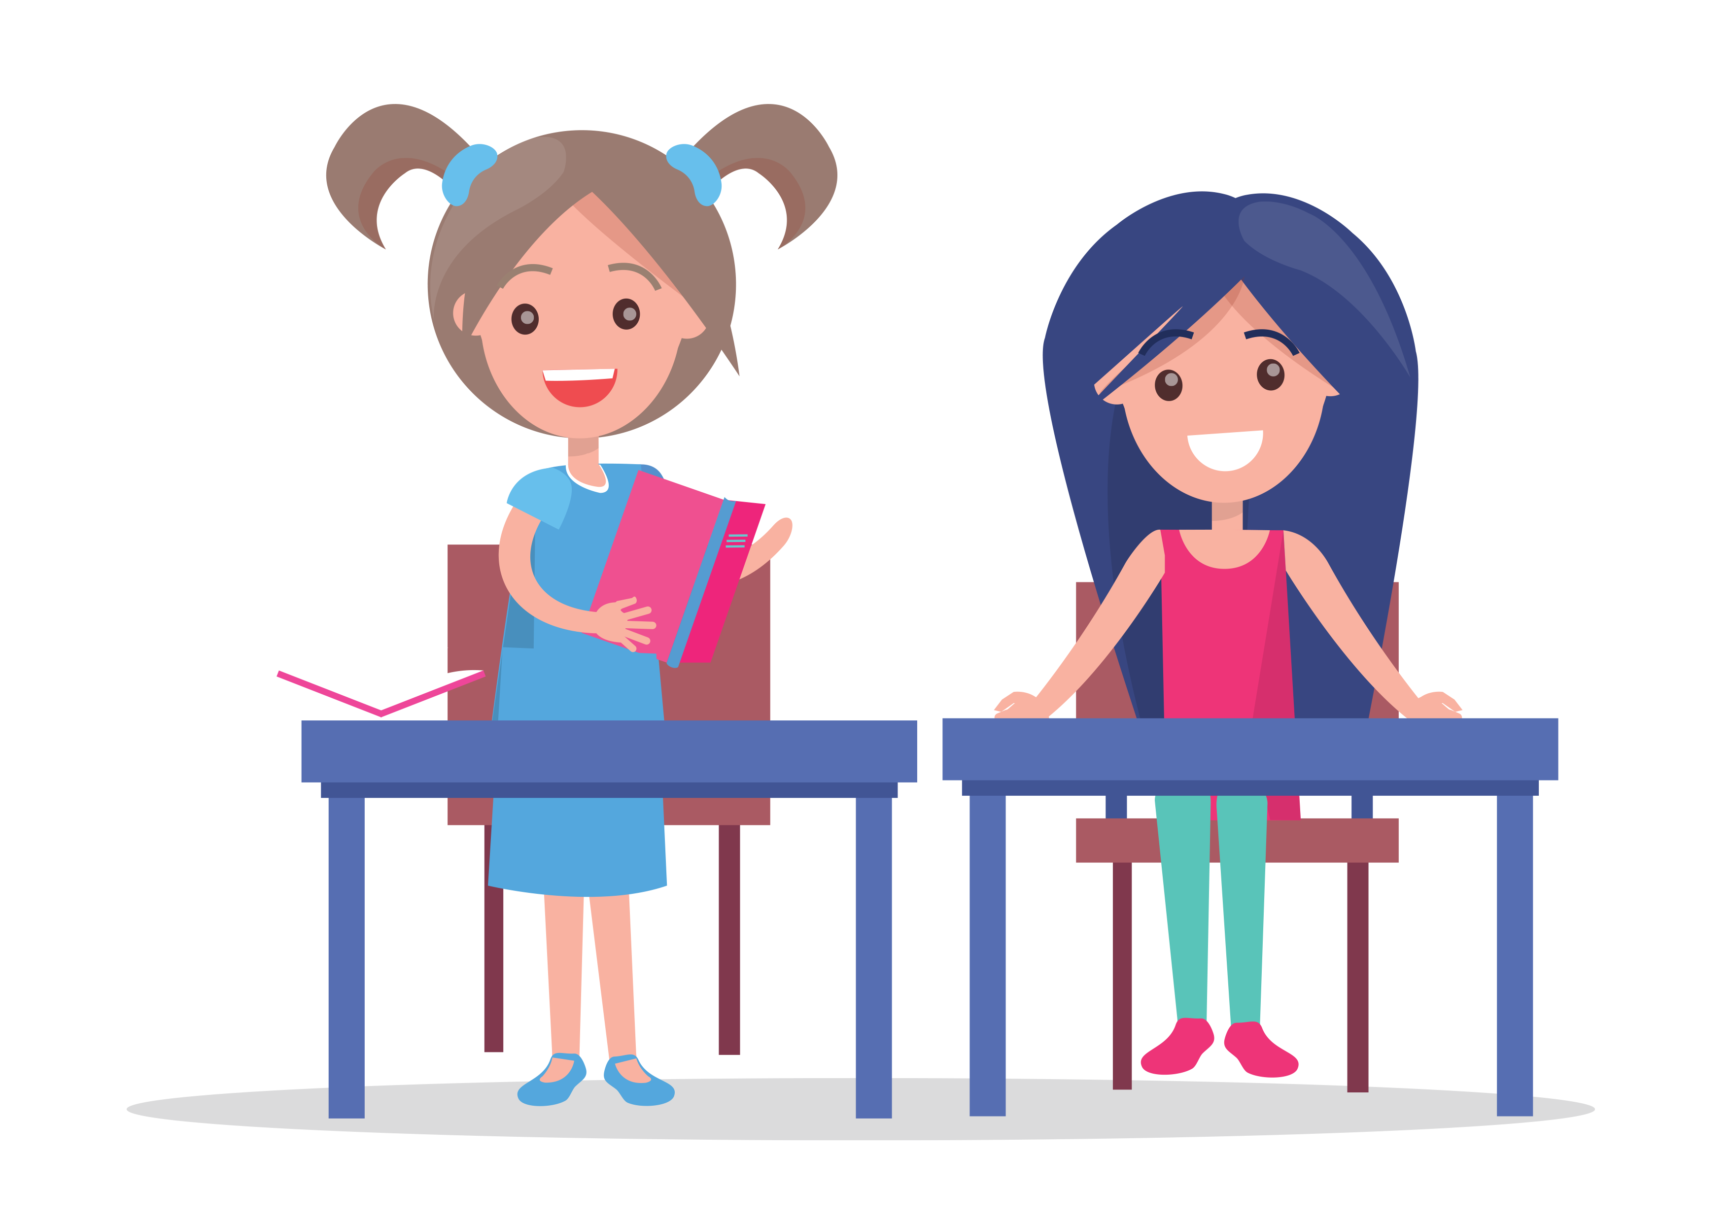
ACTIVITY: I proudly present…
KS5/ TUTORIAL ACTIVITY 2
Present your work to your peers and ask for both positive and constructive feedback.

Slide 14
If you need help…
KS5/ TUTORIAL ACTIVITY 2
If you are worried about any of the content today you can talk to a teacher or member of staff. For additional support relating to your own or someone else’s relationship with gambling/gaming you can contact Childline or BigDeal.

Slide 15
Gaming and Gambling – why now?
KS5/ Tutorial Activity 3

Slide 16
LEARNING OBJECTIVES
KS5/ TUTORIAL ACTIVITY 3
To explore the reasons why people may game or gamble more at post-16 level
To discuss strategies for making informed choices
To understand where to get information and support

Slide 17
LEARNING OUTCOMES
KS5/ TUTORIAL ACTIVITY 3
I can identify several reasons why people may game or gamble more at post-16 level
I can identify a range of strategies for making informed choices
I understand where to get information and support

Slide 18
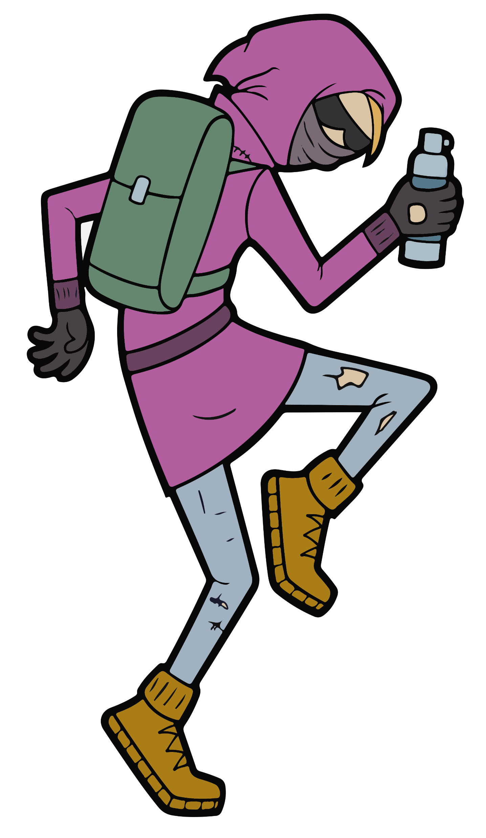
ACTIVITY: 60 second scribble
KS5/ TUTORIAL ACTIVITY 3
Why might young people game or gamble more at post-16 level?
You have 60 seconds to write down as many ideas as you can.
Consider:
Age restrictions
Access to money
Advertising
Social groups/ scenarios etc.

Slide 19
ACTIVITY: Let’s create!
KS5/ TUTORIAL ACTIVITY 3
In groups, create a resource that provides young people with a range of strategies for making informed choices.
Highlight the potential risks and strategies to stay safe
Resources could include a flyer, Youtube video, blog post etc.

Slide 20
ACTIVITY: Circle Time
KS5/ TUTORIAL ACTIVITY 3
Which strategy do you feel is the most useful for your peers?
Take it in turns to share your ideas.
I think that setting a budget is the most useful strategy.
Finding alternate ways to reduce stress is the most important thing.
Which strategy is most useful?

Slide 21
If you need help…
KS5/ TUTORIAL ACTIVITY 3
If you are worried about any of the content today you can talk to a teacher or member of staff. For additional support relating to your own or someone else’s relationship with gambling/gaming you can contact Childline or BigDeal.

